Slide 1


NATUREWISE SUGGESTER – AN ECO PRODUCT RECOMMENDER SYSTEM
Subject Code:NM1067
Student Names:
1.Swathi C (Reg.no – 731122104052)
2.Bavatharani T (Reg.no – 731122104010)
3.Shiyama Priya G (Reg.no – 731122104048)
4.Vinitha D (Reg.no – 731122104401)

Slide 2
Content
➤ Abstract
➤ Problem Statement
➤ Objective
➤ Data Collection and Preparation
➤ Proposed Solution (Methodology)
➤ Model Performance Evaluation
➤ Screenshots / Demonstration (video)
➤ Future Scope
➤ Conclusion
Notes:
Abstract
Problem Statement (Clearly define the challenge)
Objective (State your project's goal)
Background and Research (Discuss existing solutions, trends, and gaps)
Data Collection and Preparation (Focus on data sources, cleaning, and augmentation)
Proposed Solution (Methodology)
Model Architecture (e.g., CNN, U-Net, YOLOv5)
Key Techniques (e.g., Transfer Learning, Image Augmentation)
Model Performance Evaluation
Metrics (Accuracy, Precision, Recall, IoU, etc.)
Graphs (Confusion Matrix, ROC Curve, etc.)
Screenshots / Demonstration (Visual proof of system functionality)
Future Scope (Improvements, scalability, and integration ideas)
Conclusion (Summarize results and impact)
Q&A Session

Slide 3
Abstract
The Eco Product Recommender System is a machine learning-based application. It promotes sustainable consumer behavior by recommending eco-friendly products. Addresses the rising concerns of environmental degradation and the need for green practices. Uses Natural Language Processing (NLP) and classification algorithms to analyze product data. Evaluates product descriptions, categories, and other features to identify eco-friendly items. Aims to build a conscious marketplace where users can easily find and choose green products. Helps reduce users’ ecological footprint through smart recommendations.

Slide 4
Problem Statement
Consumers face overwhelming choices in the marketplace.
Difficult to distinguish genuinely eco-friendly products from those with misleading green claims.
Lack of uniform standards and transparency in product labeling.
Many products make unverified "green" claims without proof.
This leads to a gap between consumer intent and reliable information.
Eco Product Recommender System was created to address this issue.
Uses data analysis and machine learning to suggest trustworthy eco-friendly alternatives.
Helps users make confident and sustainable purchasing decisions.

Slide 5
Objective
The main objectives of the Eco Product Recommender project are as follows:
To build an intelligent recommendation system capable of identifying and suggesting environmentally sustainable products.
To process and analyze product information using machine learning algorithms, particularly natural language processing, to determine the eco-friendliness of products.
To evaluate the effectiveness of multiple models and choose the most accurate one for the classification task.
To ultimately aid consumers in reducing their environmental impact by promoting awareness and availability of green products.

Slide 6
Data Collection and Preparation
Data Source: Amazon Eco-Friendly Products dataset from Kaggle.
Attributes Included:
id, title, name, category, material, brand,
price, rating, reviewsCount, description,
url, img_url, inStock, inStockText.
Cleaning Process: Removed duplicates, handled missing values, and corrected inconsistencies.
Text Preprocessing: Applied tokenization, stopword removal, stemming/lemmatization, and lowercase conversion.
Vectorization: Used TF-IDF to transform text into meaningful numerical vectors.
Target Variable: Binary label: eco-friendly (1) or not eco-friendly (0), used for classification.

Slide 7
Proposed Solution (Methodology)
The Eco Product Recommender System is a machine learning-based application.
It promotes sustainable consumer behavior by recommending eco-friendly products.
Addresses the rising concerns of environmental degradation and the need for green practices.
Uses Natural Language Processing (NLP) and classification algorithms to analyze product data.
Evaluates product descriptions, categories, and other features to identify eco-friendly items.
Aims to build a conscious marketplace where users can easily find and choose green products.
Helps reduce users’ ecological footprint through smart recommendations.

Slide 8
Model Performance Evaluation
Evaluation Metrics Used:
Accuracy: Percentage of correct predictions over total predictions.
Precision: How many selected items were relevant.
Recall: How many relevant items were selected.
F1-Score: Harmonic mean of precision and recall.
Best Performing Model: Random Forest Classifier
Accuracy: ~89%
Precision and Recall: Balanced, showing it can reliably detect
eco-friendly products.
Confusion Matrix and Classification Report: Provided insight into
model behavior on different classes.
Conclusion: Random Forest outperformed Logistic Regression and
Decision Tree in terms of generalization and predictive power.

Slide 9
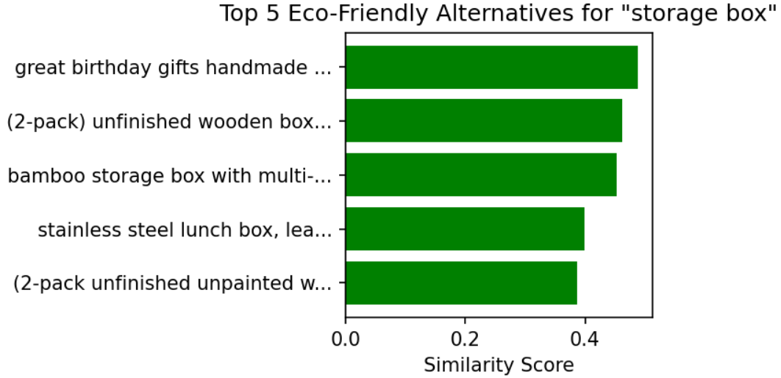
Screenshots / Demonstration (video)

Slide 10
Future Scope
Integration with E-Commerce APIs: Real-time recommendations based on actual product listings.
User Customization: Allow users to define what eco-friendly means to them (e.g., plastic-free, vegan, biodegradable).
Sentiment Analysis: Use customer reviews to understand perception of eco-friendliness.
Mobile App/Web Interface: Making the recommender accessible to the public via user-friendly platforms.
Multilingual Support: Expand accessibility across different regions and languages.
Product Rating System: Incorporate a scoring mechanism to grade the eco-friendliness of products.

Slide 11
Solution Impact
● GitHub Repository: Project files, code, and documentation are available at
https://github.com/Swathi812006/eco-product-recommender

Slide 12
Conclusion
The Eco Product Recommender shows how machine learning can support eco-conscious consumer behavior.
Utilizes text classification and Natural Language Processing (NLP) to identify eco-friendly products.
Accurately detects items that align with green and sustainable practices.
Contributes to both technological advancement and environmental sustainability.
Serves as an intelligent tool to promote conscious consumption.
Has potential for real-world integration and further scalability.
Acts as a stepping stone toward building a greener digital marketplace.

