Slide 1
Amazon Order Performance Dashboard Data Analysis Project Prepared by Koduri Venkata Swathi
Tools Used:
Python
SQL
Excel
Power BI

Slide 2
Project Overview
Objective
The objective of this project is to analyze Amazon order data and identify sales trends, customer purchasing behavior, geographic performance, fulfillment efficiency, and revenue-generating factors.
Dataset Details
Total Orders: 125K
Total Revenue: ₹77.40 Million
Product Categories: 9
States Covered: 47
Product Sizes: 11

Slide 3
Technology Stack
Tools Used
Python Data Cleaning Data Preprocessing Exploratory Data Analysis | SQL Revenue Analysis Aggregation Queries Business Insights
Excel Pivot Tables Charts Initial Exploration | Power BI Interactive Dashboard KPI Monitoring Business Reporting

Slide 4
Data Cleaning Process
Data Preparation Steps
✔ Removed unnecessary columns
✔ Handled missing values
✔ Removed duplicate records
✔ Standardized categorical data
✔ Converted date formats
✔ Created Month, Year, and Day columns
✔ Treated revenue outliers using IQR method
Data Cleaning Workflow
Raw Data ↓ Cleaning ↓ Transformation ↓ EDA ↓ Dashboard Development

Slide 5
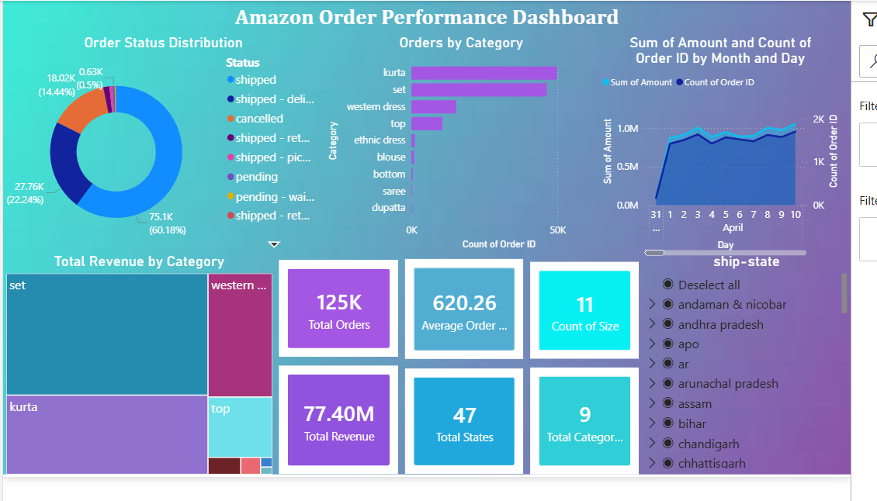
Key KPIs
Dashboard Summary
Total Orders: 125K
Total Revenue: ₹77.40 Million
Average Order Value: ₹620.26
Total Categories: 9
Total States: 47
Total Sizes: 11
Business Observation
The business processed a large volume of orders while maintaining strong revenue performance across multiple product categories and regions.

Slide 6
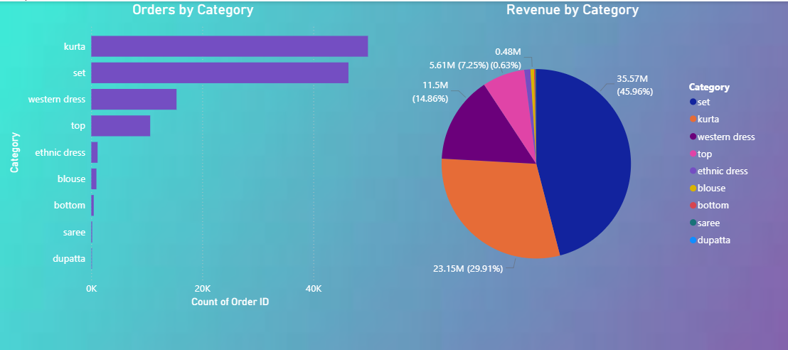
Product Category Analysis
Top Categories by Orders
Kurta
Set
Western Dress
Top
Top Revenue Categories
Set
Kurta
Western Dress
Top
Insight
Set products generated the highest revenue, while Kurta products achieved the highest order volume.

Slide 7
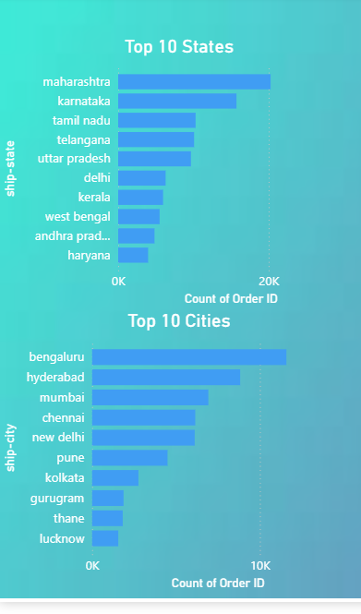
Geographic Analysis
Top States
Maharashtra
Karnataka
Tamil Nadu
Telangana
Top Cities
Bengaluru
Hyderabad
Mumbai
Chennai
Insight
Sales are concentrated in major metropolitan cities and economically strong states.

Slide 8
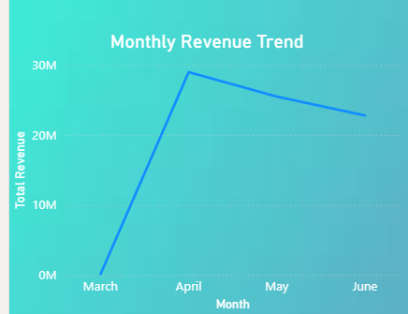
Revenue Trend Analysis
Monthly Orders Trend
Highest demand observed during April.
Order volume remained strong in May and June.
Slight decline observed after the peak period.
Insight
Demand exhibits seasonal patterns, making inventory
planning important during high-sales periods.

Slide 9
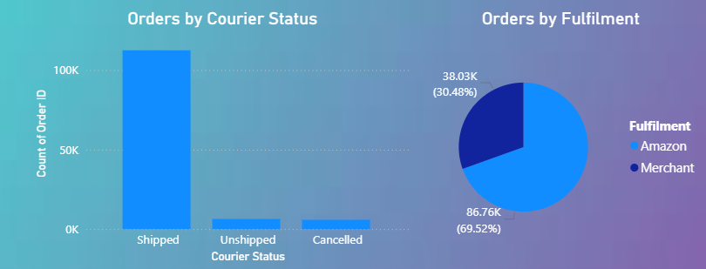
Fulfilment & Operational Analysis
Fulfillment Distribution
Amazon Fulfillment:
69.52%
Merchant Fulfillment:
30.48%
Order Status Distribution
Shipped: 60.18%
Delivered: 22.24%
Cancelled: 14.44%
Insight
Amazon Fulfillment dominates operations and contributes significantly to order processing efficiency.

Slide 10
Business Challenges
Major Challenges Identified
Revenue concentrated in a few categories.
High cancellation volume.
Dependence on specific geographic markets.
Seasonal demand fluctuations.
Underperforming product categories.
Impact
These challenges may limit future growth if not addressed strategically.

Slide 11
Strategic Recommendations
Recommended Actions
Increase Investment In
Expand Marketing In
Operational Improvements
Reduce cancellations
Improve inventory management
Optimize fulfillment performance
Improve customer experience
Set Category | Western Dress Category
Kurta Category | Top Category
Maharashtra | Tamil Nadu
Karnataka | Telangana

Slide 12
Conclusion
Project Summary
The analysis revealed strong sales concentration in specific categories and regions. Set and Kurta products emerged as key revenue drivers, while Maharashtra and Bengaluru were identified as the most valuable markets.
By focusing on high-performing categories, improving fulfillment efficiency, reducing cancellations, and expanding successful regional strategies, Amazon sellers can significantly improve profitability and business growth.
Thank You

