Slide 1
presentation title

Slide 2
agenda
INTRODUCTION
OBJECTIVES
VISUALIZATIONS
SMART QUESTIONS
SUMMARY

Slide 3

Introduction
Our research delves into the world of anime, utilizing data from Anime Planet to uncover the factors contributing to anime popularity. With a dataset of 18,000 entries and variables like genre, studio, episode count, and user ratings, we aim to provide valuable insights for creators and enthusiasts, shedding light on what makes certain anime resonate with audiences.

Slide 4
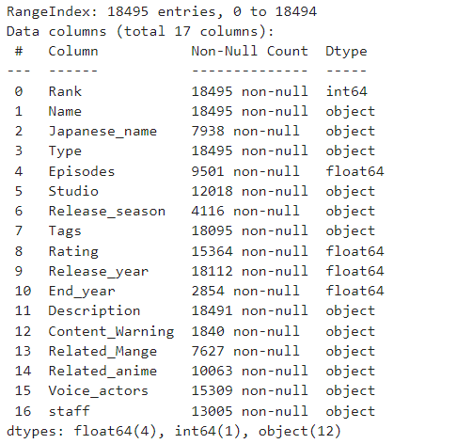
Description of Dataset and feature selection:

Slide 5
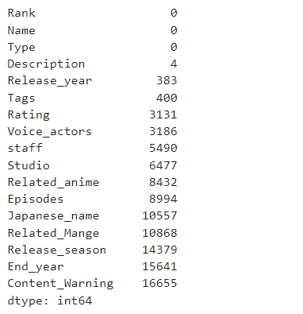
NaN Value count:

Slide 6
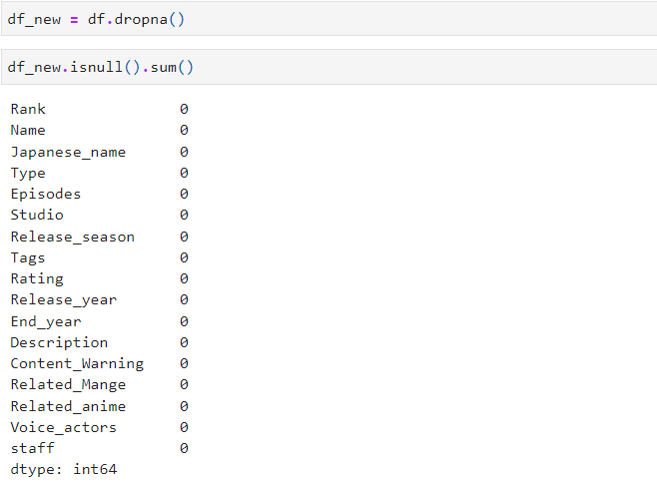
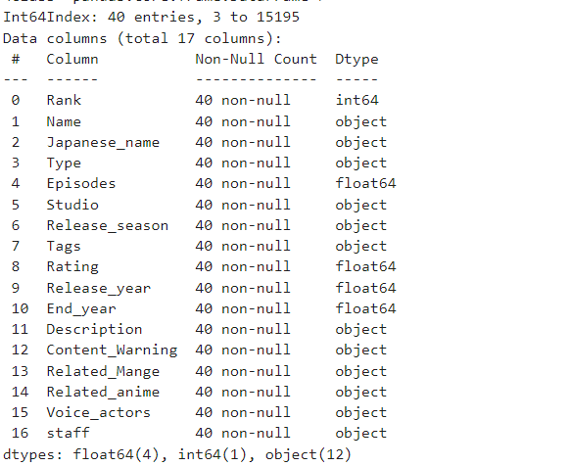
Missing Values Strategy: Drop All Values: --Not Possible

Slide 7
Dropping the unwanted columns:
There are quite a few columns with more than 50% of missing values. We will drop them.
df.drop(['Japanese_name','End_year','Content_Warning','Related_Mange'],axis=1,inplace=True)
#dropped the null values of the columns by giving axis =1 because the usage of the columns are very less# And finally, we don't need these.
df.drop(['Related_anime', 'Voice_actors', 'staff'], axis=1, inplace=True)df.head()

Slide 8
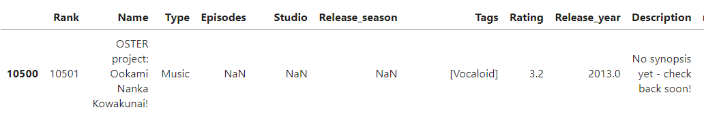
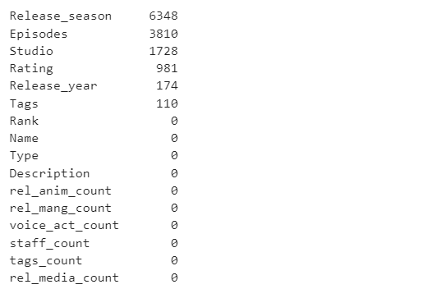
Feature- Description
Removing the value = “No synopsis Yet come back soon! ”

Slide 9
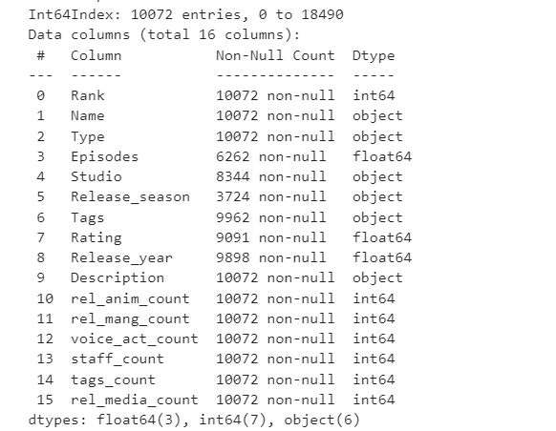
Feature Engineering:
we uses a lambda function (Anonymus Function)to count the number of string 'columns' by splitting the string at ','. If 'columns' is not empty, it calculates the length; otherwise, it sets 'columns' to 0.
Advantages: Strings are converted into the integers

Slide 10
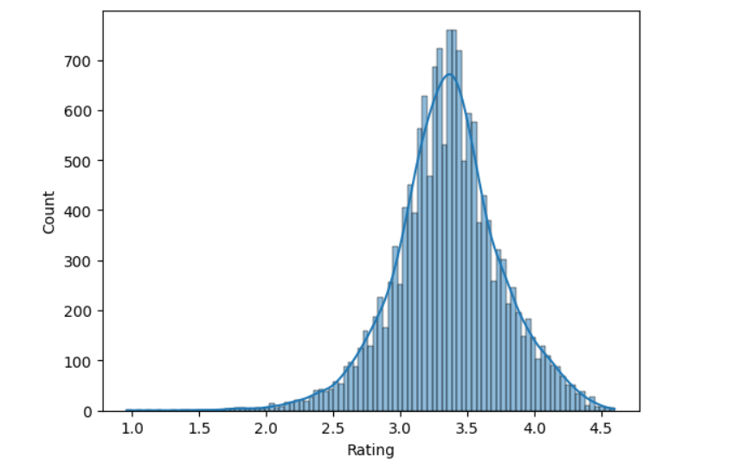
Histogram of Animae Ratings:
Most of the anime have their ratings between 3 and 4, suggesting that very few anime had very good ratings.

Slide 11
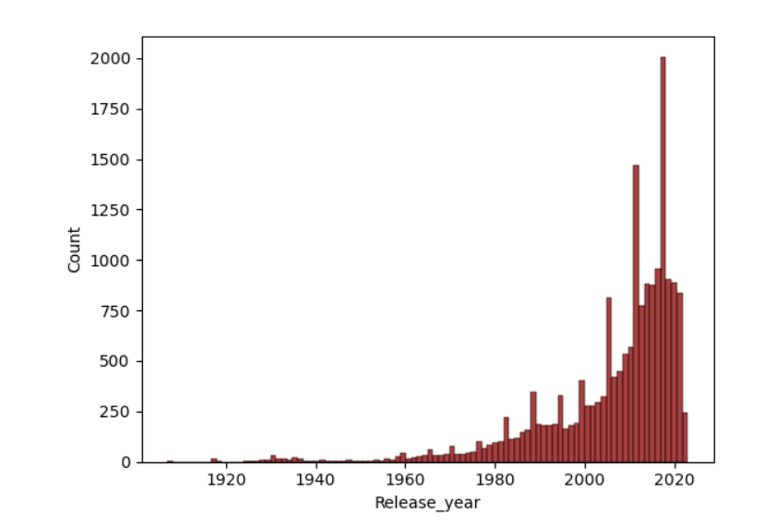
Histogram of Release Year:
Most of the anime have released in the past 10-15 years. This does check out as there was a boom in the manga and anime industry in the late 2010's

Slide 12
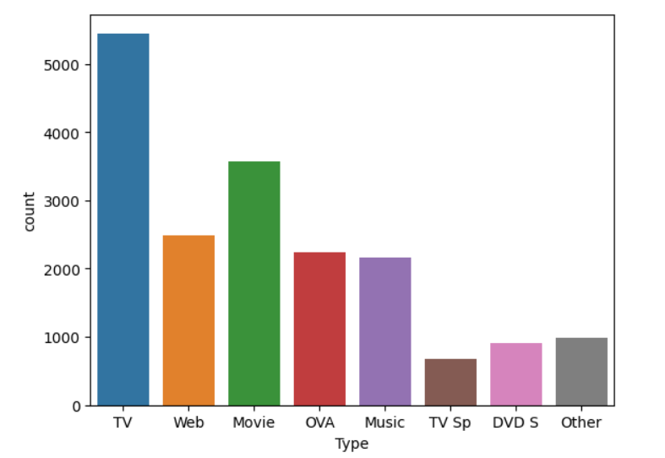
Type of the shows:
TV seems to have the highest number of anime hosted on it.

Slide 13
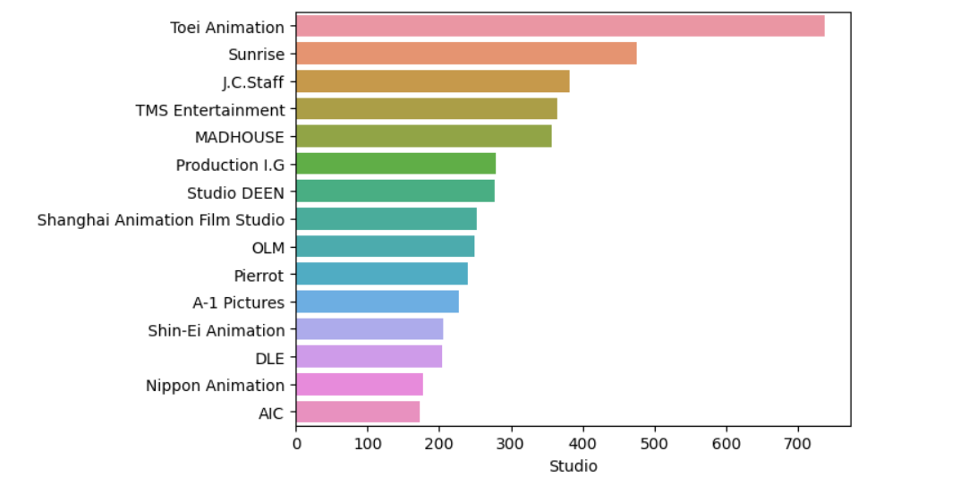
Studios and its Production:
Nothing interesting going on here, apart from the fact that there is a chinese animation studio with over 700 anime.

Slide 14
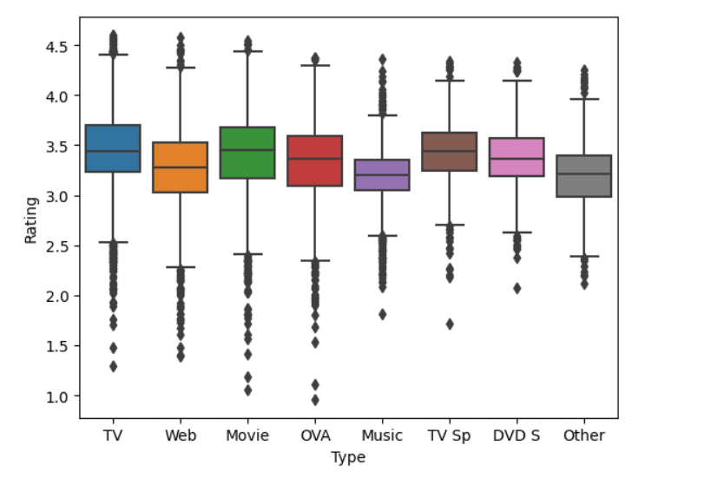
Type Vs. Ratings:
One inference which can be deduced is that the TV Sp type, even though having less number of animes hosted on it, tends to get a higher average rating

Slide 15
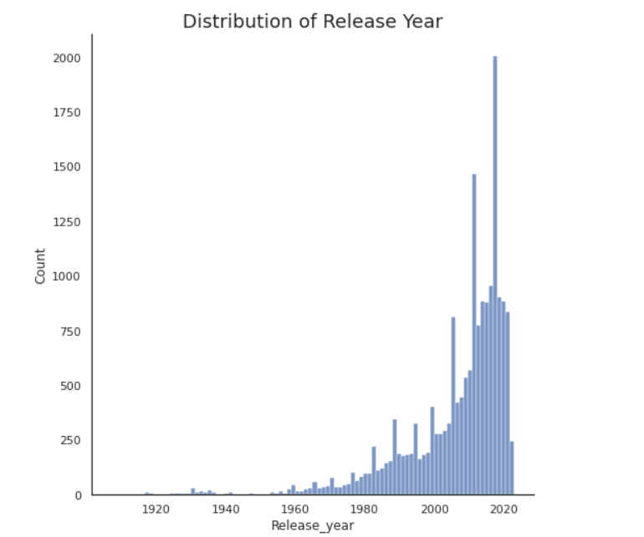
Anime Release Year Vs. Count:

Slide 16
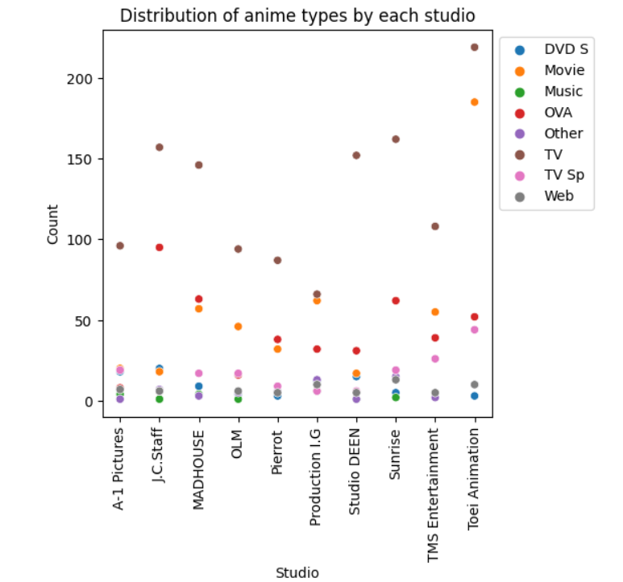
Anime Type studio and count:

Slide 17
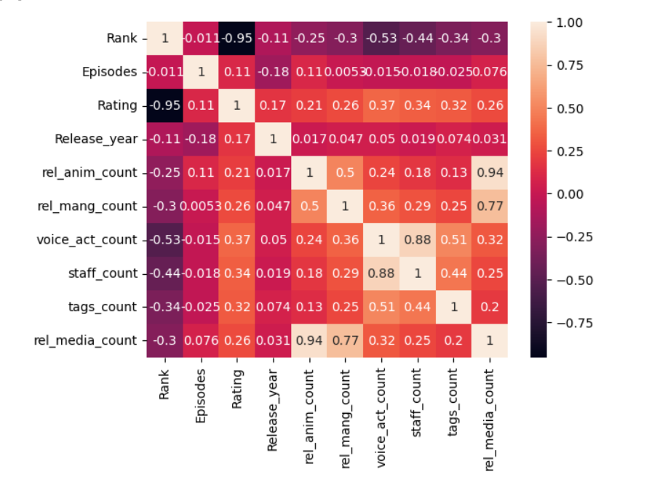
Co-relation Matrix:
Shows the strongest positive and negative relations after doing the feature engineering.
Helpful for further analysis.

Slide 18
SMART Questions:
1. How does the type of anime (e.g., TV series, movie, OVA) relate to the average user ratings onAnime Planet? Are there significant differences in ratings based on the type of anime?
2. Can we predict the user ratings of anime based on the available information such as the studio,release season, and tags? What factors have the most significant impact on an anime's rating,and can we build a predictive model for anime popularity?

Slide 19
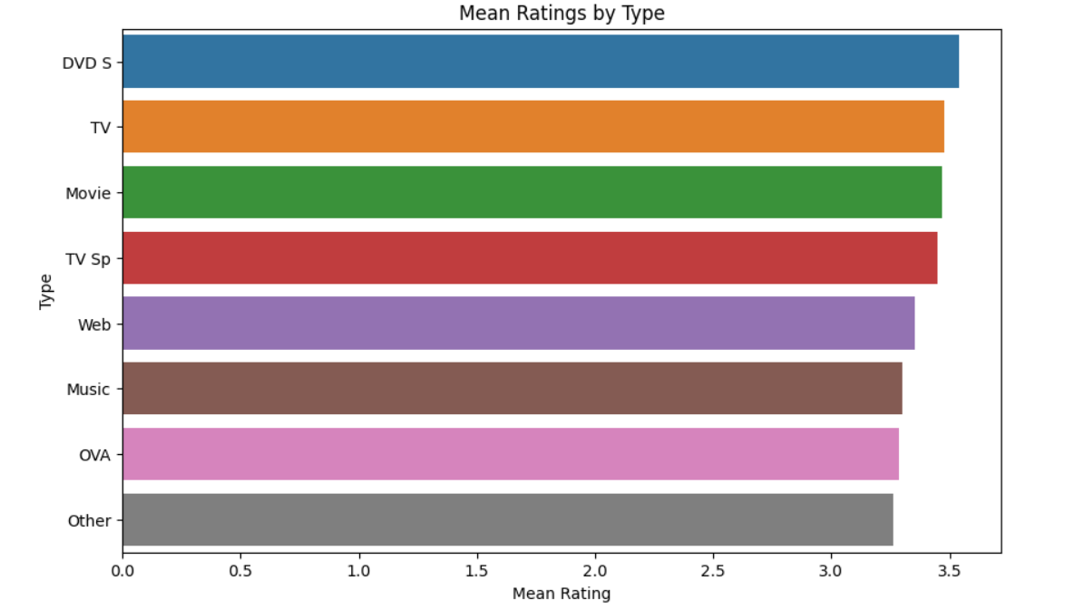
1.a.Average User Ratings:
sns.barplot(x='Rating', y='Type', data=df, ci=None, order=df.groupby('Type')['Rating'].mean().sort_values(ascending=False).index)

Slide 20
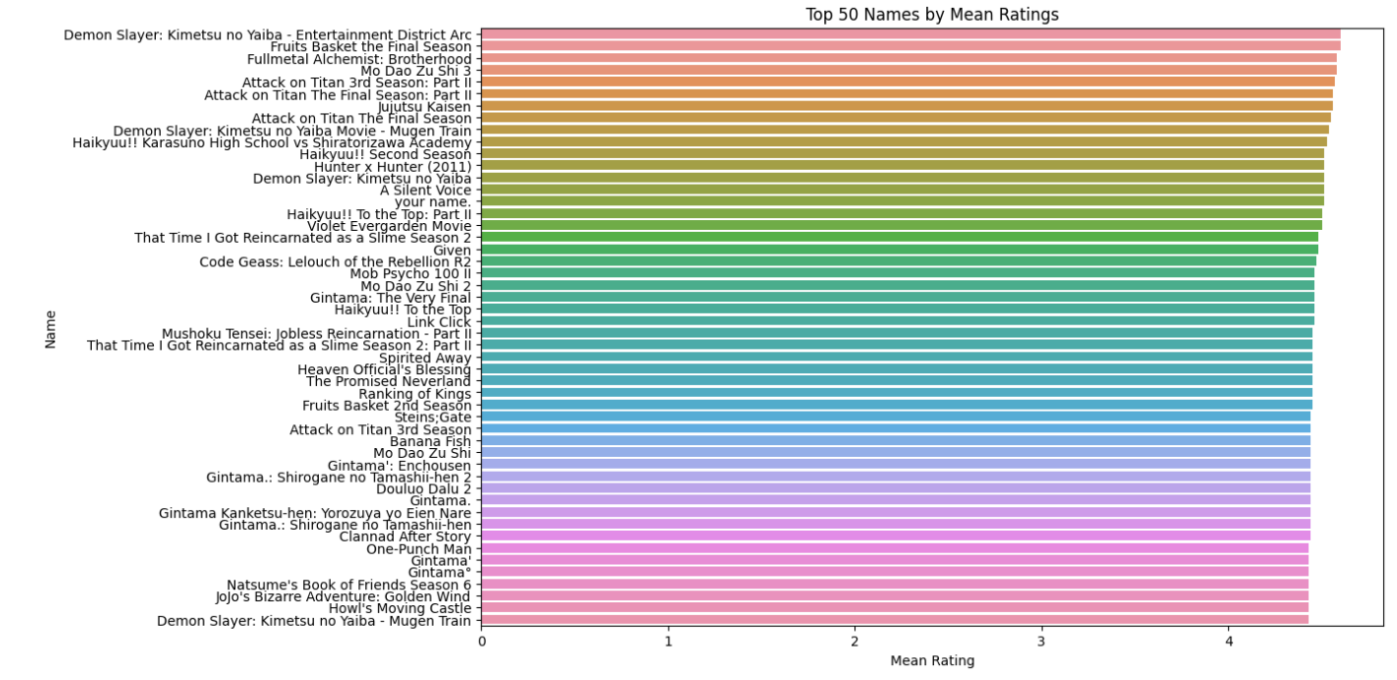
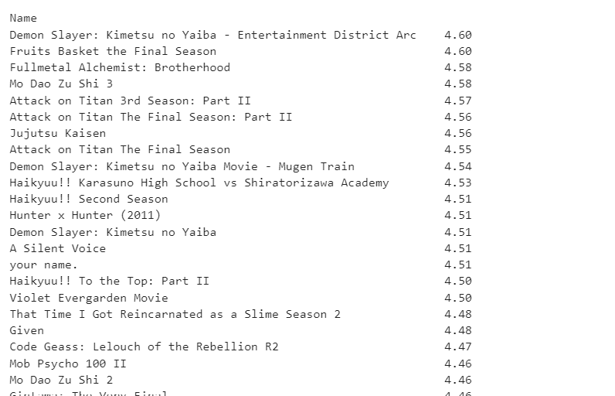
1.b.average user ratings onAnime Planet

Slide 21
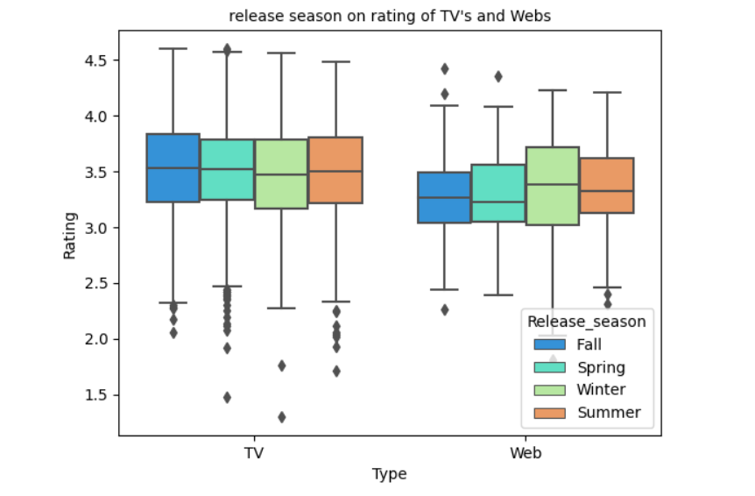
1.c.Anime Release seasons with the mean ratings:

Slide 22

CONCLUSION
The analysis that we have done is to help navigate someone who is new to anime and help them in being able to make a recommendation to get them started with what to watch. This could entail making a recommendation system based on the user ratings ​

Slide 23
REFERENCES
[1] Anime Recommendations Database. Retrieved from, :
https://www.kaggle.com/datasets/vishalmane10/anime-dataset-2022/data
[2] Python : https://www.python.org/

Slide 24
thank you

