Slide 1







INTO THE WORLD OF ANIME
Predictive Analysis of Anime Ratings
TEAM 4: Crystal Kao, Pranideep Meka, Swathi Murali Srinivasan

Slide 2
What is anime?
Anime, also known as Japanese animation, is a genre of entertainment originating in Japan but has become popularized throughout the world, especially internationally in the last 20 years (Anime Industry Data, n.d.).
The data used in the following exploration and analysis comes from Anime Planet, a place where you can “discover anime and manga, track your progress, watch anime, read manga” (Anime Planet, n.d.).
The dataset itself comes from Kaggle and contains over 18,000 anime entries over the last 100 years and contains a diverse set of variables.

Slide 3
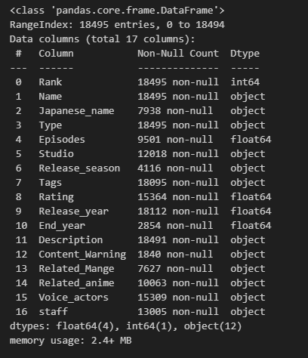
The dataset
The data contains 18,495 entries with the following columns available:

Slide 4
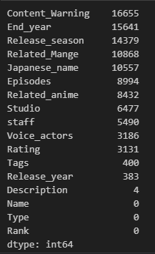
Missing Values
Number of Missing Values in each Column
As seen in the previous table, the number of non-null values is inconsistent in the columns, meaning the dataset needs to be cleaned and reformatted

Slide 5
Removal of missing values
The easiest way to clean the data is to remove all the rows with null values if it does not affect the dataset too much. However, as seen here, we are only left with 40 entries if all null values are removed so this is not a reasonable method of cleaning the data

Slide 6
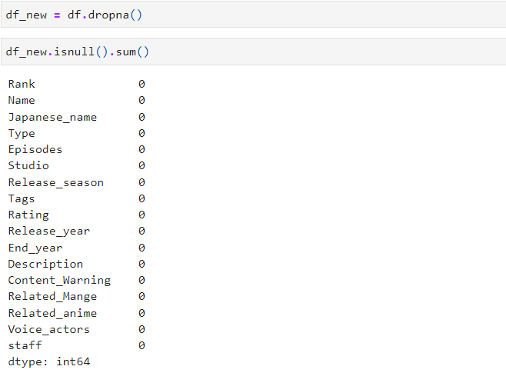
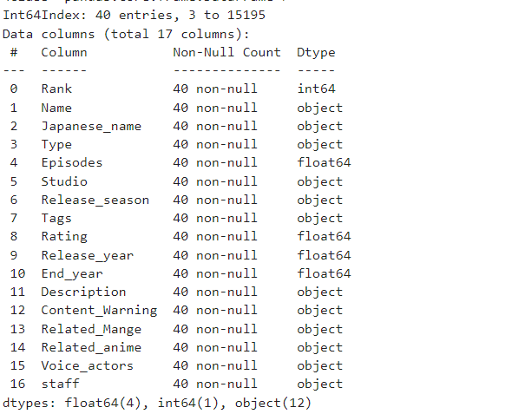
Missing Values Strategy: Drop All Values: --Not Possible

Slide 7
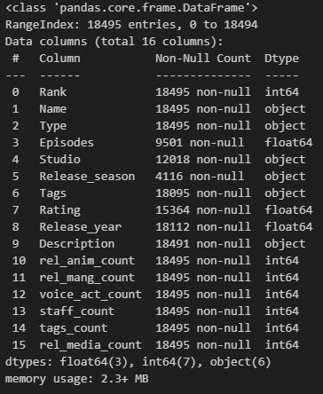
Removal of missing values: strategy-2 removing the unwanted columns:
‘Japanese_name’, ‘End_year’, ‘Content_Warning’, ‘Related_Mange’ were removed due to more than 50% of the columns being null values and are not relevant to our current analysis
Unnecessary spaces were removed from ‘Type’
Count columns were created for ‘Voice_actors’, ‘staff’,‘Related_anime’, ‘Related_Mange’, and ‘Tags’
the original columns were then removed
This creates columns based on integers instead of strings
‘Related_anime’ and ‘Related_Mange’ counts were also added together to create a ‘rel_media_count’ column

Slide 8
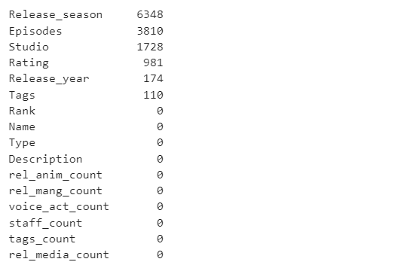
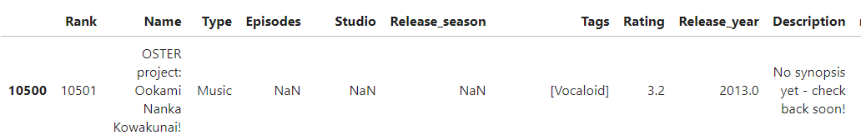
Feature- Description
Removing the value = “No synopsis Yet come back soon! ”

Slide 9
Exploratory data analysis

Slide 10
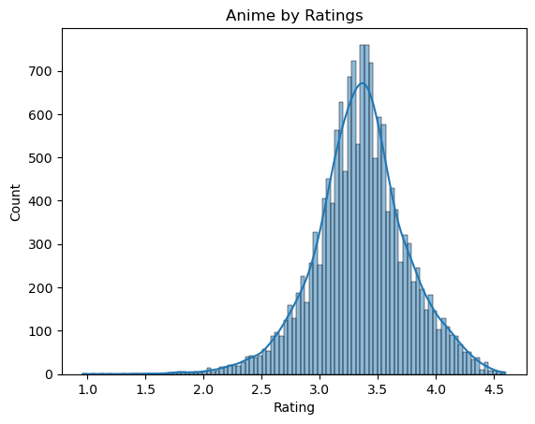
Anime Ratings
The majority of anime tend to fall within the rating range of 3 to 4, indicating that only a small number of anime received exceptionally high ratings.

Slide 11
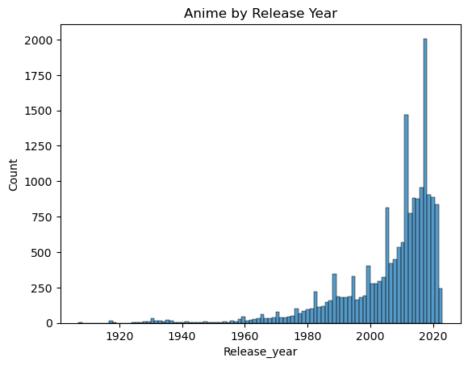
Anime Release year
Most anime were released within the last 10 to 15 years, which aligns with the significant growth observed in the manga and anime industry during the late 2010s (Anime Industry Data, n.d.).

Slide 12
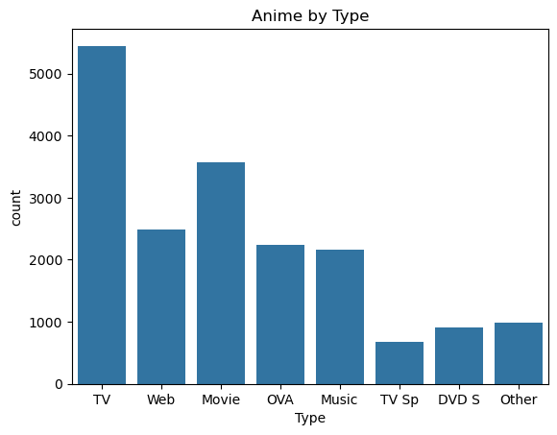
Anime media type
TV has the most anime shows available for viewing.

Slide 13
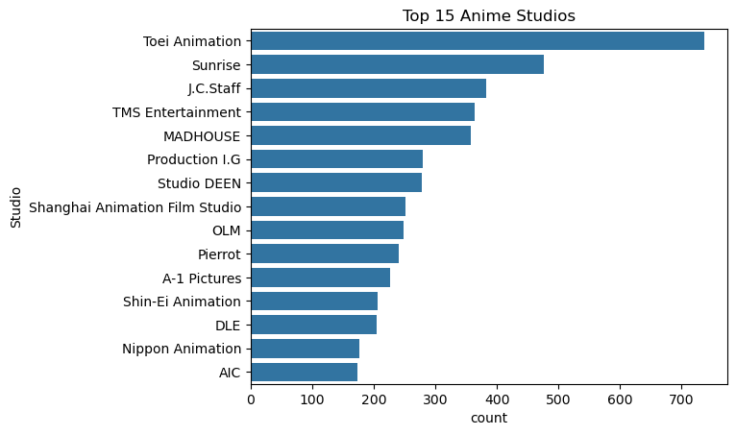
Top 15 anime studios
Toei Animation produces the most anime of any studio and the gap between first and second is over 200 anime
Interestingly there's a Chinese animation studio in the top 15 animation studio list. Chinese anime, also known as donghua, has also become popular in recent years.

Slide 14
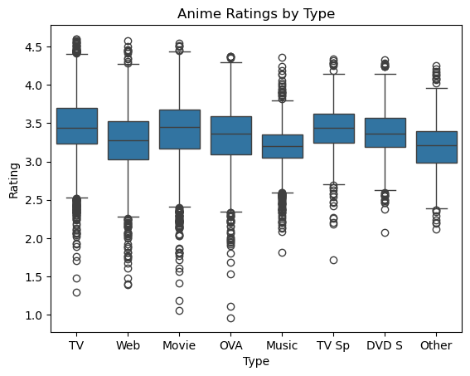
Anime ratings by type
TV had the highest average rating with TV Sp (TV Specials) at a close second

Slide 15
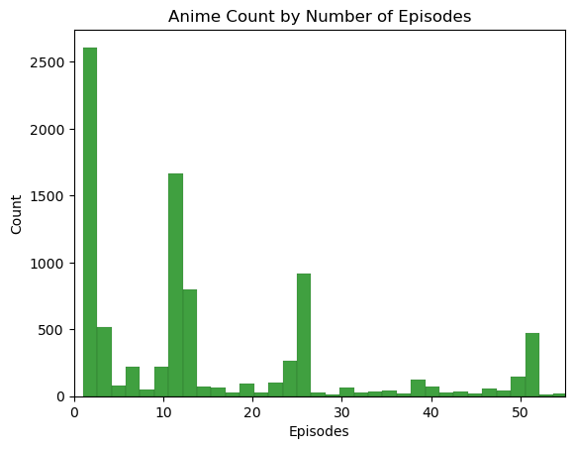
Number of episodes
Most anime with only one episode can be considered as movies since they typically have one episode. The next most common episode count is around 12, which is the average length for TV shows or Original Video Animations (OVA).

Slide 16
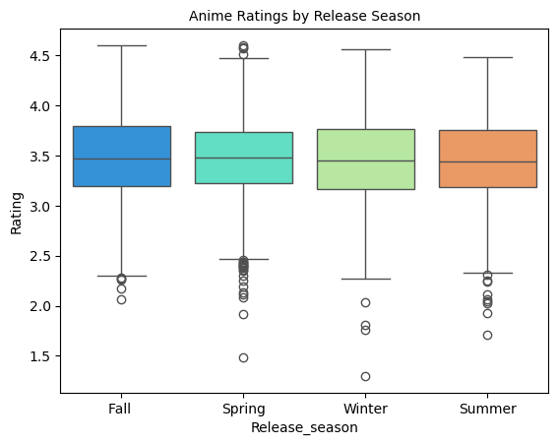
Ratings by Season
Anime releases are often categorized by season. When looking at ratings by season, there does not seem to be much of a difference between the seasons as all of them have a mean rating of ~3.5.

Slide 17
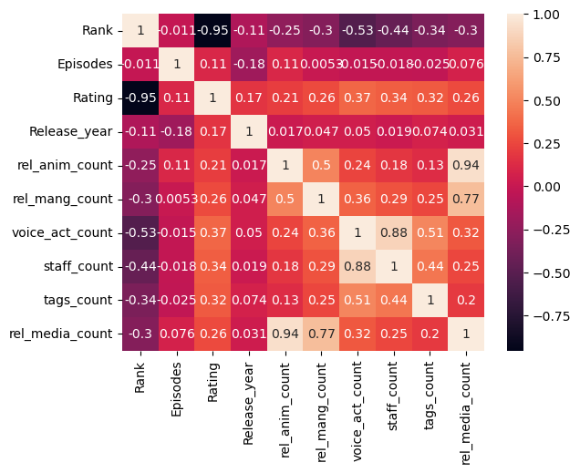
correlation
Rankings are created based on ratings so ignore that correlation. Also ignore the correlation between related media and related anime and manga because those fields make up related media.
There is an interestingly strong negative correlation between the number of voice actors and rank.
The count of staff and voice actors have a relatively high correlation with each other. This makes sense since the more voice actors you have, the more staff you need.

Slide 18
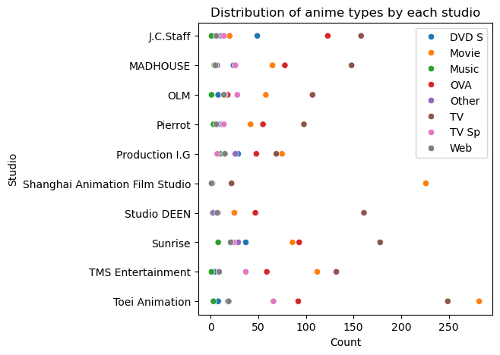
Anime Type by top studios
The studios mostly produce TV shows (brown) and movies (orange).

Slide 19
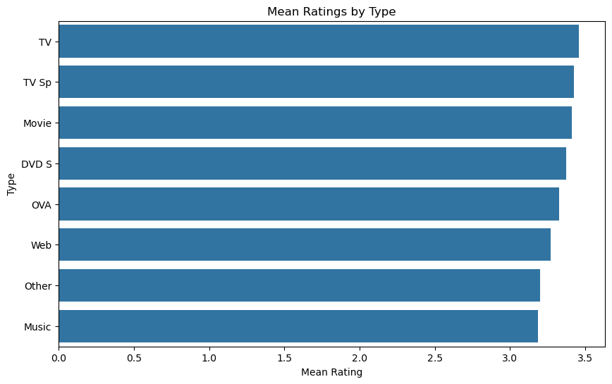
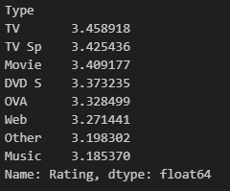
1.How does the type of anime (e.g., TV series, movie, OVA) relate to the average user ratings on Anime Planet? Are there significant differences in ratings based on the type of anime?

Slide 20
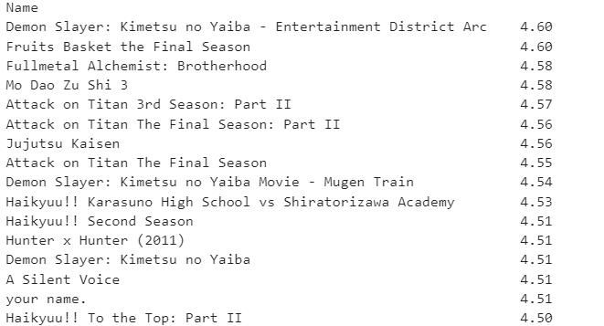
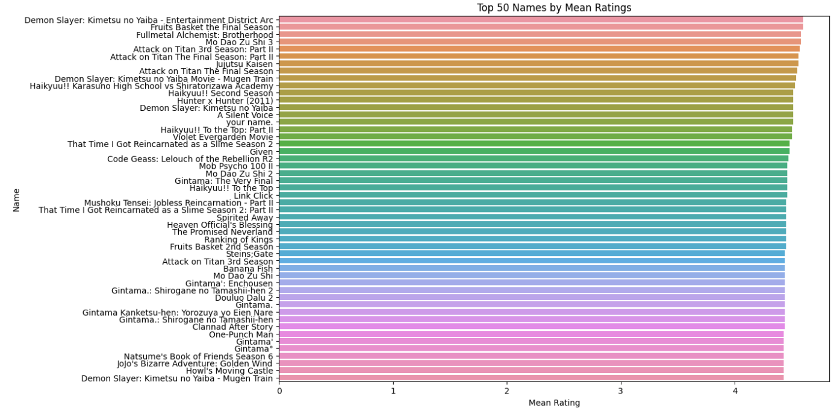
based on type of anime average user ratings:

Slide 21

2. Can we predict the user ratings of anime based on the available information such as the studio, release season, and tags? What factors have the most significant impact on an anime's rating, and can we build a predictive model for anime popularity?
To answer this question, we further cleaned the data and built the regression model

Slide 22
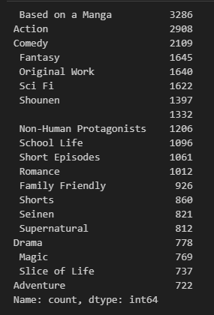
Filling missing values
List of Tags
Missing episode values were filled using the median, as anime seasons typically have 12 episodes
Missing release years were also filled using the median
Missing studio values were filled by randomly selecting a studio
The Tags, Studio, Type, Release_season were transformed from a column to a list to facilitate binary classification through one-hot encoding

Slide 23
Model
We initially created a DataFrame comprised of rows with unavailable ratings. This dataset will be utilized in the final stage to predict the ratings for these anime entries.
Next we split our data for training and testing: 80:20 split
Model performance:
MAE of 0.22 suggests that our model performs relatively well
MSE of 0.087 suggests a relatively low spread of errors
R² value of 0.16859 means that our model explains about 16.86% of the variance in the ratings. While modest, this is a common scenario in real-world data.
Mean Absolute Error: 0.22168
Mean Squared Error: 0.08718
R²: 0.16859

Slide 24
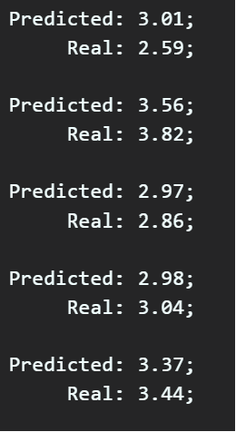
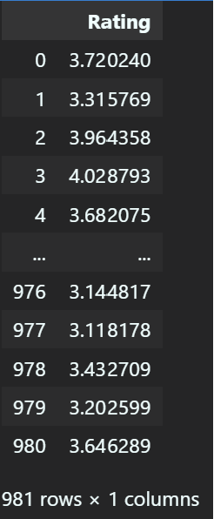
Predictions
Sample Predictions
Unrated Predictions
Sample Predictions:
We randomly selected five anime entries and compared the predicted ratings with the actual ratings.
Predicting Unrated Entries:
Using our trained model, we predicted ratings for entries with previously unavailable ratings in predicting_df_anime.

Slide 25
Key takeaways
Our model successfully predicts anime ratings
What factors have the most significant impact on an anime's rating?
The most influential factors include episodes, release year, voice actors count, and studio.

Slide 26
Conclusion
We hope our analysis helps individuals new to the world of anime in making informed viewing choices.
Potential Future Enhancement:
Our predictive model lays the groundwork for a user-friendly recommendation tool.

Slide 27
References
Anime Industry Data: 日本動画協会. The Association of Japanese Animations. (n.d.). https://aja.gr.jp/english/japan-anime-data
Welcome to anime-planet. Anime. (n.d.). https://www.anime-planet.com/
Mane, V. (2022, January 16). Anime dataset 2022. Kaggle. https://www.kaggle.com/datasets/vishalmane10/anime-dataset-2022/data

Slide 28

Thank you
THANK YOU

