Slide 1

Fake News Classification
CS579, Spring 2023, Group 60
Swathi Puskoori (A20513538)
Sri Sai Teja Narra (A20514763)

Slide 2
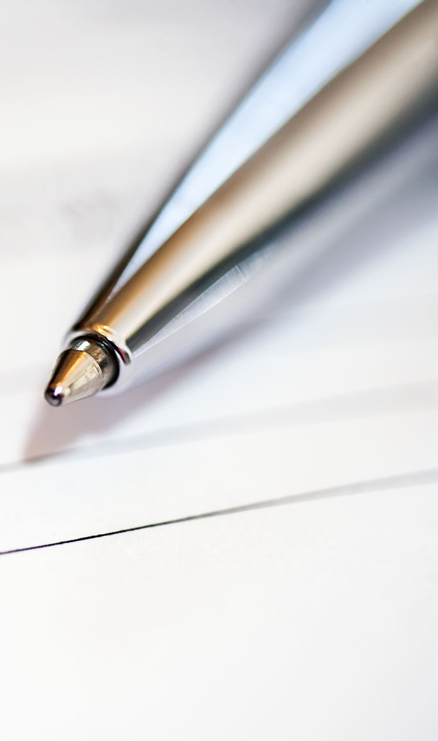
Overview
Problem Statement
Proposed Solution
Data Preprocessing
Feature Extraction, Classification & Validation
Output/Results
Conclusion
References

Slide 3

Problem Statement
This project aims to detect fake news and misinformation in social media. Given the title of a fake news A and the title of a coming news article B, we are asked to classify B into one of three categories: agreed, disagreed, or unrelated.

Slide 4
Proposed Solution
The proposed solution is a classification model that predicts whether two news headlines are referring to the same news story or not. The solution involves:
Data Preprocessing: The raw news headlines are preprocessed by converting them to lowercase, tokenizing them into words, removing stop words, and stemming the remaining words.
Feature Extraction: The preprocessed news headlines are transformed into numerical features using the TfidfVectorizer from scikit-learn. This extracts the important words from the text and assigns weights to them based on their frequency and importance.
Model Training: The logistic regression algorithm is used to train the classification model on the extracted features and corresponding labels (i.e., whether two headlines are the same or not).
Model Evaluation: The trained model is evaluated on a validation set to measure its accuracy.
Prediction: Finally, the trained model is used to predict whether the test set headlines refer to the same news story or not.

Slide 5
Data Preprocessing
Libraries used: NLTK (Natural Language Toolkit)
Preprocessing steps:
Convert text to lowercase. Example : The quick BROWN fox JUMPS over the LAZY dog -> the quick brown fox jumps over the lazy dog
Tokenize text into words. Example : the quick brown fox jumps over the lazy dog -> ["The", "quick", "brown", "fox", "jumps", "over", "the", "lazy", "dog"]
Remove stop words (common words such as "the", "and", "of", etc.) -> ["quick", "brown", "fox", "jumps", "over", "lazy", "dog"]
Stem the words (reduce them to their root form, such as "running" to "run").
Fill any missing values with an empty string using ‘fillna’.
Preprocessed data saved to CSV files

Slide 6
Feature Extraction
Libraries used: scikit-learn (sklearn)
Feature extraction method: TF-IDF (Term Frequency-Inverse Document Frequency)
TF-IDF measures the importance of each word in a document (title1 and title2) by calculating its frequency in the document and inversely scaling it by its frequency in the corpus (all documents)
The resulting TF-IDF matrix represents each document (title pair) as a vector of numerical features that can be used for machine learning

Slide 7
Classification & Validation
Classifier used: logistic regression
Logistic regression is a popular method for binary classification (two possible labels)
The logistic regression model is trained on the preprocessed and feature-extracted training data
The model learns to predict the label based on the features extracted from the text
Validation set: a portion of the training data reserved for evaluating the model during training
Evaluation metric: accuracy, the percentage of correctly predicted labels
The model is evaluated on the validation set to determine its performance

Slide 8
Outputs/ Results
We have implemented other classifiers to test for:
accuracy,
precision,
recall
f1-score
support.
Tried the following classifiers :
Multinomial Naive Bayes
Decision Trees
Logistic Regression

Slide 9
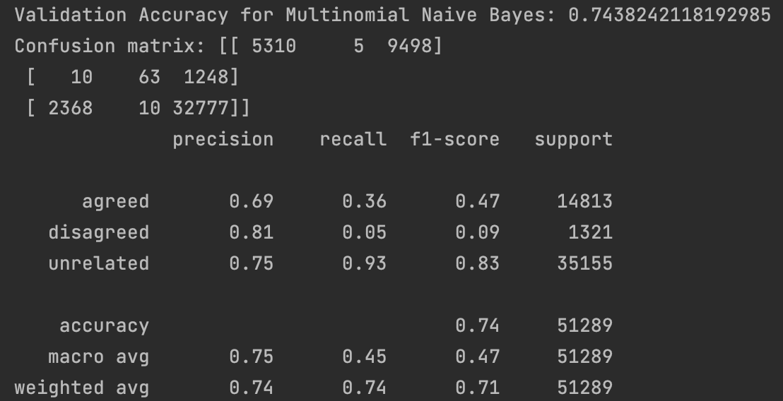
Multinomial Naive Bayes

Slide 10
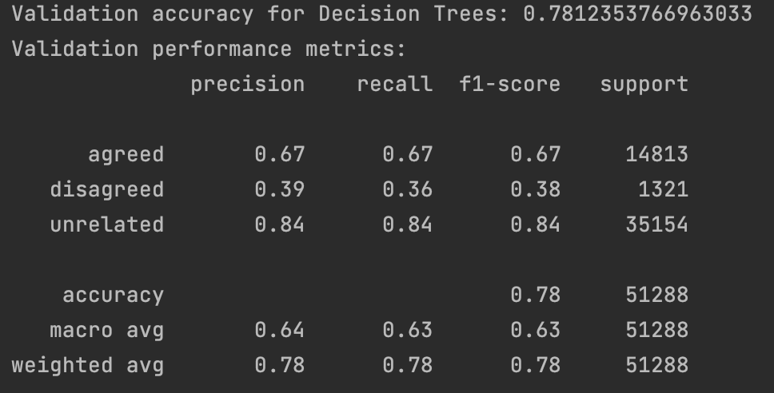
Decision Trees

Slide 11
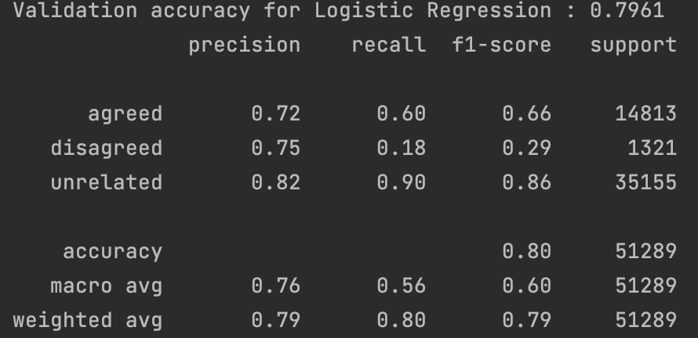
Logistic Regression

Slide 12
Conclusion
We have decided to go with the Logistic Regression classifier model, which achieved the highest accuracy score of 79.61% compared to the other two classifiers.
Using Logistic regression, we can predict the news from article A to be 79.61% accurate with respect to article A.

Slide 13
References
https://pypi.org/project/stop-words/
https://www.nltk.org/_modules/nltk/stem/wordnet.html
https://scikit-learn.org /stable/modules/generated/sklearn.feature_extraction.text.Tfidf Vectorizer.html
https://scikit-learn.org/stable/modules/generated/sklearn.metrics.pairwise.cosine_similarity.html
https://iq.opengenus.org/document-similarity-tf-idf/
https://towardsdatascience.com/natural-language-processing-feature-engineering-using-tf-idf-e8b9d00e7e76
https://iq.opengenus.org/document-similarity-tf-idf/

