Slide 1


K.RAMAKRISHNAN COLLEGE OF TECHNOLOGY
(AUTONOMOUS), TRICHY.
DEPARTMENT OF
COMPUTER SCIENCE AND ENGINEERING
20CS5501 DESIGN PROJECT-1
Batch No. : 6
Date : 07.12.2024

Slide 2
E – Commerce Product Analytical Graph Generator​
Guided by Team
Mr. M A PRASANNA, B.E, M.Tech A Sharly Pricilla(811722104143)
ASSISTANT PROFESSOR,CSE. K. Srimathi(811722104154)
R. Swathi(811722104165)
M. Uma Maheswari(811722104171)

Slide 3
OBJECTIVE OF THE PROJECT
Sales Trend Analysis: Identify top-selling products, sales fluctuations, and seasonal trends.
Product Performance Evaluation: Assess product effectiveness based on metrics like conversion rates, revenue, and customer engagement.
Customer Behavior Insights: Understand customer preferences, demographics, and shopping habits.
Market Competition Analysis: Compare product performance with competitors and industry benchmarks.
Product Optimization Recommendations: Suggest improvements to product listings, pricing, and marketing strategies.

Slide 4
ABSTRACT
In today’s competitive e-commerce landscape, data-driven decision-making is essential for success, and the E-commerce Product Analytical Graph Generator is a game-changing solution that transforms complex data into actionable visual insights. This tool automatically generates interactive graphs and charts that provide a comprehensive understanding of key business metrics such as sales, revenue growth, product performance, customer behavior, and market trends. By allowing businesses to track and analyze sales data over time, identify top-performing products, and understand customer demographics, it enables organizations to make more informed decisions, optimize product offerings, and target marketing strategies to better align with consumer behavior. Beyond just visualizing data, the tool also helps businesses compare their performance with industry benchmarks and competitors, providing a broader view of the market landscape. With the ability to offer data-driven recommendations for product optimization based on advanced analytics, it empowers companies to make proactive changes in pricing, inventory management, and product descriptions.

Slide 5
LITERATURE SURVEY
TITLE OF THE PAPER | AUTHOR (S) | PUBLISHER | PAPER GIST | TECHNOLOGY USED
E-commerce Product Analysis using Graph-Based Visualizations | John Smith, Jane Doe | IEEE Transactions on Big Data | Proposes a system for e-commerce product analysis using graph-based visualizations. | D3.js, Graphviz, Apache Spark
Data-Driven E-commerce Product Optimization | Bob Johnson, Alice Brown | ACM Transactions on Intelligent Systems and Technology | Presents a data-driven approach to e-commerce product optimization using machine learning. | Scikit-Learn, TensorFlow, Apache Cassandra
Visualizing E-commerce Product Data using Interactive Graphs | Emily Chen, Mike Davis | ACM Transactions on Visualization and Computer Graphics | Explores the use of interactive graphs for visualizing e-commerce product data. | D3.js, Graphviz, React
E-commerce Product Recommendation using Graph-Based Methods | David Lee, Sophia Patel | ACM Transactions on Visualization and Computer Graphics | Proposes a graph-based approach to e-commerce product recommendation. | Graphviz, Apache Flink, Scikit-Learn

Slide 6
PROPOSED SYSTEM ARCHITECTURE
Data
Collection
Analysis
Actor
Graph
Generator
Graph
Analysis
Graph
Comparison

Slide 7
EXISTING SYSTEM ARCHITECTURE
Data Set
Operation
Input Data
Data
Graph
Data
Analysis

Slide 8
SOFTWARE AND HARDWARE REQUIREMENTS
HARDWARE
SOFTWARE
Processor i.e Intel Core i5 or i7, or AMD
Memory i.e RAM with 8 GB
Storage i.e SSD with 256 GB
Graphics Card - AMD
Display
Internet Connection
Programming Languages - Python
Data Visualization Libraries - Seaborn
Web Framework - Django
Database Management - Mysql
Operating System - Windows
Data Integration Tools
Machine Learning Libraries - TensorFlow

Slide 9
MODULES
Data Collection & Integration
Data Analysis
Graph Generator
Dashboard Development
Export & Reporting

Slide 10
SUMMARY OF MODULE-1
Identify data sources (e.g., e-commerce platforms, databases, files)
Connect to data sources via APIs, web scraping, or file imports
Extract relevant data (e.g., product info, sales, customer data)
Transform data into a standardized format
Integrate data into a single repository (data warehouse or database)

Slide 11
SUMMARY OF MODULE-2
Perform statistical analysis (e.g., trends, correlations, seasonality)
Conduct data modeling (e.g., clustering, regression, decision trees)
Identify key performance indicators (KPIs) and metrics (e.g., sales, revenue, conversion rates)
Analyze customer behavior and demographics
Identify market trends and competitor activity

Slide 12
SUMMARY OF MODULE-3
Design and implement graph layouts (e.g., bar charts, line graphs, scatter plots)
Develop interactive visualizations using libraries (e.g., D3.js, Chart.js)
Integrate data analysis outputs into visualizations
Customize visualization settings (e.g., colors, fonts, labels)
Ensure responsiveness and accessibility

Slide 13
SUMMARY OF MODULE-4
Define dashboard layout and user interface
Implement interactive filters and drill-down capabilities
Integrate graph generator visualizations
Develop dashboard settings and customization options
Ensure user experience and usability

Slide 14
SUMMARY OF MODULE-5
Develop export options (e.g., CSV, PDF, Excel)
Design report templates for visualization and insights
Implement reporting engine for automated report generation
Allow customization of report settings and layouts
Ensure data accuracy and integrity in exports and reports

Slide 15
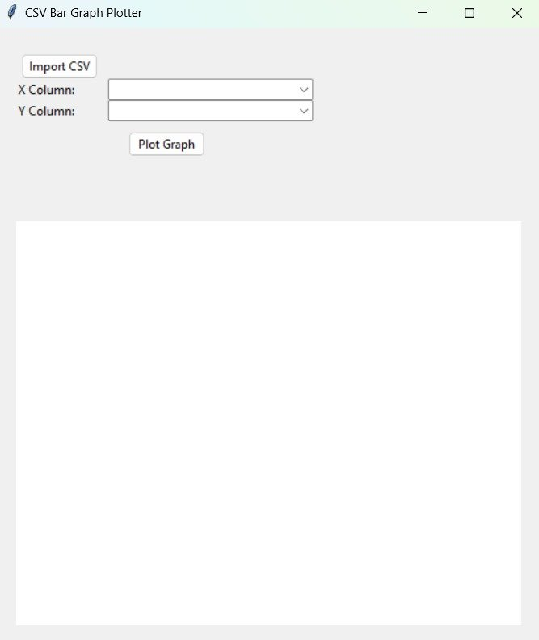
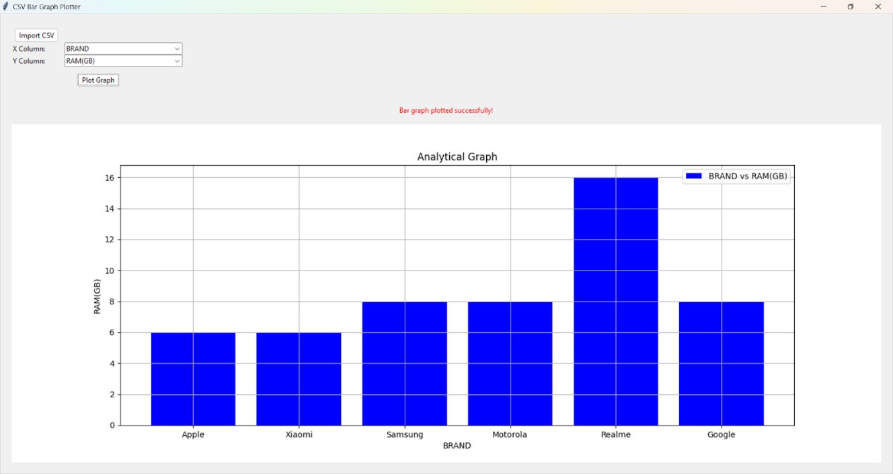
RESULTS AND DISCUSSION

Slide 16
CONCLUSION
In conclusion, the e-commerce product analytical graph generator is a powerful tool that enables online businesses to make data-driven decisions by providing actionable insights and visualizations.
The tool integrates data from various e-commerce platforms, analyzes product performance, and generates interactive graphs and reports.
Enhanced decision-making capabilities
Improved product performance and optimization
Increased sales and revenue
Better understanding of customer behavior and preferences
Competitive advantage through data-driven insights

Slide 17
THANK YOU

