Slide 1
AI-Driven Vulnerability Analysis in Critical Software Systems
Swathi Selvakumaran
UID:119090206
ENPM 808: INDEPENDENT STUDY
Dr. Tony D. Barber

Slide 2
Why Software Vulnerability Detection
Data Breaches and Financial Losses: Vulnerabilities can act like a backdoor for attackers, allowing them to steal sensitive data like financial information, personal records, or intellectual property. This can result in significant financial losses for businesses, due to fines, lawsuits, and the cost of data recovery.
Operational Disruption: Exploiting vulnerabilities can lead to system crashes, service outages, and overall disruption of operations. This can cause lost productivity, inconvenience for users, and potential damage to reputation.
Compliance Violations and Legal Issues: Organizations have a responsibility to protect user data and may be subject to regulations regarding data security. Failing to address vulnerabilities can lead to non-compliance and legal consequences.
Wider System Infiltration: In some cases, a breach through vulnerable code in one part of a system can be used as a springboard to attack other connected systems. This can have a cascading effect, compromising a much larger network.
Reputational Damage: News of a security breach can severely damage a company's reputation, leading to a loss of trust from customers and partners.

Slide 3
Functional Requirements
Code Scanning and Vulnerability Detection: The system should scan source code during compilation and runtime to identify potential security threats like DDoS attacks and ransomware.
Vulnerability Analysis and Prioritization: The system should analyze each vulnerability based on severity, impact, and likelihood of occurrence to prioritize remediation efforts.
User Interface: The system should provide a user interface for initiating scans, viewing vulnerabilities, and accessing recommendations.
AI Model Integration: The system should allow developers to integrate and train AI models for vulnerability detection.
Integrations: The system should integrate with existing development tools and support third-party plugin integration for extended functionality.

Slide 4
Non-Functional Requirements
Performance: The system should deliver code analysis results within a reasonable timeframe.
Scalability: The system should be able to handle an increasing number of users and code submissions without performance degradation.
Security: The system should ensure the confidentiality and integrity of sensitive code data throughout the analysis process.
Usability: The system should be user-friendly and provide clear error messages and documentation.
Reliability: The system should be resilient to failures and recover quickly from disruptions.

Slide 5
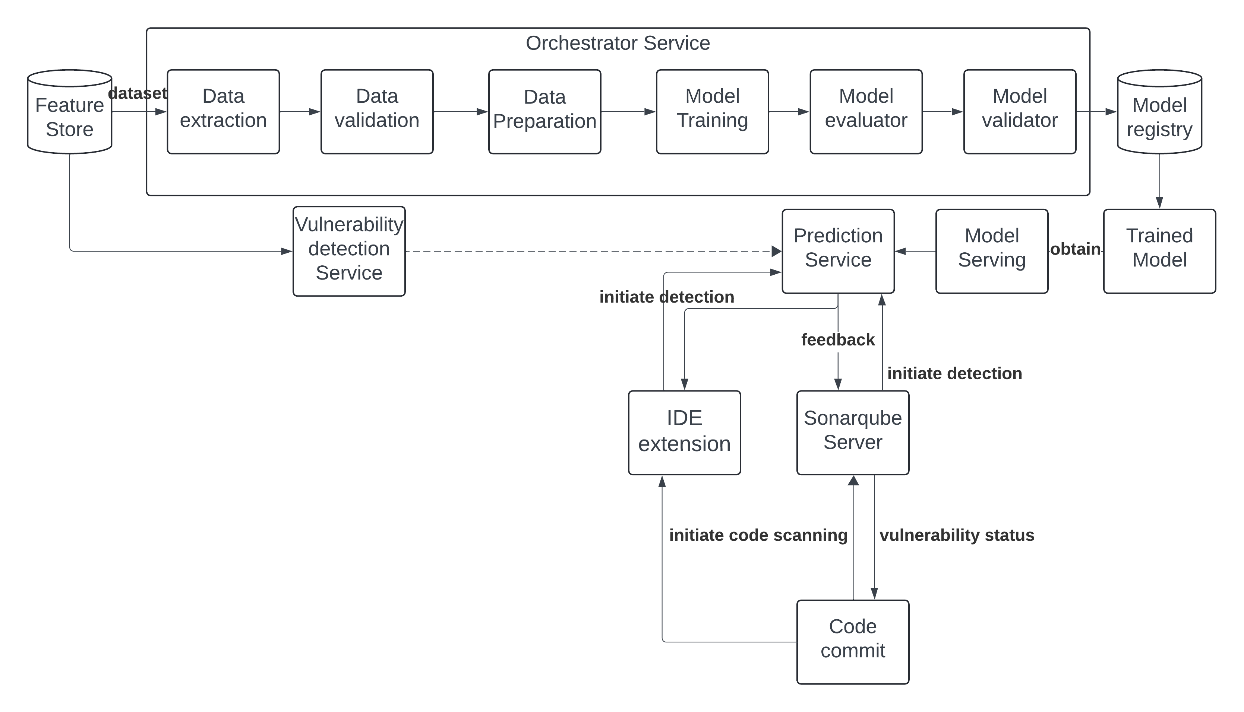
Design

Slide 6
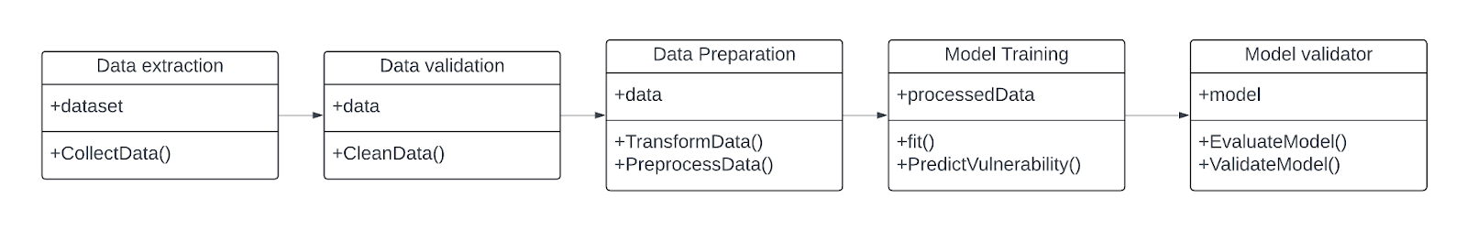
Orchestrator Service

Slide 7
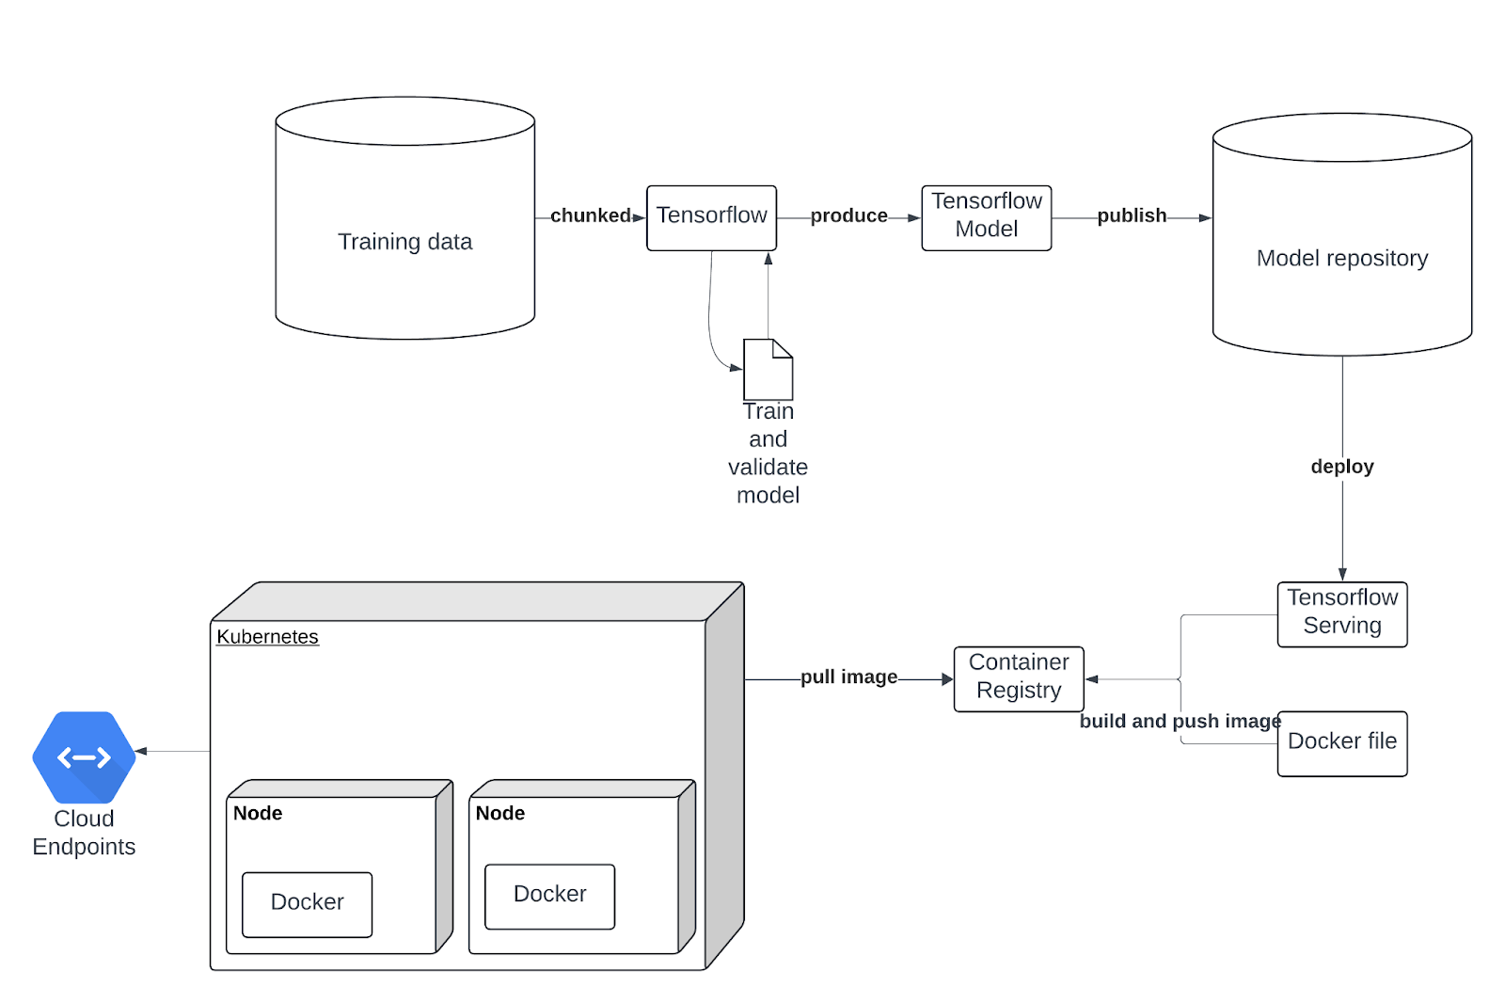
Deployment

Slide 8
Implementation

Slide 9
Machine learning Approach
Supervised Learning: The code trains a model using labeled data. This data consists of Java code snippets and their corresponding vulnerability labels (one-hot encoded). The model learns the patterns between the code features and the presence/absence of vulnerabilities.
Multi-label Classification: The vulnerability labels can represent multiple types of vulnerabilities that a code snippet might have. The model predicts a set of labels (potentially multiple) for each code snippet, making it a multi-label classification problem.
Notes:
The code utilizes a pre-trained transformer model (CAUKiel/JavaBERT) for feature extraction. This model has been trained on a massive dataset of Java code and can capture essential features from the code structure and syntax. These features are then used by the vulnerability classifier (a neural network with a linear layer on top) to predict the vulnerability labels.

Slide 10
Data Acquisition
The dataset is obtained from SARD and Juliet test suite. Each snippet is associated with:
Code: The actual Java code content.
CWE: The Common Weakness Enumeration (CWE) ID of the vulnerability we are testing for.
isVulnerable: A binary label indicating the presence (True) or absence (False) of a vulnerability.
labels: A list of vulnerability labels (might be redundant with CWE).
one-hot: A one-hot encoded representation of the vulnerability labels.

Slide 11
Data Preprocessing
Code Cleaning:
Comments and whitespaces were removed from the code to focus on the core structure and syntax.
Label Handling:
The isVulnerable label provides a clear binary classification target.
The labels list is used for training a multi-label classification model if it contains more specific vulnerability types.
The one-hot encoded labels are is the preferred format for feeding the model during training as they represent each label as a separate binary feature.

Slide 12
Tokenization & Batching
The Java code snippets are tokenized using a pre-trained JavaBERT tokenizer. Tokenization breaks down the code into smaller units (words, sub-words, or special characters) that the model can understand and process.
The tokenized code sequences might have varying lengths. Padding is applied to ensure all sequences within a batch have the same length (maximum length). The data is shuffled and divided into batches for efficient training.

Slide 13
Model Parameters
Epochs: 10
Batch Size: 12 (defined by BATCH_SIZE variable)
Learning Rate: 5e-5 (set in the get_optimizer function)
Tokenizer: CAUKiel/JavaBERT (loaded from transformers)
Hidden Layer Size: 768
Dropout Probability: 0.1
Number of Classes: 22

Slide 14
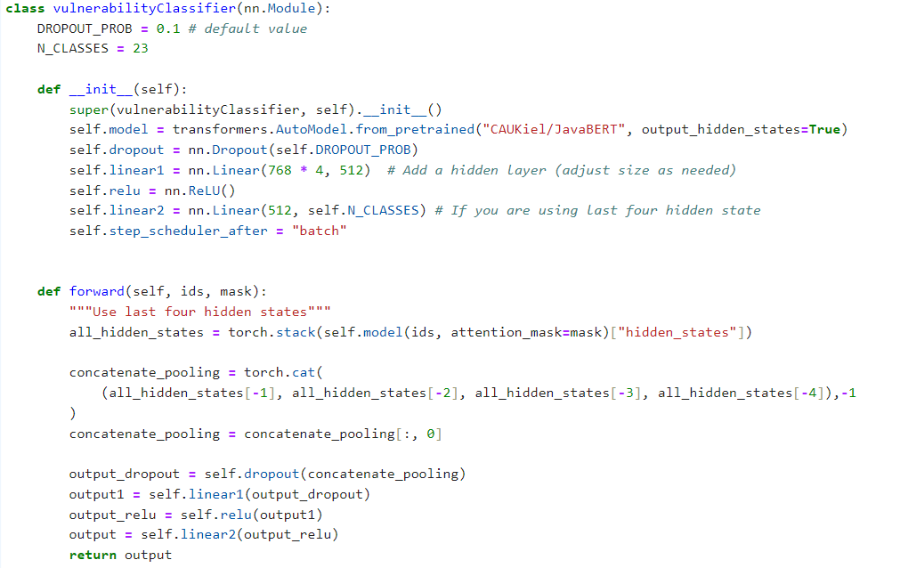
Model explanation
Notes:
1. Pre-trained JavaBERT Model (CAUKiel/JavaBERT):
This model acts as a feature extractor.
It has been trained on a massive dataset of Java code and learns general representations of code elements like functions, variables, and control flow structures.
When fed a Java code snippet, JavaBERT outputs a vector representing the essential features of the code relevant to vulnerability prediction.
2. Multi-Layer Perceptron (MLP):
This is a neural network architecture with multiple hidden layers of interconnected nodes.
The output vector from JavaBERT is fed into the first hidden layer of the MLP.
Each hidden layer applies a non-linear activation function (like ReLU) to transform the data and learn complex relationships between the features.
The final layer of the MLP has a number of neurons equal to the number of vulnerability classes the model predicts.
3. Dropout Layer:
A dropout layer might be included between hidden layers to prevent overfitting during training.
Dropout randomly drops a certain percentage of activations in a layer, forcing the model to learn more robust features and reduce reliance on specific neurons.
4. Output Layer:
The output layer uses a sigmoid activation function to transform the final hidden layer's activations into probabilities between 0 and 1.
These probabilities represent the likelihood of the code snippet belonging to each of the predicted vulnerability classes.
Overall Model Functionality:
A code snippet is preprocessed (cleaned and tokenized).
The pre-trained JavaBERT model extracts features from the tokenized code.
The features are passed through the MLP layers, potentially with dropout applied.
The output layer generates probabilities for each vulnerability class.
A threshold (e.g., 0.5) is applied to the probabilities to classify the code snippet as vulnerable or not for each class (depending on the chosen classification strategy).
Key Points:
This architecture leverages the power of a pre-trained model for feature extraction and combines it with a neural network for vulnerability classification.
The specific number of hidden layers, neurons per layer, and dropout rate might be hyperparameters tuned during training to optimize performance.
The code utilizes a multi-label classification approach, meaning the model can predict multiple vulnerability classes for a single code snippet.
Note: Without access to the complete code, especially the vulnerabilityClassifier class definition, this explanation is based on the provided information and common practices in vulnerability prediction using deep learning models.

Slide 15
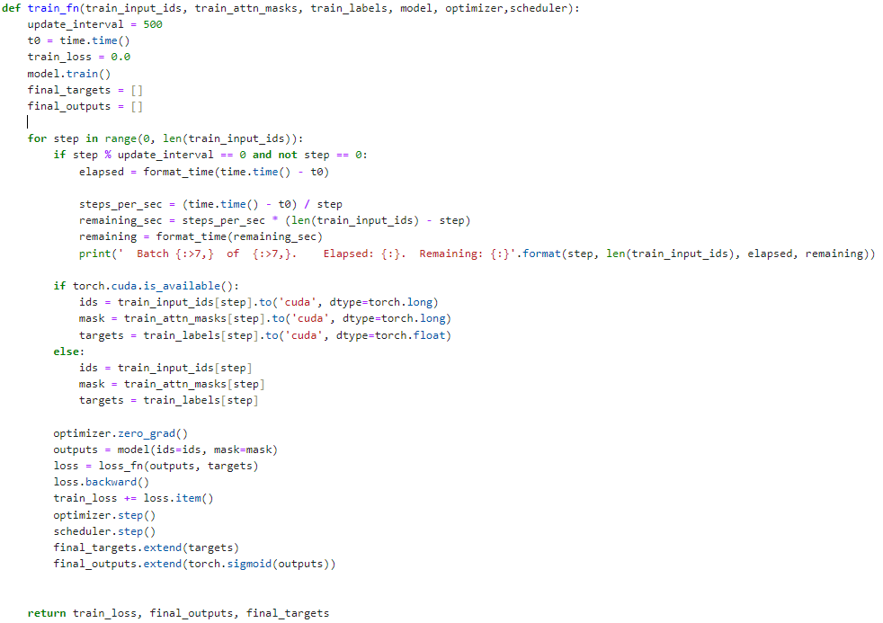
Model Training
Data Loading
Model Definition
Optimizer and Loss function
Forward pass
Backward pass and Optimization
Epochs and Evaluation

Slide 16
Model Prediction
Input | Decision | Action | Output
New Java code snippet
Yes | Preprocessing (Cleaning & Tokenization) | Apply same techniques as training data | Preprocessed code snippet
Preprocessed code snippet | Yes (Multi-label classification?) | Use JavaBERT to extract features | Feature vector
 | No | Use JavaBERT to extract features | Feature vector
Feature vector | Yes | Pass through MLP layers | Intermediate feature representations
 | No | Pass through MLP layers | Intermediate feature representations
Intermediate feature representations |  | Pass through output layer | Probabilities for each vulnerability class
Probabilities for each vulnerability class | Yes (Binary classification?) | Apply threshold (e.g., 0.5) | Predicted vulnerability class(es)
 | No | Apply threshold (optional) or select top-k probabilities | Predicted vulnerability class(es) with probabilities (optional)
Preprocessing New code
Forward pass
Classification
Probability
Notes:
raining Phase of the Vulnerability Classifier Model
The training phase involves using the prepared data to train the vulnerability classifier model. Here's a breakdown of the key steps:
1. Data Loading:
The preprocessed and formatted training data (code snippets, labels) are loaded into memory or accessed from a data loader.
2. Model Definition:
The vulnerabilityClassifier class likely defines the model architecture.
It specifies:
The pre-trained JavaBERT model (loaded using transformers.AutoModel.from_pretrained).
The number of hidden layers and neurons in the MLP.
Dropout layer configuration (probability for dropping activations).
Output layer with a sigmoid activation function.
3. Optimizer and Loss Function:
An optimizer (e.g., AdamW) is chosen to update the model's weights based on the calculated loss during training.
A loss function (e.g., binary cross-entropy for binary classification or multi-class cross-entropy for multi-label classification) is used to measure the difference between the model's predicted probabilities and the actual vulnerability labels.
4. Forward Pass:
A batch of training data (code snippets and labels) is fed into the model.
The JavaBERT model extracts features from the code.
The features are passed through the MLP layers.
The output layer generates probabilities for each vulnerability class.
5. Backward Pass and Optimization:
The loss function calculates the difference between the predicted probabilities and the actual labels.
The calculated loss is backpropagated through the network.
The optimizer uses the gradients to update the weights of the model in a direction that minimizes the loss.
6. Epochs and Evaluation:
The training process iterates over the entire dataset multiple times (epochs).
After each epoch, the model might be evaluated on a validation set to monitor its performance and prevent overfitting.
Overfitting occurs when the model memorizes the training data and performs poorly on unseen data.
7. Saving the Model:
Once training is complete, the model's state dictionary containing the trained weights and biases is saved for later use (prediction or further training).
Model Prediction
The trained model can be used to predict vulnerabilities in new, unseen Java code snippets:
1. Preprocessing New Code:
The new code snippet is preprocessed similarly to the training data (cleaning and tokenization).
2. Forward Pass:
The preprocessed code is fed into the trained model.
JavaBERT extracts features.
The features are passed through the MLP layers.
The output layer generates probabilities for each vulnerability class.
3. Classification (Thresholding):
Depending on the chosen classification strategy:
For binary classification (vulnerable vs. non-vulnerable), a threshold (e.g., 0.5) is applied to the predicted probability. Values above the threshold are classified as vulnerable.
For multi-label classification, a threshold might be applied to each class probability independently, or a more sophisticated approach like selecting the top-k most likely vulnerabilities might be used.
4. Output:
The model outputs the predicted vulnerability class(es) or a list of probabilities for each class, depending on the configuration.
Overall, the training phase involves iteratively refining the model's weights to learn from the labeled data. The trained model can then be used to predict vulnerabilities in new code based on the patterns it has learned from the training data.

Slide 17

Testing
Test Data Preparation:
The test dataset is loaded and preprocessed.
Model Evaluation:
The trained model is used to predict vulnerabilities on the unseen test set.
Evaluation metrics like accuracy, confusion matrix, and classification report are generated to provide a comprehensive assessment of the model's performance on unseen data.
Testing Accuracy:

Slide 18
Model Evaluation : Training loss

Slide 19
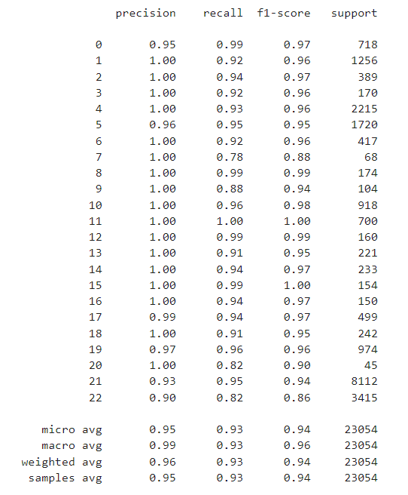
Model Evaluation : Classification Report

Slide 20
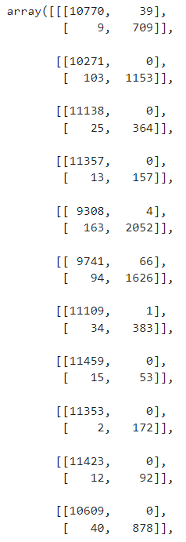
Model Evaluation : Confusion Matrix

Slide 21
API Development
Accepts code snippets as input: The API takes code sections or entire files in JSON format through POST requests.
Preprocesses code: The code is cleaned (removing comments and whitespaces) before being fed to the model.
Tokenizes code: The code is broken down into smaller units (tokens) suitable for the model's processing.
Predicts vulnerabilities: The vulnerability classifier model predicts the presence of various vulnerabilities based on the code's content.
Returns predictions: The API responds with a JSON object containing the predicted vulnerabilities associated with the code sections or files.
Notes:
The script utilizes pre-trained models:
CAUKiel/JavaBERT: A transformer model trained for understanding Java code.
A multi-label binarizer (mlb): This model maps vulnerability labels to binary vectors for efficient prediction.
The code is chunked and processed in batches to handle sequences exceeding a maximum length.
A sigmoid function is applied to the model's output to convert it into probabilities between 0 and 1.
A threshold of 0.5 is used for filtering the predicted vulnerabilities (probabilities above 0.5 are considered vulnerabilities).

Slide 22
API Development
The script utilizes pre-trained models:CAUKiel/JavaBERT: A transformer model trained for understanding Java code.
A multi-label binarizer (mlb): This model maps vulnerability labels to binary vectors for efficient prediction.
The code is chunked and processed in batches to handle sequences exceeding a maximum length.
A sigmoid function is applied to the model's output to convert it into probabilities between 0 and 1.
A threshold of 0.5 is used for filtering the predicted vulnerabilities (probabilities above 0.5 are considered vulnerabilities).
Notes:
The script utilizes pre-trained models:
CAUKiel/JavaBERT: A transformer model trained for understanding Java code.
A multi-label binarizer (mlb): This model maps vulnerability labels to binary vectors for efficient prediction.
The code is chunked and processed in batches to handle sequences exceeding a maximum length.
A sigmoid function is applied to the model's output to convert it into probabilities between 0 and 1.
A threshold of 0.5 is used for filtering the predicted vulnerabilities (probabilities above 0.5 are considered vulnerabilities).

Slide 23
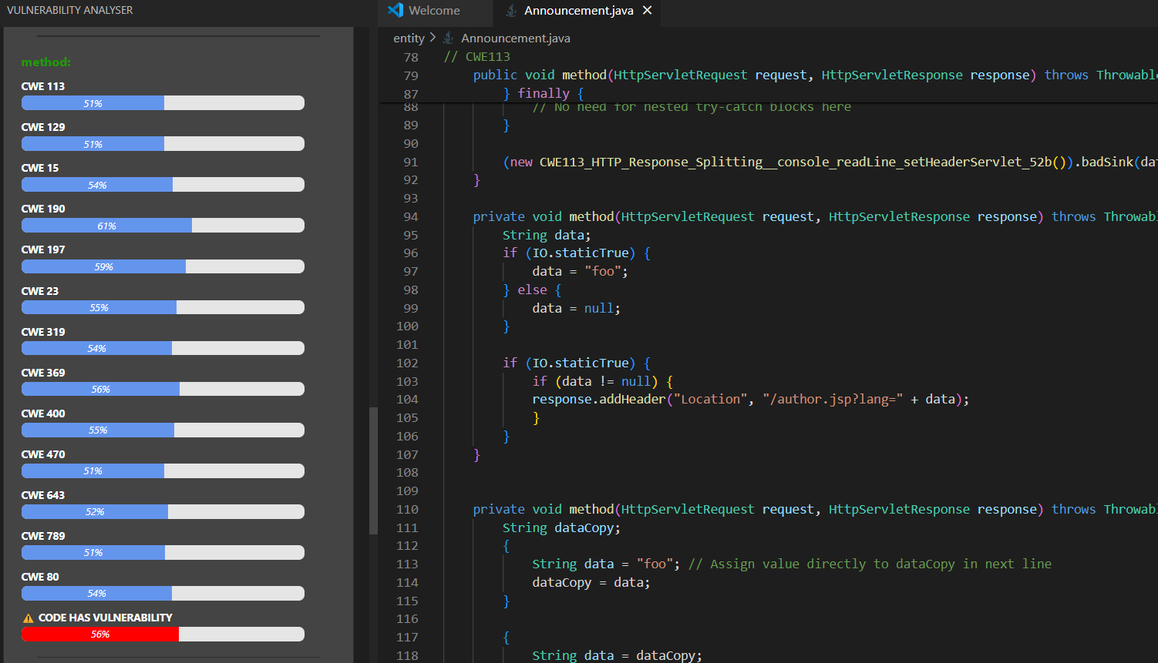
IDE Extension

Slide 24
DOCKER IMAGE
docker run -it --rm -p 9696:9696 <image>

Slide 25
What went wrong
Deployment: The Model size was huge and hence was unable to host on cloud free tier leading to insufficient memory
PyTorch: PyTorch was throwing error with latest updated version. Required installation with the help of conda.
Model training took lot of time and memory as GPU was unavailable.
Learning time was large

Slide 26
Future work
Working with webhooks to integrate the API endpoint with SonarQube
Improve the model accuracy to reduce false negatives
Modify model for line by line vulnerability prediction instead of method vulnerability prediction

Slide 27
Learning outcome
Deep Learning for Vulnerability Prediction
Multi-Layer Perceptrons (MLPs)
Multi-label Classification
Text Preprocessing and Tokenization
Flask Web API Development
Importance of Data Quality
Challenges of Deep Learning

Slide 28
Thank you!
Questions?

