Slide 1

BCCE301 Cooperative Education Project
Analysis of JavaScript Testing Framework in Canterbury
Swathi Soman
99162569

Slide 2
Project
Student Specialisation : Information and communication Technology
Project Needs : Analysis of the most commonly used
JavaScript Testing framework in Canterbury
Project Type : JavaScript testing and development

Slide 3
Main Scope
Identify the widely used JavaScript testing framework in Canterbury
Conduct survey among the IT professionals, perform analysis and identify the popular framework
Write unit tests with respect to the result obtained from the survey.
i.e. write unit tests with the most popular JavaScript framework.

Slide 4
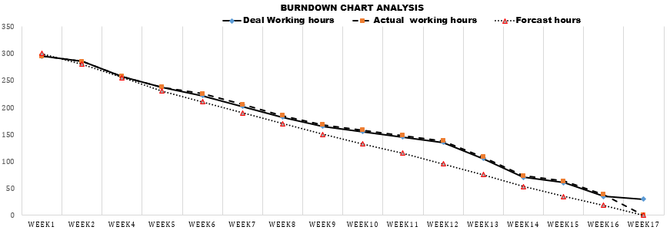
Timelines / Deliverables

Slide 5
The Project Process
Paper Survey
Conduct Survey
Online Survey
Perform Analysis
Write Unit Tests

Slide 6
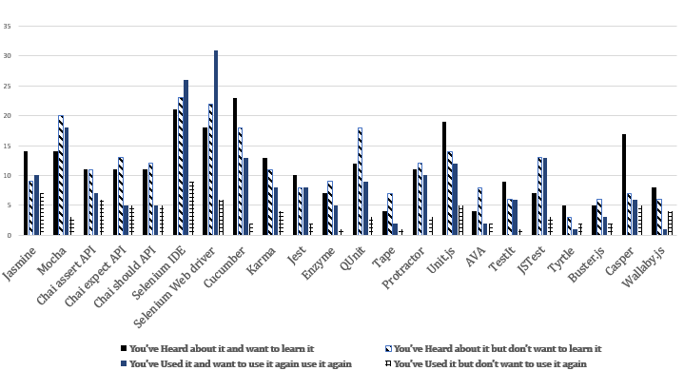
Survey

Slide 7
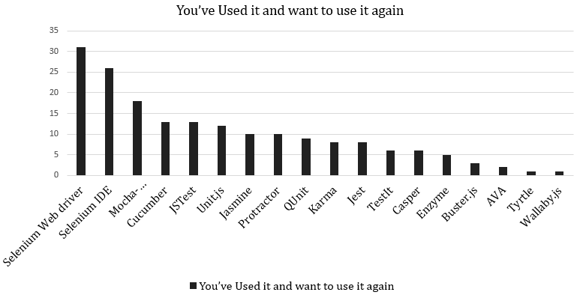
Survey Analysis

Slide 8
Scope
All the details about the analysis of the survey was provided to the Industry Supervisor( Dr Mike Lance)
Phase 1: Conduct survey among the professionals to identify the popular frameworks
Phase 2: Perform unit test for the frameworks which are most popular
As per the suggestion from the IS the frameworks for the unit tests were identified and Unit tests were conducted for different examples.

Slide 9







Frameworks
Jasmine
UnitJS
Mocha-chai
Frameworks
JStest
Selenium IDE
QUnit
Selenium Web Driver
Cucumber

Slide 10
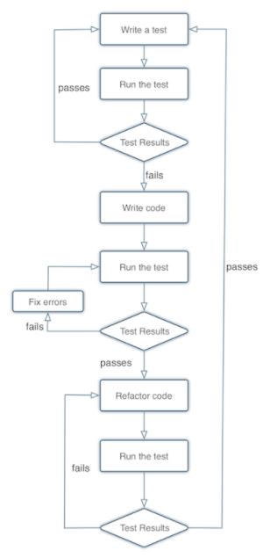
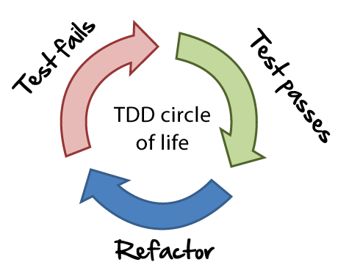
Methodology
Test Driven Development(TDD)

Slide 11
Milestones Achieved
Recreation of the existing framework
Survey
Identifying popular Framework
Implementing Framework to perform unit tests

Slide 12
Problems Encountered
Confirmation on survey questions and the online survey
Confirmation in getting the ethics approved
Unavailability of the ticket to attend the Tech Summit meetup
Unable to find professionals with JavaScript Testing Knowledge
Unexpected sickness of tutor (Industry Supervisor) and team member
Lack of Knowledge on the JavaScript

Slide 13
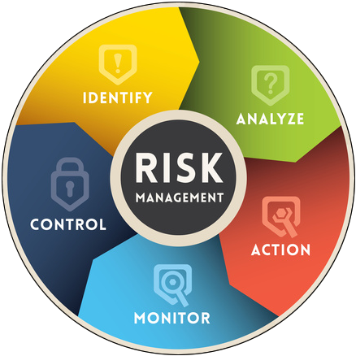
Risk Management
Risk | Probability | Impact
Tight timelines | High | High
Operational Risks | Medium | High
Technical Risks | High | High
Tutor Unavailability | Medium | High
Personal Risk | Medium | Medium

Slide 14

Quality Assurance
Internal /External Quality Assurance
Maintainability
Flexibility
Portability
Readability and Correctness
Efficiency and Adaptability

Slide 15
Course Management
Weekly reports and meetings
Weekly reports and meeting held with the industry as well as the academic supervisors
Frequent updates on to the industry and academic supervisor on the project
Subject PR203 chosen with the project
Unable to focus on the project when there are tasks given by the subject at the same time
Could acquire knowledge on the subject which would be useful for my future and career.
Other Priorities
Part time work

Slide 16
Learning Outcomes
What was learnt
The principle of the JavaScript programming.
Learning on the different JavaScript testing frameworks such as Jasmine, Mocha (expect, should, assert), QUnit, Cucumber, JStest.
Familiarity to conduct the surveys among the professionals
Creation of reports, how to be dedicated in the given work and maintain professionalism
Confidence
What Next?
All the learnings which I gained from the project will help me in being a test analyst or a developer in near future.

