Slide 1

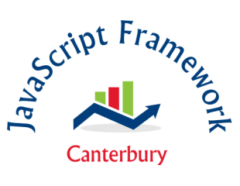
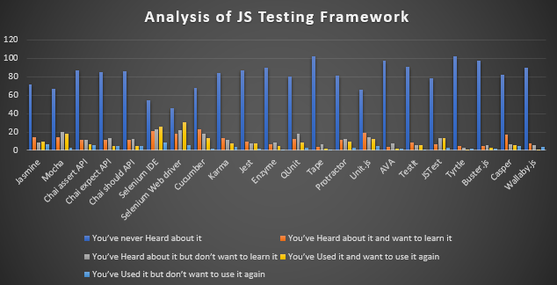





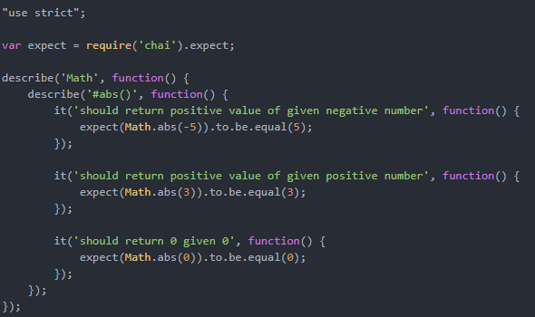
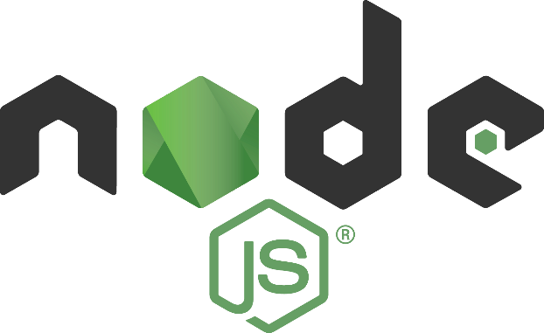
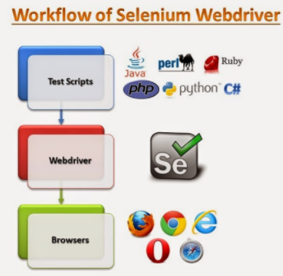
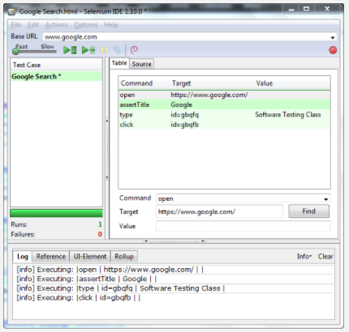
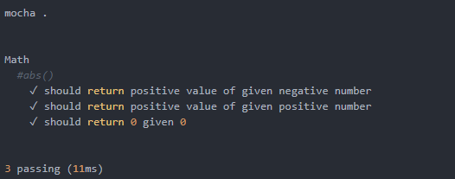
Analysis of JavaScript Testing Framework in Canterbury
Swathi Soman , sws0077@arastudent.ac.nz
Industry Supervisor: Dr Mike Lance Academic Supervisor : Phillip Roxborogh Course Supervisor : David Weir
Software testing is the process of executing program with intent to find strong errors. Like the rest of JavaScript, the testing environment is a highly competitive one with rapid release cycles, feature and performance comparisons and constant superiority between the frameworks. This project aims to identify the popular JavaScript testing frameworks in Canterbury. Survey is conducted to identify the popular JavaScript testing framework .Unit tests are written based on the popular framework.
Overview
Survey
The survey was conducted among the Canterbury Tech Custer and JavaScript Meetup groups to identify the most widely used JavaScript testing frameworks. There were almost around 113 professionals participated in the survey, which was conducted through paper and online. The graph below shows the result of the analysis.
Frameworks
WebDriver is a web automation framework that allows you to execute your tests against different browsers, not just Firefox (unlike Selenium IDE). It aims to provide a friendly API that's easy to explore and understand. WebDriver also enables to use programming language in creating your test scripts .
Conditional Operators like if-then-else or switch-case used.
Looping can be performed like do-while.
Selenium IDE is basic, simple to learn and convenient record and play tool for web applications. Expectation to absorb information for Selenium IDE is less and no compelling reason to learn test scripting language. It is open-source tool and accessible for download for free. Selenium IDE implies Integrated Development Environment (IDE) used for selenium tests. It is in terms of Firefox extension and used for recording, altering and playback scripts.
Mocha is a component rich JavaScript test structure running on Node.js and in browser, making asynchronous testing basic and fun. Mocha tests run serially, taking into account adaptable and precise detailing, while at the same time mapping uncaught special cases to the correct test cases. It's used for unit and integration testing, and it's a great candidate for BDD (Behaviour Driven Development).
Technologies Used
Selenium Web Driver
Selenium IDE
Mocha
References
Guru99. (n.d.). Retrieved from www.guru99.com: https://www.guru99.com/introduction-webdriver-comparison-selenium-rc.html
Mocha. (n.d.). Retrieved from mochajs.org: https://mochajs.org/
Robinson, S. (2016, June 08). Stack Abuse. Retrieved from stackabuse.com: http://stackabuse.com/testing-node-js-code-with-mocha-and-chai/

Slide 2
Analysis of JavaScript Testing Framework in Canterbury
Swathi Soman , sws0077@arastudent.ac.nz
Industry Supervisor: Dr Mike Lance Academic Supervisor : Phillip Roxborogh Course Supervisor : David Weir
Software testing is the process of executing program with intent to find strong errors. Like the rest of JavaScript, the testing environment is a highly competitive one with rapid release cycles, feature and performance comparisons and constant superiority between the frameworks. This project aims to identify the popular JavaScript testing frameworks in Canterbury. Survey is conducted to identify the popular JavaScript testing framework .Unit tests are written based on the popular framework.
Overview
Survey
The survey was conducted among the Canterbury Tech Custer and JavaScript Meetup groups to identify the most widely used JavaScript testing frameworks. There were almost around 113 professionals participated in the survey, which was conducted through paper and online. The graph below shows the result of the analysis.
Frameworks
WebDriver is a web automation framework that allows you to execute your tests against different browsers, not just Firefox (unlike Selenium IDE). It aims to provide a friendly API that's easy to explore and understand. WebDriver also enables to use programming language in creating your test scripts .
Conditional Operators like if-then-else or switch-case used.
Looping can be performed like do-while.
Selenium IDE is basic, simple to learn and convenient record and play tool for web applications. Expectation to absorb information for Selenium IDE is less and no compelling reason to learn test scripting language. It is open-source tool and accessible for download for free. Selenium IDE implies Integrated Development Environment (IDE) used for selenium tests. It is in terms of Firefox extension and used for recording, altering and playback scripts.
Mocha is a component rich JavaScript test structure running on Node.js and in browser, making asynchronous testing basic and fun. Mocha tests run serially, taking into account adaptable and precise detailing, while at the same time mapping uncaught special cases to the correct test cases. It's used for unit and integration testing, and it's a great candidate for BDD (Behaviour Driven Development).
Technologies Used
Selenium Web Driver
Selenium IDE
Mocha
References
Guru99. (n.d.). Retrieved from www.guru99.com: https://www.guru99.com/introduction-webdriver-comparison-selenium-rc.html
Mocha. (n.d.). Retrieved from mochajs.org: https://mochajs.org/
Robinson, S. (2016, June 08). Stack Abuse. Retrieved from stackabuse.com: http://stackabuse.com/testing-node-js-code-with-mocha-and-chai/

