Slide 1


The Crown Group
A Business Review – June ‘20
Redefining Melbourne's skyline with innovative developments
by Swathi Subramanyan

Slide 2
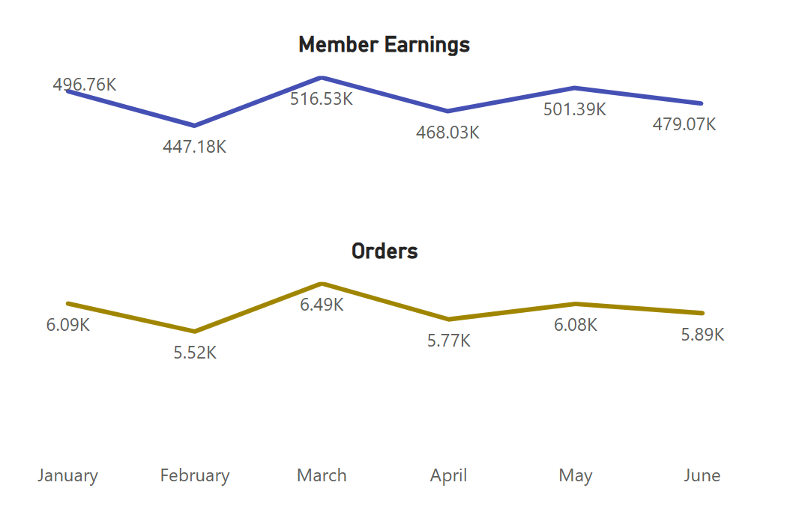
Overview
Crown operates 30 restaurants across 5 cities, specializing in 5 cuisines and serving a community of 350 members.
June Performance Highlights
Member Earnings* has decreased by 4.6% MoM to 479K. Tel Aviv accounts for 31.8% of the Earnings lost.
3% MoM decline in orders to 5892. Business peaked in March ‘20 with 6490 orders.
Key Insights
M112 & M157 are most valuable to the group with 0.6% contribution to YTD Member Earnings.
R19 (27.7%), R20 (25.7%). R28 (25.06%) recorded the highest % Earnings lost between Jan & Feb
Staffing should address busiest hours: 12 – 1 PM, 7 – 10 PM
* Member Earnings (calculated monthly per member) is the revenue generated directly from a group member. It is calculated as the total difference between the expenditure earned and the commission earned for each member per month.

Slide 3
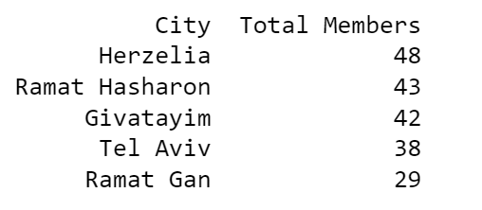
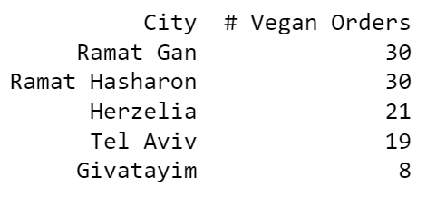
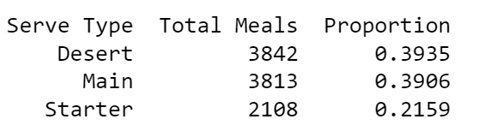
Descriptive Insights
1. How many members in each of the cities?
2. Which cities have the most vegan meals by members and orders?
3. What is the proportion of serve types for the Italian restaurant?
* PFA the respective SQL code in the attached IPYNB or PDF files.

Slide 4
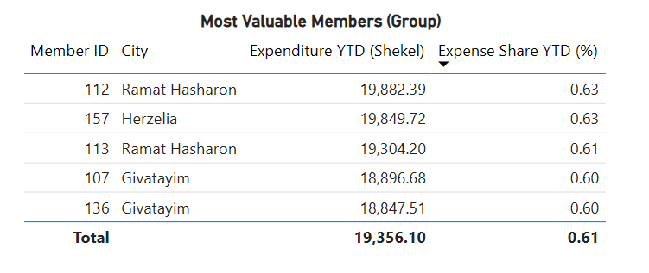
Most Valuable Members (Group)
Most Valuable Members are repeat customers who also contribute significantly to the earnings. (See below for exact formula).
M112 (19.8K), M113 (19.3K) from Ramat Hasharan, M157 (19.8K) from Herzelia were determined to be most valuable YTD ‘20.
Scope – Promotions, Loyalty Rewards
* Customer value was determined by – 0.7 * total expense + 0.3 * frequency of ordering. Higher weight was given to order size.
* Visualizations were generated in PowerBI

Slide 5
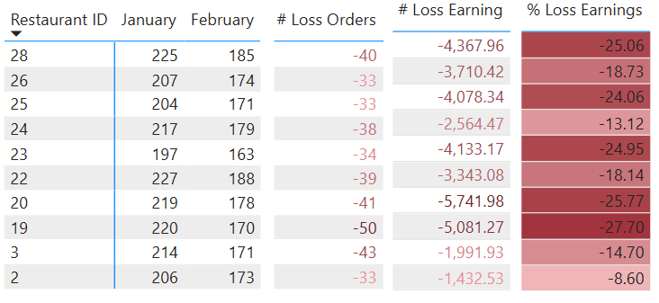
Earning Dip in Feb’20
From the Earnings trendline – 9% (49.58K) drop in Member Earnings between Jan and Feb ‘20
Restaurants - R19 (27.7%), R20 (25.7%). R28 (25.06%) were most impacted.
Scope – Check competitor activity, social media sentiment in these months. Is the trend seasonal to industry or specific to restaurant?
* Member Earnings (calculated monthly per member) is the revenue generated directly from a group member. It is calculated as the total difference between the expenditure earned and the commission earned for each member per month.

Slide 6
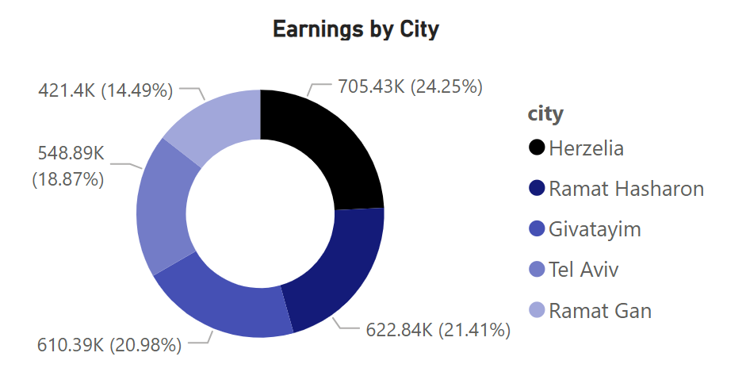
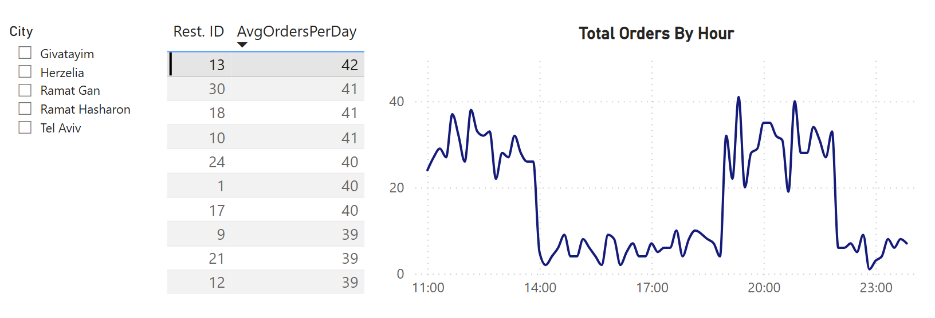
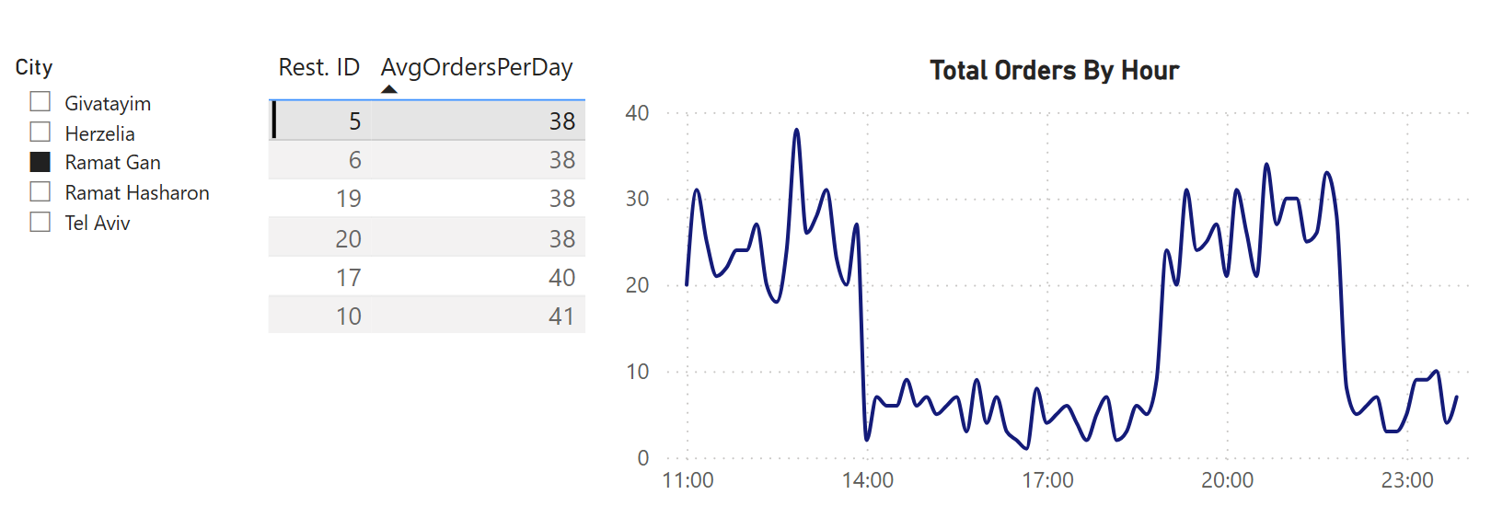
Staffing Guide for Busy Hours
Staffing is a major cost in hospitality, with luxurious service requiring more staff and higher expenses. Effective preparation is key.
Busiest hours on average – 12 – 1 PM, 7 – 10PM. Evenings tend to be busier than mornings
Herzelia (24.3%) earns most while Ramat Gan (14.5%) earns least. Staffing can be done appropriately
Scope – Shift Allocations, Budgeting
Overall Busiest Restaurant (YTD) - R13
Relatively Well-Paced Restaurant in Ramat Gan – R5
* The graphs has been smoothed for readability. AvgOrdersPerDay is based on YTD values

Slide 7
References
Kaggle: Restaurant members and orders dataset
Gamma for PPT Template

