Slide 1
Team 7 - Artificial Neural Networks ( Lead Scoring )

Slide 2
Agenda
1
Problem Statement
2
Business Hypothesis
3
EDA
4
Feature Engineering
5
Model Selection
6
Model Development and Tuning
7
Conclusion

Slide 3
What is our Problem Statement Type?
Lead Scoring
Lead scoring is a systematic approach to ranking prospects based on their perceived value to the organization. It helps sales and marketing teams prioritize leads based on their likelihood to convert into paying customers.
Key Components of Lead Scoring:
Demographic Information:
Evaluates characteristics such as job title, industry, company size, and location to determine fit with the ideal customer profile.
Behavioral Data:
Analyzes interactions with the company, including website visits, email engagement, social media activity, and event participation to gauge interest and intent.
Engagement Level:
Measures how actively a lead engages with marketing materials, such as downloading content, attending webinars, or requesting demos.
Lead Source:
Considers the channel through which the lead was generated (e.g., organic search, paid ads, referrals) to assess quality and potential value.
Scoring Model:
Utilizes a point-based system where leads receive scores based on the above factors, allowing for easy comparison and prioritization.

Slide 4
Problem Statement
Use-case:
“In a competitive market, our company invests significantly in lead generation across various channels such as digital marketing, events, social media, and inbound inquiries. However, converting these leads into paying customers remains a challenge. The sales team is often overwhelmed with a large volume of leads, making it difficult to prioritize efforts on high-quality prospects that are more likely to convert. The current process for evaluating and prioritizing leads is largely manual, subjective, and lacks a consistent framework, resulting in missed opportunities, wasted resources, and inefficient sales cycles.”

Slide 5
Understanding the Challenges faced by the company
Overwhelming Lead Volume:
The sales team is inundated with a high number of leads from various channels, making it difficult to manage and prioritize effectively.
Difficulty in Identifying High-Quality Leads:
Without a structured lead scoring system, the company struggles to differentiate between high-potential leads and those less likely to convert, resulting in missed opportunities.
Resource Misallocation:
Time and effort are often wasted on low-quality leads, diverting resources away from more promising prospects and impacting overall sales productivity.
Extended Sales Cycles:
The lack of a streamlined approach to lead management contributes to longer sales cycles, delaying revenue generation and affecting cash flow.
Inconsistent Sales Performance:
Variability in lead quality and the absence of a standardized evaluation process lead to inconsistent sales outcomes across the team.
Limited Insights for Strategy Optimization:
The absence of data-driven insights into lead behavior and engagement makes it challenging to refine marketing strategies and improve lead generation efforts.
Sales Team Frustration:
The overwhelming nature of lead management and the inefficiencies in the current process can lead to frustration and burnout among sales team members.

Slide 6
Solution that we are offering!
1. Comprehensive Data Analysis:
Data Integration:
We will consolidate the provided Excel dataset, which contains 36 columns, ensuring all relevant information is organized for analysis.
Historical Data Utilization:
We will analyze the existing data to identify patterns and trends that correlate with successful lead conversions, focusing on key attributes within the dataset.
2. Predictive Lead Scoring Model Development:
Hypothesis Formation:
Based on our analysis of the 36 columns, we will formulate hypotheses regarding the key factors that influence lead conversion.
Feature Engineering:
We will extract and select relevant features from the dataset, including demographic, behavioral, and engagement metrics, that are critical for predicting lead success.
Model Training and Tuning:
Using the extracted features, we will train a custom predictive lead scoring model with machine learning algorithms and fine-tune it to ensure the best fit for accurate lead conversion predictions.

Slide 7
Agenda
1
Problem Statement
2
Business Hypothesis
3
EDA
4
Feature Engineering
5
Model Selection
6
Model Development and Tuning
7
Conclusion

Slide 8
Hypothesis that we got from Business Point of view!
Demographic Factors:
Hypothesis 1: Leads from specific geographic regions (e.g., urban vs. rural) are more likely to convert than those from other regions.
Hypothesis 2: Leads with certain job titles or roles (e.g., decision-makers like managers or executives) have a higher conversion rate compared to other roles.
Engagement Metrics:
Hypothesis 3: Leads who engage with multiple marketing channels (e.g., email, social media, webinars) are more likely to convert than those who engage with only one channel.
Hypothesis 4: The frequency of interactions (e.g., number of website visits, email opens, or downloads) positively correlates with the likelihood of conversion.
Behavioral Indicators:
Hypothesis 5: Leads who download specific resources (e.g., whitepapers, case studies) are more likely to convert than those who do not engage with such content.
Hypothesis 6: Leads that request a demo or consultation are significantly more likely to convert compared to those who do not take such actions.
Lead Source:
Hypothesis 7: Leads generated from certain marketing campaigns (e.g., paid ads, organic search, referrals) have higher conversion rates than leads from other sources.
Hypothesis 8: Leads that come from high-quality sources (e.g., industry events or targeted campaigns) are more likely to convert than those from less targeted sources.
Time Factors:
Hypothesis 9: Leads that engage within a specific time frame (e.g., within a week of initial contact) are more likely to convert than those who engage later.
Hypothesis 10: The time taken for a lead to respond to initial outreach correlates with their likelihood to convert (e.g., quicker responses indicate higher interest).

Slide 9
Agenda
1
Problem Statement
2
Business Hypothesis
3
EDA
4
Feature Engineering
5
Model Selection
6
Model Development and Tuning
7
Conclusion

Slide 10
Exploratory Data Analysis (EDA) - Overview
Dataset Composition:
The dataset contains 36 columns with various attributes related to leads, including demographic, engagement, and conversion data.
Data Quality Assessment:
Analyze missing values and outliers to ensure data integrity and determine appropriate handling methods.
Descriptive Statistics:
Calculate summary statistics (mean, median, standard deviation) for numerical features and analyze the distribution of categorical variables.
Engagement Metrics Analysis:
Examine key engagement metrics (e.g., total visits, time spent, page views) to compare behaviors between converted and non-converted leads.
Correlation Analysis:
Generate a correlation matrix to identify relationships between features and the target variable (lead conversion) to inform model development.
Key Features:
Lead Source
Origin
Last Activity
Tags
Total Visits
Time Spent

Slide 11
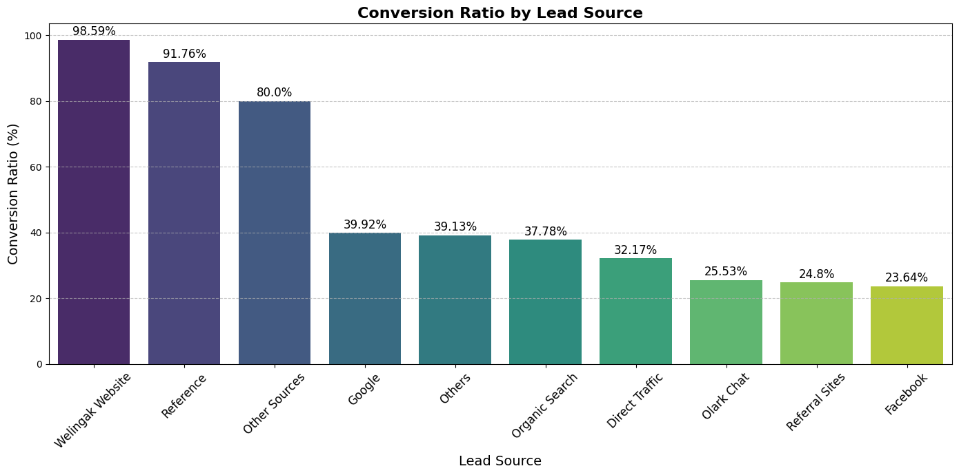
Hypotheses

Slide 12
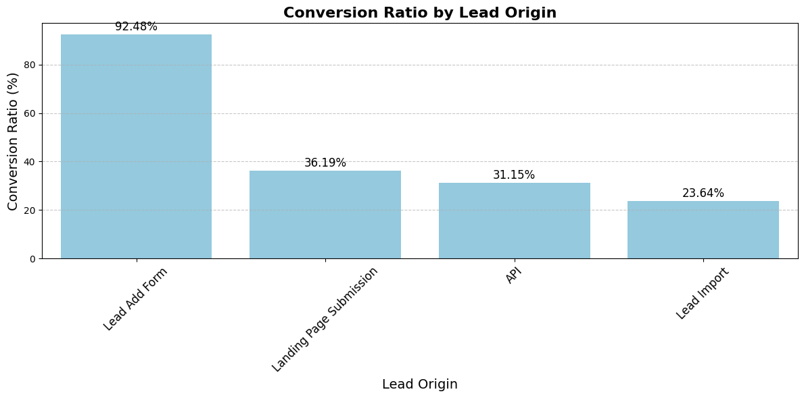

Slide 13
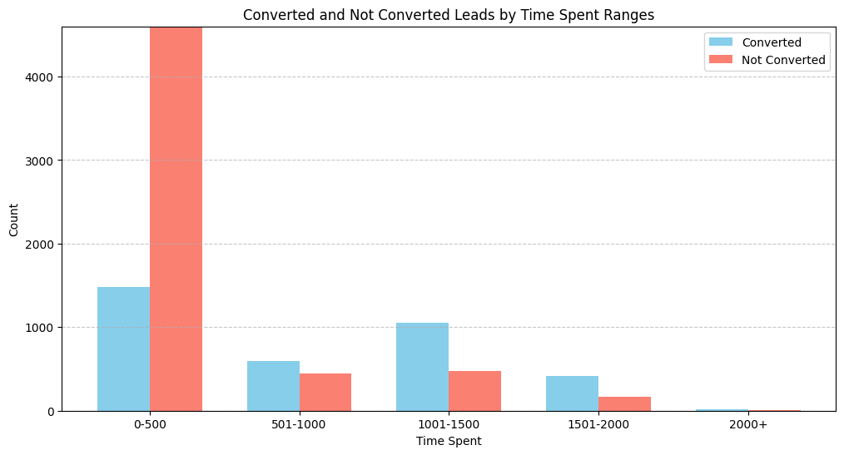

Slide 14
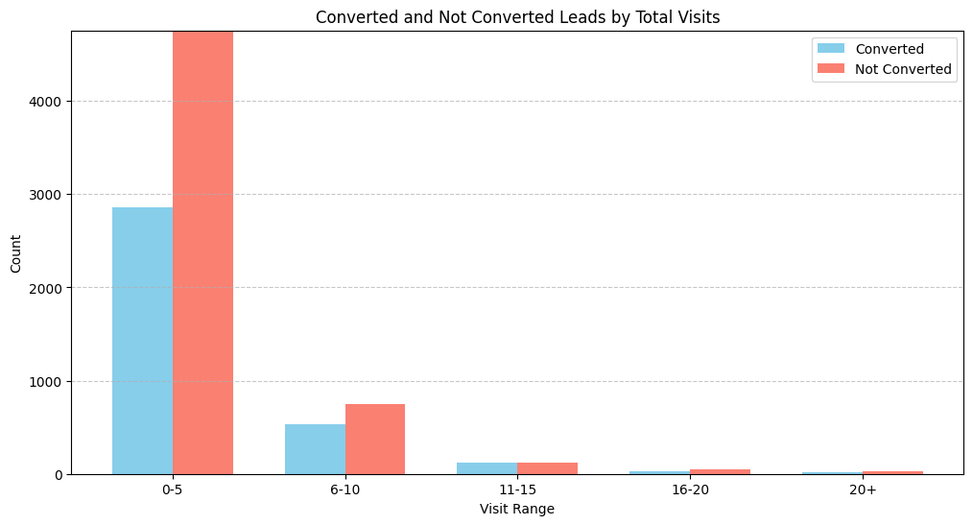

Slide 15
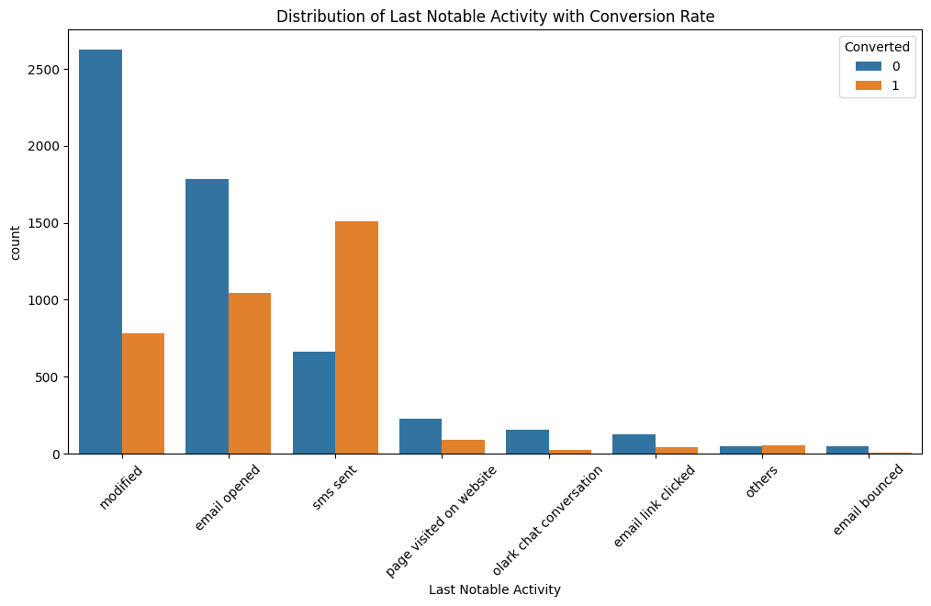
Total Number of counts for Each Last Notable Activity

Slide 16
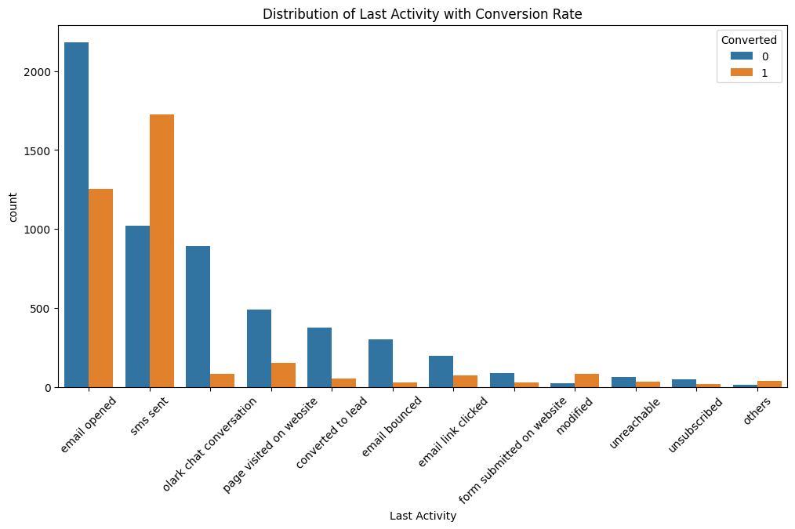
Total Number of counts for Each Last Activity

Slide 17
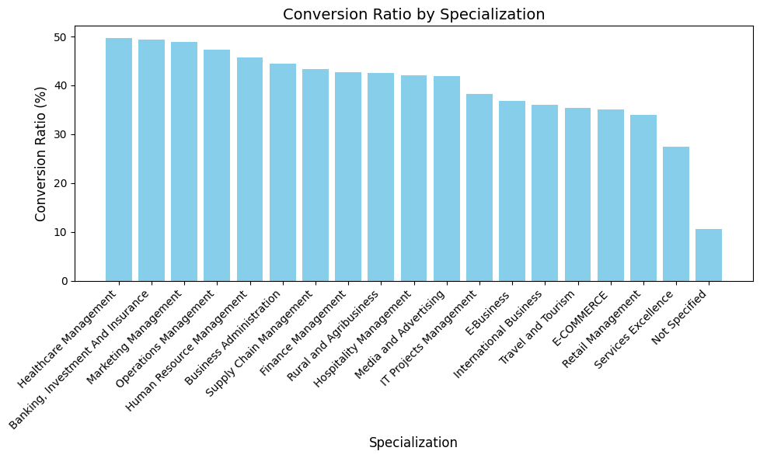
Conversion rate for each specialization

Slide 18
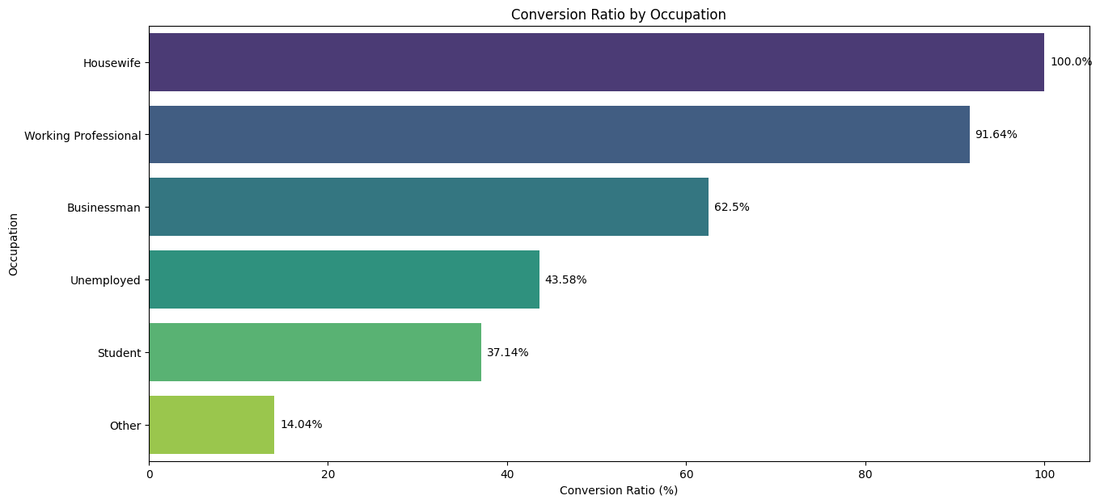

Slide 19
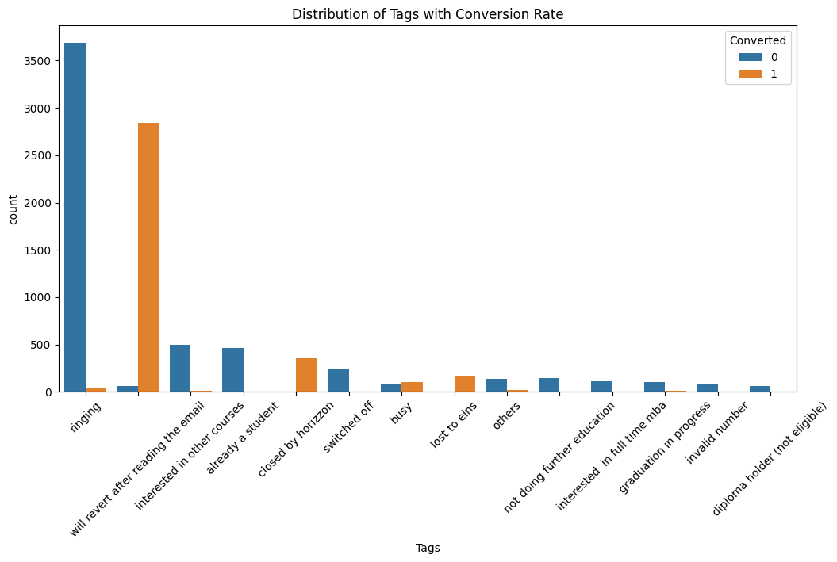

Slide 20
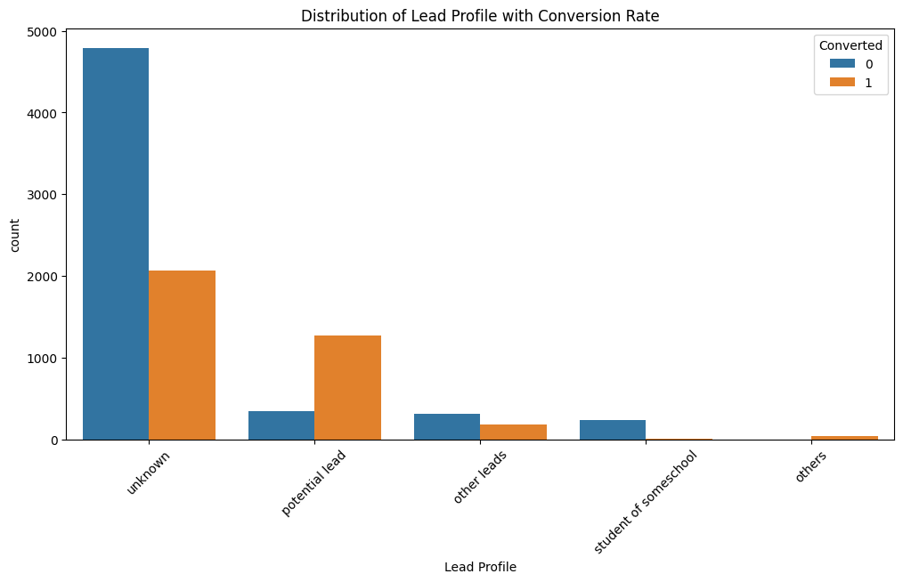
"Leads with the profile of 'Potential Lead' have more possibility of getting converted"

Slide 21
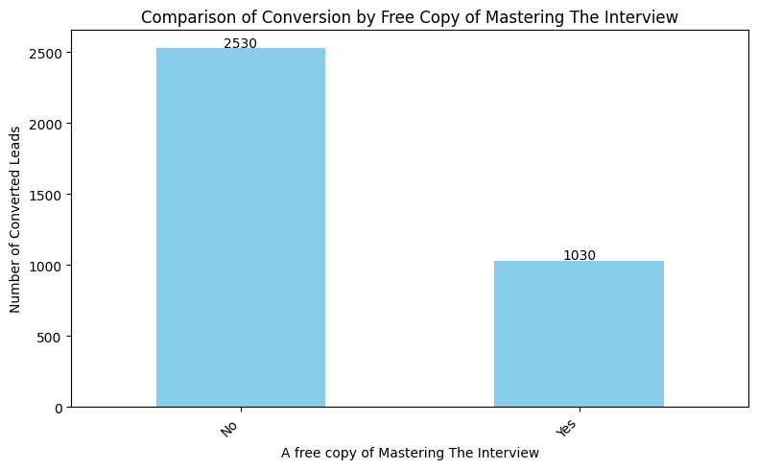
"Leads who are getting a free copy of Mastering the interview might be converted"

Slide 22
Agenda
1
Problem Statement
2
Business Hypothesis
3
EDA
4
Feature Engineering
5
Model Selection
6
Model Development and Tuning
7
Conclusion

Slide 23
Feature Engineering Overview
Feature Creation:
Combined Total Visits, Total Time Spent on Website, and Page Views Per Visit into a single metric called Engagement Score. This composite score provides a more holistic view of lead engagement.
Feature Bucketing:
Converted the Lead Quality column into a Lead Quality Score column using a predefined mapping:
'High in Relevance': 4
'Might be': 3
'Not Sure': 2
'Low in Relevance': 1
'Worst': 0
This transformation allows for easier numerical analysis and comparison of lead quality.
Feature Transformation:
Transformed the binary response from the column "A free copy of Mastering The Interview" by converting 'Yes' to 1 and 'No' to 0. This binary encoding facilitates the inclusion of this feature in predictive modeling.
4. Categorical Encoding:
Converted categorical variables such as Tags, Occupation, and Specialization into numerical values. This process allows these features to be used in machine learning algorithms that require numerical input.
After conversion, these numerical values were standardized to ensure they are on a similar scale, improving model performance.

Slide 24
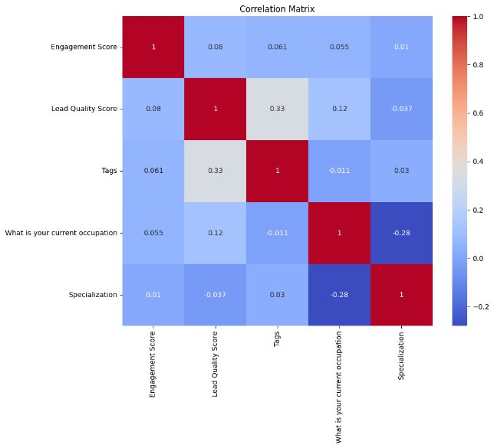
Feature Engineering Overview
5. Feature Correlation:
Conducted correlation analysis to identify relationships between engineered features and the target variable (lead conversion). This step helps in understanding which features contribute most significantly to predicting lead conversion and informs further feature selection.

Slide 25
Agenda
1
Problem Statement
2
Business Hypothesis
3
EDA
4
Feature Engineering
5
Model Selection
6
Model Development and Tuning
7
Conclusion

Slide 26
Model Selection
The project focuses on Lead Scoring, where we predict the likelihood of a lead converting into a Customer.We selected these four models based on their ability to handle classification tasks effectively.
Logistic Regression: A statistical model that predicts the probability of a class using a logistic function. It is mainly used for binary classification tasks.
Support Vector Machine (SVM): A model that finds the optimal hyperplane to separate data points with the maximum margin. It works well for high-dimensional datasets.
Random Forest: An ensemble learning method that builds multiple decision trees and combines their outputs for better accuracy. It helps reduce overfitting and improves generalization.
LightGBM: A gradient boosting framework that builds decision trees efficiently for fast and accurate predictions. It is optimized for large datasets and low memory usage.

Slide 27
Agenda
1
Problem Statement
2
Business Hypothesis
3
EDA
4
Feature Engineering
5
Model Selection
6
Model Development and Tuning
7
Conclusion

Slide 28
Logistic Regression: Baseline model for probabilistic interpretation.
SVM: Effective for high-dimensional spaces and complex boundaries.
Random Forest: Robust ensemble method to handle non-linearity and feature importance.
LightGBM: High-performance gradient boosting for large datasets with speed.
Common Preprocessing Steps
Train-Test Split: test_size=0.2, random_state=42 for reproducibility.
Class Imbalance Handling: Used class_weight='balanced' (or equivalent in LightGBM) to address skewed lead conversion rates.
Hyperparameter Tuning: Use GridSearchCV or RandomizedSearchCV to optimize models (e.g., C for SVM, max_depth for Random Forest).
Feature Importance: Extract from Random Forest/LightGBM to refine features.
Threshold Adjustment: Optimize decision thresholds based on business costs (e.g., higher recall for not missing potential leads).
Model Development for Lead Scoring

Slide 29
Model Evaluation
Model | Accuracy | Precision (0/1) | Recall (0/1) | F1-score (0/1)
Logistic Regression | 81% | 86% / 74% | 82% / 79% | 83% / 77%
SVM | 67% | 69% / 61% | 80% / 47% | 74% / 53%
Random Forest | 97% | 98% / 96% | 97% / 98% | 98% / 97%
LightGBM | 98% | 98% / 96% | 98% / 98% | 98% / 97%
Model | Training Accuracy | Test Accuracy
Logistic Regression | 80.61% | 80.68%
SVM | 68.07% | 66.56%
Random Forest | 99.89% | 97.29%
LightGBM | 99.22% | 97.67%

Slide 30
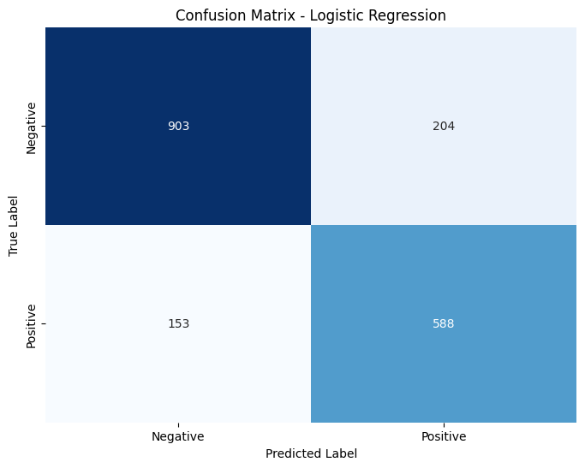
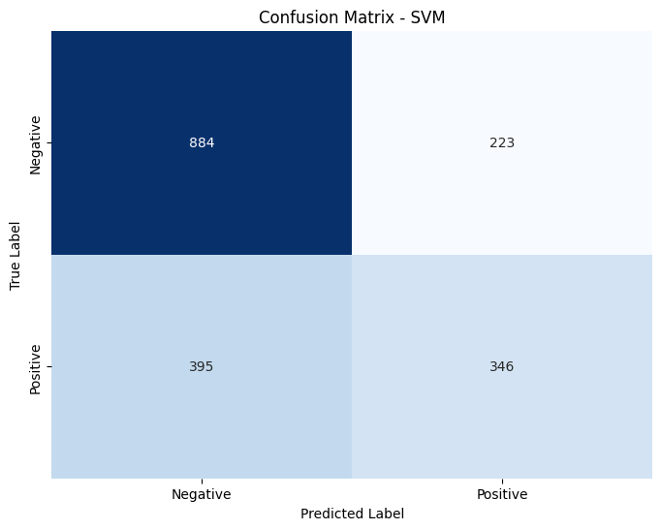
Confusion Matrix

Slide 31
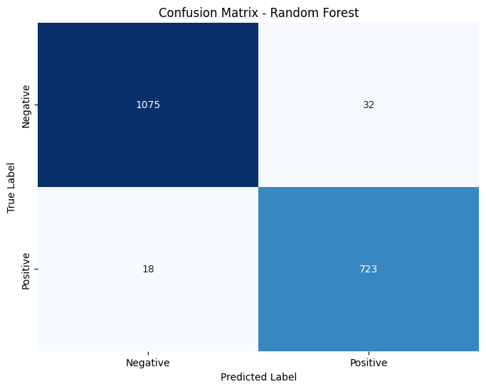
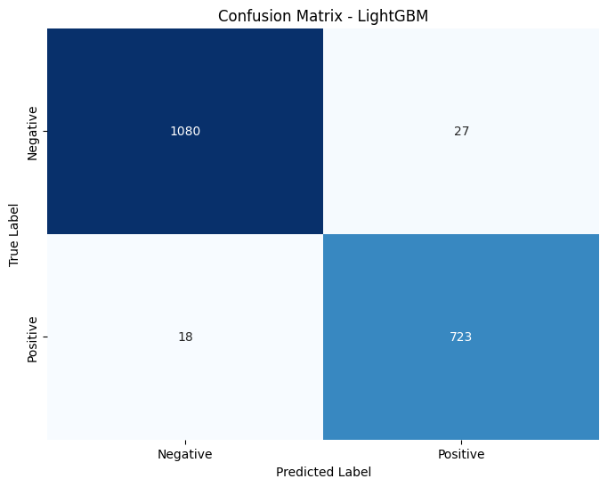
Confusion Matrix

Slide 32
Hyperparameter Tuning
Hyperparameter | Description | Default Value | Used Value
class_weight | Adjusts class imbalance by giving more weight to minority classes. Helps in datasets with skewed distributions. | None | 'balanced'
random_state | Ensures reproducibility of results by setting a seed for randomness. | None | 42
verbose | Controls the level of logging output. -1 disables logs for cleaner outputs. | 1 | -1

Slide 33
Agenda
1
Problem Statement
2
Business Hypothesis
3
EDA
4
Feature Engineering
5
Model Selection
6
Model Development and Tuning
7
Conclusion

Slide 34
Conclusion
In a competitive market where lead generation efforts require significant investment, the lack of an efficient lead prioritization system leads to wasted resources, missed opportunities, and inefficient sales cycles. The current manual and subjective approach makes it difficult for sales teams to focus on high-potential leads, resulting in lower conversion rates and longer sales cycles.
The LightGBM-based Lead Scoring Model developed in this project addresses these challenges by:
Automating Lead Prioritization – The model predicts conversion likelihood, allowing sales teams to focus on leads with the highest probability of becoming customers.
Improving Efficiency – By reducing time spent on low-quality leads, the sales team can allocate efforts more strategically.
Enhancing Decision-Making – The model provides interpretable feature importance, helping marketing teams refine lead generation strategies.
Ensuring Consistency – Unlike subjective manual evaluations, the model applies a data-driven, unbiased approach to lead scoring.
Key Outcomes:
Higher Conversion Rates – Sales teams can prioritize leads with the highest predicted conversion probability.
Reduced Wasted Efforts – Fewer resources are spent pursuing unlikely-to-convert leads.
Scalable Solution – The model can adapt to evolving lead behavior and market trends

Slide 35
Thank You

