Slide 1
Capstone Project
119cs0013-Kammila swathi

Slide 2
Problem Statement
Hotel Reservation Cancellation Prediction
Given a Dataset containing data of reservations made by customers in different hotels, train the machine learning model to predict whether the customer cancels hotel reservation or not.

Slide 3
Dataset Details
No. of rows = 119390
No. of attributes = 32
No. of independent variables = 31
No. of numeric variables = 12
No. of object variables = 19
Target variable = is_canceled

Slide 4
Independent variables in the dataset
Hotel
• Lead_time
• Arrival_date_year
• Arrival_date_month
• Arrival_date_week_number
• Arrival_date_day_of_month
• Stays_in_weekend_nights
• Stays_in_week_nights
•Adults
Children
adr
Babies
Meal
Country
Market_segment
distribution_channel
is_repeated_guest
previous_cancellations
previous_bookings_not_cancelled
reserved_room_type
assigned_room_type
booking_changes
deposit_type
agent
company
days_in_waiting_list
customer_type
required_car_parking_spaces
total_of_special_requests
reservation_status
reservation_status_date

Slide 5
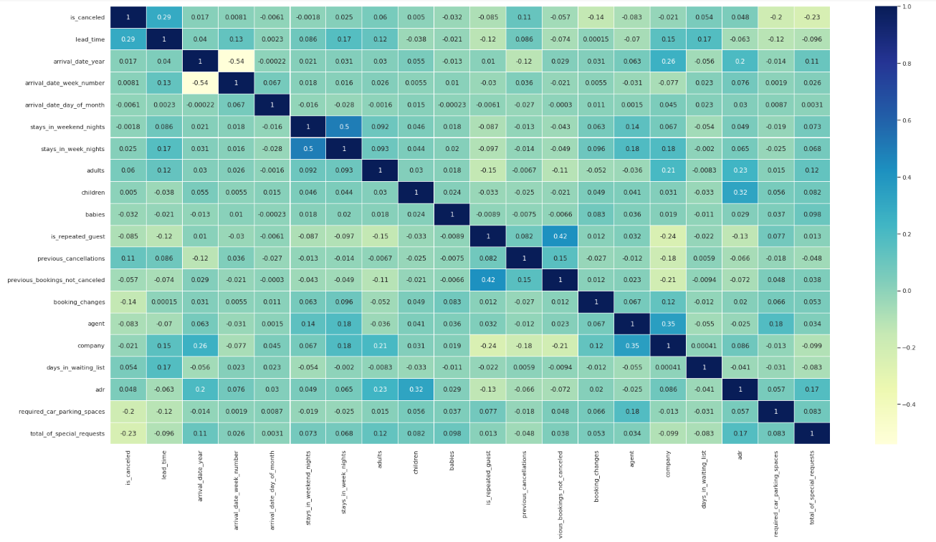
Correlation Matrix

Slide 6
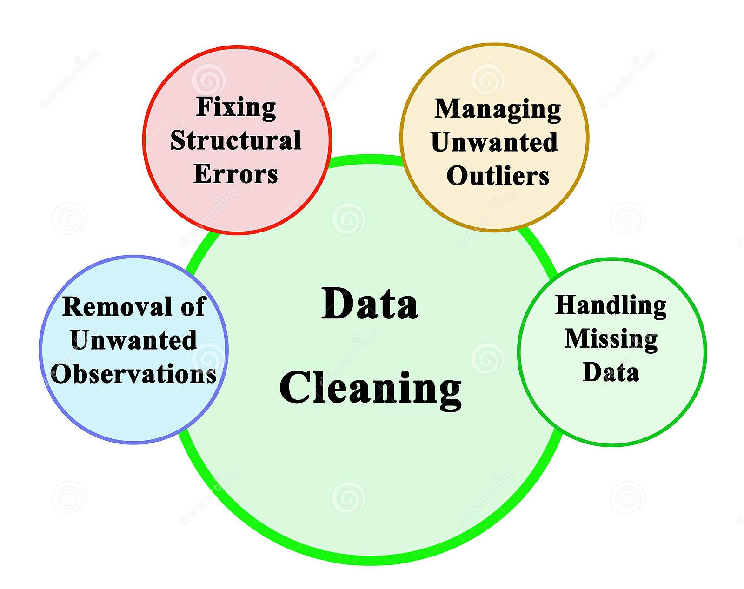
Data Cleaning
Data cleaning is the process of fixing or removing incorrect, corrupted, incorrectly formatted, duplicate, or incomplete data within a dataset. It involves
Replacing NULL/MISSING Values
Replacing categorical missing values with Mean/Median
No. of null values in [children] = 4
No. of null values in [agent] = 16340
No. of null values in [company] = 112593
Replacing numerical missing values with Mode
No. of null values in [country] = 488

Slide 7
Data Cleaning
Removing the Duplicate Values
No. of duplicate values in the data set = 32013
Since we have 32013 duplicate records in the data, we will remove this from the data
set so that we get only distinct records. Post removing the duplicate, we will check
whether the duplicates have been removed from the data set or not.
No. of rows in the dataset after removing duplicates = 87377

Slide 8
Encoding Categorical Data
Encoding categorical data is a process of converting categorical data into integer format so that the data with converted categorical values can be provided to the different models.
An approach to encoding categorical values is to use a technique called label encoding.
Label encoding is simply converting each value in a column to a number.
Categorical variables in our data set:
Hotel, arrival_date_month, mean, country, Market_segment, distribution_channel, reserved_room_type, assigned_room_type, deposit_type, customer_type, reservation_status, reservation_status_date.

Slide 9
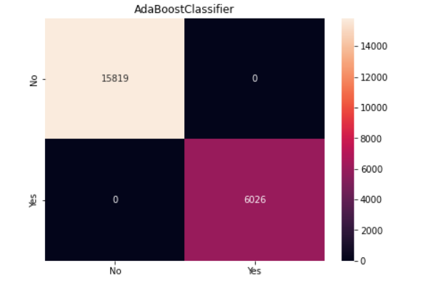
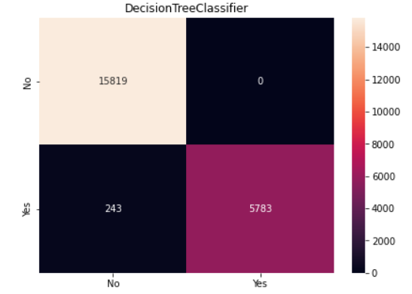
Training the Model
Size of training data = 75%
Size of testing data = 25%
Confusion Matrix

Slide 10
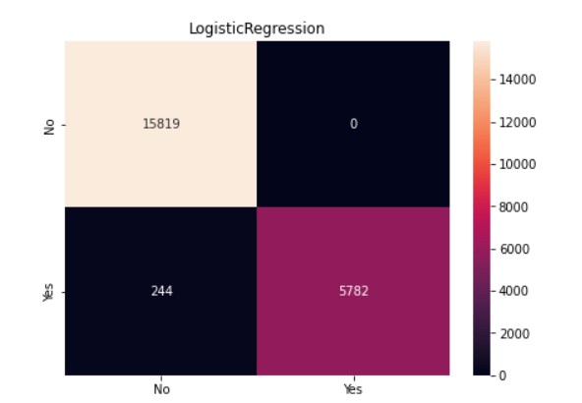
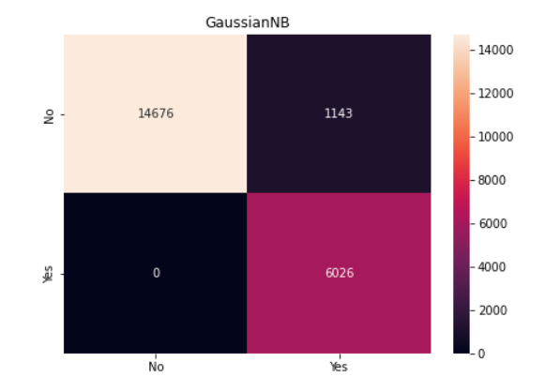
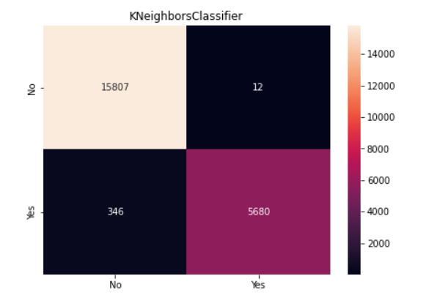
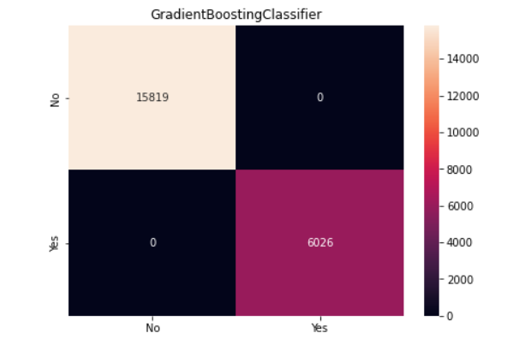
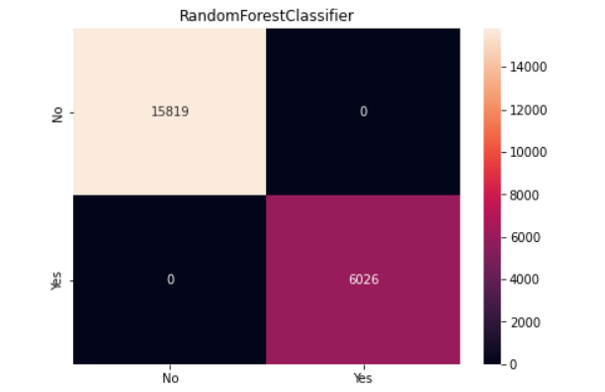
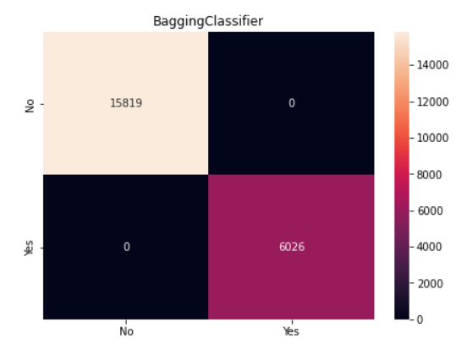
Confusion Matrix

Slide 11
Accuracy using Various Classifiers
LogisticRegression
Training Accuracy : 0.9882194958188366
Testing Accuracy : 0.9888303959716183
Gaussian Naive Bayes
Training Accuracy : 0.9468656534212293
Testing Accuracy : 0.9487296864271
K Neighbors Classifier
Training Accuracy : 0.9882957944210462
Testing Accuracy : 0.9831998168917372
DecisionTreeClassifier
Training Accuracy : 0.9882347555392785
Testing Accuracy : 0.9888761730373083
RandomForestClassifier
Training Accuracy : 1.0
Testing Accuracy : 1.0

Slide 12
Conclusion
The highest accuracy in this problem is obtained using the
RANDOM FOREST CLASSIFIER.
Highest Accuracy=100%

