Slide 1


DRIVER-DROWSINESS-DETECTION

Slide 2

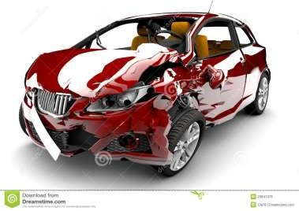
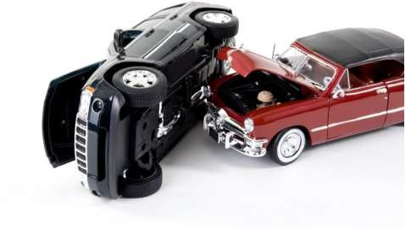
OBJECTIVE
Nowadays the driver safety in the car is one of the most wanted system to avoid accidents. Our objective of the project is to ensure the safety system. For enhancing the safety, we are detecting the eye blinks of the driver and estimating the driver status and control the car accordingly.

Slide 3




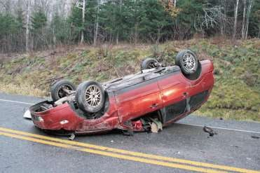
Abstract:
A computer vision based thoughts have been used for the creation of a Drowsy Driver Detection System. The little camera has been utilized by framework that concentrates straight towards the essence of driver and checks the driver's eyes with a particular ultimate objective to perceive weakness. A notice sign is issued to alert the driver, in such circumstance when exhaustion is perceived. The framework oversees using information picked up for the picture to find the facial tourist spots, which gets the area where the eyes of an individual may exist. On the off chance that the eyes of driver are discovered close for a specific measure of casings, the proposed framework accept that the driver is falling asleep and an alarm of caution has been issued. The structure can work just when the eyes are found, and works in encompassing lighting conditions too.

Slide 4
INTRODUCTION:
Driver exhaustion is a noteworthy factor in countless mishaps. Late measurements gauge that yearly 1,200 passings and 76,000 wounds can be credited to fatigue related crashes
Driver drowsiness and fatigue is a major factor which results into numerous vehicle accidents. Developing and maintaining technologies which can efficiently detect or prevent drowsiness at the wheel and alert the driver before am mishap is a major challenge in the field of accident prevention systems. Because of the dangerous that drowsiness can cause on the roads some methods need to be developed for preventing counteracting its effects.
With the advent of modern technology and real time scanning systems using cameras we can prevent major mishaps on the road by alerting car driver who is feeling drowsy through a drowsiness detection system
The point of this undertaking is to build up a prototype drowsiness detection system. The spotlight will be put on planning a framework that will precisely monitor the open or shut condition of the driver's eyes continuously.
By monitoring the eyes, it is believed that the symptoms of driver fatigue can be detected early enough to avoid a car accident. Detection of fatigue involves the observation of eye movements and blink patterns in a sequence of images of a face.

Slide 5
Problem statement
Designing a prototype Drowsiness Detection System which will focus on continuously and accurately monitoring the state of the driver’s eyes in real time to check whether they are open or closed for more than a given period of time.

Slide 6

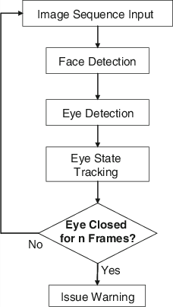
METHODOLOGY:

Slide 7
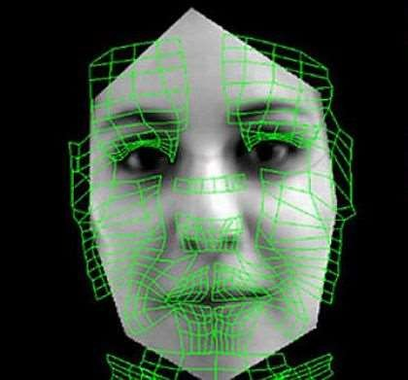
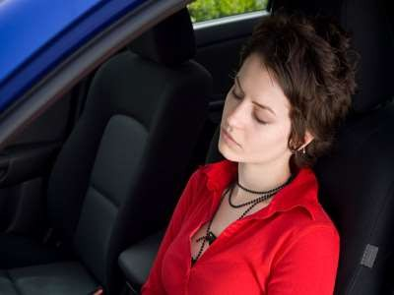
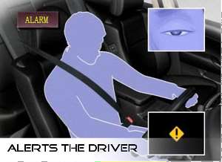

Slide 8
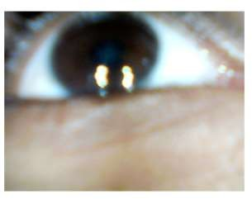
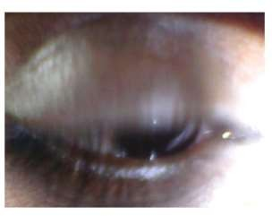
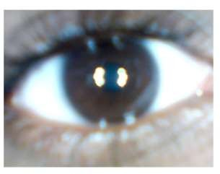
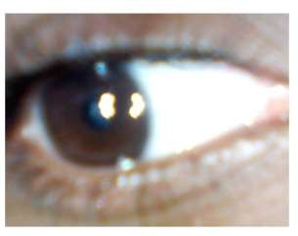
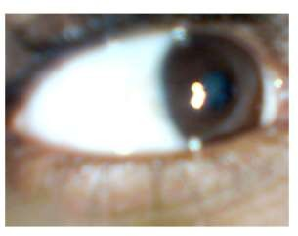
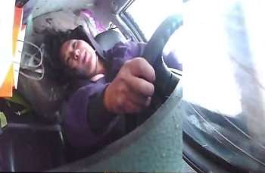

Slide 9
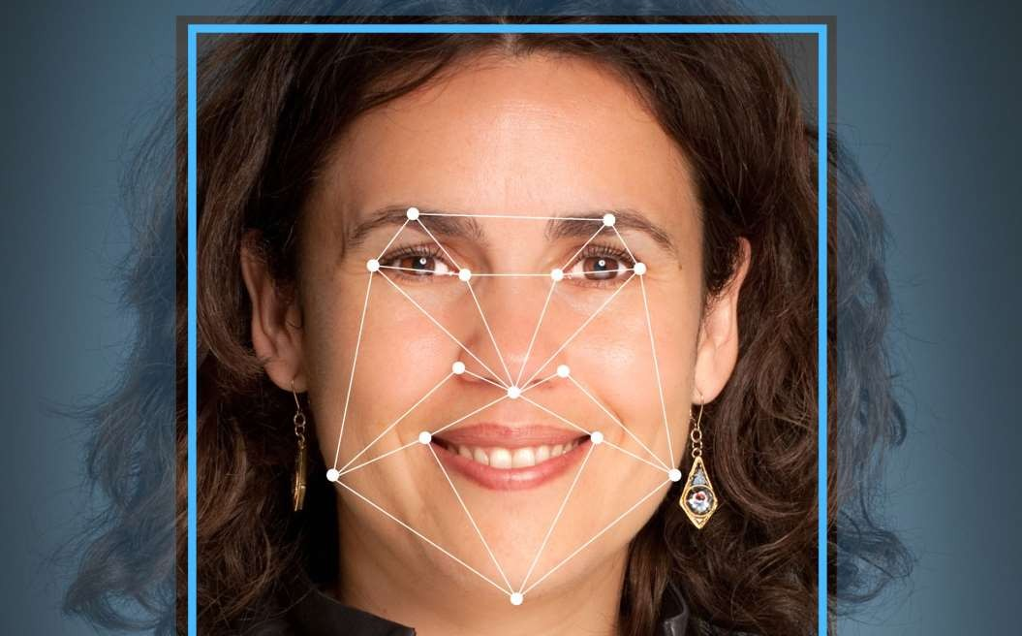

Slide 10
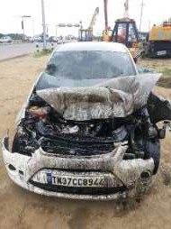
Future’s
Anti-drowsiness Alarm
Make Easy drive
Drink and Drive production
Medical accent
Directly interface to any Hardware using Arduino
Low cost
High Security
This program can use for Aircraft Also

Slide 11
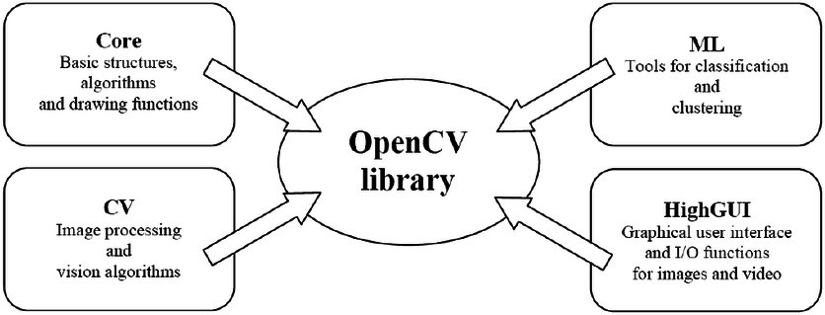

Slide 12

Introduction to opencv
OpenCV is a Python open-source library, which is used for computer vision in Artificial intelligence, Machine Learning, face recognition, etc.
In OpenCV, the CV is an abbreviation form of a computer vision, which is defined as a field of study that helps computers to understand the content of the digital images such as photographs and videos.
It was officially launched in 1999 by Intel. It was written in C/C++ in the early stage, but now it is commonly used in Python for the computer vision as well.
It extracts the description from the pictures, which may be an object, a text description, and three-dimension model, and so on.

Slide 13
DLIB
DLib is an open source C++ library implementing a variety of machine learning algorithms, including classification, regression, clustering, data transformation, and structured prediction.
DLib provides a good framework for developing machine learning applications in C++.
What makes DLib unique is that it is designed for both research use and creating machine learning applications in C++.

Slide 14
Other modules we used
NumPy :
NumPy, which stands for Numerical Python, is a library consisting of multidimensional array objects and a collection of routines for processing those arrays.
Using NumPy, mathematical and logical operations on arrays can be performed.

Slide 15

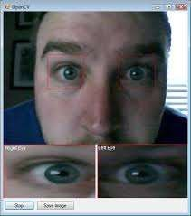
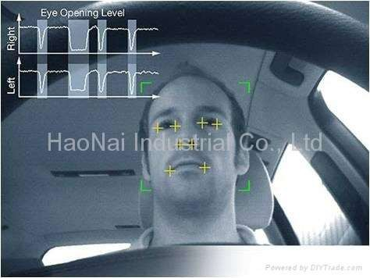
Image Captured by Camera

Slide 16
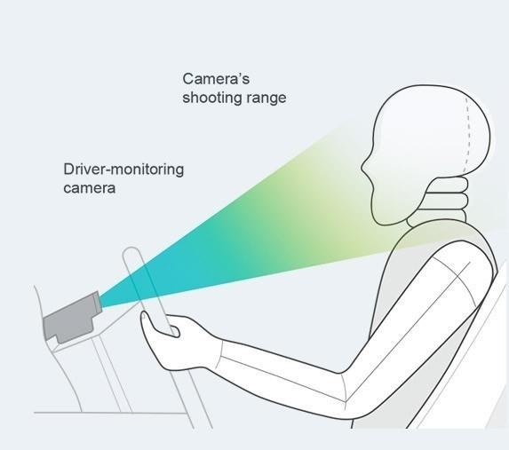

Slide 17
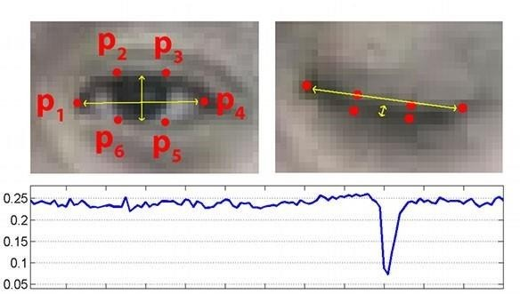
Picture 1 : Eye marks when the eye is open
Picture 2 : Eye marks when the eye is closed
Picture 3: Eye Aspect Ratio plotted over time, the downfall in the aspect ratio graph shows a blink of the driver
Eye aspect ratio

Slide 18
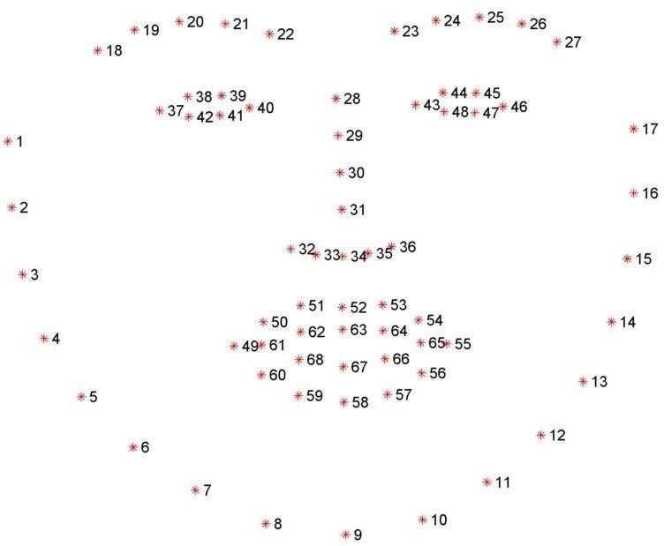
Fig8.Facial landmarks set which is detected via dlib

Slide 19
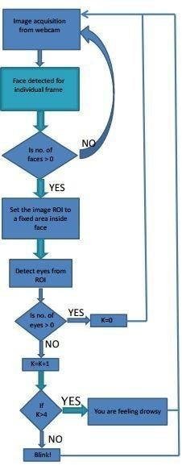
ALGORITHM & IMPLEMENTATION

Slide 20
CONCLUSION
Thus we would have successfully designed and developed partial implementation of the Driver Drowsiness Detector using Python and OpenCv along with the a cam to detect the face.
The system to be developed is to be tested and limitations are identified. The rest of the work will be done according to what is planned already.

Slide 21
Future Scope
This framework can be stretched out further to have abundant security highlights, for example, just a certain no of individuals can have specialist get to or work the vehicle.
If there should be an occurrence of an endeavor to robbery, the vehicle's motor don't begin or an alarm sounds.
A picture of the burglar is taken in an attempted theft &sent to the owner of the vehicle who can register a case against the thief of the vehicle.

Slide 22
THANK YOU
GUIDE:
MRS.K.SRAVANTHI
S.SWATHI
B.SHIVANI
E.RAKESH
M.PRATHYUSHA
E.RAJU

