Slide 1

A Project Report On
Placement Management System
By
Rongali Swathi
B.Tech
Batch: 2021-5762
Center: Banglore S-prayas
Under the Guidance of
Chittranjan Gosh
Technical Trainer

Slide 2
Introduction
Our project Explains about the Placements of students website name was Placement Management System this project mainly explains about the recruitment of students here recruiters are the professionals who implement and take care of the whole student recruitment process. Consequently, depending on the size of the institution, the student recruitment process will be held in three modules
Modules:
Student Module
Recruiter Module
College Module
Student Module: Placement Management System manages student information in the college with regard to placement. It improves existing system . It has the facility of maintaining the details of the student, thereby reducing the manual work. ... Placement Management System can be accessed throughout the college with proper login provided.

Slide 3
Recruiter Module:
The Recruitment module administers and manages the processes related to the selection and hiring of candidates for vacancies within the organization and at the same time stores and systematizes the entire information about the received applications.
College Module:
Admin can manage the training programs conducted in the college. Admin is also able to analyze the placement activities of each student. active placement drives and registered students. Every batch has a tutor that manages the placement activities of their batch.
Software Requirements
Frontend: HTML, CSS, JavaScript, Bootstrap, Hibernate.
Back end: MySQL workbench 8.0.23CE.
Middleware/Server: Apache Tomcat v8.5. IDE: Eclipse IDE for Java EE Developers
Browser: Best result on Google Chrome
Operating System: Window 10.

Slide 4
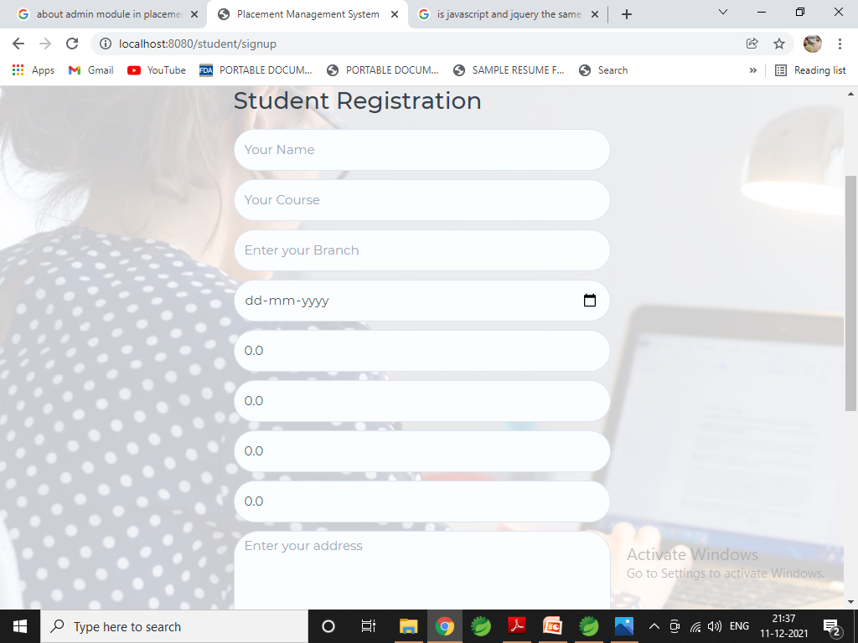
Register Page

Slide 5
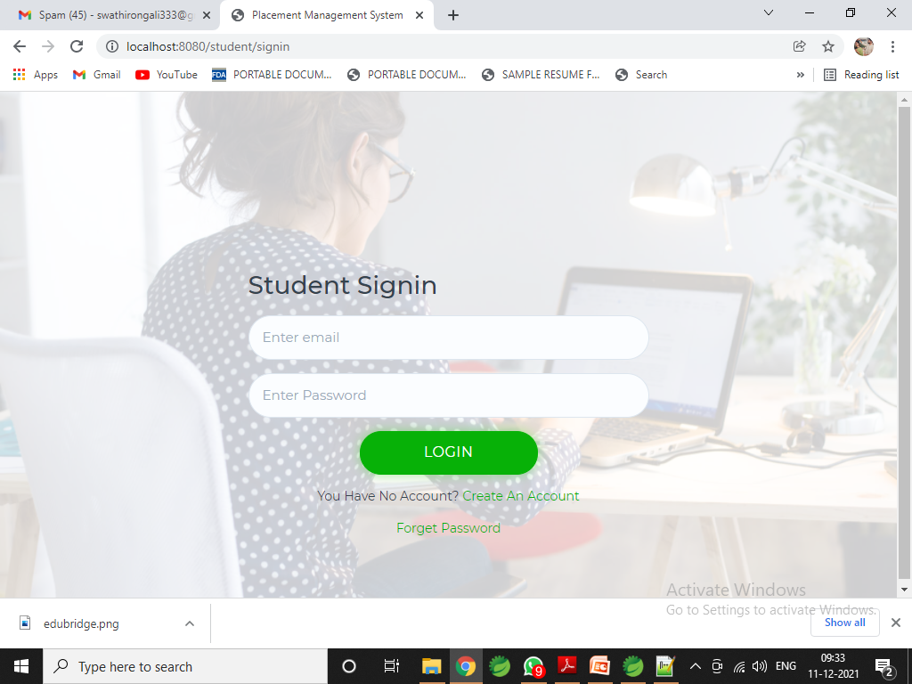
Login Page

Slide 6
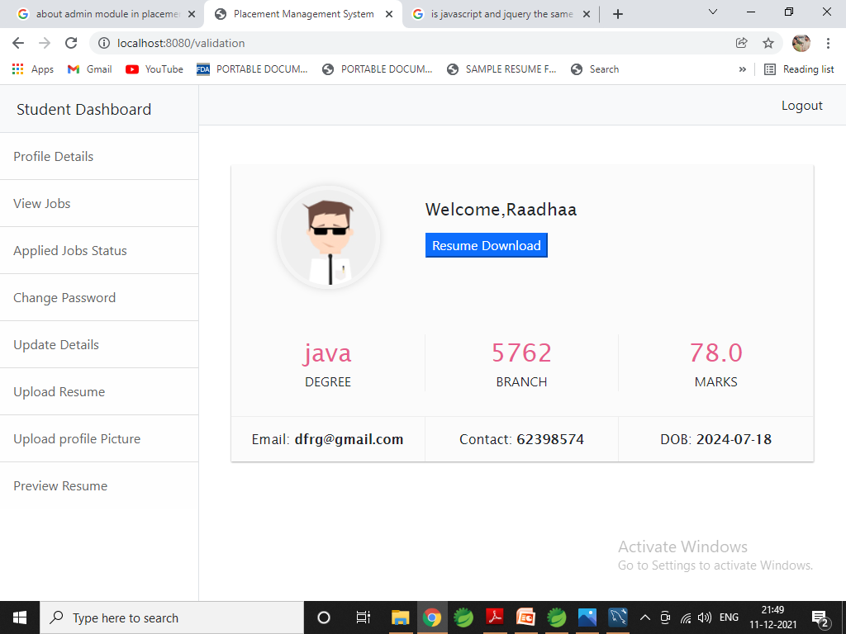
Student Dashboard

Slide 7
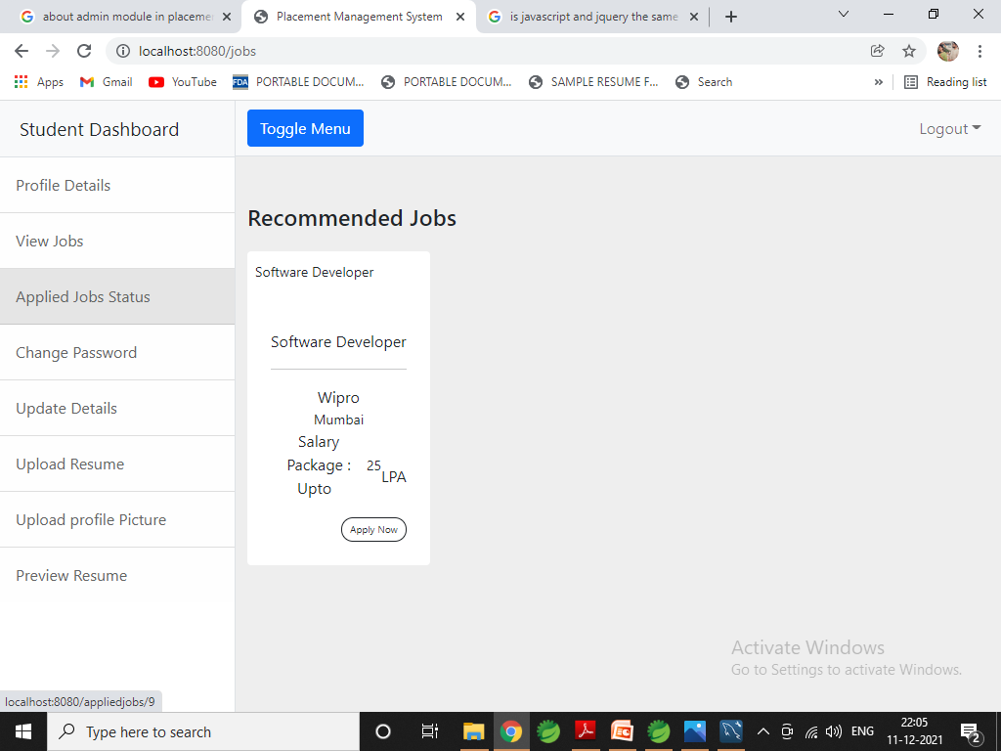
Job Applied

Slide 8
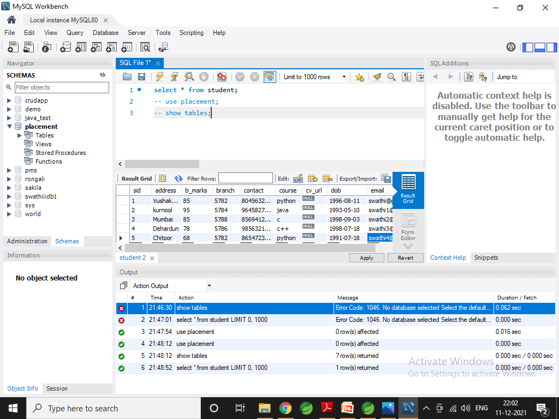
Data Added in Database

Slide 9


