Slide 1


CSCI 5448 - Team 37 - Rec Center Mgmt System
Yuvraj Arora, Dixit Patel, Swathi Upadhyaya

Slide 2
Project Description
A system to provide access to students and customers to avail fitness services and amenities from a well-equipped Sports Studio.
Features :
Enables users to request an appointment with a trainer.
Provides interfaces for reserving courts and gym equipments.
Platform offers facilities for users to register for events like competition, hikes and workshops.

Slide 3
Module Structure
Controller
POJO Model Class
Service Layer
Utility Package
Repository

Slide 4
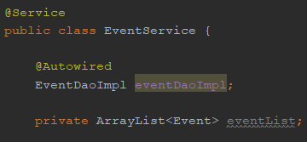
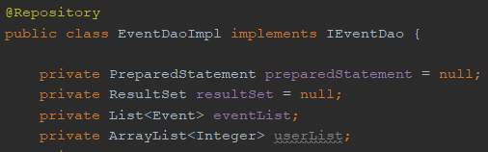
Development Tools
SpringBoot Application - Annotation Based Configuration

Slide 5
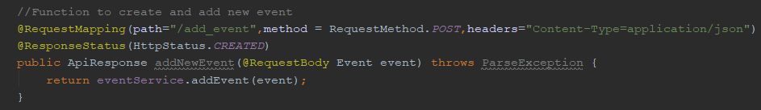
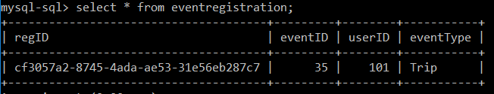
RESTful API - Using HTTP Message Converters
MySql Relational Database

Slide 6
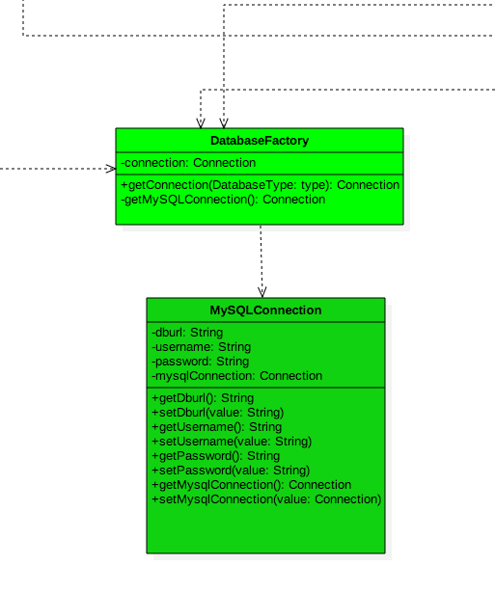
Factory Design Pattern
Creational
Benefits : SOLID , Inversion of Control (IoC), Adapt to changing req
Database connectivity
DatabaseFactory ->getConnection()

Slide 7
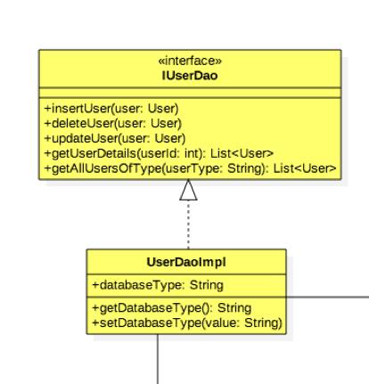
Data Access Object Design Pattern
Used to separate low level data accessing operations from high level business services.
Object <-> Table
InterfaceDao ← ConcreteDao
UserDaoImpl ->DatabaseFactory->getConnection(type)

Slide 8
Demo

