Slide 1
Prediction of Human Heart Disease using Data Mining Techniques
Made by,
Swati Verma
MT19073

Slide 2
Introduction:
Heart diseases has become very common in today’s world.
Due to changing environment and lifestyle such diseases are becoming more prevalant.
This project uses different data mining techniques and four different classifiers to classify whether a person suffers from heart disease or not.
The data set is take from cleveland data set which consists of 1025 records and 14 attributes.
Attributes includes age, sex, chest pain, cholesterol, exanag, and many other features which are used to predict heart disease.
At the end accuracies of different classifiers are compared to choose the best one.

Slide 3
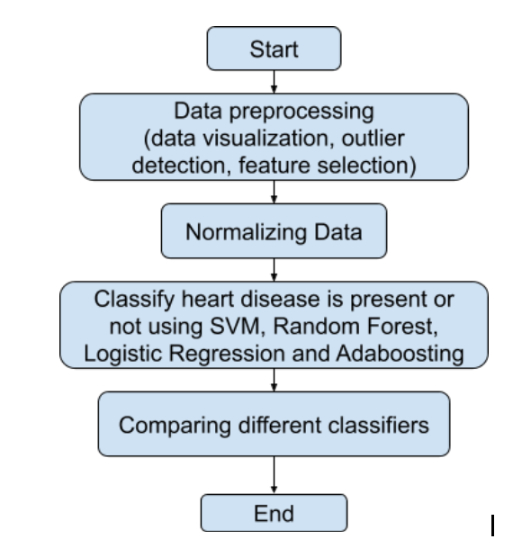
Steps performed:

Slide 4
Data Analysis and Preprocessing:
First data cleaning is done and all the missing and null values are filled with mean values.
Class imbalance problem is checked and it was found that there is no class imbalance problem.
Data distribution is seen using histograms and PCA so that data can be easily analysed by reducing dimensionality of the attributes.
Outlier detection is done using box plot and rows corresponding to outliers are removed.
Feature selection is done using correlation matrix and selectKbest technique.
Data is normalized and then classifiers are applied.

Slide 5
Classifiers used:
Support Vector Machine- gives optimal hyperplane so that it can correctly classeify new data.
Logistc Regression- As our dataset has binary outcome and Logistic regression performs best for binary output so it it used.
Random Forest- an ensemble classifier which uses descision tree and partitions data, train descision tree model for every partition and at the end combines the result to give best outcome.
Adaboost Classifier- uses many weak classifiers and combines the result by voting system and hence creates a strong classification model.

Slide 6
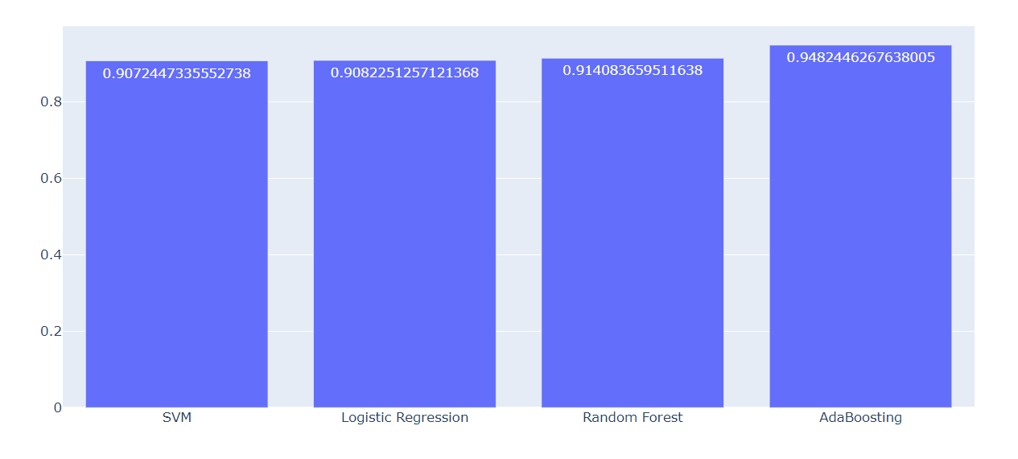
Results:
Among all the classifiers adaboosting is giving most accurate result because it uses a mixture of classifiers.Average accuracies of classifiers are listed below:

Slide 7
Conclusion and Future Work:
I have compared different classification models by using important features which can lead to heart disease. This is important because as soon as the problem is detected it can be treated as early as possible. So using classifiers such as adaboosting and random forest may help us to give more accurate results.
In future, we can combine data mining techniques with IOT based techniques such as by using sensors and collecting data from sensor at realtime we can predict any unusual activity and help the person to be diagnosed as soon as possible.

