Slide 1

Applying Genetic Algorithm to the Knapsack Problem
Qi Su
ECE 539
Spring 2001 Course Project

Slide 2


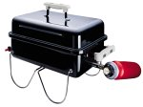


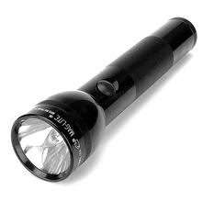


Introduction – Knapsack Problem
We have a list of positive integers a₁, …, a_{n}, and another integer b.
Find a subset a_{i1}, …, a_{ik}, so that a_{i1} +… + a_{ik} = b.
Size A1
Size A2
Size A4
Size A3
Pack Volume=b
Size A7
Can we find k objects which will fit the pack volume b perfectly?
Size A5
Size A6

Slide 3
Knapsack Problem
Candidate Solutions can be represented as knapsack vectors:
S=(s₁, … , s_{n}) where s_{i} is 1 if a_{i} is included in our solution set, and 0 if a_{i} is not.
Example:
We are given a₁, a₂, a₃, a₄, a₅, a₆ and b.
A potential solution is the subset a₁, a₂, a₄ .
We represent it as a knapsack vector:
(1, 1, 0, 1, 0, 0)

Slide 4
Introduction – Genetic Algorithm
Outline of the Basic Genetic Algorithm
[Start] Generate random population of n chromosomes (suitable solutions for the problem)
[Fitness] Evaluate the fitness f(x) of each chromosome x in the population
[New population] Create a new population by repeating following steps until the new population is complete
[Selection] Select two parent chromosomes from a population according to their fitness (the better fitness, the bigger chance to be selected)
[Crossover] With a crossover probability cross over the parents to form a new offspring (children). If no crossover was performed, offspring is an exact copy of parents.
[Mutation] With a mutation probability mutate new offspring at each locus (position in chromosome).
[Accepting] Place new offspring in a new population
[Replace] Use new generated population for a further run of algorithm
[Test] If the end condition is satisfied, stop, and return the best solution in current population
[Loop] Go to step 2

Slide 5
Project Overview
Genetic Algorithm Approach
Start with a population of
Compute fitness scores
random knapsack vectors:
(0,0,1,0,1,0,0,1,1,1)
(1,1,0,0,0,1,0,0,1,0)
(1,0,1,0,0,0,1,1,0,1)
…..
7
8
20
…..
Reproduce
(1,1,0,0,0,1,0,0,1,0)
(1,0,1,0,0,0,1,1,0,1)
(1,1,0,0,0,0,1,1,0,1)
(0,0,1,0,1,0,0,1,1,1)
(1,0,1,0,0,0,1,1,0,1)
(0,0,1,0,1,0,1,1,0,1)
….
….

Slide 6
Project Overview
Genetic Algorithm Approach
Random mutation
(1,1,0,0,0,0,1,1,0,1)
(1,1,0,0,0,0,1,1,0,1)
(0,0,1,0,1,0,1,1,0,1)
(0,0,1,0,1,1,1,1,0,1)
….
….
Repeat reproduction and mutation process until
A valid solution is found
200,000 iterations executed

Slide 7
Project Overview
Exhaustive Search Approach
(0,0,0,0,0,0,0,0,0,1)
(0,0,0,0,0,0,0,0,1,0)
Check all possible knapsack vectors until a valid solution is found
(0,0,0,0,0,0,0,0,1,1)
(0,0,0,0,0,0,0,1,0,0)
(0,0,0,0,0,0,0,1,0,1)
(0,0,0,0,0,0,0,1,1,0)
….

Slide 8
Project Overview
Backtracking Approach
Knapsack set={20,30,70,50 } b=100
Iteration: Current Included Set
  {20}
  {20, 30}
  {20, 30, 70} Sum>b: backtrack: remove 70, try another choice
  {20, 30, 50} Sum==b: valid solution found.

Slide 9
Project Overview
Random Approach
(0,0,1,0,0,1,1,1,1,0)
Randomly generate knapsack vectors until a valid solution is found
(1,1,0,1,0,0,0,0,1,0
(0,0,1,1,1,0,0,1,0,0)
(0,1,1,0,1,0,0,1,0,1)
(1,1,0,1,1,1,0,1,0,0)

Slide 10
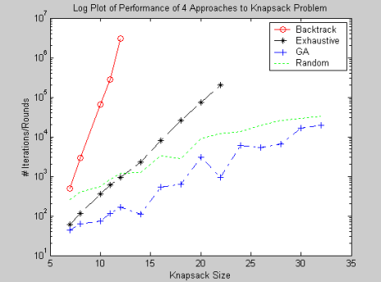
Results
Comparison of Four Approaches in terms of Iterations

Slide 11
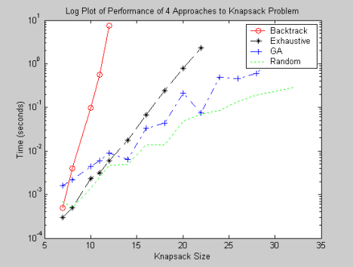
Results
Comparison of Four Approaches in terms of execution time

Slide 12
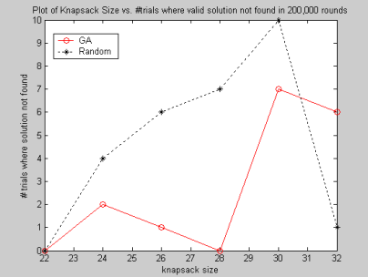
Results
Comparison of GA and Random for number of trials/200 where a valid solution wasn’t found

Slide 13
Results
Sumary Comparison of Four Approaches
GA is a good approach to solve the knapsack problem.
GA performs better than Exhaustive search and Backtracking.
GA and Random performances may be hard to compare because our completion criteria is
1. Find valid solution
2. 200,000 iterations
GA and Random perform different amount of work per iteration.

Slide 14
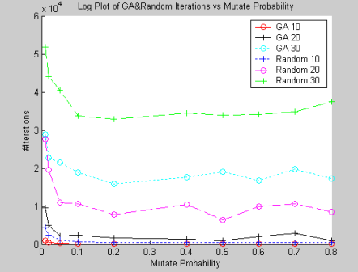
GA vs Random at Different Mutation Probabilities
Compare Iterations

Slide 15
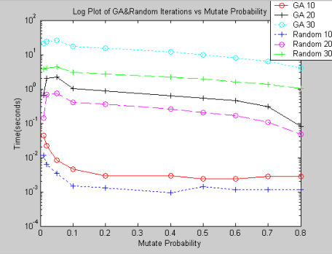
GA vs Random at Different Mutation Probabilities
Compare Execution Time

Slide 16
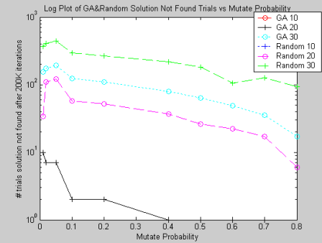
GA vs Random at Different Mutation Probabilities
Compare Number of Trials/200 where a valid solution wasn’t found

Slide 17
GA vs Random at Different Mutation Probabilities
Summary
Iterations suggest GA better.
Execution Time suggest Random better.
Trials where solution not found suggest GA better.
Current experimental setup of 200,000 iterations as completion precludes conclusive direct comparisons between GA and Random. We should change experiment to terminate execution after a fixed amount of time.

Slide 18
Conclusion
Genetic algorithm is a superior approach to the traditional exhaustive search and backtracking algorithms in solving the knapsack problem.
GA always finds a valid solution faster than the two traditional approaches.
A direct comparison between the performance of GA and random solution search method is difficult in the context of this experiment.
Future works – change execution termination criteria from fixed number of iterations to fixed amount of execution time.

