Slide 1
ROCKBUSTER STEALTH Data Analysis

Slide 2
OVERVIEW
Rockbuster Stealth LLC is a movie rental company that used to have stores around the world. The Rockbuster Stealth management team is planning to use its existing movie licenses to launch an online video rental service in order to stay competitive.
Stakeholders of Rockbuster Stealth expect data –driven answers from following series of business questions which they can use for their 2020 company strategy.
Which movies contributed the most/least to revenue gain?
What was the average rental duration for all videos?
Which countries are Rockbuster customers based in?
Where are customers with a high lifetime value based?
Do sales figures vary between geographic regions?

Slide 3
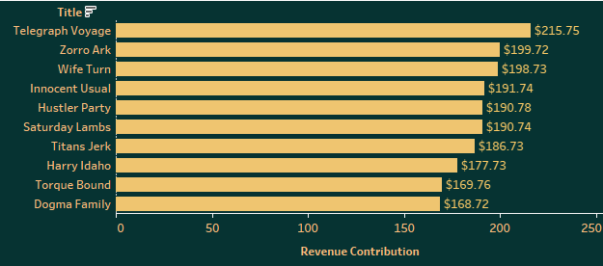
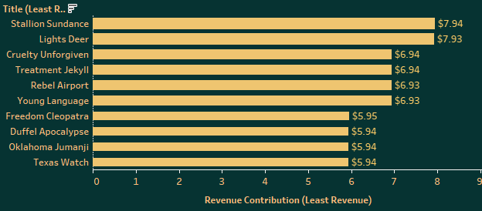
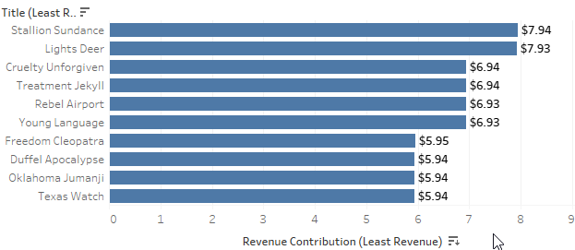
MOST / LEAST REVENUE CONTRIBUTION
Telegraph Voyage contributed highest Revenue of $215.75
Texas Watch countributed least Revenue of $5.94
B
SUN
A
NEPTUNE

Slide 4
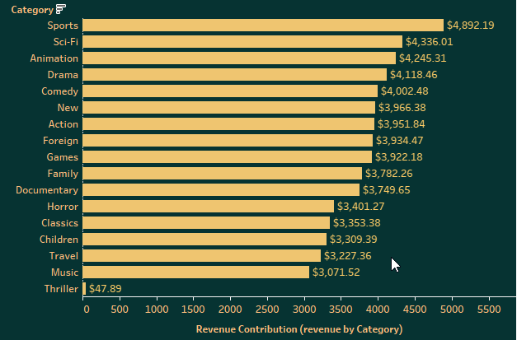
REVENUE BY MOVIE CATEGORY
Sports is the Genre which earned highest revenue of $4,892.
Thriller is the Genre which earned least revenue of $47,89.

Slide 5
AVERAGE RENTAL DURATION
Average Rental Duration
Rockbuster Average Rental Duration for all videos varying between 4 to 6 Days . Thriller is the Genre with highest rental duration of 6 Days.

Slide 6
STATISTICAL ANALYSIS
RENTAL DURATION
RENTAL RATE
D
R
Minimum: 3 days
Maximum: 7 Days
Average: 5 Days
Minimum: $0.99
Maximum: $4.99
Average: $2.98
MOVIE LENGTH
REPLACEMENT COST
L
C
Minimum: 46 Mins.
Maximum: 185 Mins.
Average: 115 Mins.
Minimum: $9.99
Maximum: $29.99
Average: $19.84

Slide 7
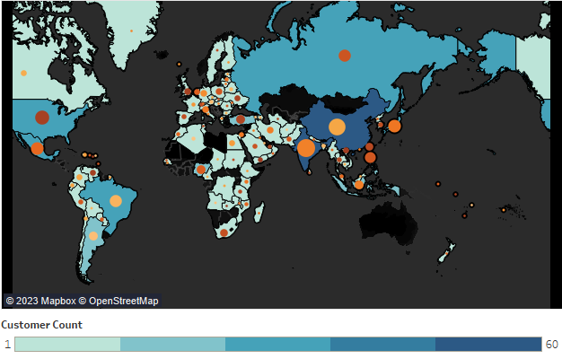
ROCKBUSTER’S CUSTOMERS
ROCKBUSTER CUSTOMERS
As shown in Map , Rockbuster total 584 customers are based in 108 countries.
Top 10 Countries:
Country Name | Customer Count
India | 60
China | 53
United States | 36
Japan | 31
Mexico | 30
Brazil | 28
Russian Federation | 28
Philippines | 20
Turkey | 15
Indonesia | 14

Slide 8
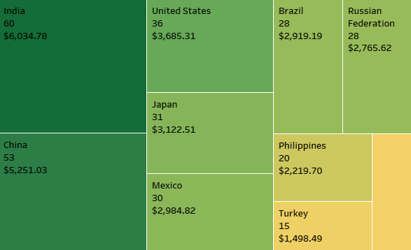
HIGH LIFETIME CUSTOMERS
Top 10 Countries where Rockbuster highest customers count with total revenue.

Slide 9

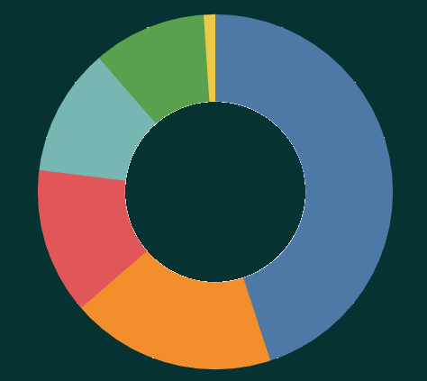





GEOGRAPHIC REGION SALES
AFRICA
OCEANIA
Total Revenue $6,342
Total Revenue $6,342
SOUTH AMERICA
ASIA
Total Revenue $7,141
Total Revenue $27,577
NORTH AMERICA
EUROPE
Total Revenue $6,342
Total Revenue $8,164
Total Revenue $61,312

Slide 10
SUMMARY
SUMMARY
Most Profitable Regions: Asia, North America, South America
Countries with high Customers Count: India and China
Most favorite Genre : Sports, Sci-Fi, Animation, Drama, Comedy

Slide 11
RECOMMENDATIONS
It is recommended to increase promotional services in region like Africa.
Rockbuster should continue to promote online services in Asia regions specifically India and China.
Rockbuster can provide subscription offers or discount on rental to our High value customers.
Inventory related to the Movies with highest revenue should increase.
We can recommend subscription offers or discount on rental to our High value customers

Slide 12
THANK YOU!
Presented by:
Swati Gaikwad
For any questions, feel free to contact at:
swati.y.gaikwad@gmail.com
Tableau Visualization Link:
Task3.10 | Tableau Public

