Slide 1
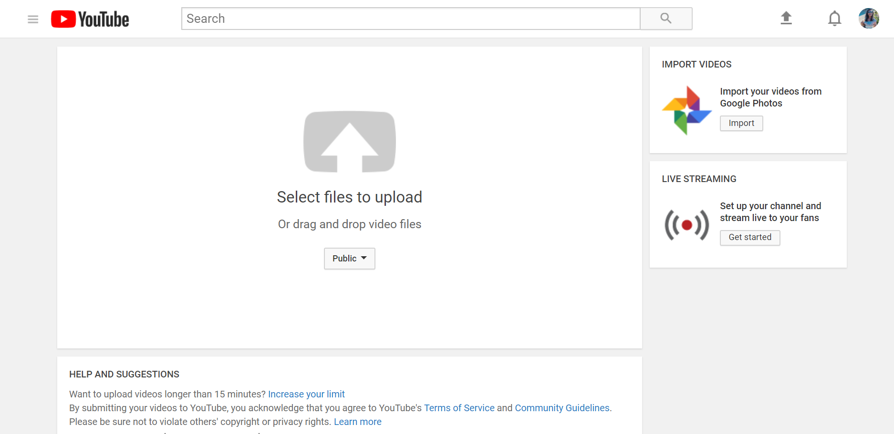
Youtube_Channels_Analysis
YouTube Sentiment Analysis
Project By :
Swati Giri
Project By :
Swati Giri

Slide 2
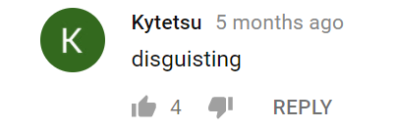
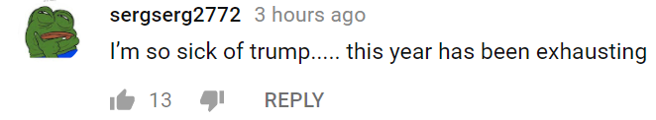
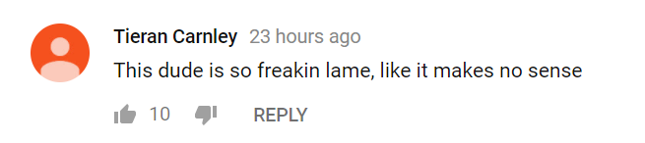
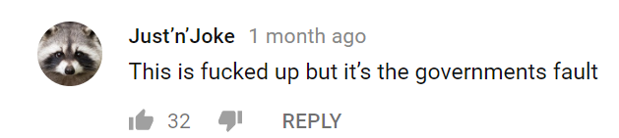
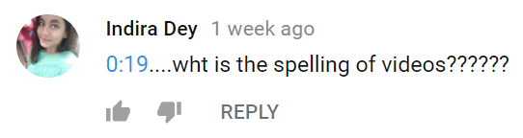
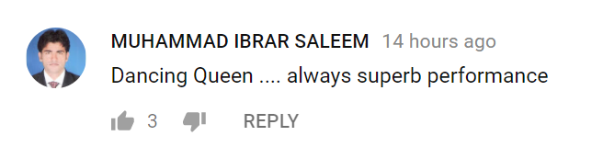
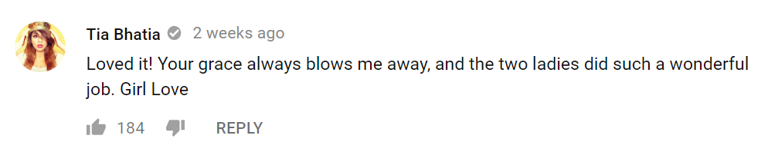
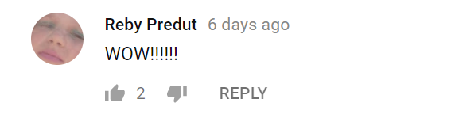
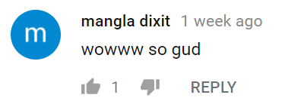
Negative
Neutral
Positive

Slide 3
Motivation
Starting a youtube channel based on my interests.
Finding the right youtube category with least toxic audience.
Identifying which category of contents has most number of positive and wholesome comments.

Slide 4
Source of data : Youtube API
Data Cleanup Tool : Pandas
Data Visualization Tool : Matplotlib
Sentiment Analysis : Vader Sentiment

Slide 5
The Data exploration and Analysis Steps :
Categorizing channels based on content type.
Getting data from channels using API request.
Scatter plot between number of likes and number of views.
Sentiment Analysis of comments.
Bar graph to show compound sentiments of viewers per channel.
Category wise plot of compound sentiments.
Stacked bar graph showing the percentage of neutral, positive , negative and compound sentiments in each channel.

Slide 6
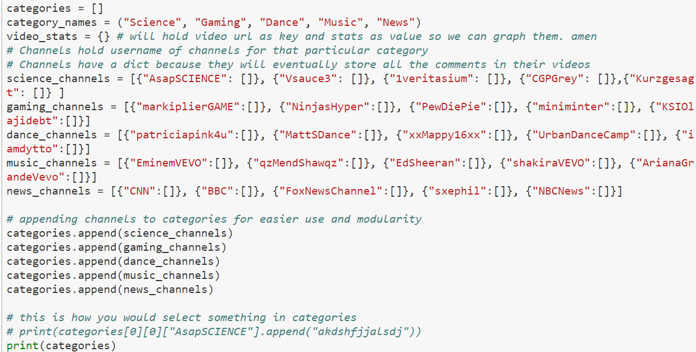
Categories of Interest: Science, Gaming, Dance, Music, News
Gaming
Dance
Music
News
Channels in each category

Slide 7
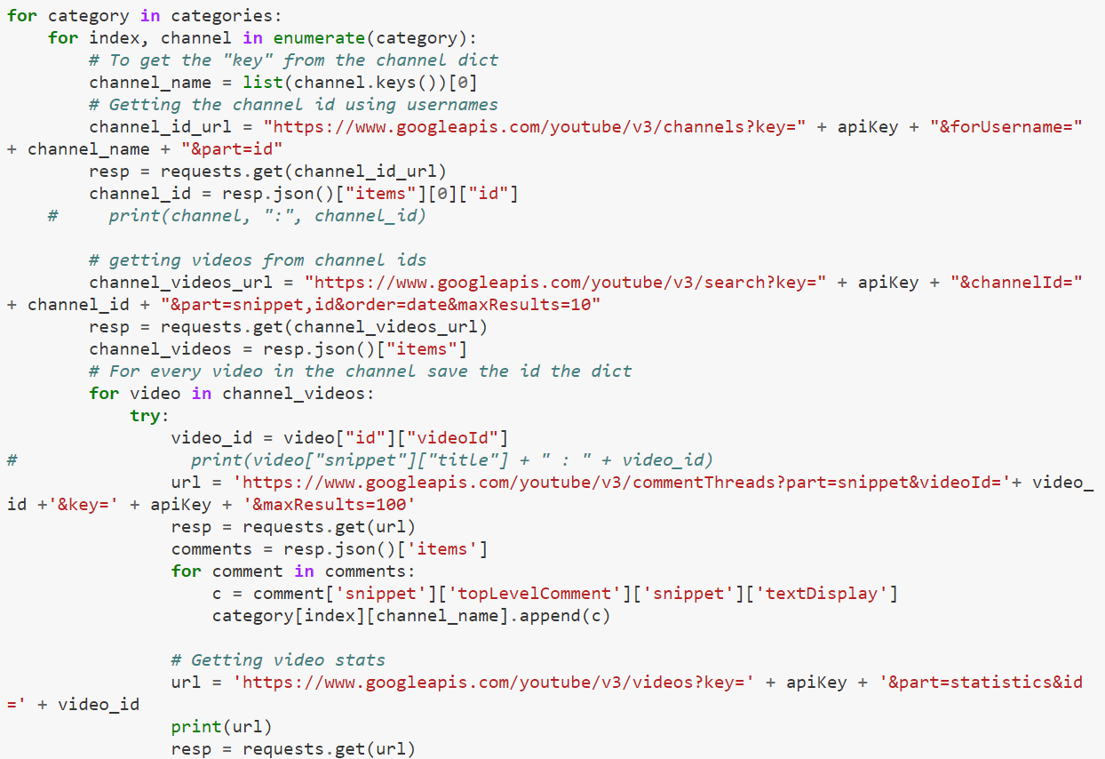
Grab the data
Getting Channel ID
Getting Channel Video url
Getting video stats

Slide 8
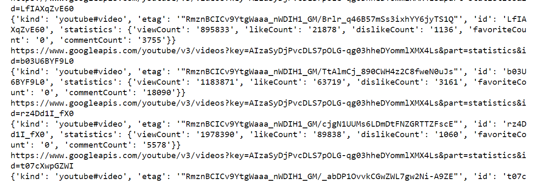
Pulling data from YouTube API
( Data Of Interest )

Slide 9
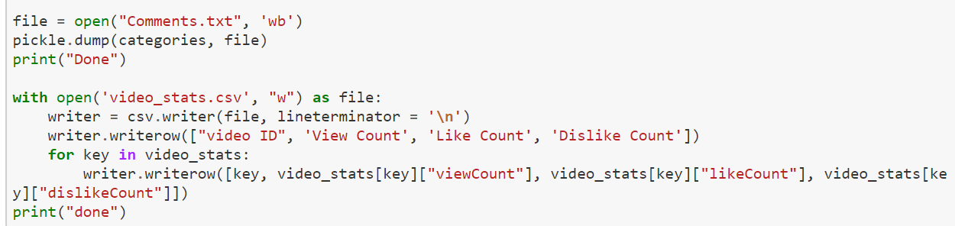
Saving Data to files
Saving Comments
Saving Data Stats

Slide 10
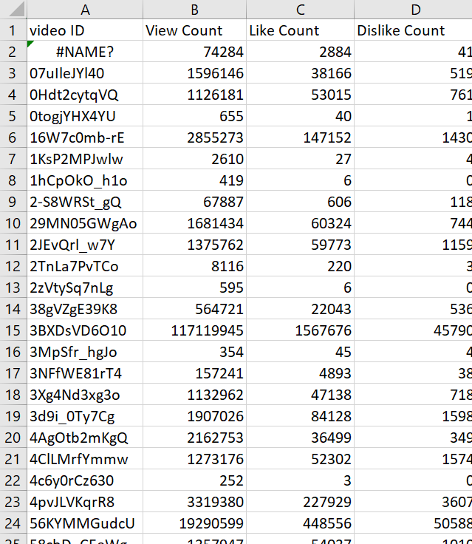
Data Retrieved and Saved as CSV

Slide 11
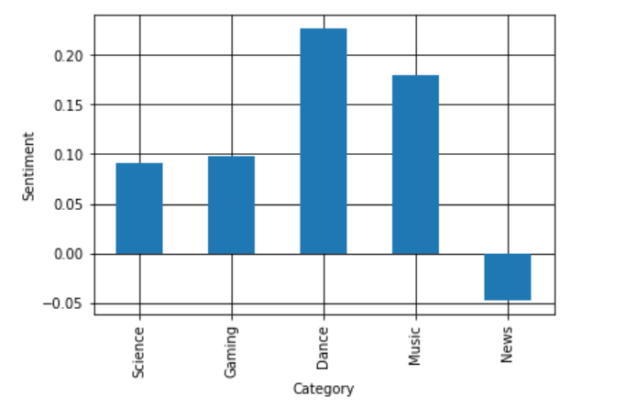
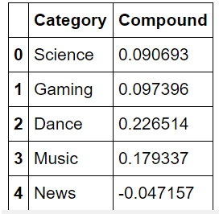
Results
It will be a good option to start a channel in dance category as the compound sentiment of comments for Dance Category is 0.226514 for 50 videos analyzed i.e 5000 comments. Dance Category has most number of positive comments out of the 4 other categories.
News category will not be a good choice to start a channel as the compound sentiment of comments for News Category is -0.047 for 500 videos analyzed. News Category has most number of negative comments out of the 4 other categories.

Slide 12
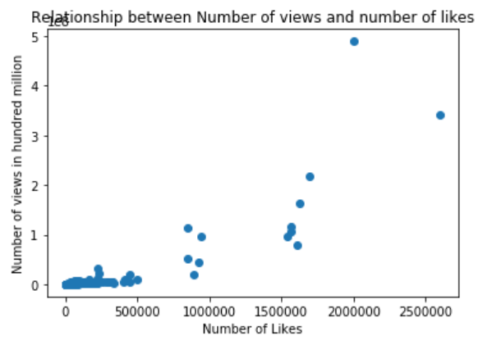
3. It can be seen from the following graph that there is a direct relationship between number of views and number of likes. More the number of views , more is the number of likes on the video.

Slide 13
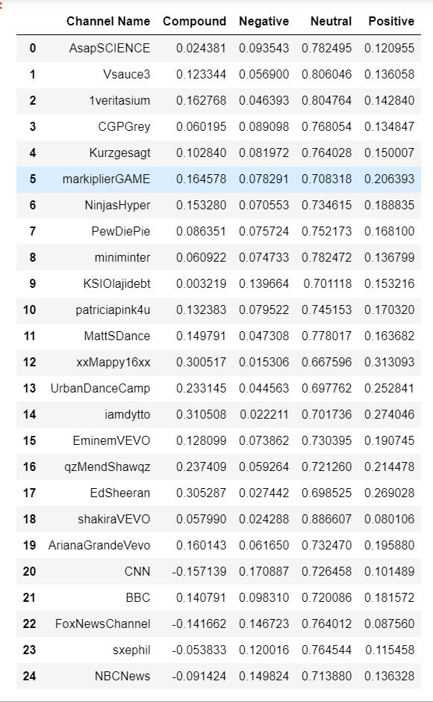
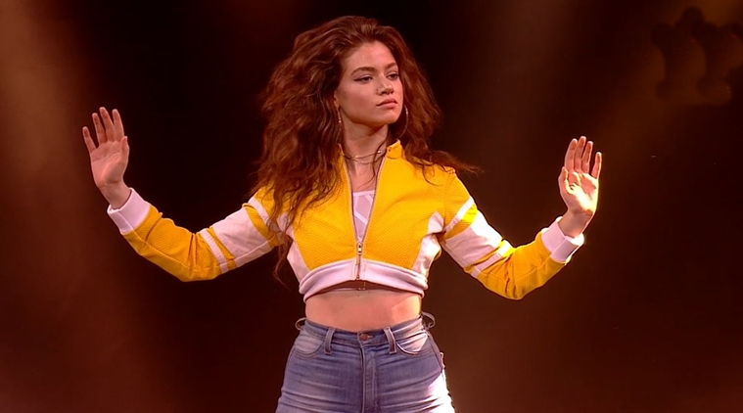
4. Compound sentiment of Dance channel “iamdytto” is 0.310508 , which is the highest amongst all the other dance channel.

Slide 14
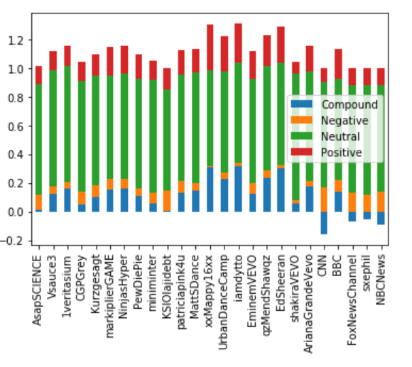
5. Most of the comments lie under neutral sentiment, could be because of the inability of VaderSentiment library to take emoji in account.

Slide 15
Findings
Based on my analysis, likes, comments and number of views seem to be a good indicator of the positivity and wholesomeness of the group of channels.
At the same time a lot of comments get categorized as neutral which needs to be investigated, the potential cause could be the use of emojis which the library does not understand.
Limitations

