Slide 1
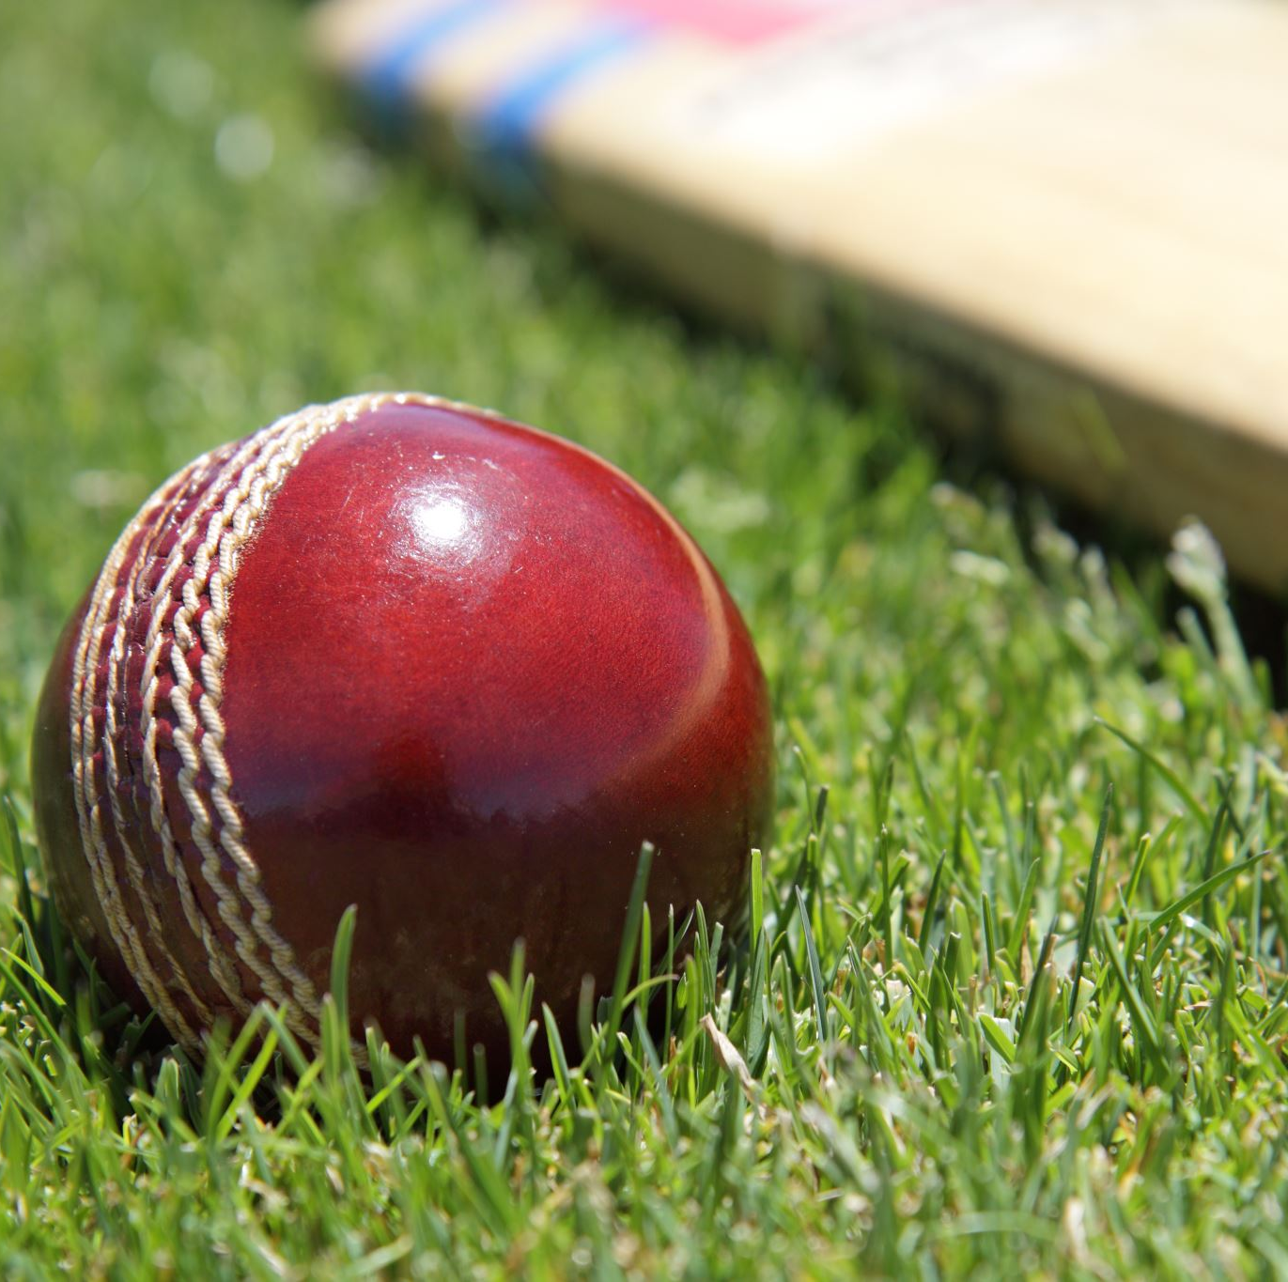
Cricket Performance Analysis Application: CPAA

Slide 2
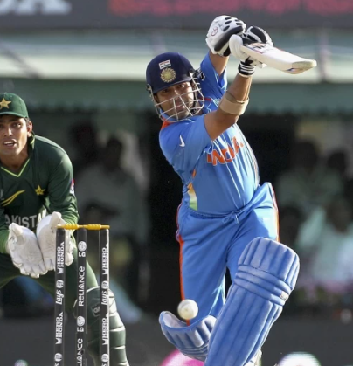
What is Cricket?
Cricket is a bat-and-ball game played between two teams of eleven players on a field with a 22-yard (20-meter) pitch at its center. The objective of the game is to score runs when at bat and to dismiss the opposing batsmen when in the field.

Slide 3
Key Elements of Cricket
1. Players and Teams
Each team consists of eleven players.
Roles include batsmen, bowlers, fielders, and a wicketkeeper.
2. The Pitch
A rectangular 22-yard long pitch is at the center of the field.
At each end of the pitch are the wickets, each consisting of three stumps topped by two bails.
3. Innings
An innings consists of one team batting while the other team bowls and fields.
Teams switch roles after all batsmen are dismissed or a predetermined number of overs are bowled.
4. Overs
An over consists of six legal deliveries bowled by a bowler.
After an over is completed, another bowler bowls from the opposite end of the pitch.
5. Batting
The batting team aims to score runs by hitting the ball bowled at them and running between the wickets.
Runs can also be scored by hitting the ball to the boundary.
6. Bowling and Fielding
The bowling team aims to dismiss the batsmen by hitting the wickets with the ball, catching the ball off a batsman’s shot, or other methods.
Fielders support the bowlers by catching the ball, stopping runs, and attempting run-outs.

Slide 4
Terminologies used in CPAA
Types of Matches:
One Day Internationals (ODIs)
Each team faces a fixed number of overs, that is 50.
The game typically lasts around eight hours.
Twenty20 (T20)
Each team faces 20 overs.
A fast-paced format designed to be completed in about three hours

Slide 5
Terminologies used in CPAA
Scoring:
Runs
Runs are scored by batsmen running between the wickets or by hitting the ball to the boundary.
A boundary scores four runs if the ball hits the ground before crossing the boundary or six runs if it crosses without touching the ground.
Extras
Runs awarded for errors by the fielding side, such as no-balls, wides, byes, and leg-byes.

Slide 6
Terminologies used in CPAA
Dismissals/ Out
Catch out
Bowled
Stumped
Leg Before Wicket (LBW)
Run Out
Hit Wicket

Slide 7
Statistics used in CPAA
Batsman Analysis
No. of Fours : This stats shows runs scored vs No. of fours, that is how many fours a player has hit to score ‘n’ number of runs in different matches.
No. of Sixes : This stats shows runs scored vs No. of sixes, that is how many sixes a player has hit to score ‘n’ number of runs in different matches.
Percentage of Runs: This metric represents the percentage of total runs a batsman scored in a particular way (e.g., through boundaries, singles).
Dismissal of Batsman: This metric details how a batsman got out, such as being bowled, caught, run out, LBW (Leg Before Wicket), stumped, etc.
Strike Rate: The number of runs scored per no of balls faced by the batsman.
Run-Freq: It shows frequency of runs scored by the batsman.
Run-Ranges: It shows percentage of runs scored by the batsman between different ranges.
Ground Average: Average numbers of runs scored by a batsman at a specific ground.
Avg Runs Scored vs. Opposition : Average runs scored vs different opposition teams.
Moving Average : Average runs scored by a batsman over a series of timeframe.

Slide 8
Statistics used in CPAA
Bowler Analysis
Wickets-Runs Plot: This plot shows the relationship between the number of wickets a bowler took and the runs they conceded in various matches.
Wickets Frequency Percent: This plot shows percentage of frequency of wickets taken in different matches.
Average Wickets at Ground: The average number of wickets a bowler took at a specific ground.
Average Wicket Against Opposition: The average number of wickets a bowler took against different opposing teams..
Economy Rate: The average number of runs conceded per over bowled by a bowler.
Moving Average : Average wickets taken by a bowler over a series of timeframe.
Wicket Rate: The average number of wickets a bowler took per match or per a certain number of balls bowled

Slide 9
Statistics used in CPAA
Relative Batsmen Analysis:
Mean Strike Rate: Relative: The relative mean strike rate compares a player's strike rate to other players.
Runs Frequency Performance: Relative: This metric compares the percentage of frequency distribution of runs scored by a batsman relative to other batsmen.
Relative Bowlers Analysis:
Economy Rate: Relative: The relative economy rate compares a bowler's economy rate to other bowlers.
Wicket Percentage : Relative: Comparison of the percentage of frequency of wickets taken by a bowler relative to other bowlers.
Wicket Rate: Relative: The relative wicket rate compares a bowler's rate of taking wickets to other bowlers.
Current Status:
Using t-statistics on average runs scored by batsman or average wickets taken by bowler the current form status of the player is determined using p-value.

Slide 10
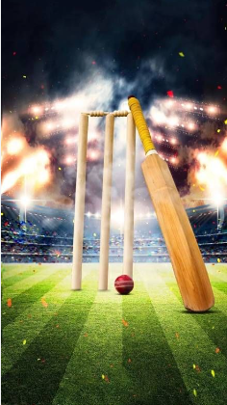
THANK YOU

