Slide 1
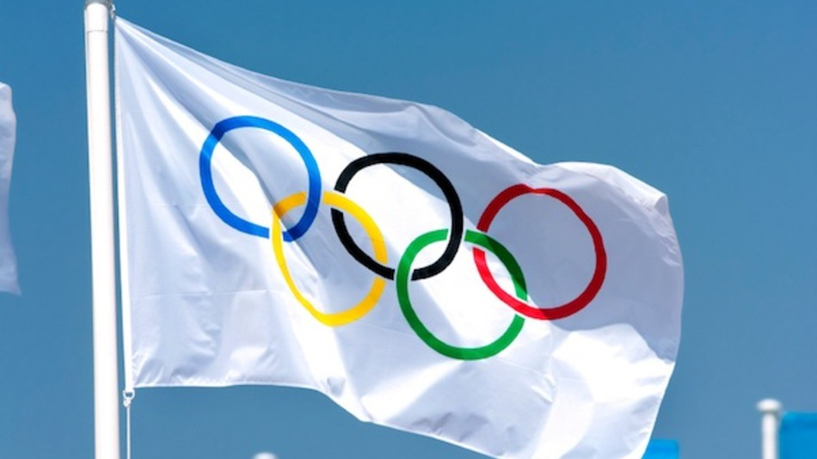
Summer Olympics
[1896 – 2012]
Exploratory Data Analysis
by Swati Patil [Bangalore-India]

Slide 2
Data Exploration
Today, we will explore the dataset on Summer Olympics Games, including games from 1896 till 2012.
The dataset has been accessed from Github website.

Slide 3
Data Cleaning and Munging
This dataset has more than 31K rows and 9 columns like Year, City, Sport, Discipline, Athlete, Country, Gender, Event and Medal.
After the data cleaning and munging using most powerful pandas_profiling package in Python, we got 31161 rows for further analysis.

Slide 4
Challenges in the Data
This data is huge in a sense that it has Summer Olympic Games data from 1896 till 2012. Many sports were played during each game by various Athletes of different Countries.
For each sport, they distributed Gold, Silver and Bronze medals to the winners.
One Game – many sports, One Sport – many disciplines, events and winners.
By just looking at numbers, records we will not get meaningful information in short time.

Slide 5
Exploratory Data Analysis
This dataset comprises mainly of categorical values.
Slicing and Dicing technique is used to understand the data in better way.
Initially investigated data to understand what is the meaning of each column, if there is any missing or irrelevant entry.
Graphical representation helped to analyze data in better way. Seaborn, Folium packages are used.

Slide 6
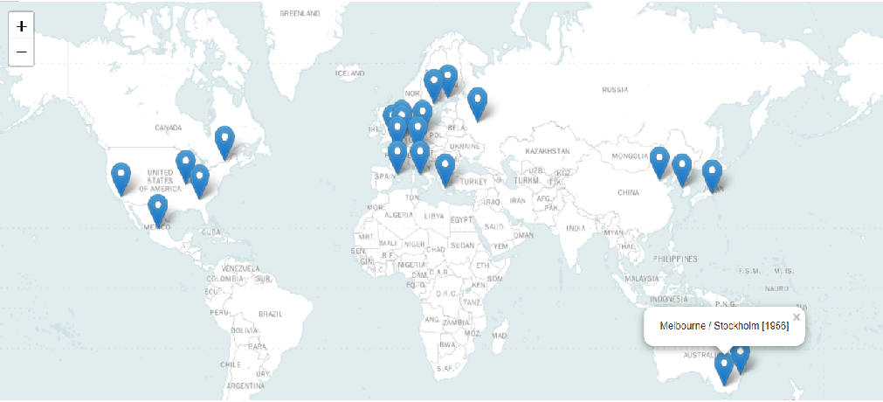
Cities where Games were held
Used Folium package to mark cities on the world map

Slide 7
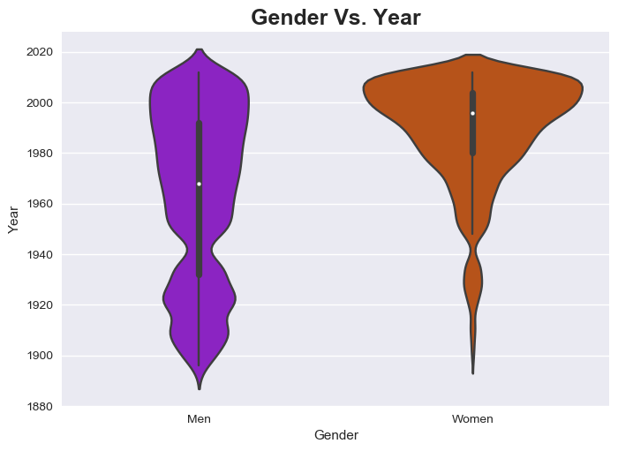
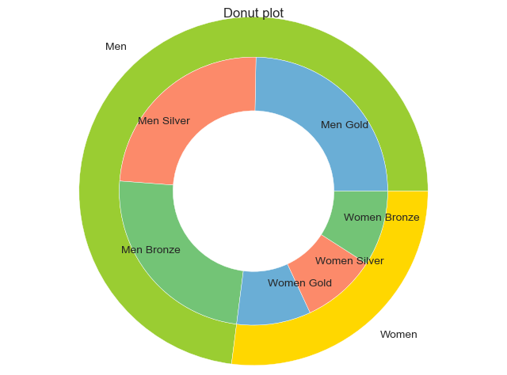
Men and Women Participation
Men participation is more than women and consistent
but women participation has increased over the time
-Seaborn Violinplot and Donut chart is used

Slide 8
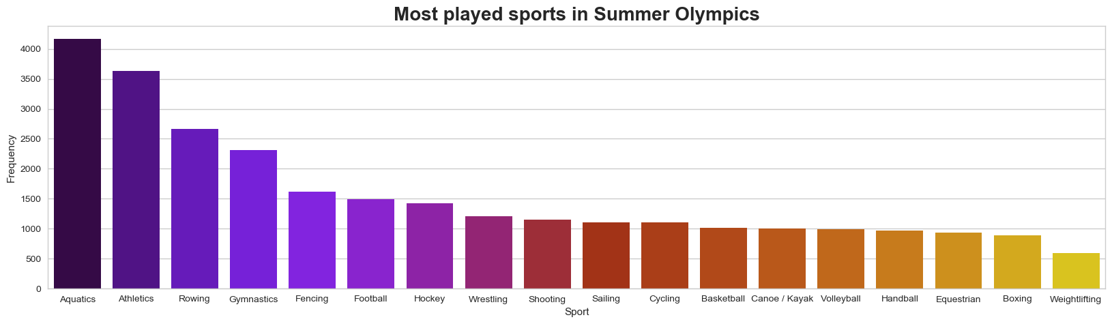
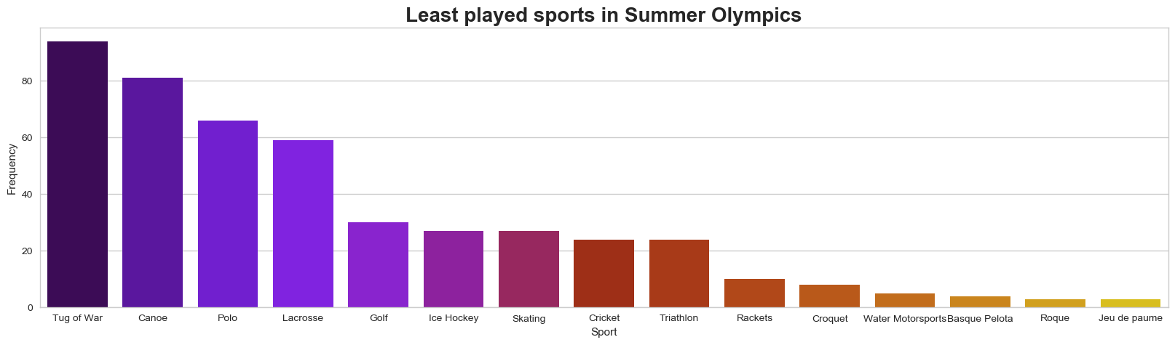
Sports, Discipline and Events
Sports played are not consistent over the period of years.
Many sports like Aquatics, Athletics, Football, Hockey etc. are still there.
But the sports like Cricket, Tug-of-War were played for few years only

Slide 9
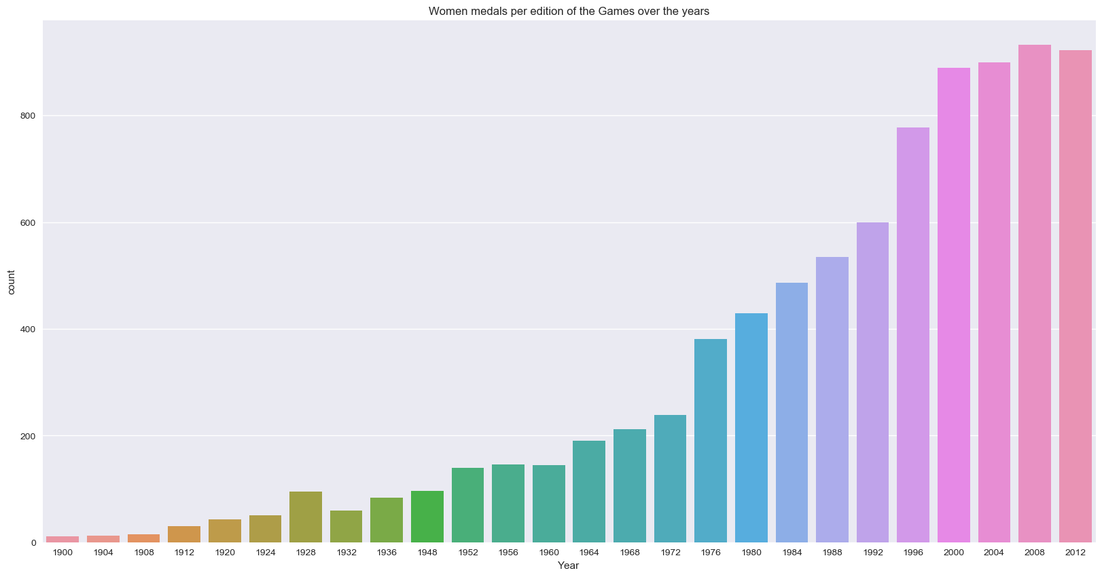
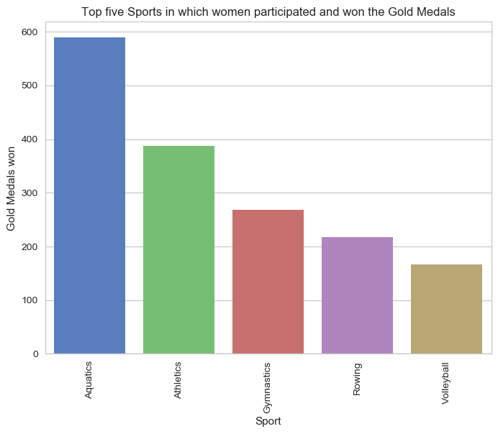
Women Participation
Women participation in the games has drastically increased from 1976, so the winning medals
Aquatics, Athletics, Gymnastics, Rowing and Volleyball are the top 5 games in which women won most of the medals.

Slide 10
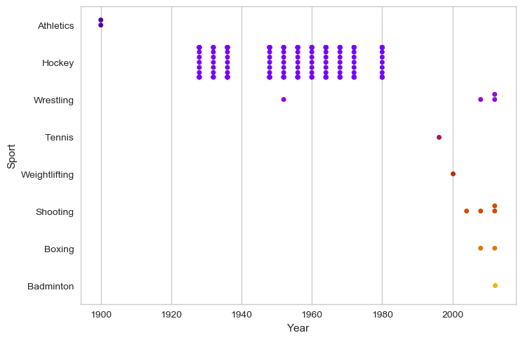
Indian Players
- Won silver medal first time in Athletics in 1900
- Then till 1980, most medals were won in Hockey
- After 1980, they won medals in various sports like Wrestling, Tennis, Weightlifting,
Shooting, Boxing and Badminton

Slide 11
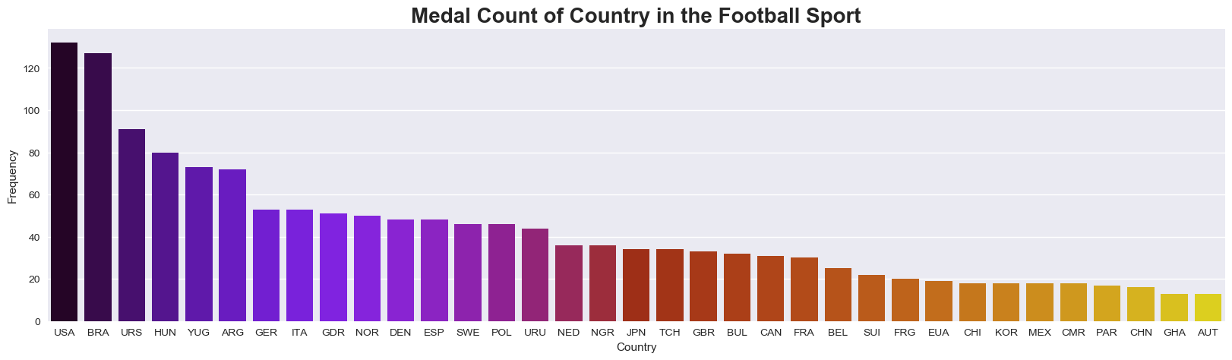
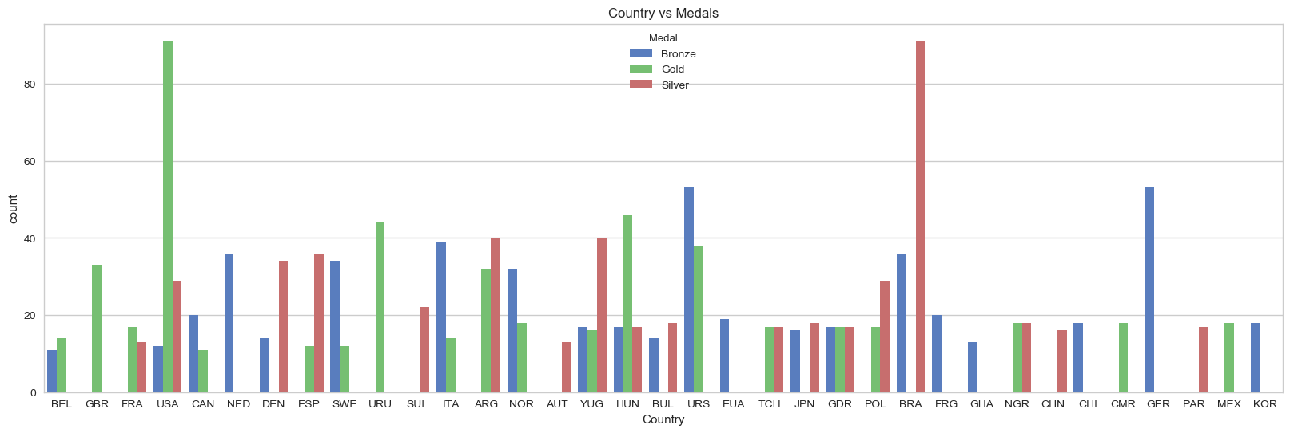
Football
USA is Football Gold Medal leader and Brazil is Silver Medal leader.

Slide 12
Games – Now and Then ?
Exploring various aspects like sports played, country participation, medals distribution etc. in 1896 (First Summer Olympic Game) and the recent one i.e. 2012 Summer Olympic Games.
In 2012 Summer Olympics Games,
there were 26 different sports played as compared to 9 sports in 1896,
85 countries participated as compared to 11 countries in 1896
and players won 1945 medals as compared to 151 medals in 1896.
Players participating in Aquatics won the most medals in 2012
And Gymnastics in 1896.
In 1896, Greece won most medals among participating countries.
But, in 2012, USA topped the medals tally.

Slide 13
Conclusion
Technically, Python packages in line with Exploratory Data Analysis concepts helped to analyze data quickly and in short and sweet manner.
Analytically few points are as below:
The games were held mostly in Europe. There are few cities like Athens, Paris, Los Angeles where Games were held for more than once.
Now-a-days many countries, players are participating in the games than before. So, automatically medal distribution has also increased over the period of time. Various sports are part of these Olympic Games now.
Women participation in sports has increased over the period of time.
Indian players were winning medals only in Hockey before but now they are participating and winning medals in various other sports as well.
In the recent years, many smaller countries are qualifying for Summer Olympic Games.

Slide 14
After all… It is a GAME. Thank You!

