Slide 1
SUPPLYMIND AI
An AI co-pilot for your
supply chain
Introducing the app: what it does, how it works, and what it looks like
Prepared for a first-time audience · No prior knowledge assumed
Notes:
Welcome everyone. Today I'm introducing SupplyMind AI - a tool we've been building that helps a supply chain team catch problems (like a product about to run out of stock, or a supplier that keeps delivering late) before they turn into a crisis. I'm assuming zero prior knowledge here - by the end of this you'll know exactly what it does, how it works, and what it looks like day to day. We'll walk through the app screen by screen, using real screenshots, not mockups.

Slide 2
WHY THIS EXISTS
Supply chain problems are usually found too late
● Stockouts surprise people. A product runs out before anyone notices demand had picked up.
● Supplier issues hide in spreadsheets. A supplier that's slowly getting less reliable rarely trips an alarm.
● Answers take too long. “What's our risk right now?” often means pulling three reports and waiting a day.
● Decisions are made on gut feel. Without a fast way to test “what if,” teams either move too slowly or guess.
THE COST OF FINDING OUT LATE
● Emergency orders at a premium price
● Missed customer commitments
● Firefighting instead of planning
● Risk that's invisible until it's a crisis
SupplyMind AI
2
Notes:
Let's start with the problem, because the app only makes sense once you see the gap it fills. Right now, most supply chain problems are found the hard way - after a shelf is empty, after a customer complains, after a shipment is already late. The data to catch these things earlier usually already exists - it's sitting in spreadsheets, a database, or a handful of reports - but nobody has time to check it constantly, and turning raw numbers into a clear 'is this okay or not' answer takes real analysis work. That gap - data exists, but nobody's watching it continuously - is exactly what SupplyMind AI closes.

Slide 3
IN ONE SENTENCE
A tool that watches your supply chain data and tells you, in plain English, what needs attention
“Connect your data once. SupplyMind AI checks it continuously, in plain
language, and lets you ask questions or test decisions before you make them.”
● Not a dashboard you have to interpret. It already tells you what's fine and what needs a look.
● Not a black box. Every answer shows its confidence and the reasoning behind it - never a guess dressed up as fact.
● Not a one-way report. You can ask it follow-up questions and test “what if” scenarios before committing to anything real.
SupplyMind AI
3
Notes:
So here's the pitch in one sentence: you connect your data once, and from then on the system continuously checks it and tells you, in plain language, what's fine and what needs your attention. Three things make this different from 'just another dashboard.' First, it does the interpreting for you - instead of a wall of numbers, you get a sentence like 'stockout risk is low, no action needed.' Second, it's honest about uncertainty - every answer comes with a confidence score, so you always know how much to trust it, instead of a chart that looks equally confident whether it's right or wrong. And third, it's a conversation, not a static report - you can ask follow-up questions in plain English, and you can test a hypothetical change - like 'what if demand jumps 20%' - before it's real.

Slide 4
HOW IT WORKS
Three steps, no technical setup required
1
2
3
Connect your data
Specialist AI agents check it
You get plain-English answers
→
→
A database, a CSV file, or a Google Sheet.
Connect once, map it to what the system needs.
Each one focuses on a single question - demand,
stockout risk, suppliers, shipments, data quality -
and reports back with a confidence score.
One glance at the dashboard, ask a question
directly, or test a scenario before you act on it.
SupplyMind AI
4
Notes:
The whole flow is three steps. Step one: you connect your data - that could be a live database, an uploaded spreadsheet, or a Google Sheet - and you do that once. Step two, behind the scenes, a team of specialist AI agents each check one thing - one looks at demand patterns, one at stockout risk, one at supplier reliability, one at shipment delays, one at data quality - and each one reports back with a confidence score, not just a raw number. Step three, you get the results in plain English - you can glance at a one-page dashboard, ask a direct question like you're texting a colleague, or test a hypothetical scenario before you commit to a real decision. No technical setup, no query language to learn.

Slide 5
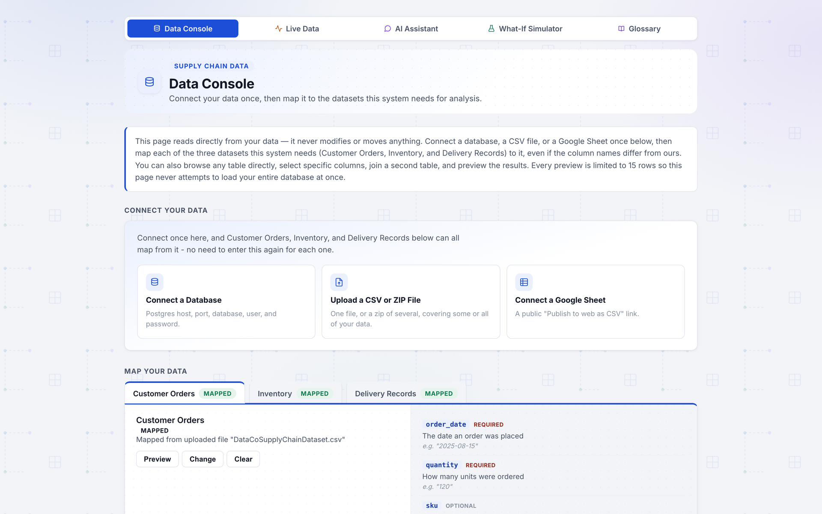
SCREEN 1 OF 5 · DATA CONSOLE
Connect your data once
● Three ways in. A live Postgres database, an uploaded CSV/ZIP, or a public Google Sheet.
● You map it once. Line up your columns (even if they're named differently) to what the system needs - Customer Orders, Inventory, Delivery Records.
● Read-only, always. This page never modifies or moves your data - it only reads it.
● Safe previews. Every preview is capped at 15 rows, so it never tries to load your whole database at once.
SupplyMind AI
5
Notes:
This is the very first screen anyone sees: the Data Console. This is where you connect your data - three options, a live database, a CSV or zip file upload, or a public Google Sheet link - and you only have to do it once. Then you map your columns to the three things the system needs: Customer Orders, Inventory, and Delivery Records - and it doesn't matter if your column names are different from ours, you just point at them. Two things worth calling out for anyone nervous about a new tool touching their data: this page is strictly read-only, it never modifies or moves anything, and every preview is capped at 15 rows so it's never going to try to pull your entire database into memory.

Slide 6
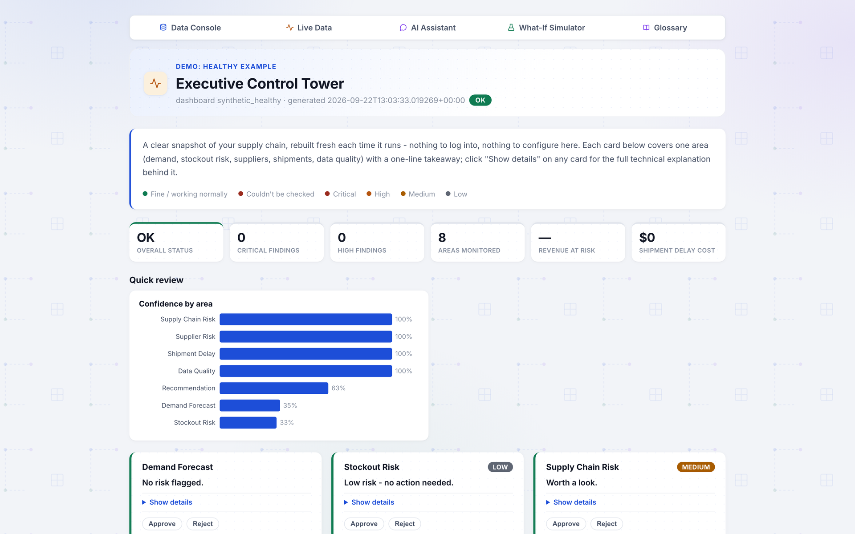
SCREEN 2 OF 5 · LIVE DATA
The Executive Control Tower - one page, one glance
● One card per area. Demand, stockout risk, suppliers, shipments, data quality - each with a one-line takeaway.
● Color says it all. Green means fine, amber means worth a look, red means critical - no reading required.
● Rebuilt fresh each time. Nothing to log into or configure - it's a snapshot of right now.
● Confidence, not just numbers. A “Confidence by area” chart shows how much to trust each finding.
SupplyMind AI
6
Notes:
This is the dashboard - we call it the Executive Control Tower, because it's meant to be the one page a busy executive checks each morning. Every area of the supply chain gets its own card - demand, stockout risk, suppliers, shipments, data quality - and each card gives you a one-line takeaway plus a color: green for fine, amber for worth a look, red for critical. You don't have to read anything to know where to focus. Notice the top-level numbers too - overall status, critical findings, high findings - all summarized before you scroll an inch. And this 'Confidence by area' chart is something most dashboards don't have: it tells you how much to trust each individual finding, not just what the finding is.

Slide 7
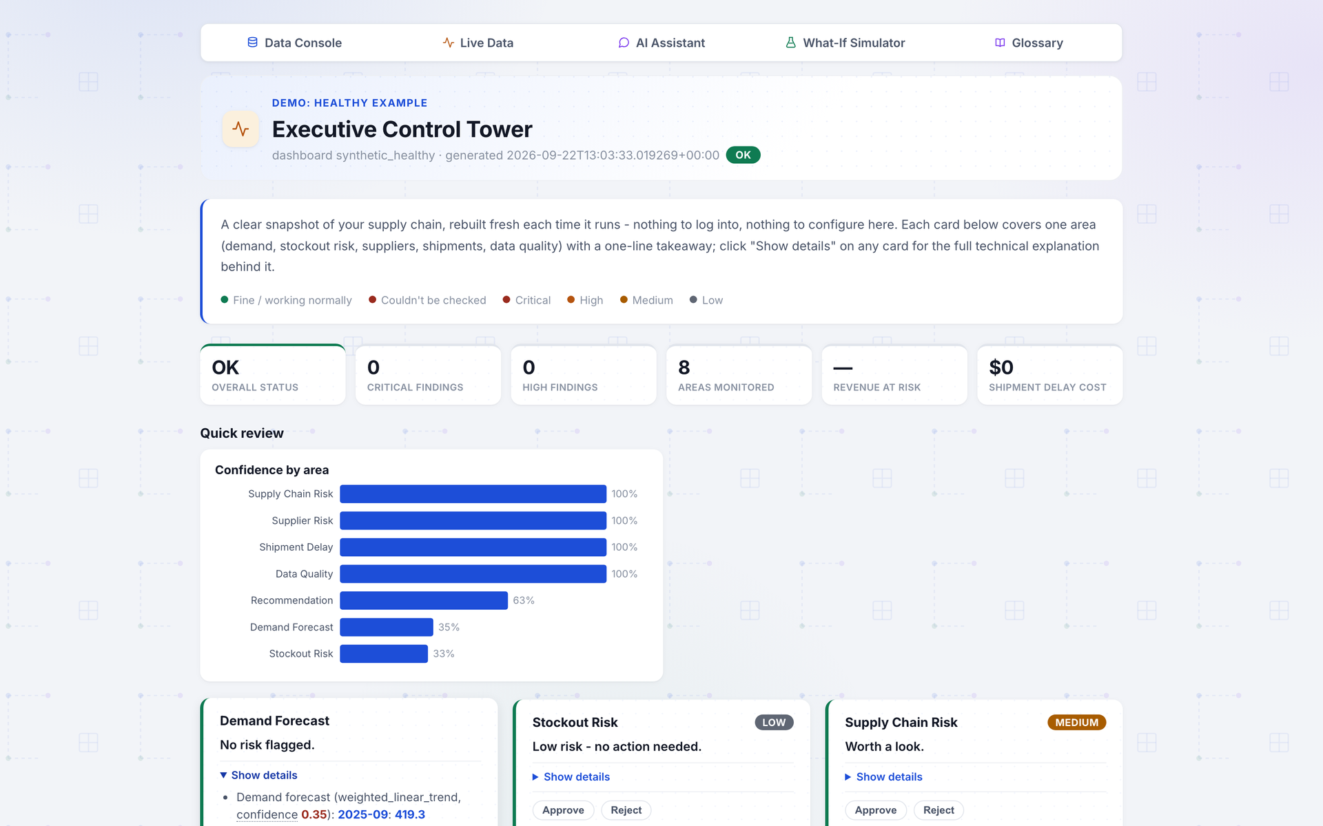
SCREEN 2 OF 5 · LIVE DATA (CONTINUED)
Drill down when you need to - the full reasoning is one click away
● “Show details” on any card. Expands to the full technical explanation behind the one-line takeaway.
● Important numbers are color-coded. Confidence, risk score, and stockout probability change color based on their own value - not just a flat highlight.
● Same colors everywhere. The same green/amber/red convention is used consistently across the dashboard, AI Assistant, and What-If Simulator.
● Approve / Reject on every finding. A human always stays in the loop before anything is acted on.
SupplyMind AI
7
Notes:
If the one-line summary isn't enough, every card has a 'Show details' toggle that expands into the full technical reasoning - the actual numbers, the actual thresholds, why the system reached that conclusion. This is a deliberate design choice: the app never asks you to just trust a black box. One detail I'll point out because it took real work: the important numbers - confidence, risk score, stockout probability - aren't just highlighted in one flat color anymore. They're colored based on their own value, so a risk score of 8 shows as neutral gray and a risk score of 65 shows as red, using the exact same thresholds the system uses internally to classify severity - so the color can never disagree with the words next to it. And every finding has Approve and Reject buttons, because a human always stays in the loop.

Slide 8
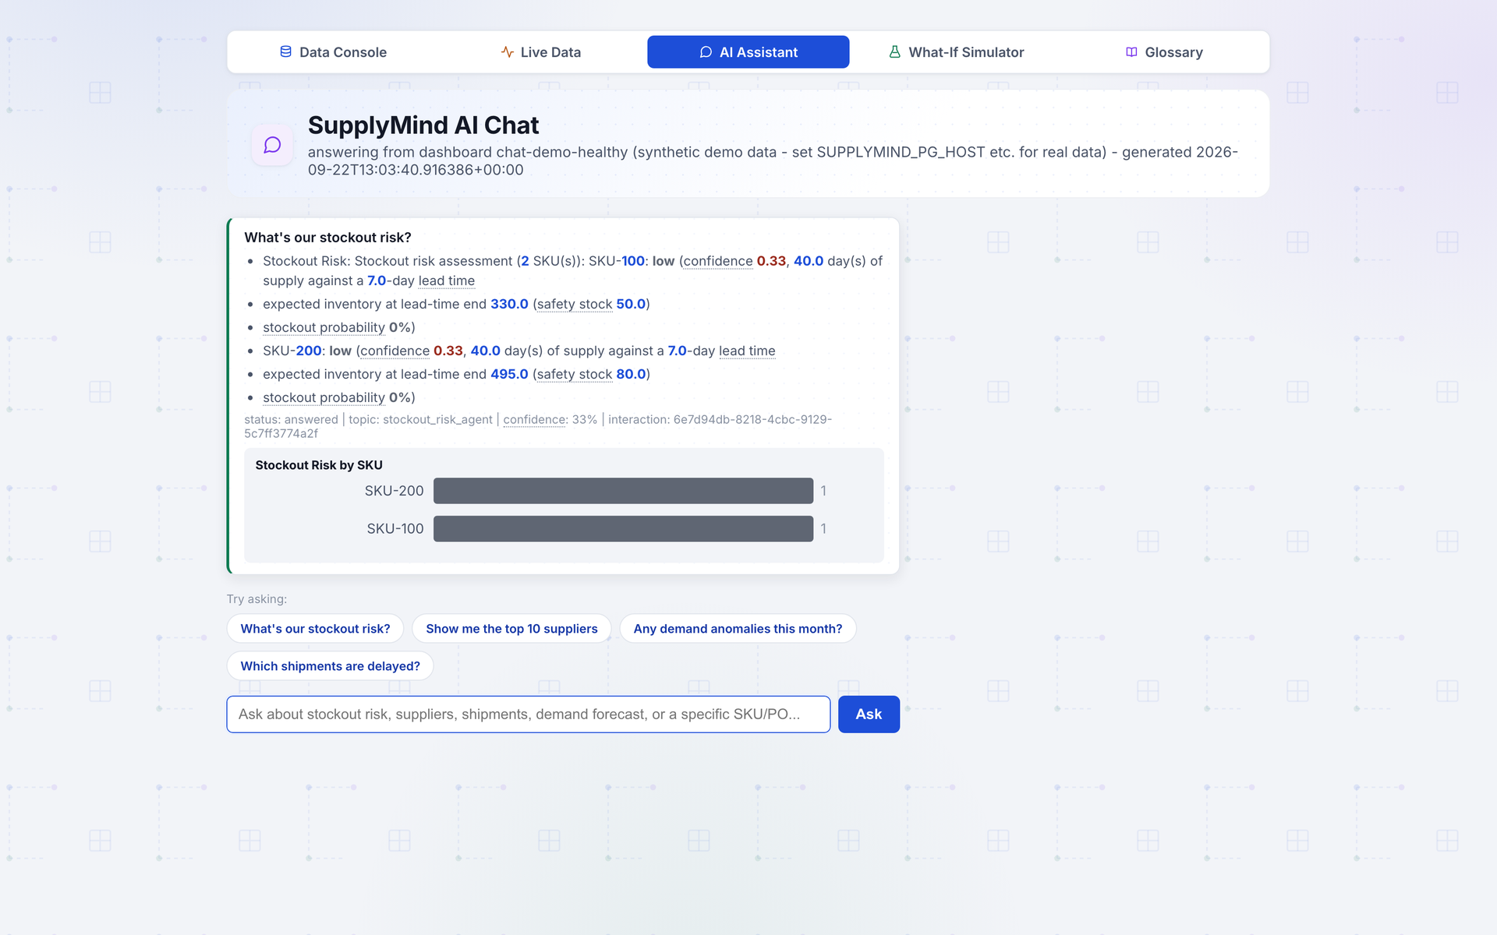
SCREEN 3 OF 5 · AI ASSISTANT
Ask a question, get a straight answer
● Type a plain-English question. “What's our stockout risk?” - no query language, no filters to configure.
● Example questions to get started. Suggested chips for the four most common questions.
● Answers cite their own numbers. Confidence, SKU-level detail, and a small chart - not just a paragraph of prose.
● Same honesty as the dashboard. Every answer shows status, topic, and a confidence percentage.
SupplyMind AI
8
Notes:
This is the AI Assistant - think of it as texting a very well-informed colleague who has read every report. You type a plain-English question, like 'what's our stockout risk,' and it answers directly, with the specific SKUs, the specific numbers, and a small chart when that helps. If you're not sure what to ask, there are example questions right there to get started. And just like the dashboard, it never hides its confidence - you can see right there 'confidence 33%,' so you know this is a lower-confidence read and maybe worth a second look, versus a 90%+ answer you can act on immediately.

Slide 9
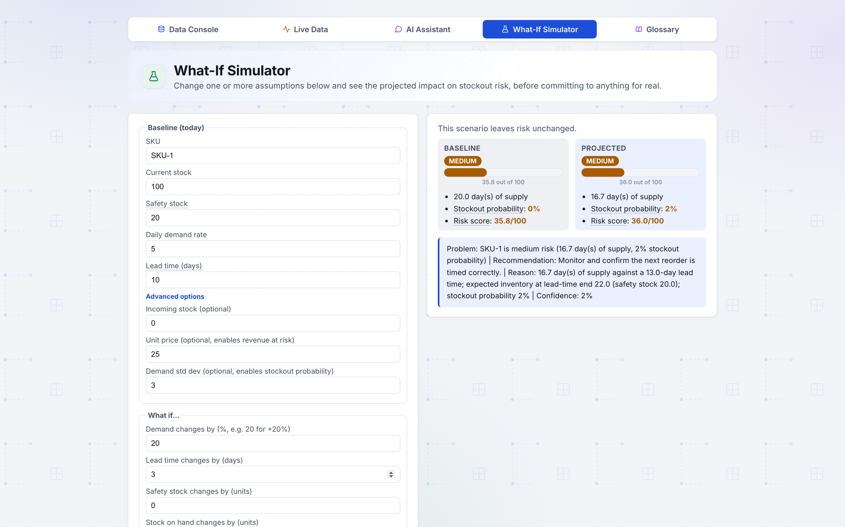
SCREEN 4 OF 5 · WHAT-IF SIMULATOR
Test a decision before you make it real
● Start from today's real numbers. Current stock, safety stock, demand rate, lead time - your actual baseline.
● Change one or more assumptions. “What if demand jumps 20%?” “What if the lead time grows by 3 days?”
● Instant before/after comparison. Baseline vs. projected risk, side by side, with a plain-English recommendation.
● Nothing is committed. It's a sandbox - you can try five scenarios and act on none of them.
SupplyMind AI
9
Notes:
This is the What-If Simulator, and it's probably the most fun screen to demo. It starts from your real, current numbers for a SKU - stock on hand, safety stock, demand rate, lead time - and then lets you change one or more assumptions: what if demand jumps 20%, what if the lead time grows by 3 days. Click Run Simulation, and it shows you baseline risk versus projected risk side by side, plus a plain-English recommendation - here it says 'monitor and confirm the next reorder is timed correctly.' Nothing here is real or committed - it's a sandbox for testing ideas before you act on them for real. This is how a team moves from reacting to problems to actually planning around them.

Slide 10
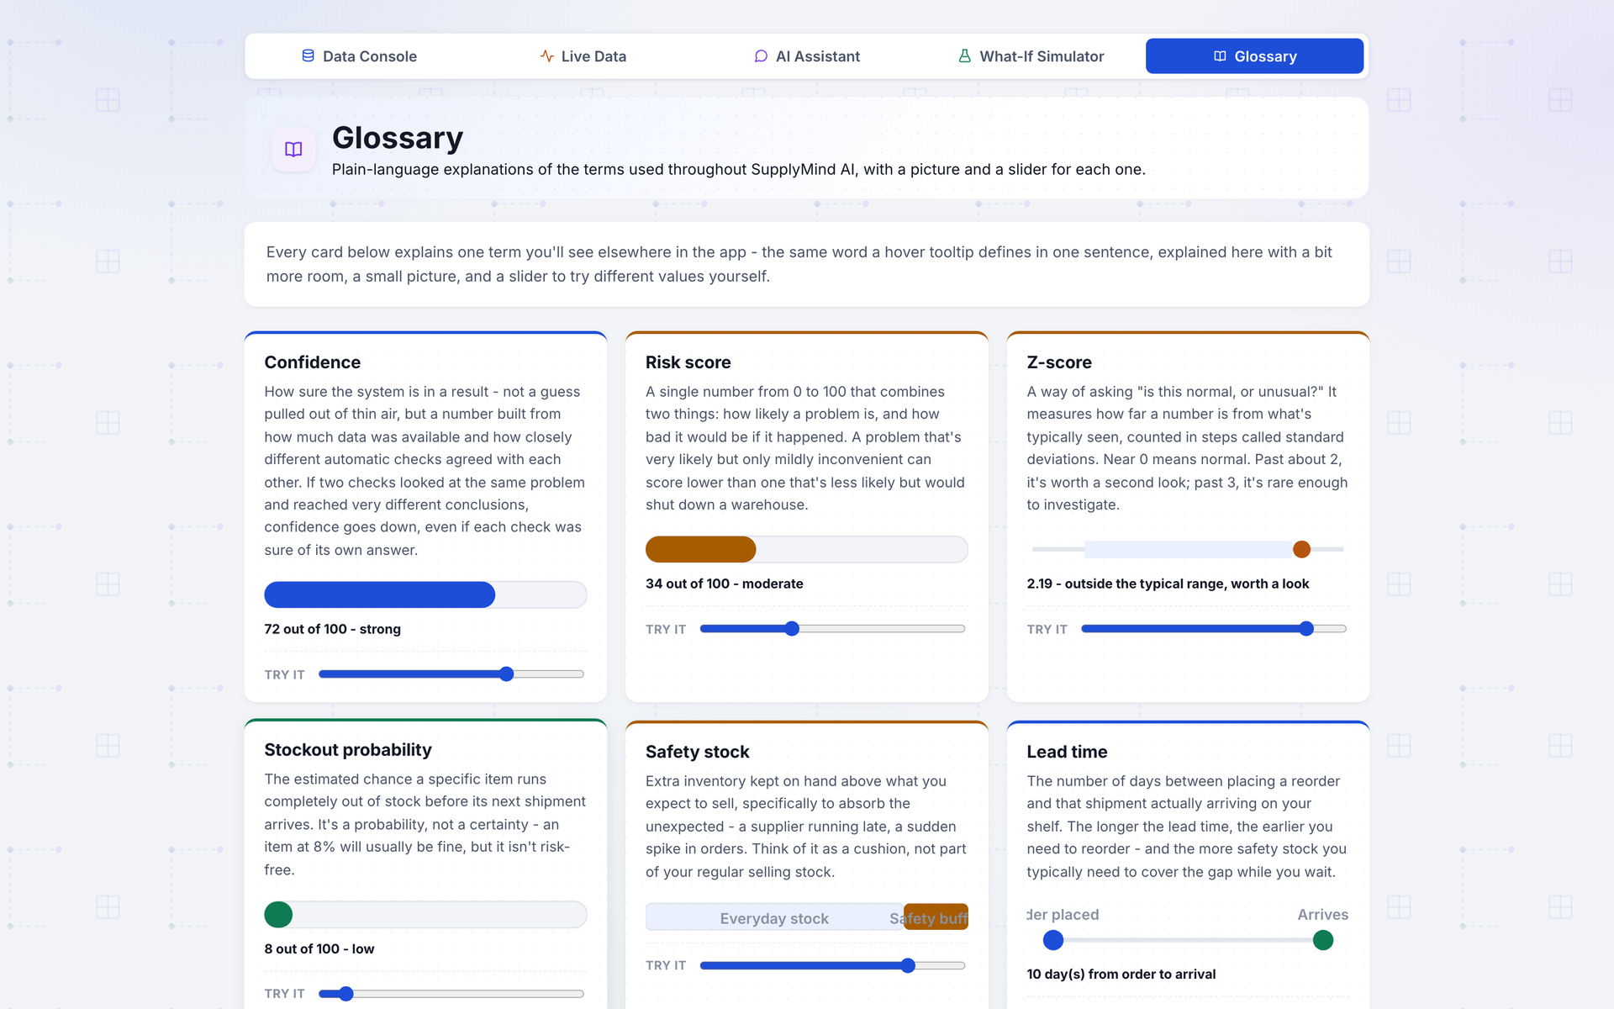
SCREEN 5 OF 5 · GLOSSARY
Never wonder what a term means
● Every term, explained simply. Confidence, risk score, z-score, safety stock, lead time - one card each, in plain language.
● A picture for every concept. A slider or small chart you can try yourself, not just a wall of text.
● Same tooltip everywhere. Hovering a term anywhere in the app shows the same one-sentence definition used here.
● Built for someone new. No assumption that you already know supply chain or data science jargon.
SupplyMind AI
10
Notes:
Last screen: the Glossary. Every technical term used anywhere in the app - confidence, risk score, z-score, safety stock, lead time - gets its own plain-language card here, with a small interactive picture, like a slider you can drag yourself to build intuition for what a 'high' or 'low' value actually looks like. This matters because the app is meant for people who don't have a data science background. And it's not a separate, disconnected reference - the same one-sentence definition you see here is exactly what pops up if you hover over that term anywhere else in the app, so there's never a mismatch between what a tooltip says and what this page says.

Slide 11
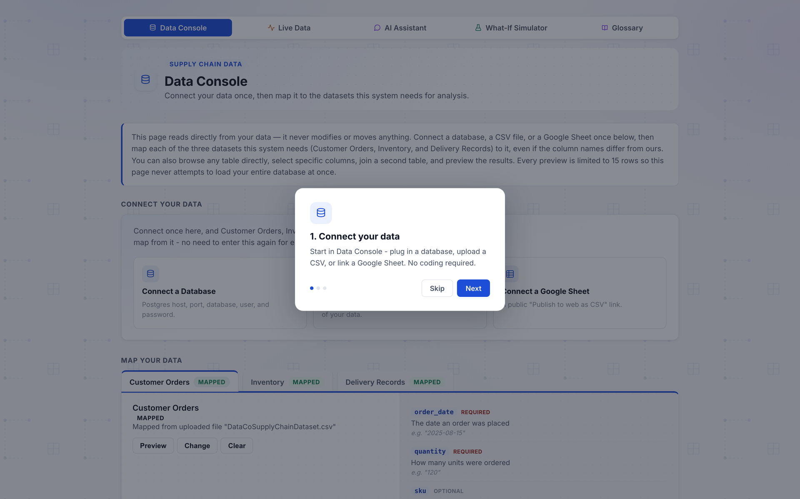
FIRST-TIME EXPERIENCE
New users get a 60-second orientation, automatically
● Shows once, automatically. The very first time anyone opens the app in their browser - on any of the 5 screens.
● Three steps, no reading required. Connect your data → Run analysis → Ask questions, test scenarios.
● Never nags twice. Remembered per browser, so a returning user just sees the app.
SupplyMind AI
11
Notes:
One more thing worth showing: what a brand-new user sees the very first time they open the app, on any browser, on any of the five screens. A short three-step overlay - connect your data, run analysis, ask questions and test scenarios - orients them in a few seconds. It only shows once, ever, per browser, so it never becomes an annoyance for people who already know their way around. This is a small thing, but it reflects the overall design philosophy: don't assume the person in front of the screen already knows how any of this works.

Slide 12
UNDER THE HOOD (BRIEFLY)
A team of specialists, not one big black box
Six specialist agents, each focused on one question:
Demand Forecasting
Stockout Risk
Risk Detection
Supplier Evaluation
Shipment Delay Analysis
Data Quality Monitoring
An Orchestrator Agent coordinates all six, cross-checks their answers, and flags disagreement:
If two agents look at the same data and reach very different conclusions, confidence goes down automatically - the system tells you it's unsure rather than quietly picking one answer.
SupplyMind AI
12
Notes:
Quick look under the hood, kept deliberately non-technical. There isn't one giant AI trying to do everything - there are six specialist agents, each responsible for exactly one question: demand forecasting, stockout risk, risk detection, supplier evaluation, shipment delay analysis, and data quality monitoring. An Orchestrator Agent sits above all of them, coordinates them, and - this is the important part - cross-checks their answers against each other. If two agents look at the same underlying data and reach very different conclusions, the system doesn't just quietly pick one - it lowers its confidence and tells you it's unsure. That's a deliberate safety design: production systems need to be predictable, so the AI's job here is to reason and flag things, never to silently guess.

Slide 13
WHERE THINGS STAND TODAY
A working local tool, actively growing
● All 5 screens work end-to-end today. Data Console, Live Dashboard, AI Assistant, What-If Simulator, and Glossary - everything in this deck is real, running software, not a mockup.
● Tested continuously. 1,107 automated tests currently pass across the codebase; every change ships with new tests, not just code.
● Runs locally right now. One command starts the whole app on your own machine - no cloud deployment yet.
● Built the disciplined way. Every screen was built, then deliberately broken to find edge cases, then hardened - not just built once and shipped.
WHAT'S NEXT
● Deploy so the team can access it without running it locally
● Connect it to a real, live data source
● Expand the AI Assistant's question coverage
● Gather feedback from real day-to-day use
SupplyMind AI
13
Notes:
So where does this actually stand today? Everything in this deck is real - every screenshot you saw is the actual running app, not a mockup or a prototype rendering. Right now it runs locally, meaning one command starts the whole thing on a single machine - it hasn't been deployed anywhere shared yet. It's also tested seriously: over eleven hundred automated tests pass across the codebase today, and the team's own working discipline is to build a feature, then deliberately try to break it with bad inputs and edge cases, then harden it - not just build something once and call it done. What's next is straightforward: get it deployed somewhere the whole team can reach without running it locally, connect it to a real live data source instead of demo data, expand what the AI Assistant can answer, and then get real feedback from people using it day to day.

Slide 14
QUESTIONS?
Let's talk about what this could
do for your team.
SupplyMind AI — an AI co-pilot for your supply chain
Thank you
Notes:
That's the tour. To recap in one breath: SupplyMind AI connects to your data once, has a team of specialist AI agents continuously check it, and gives you plain-English answers - on a one-page dashboard, through a chat-style assistant, or by letting you test decisions before you make them - and it never hides how confident it is. Happy to take questions, or if it's useful, I can pull up any of the five screens live and click around instead of just showing static screenshots.

