Slide 1
HEART DISEASE RISK DETECTION SYSTEM
Submitted in the partial fulfillment for the award of the degree of
BACHELOR OF ENGINEERING
IN
CSE-AIML
Submitted by:
21BCS3719- KHUSHBU
21BCS6131- SWATI
21BCS3716- PUMMY
Under the Supervision of:
NEERU BALA MA’AM
Department of AIT-CSE
DISCOVER . LEARN . EMPOWER

Slide 2
Outline
Introduction to Project
Problem Formulation
Objectives of the work
Methodology used
Results and Outputs
Conclusion
Future Scope
References

Slide 3
Introduction to Project
Heart disease is a leading cause of mortality worldwide, responsible for millions of deaths each year. Early detection and intervention are critical for improving patient outcomes and reducing the burden of this disease.
In recent years, machine learning techniques have emerged as a promising tool for predicting heart disease risk and supporting clinical decision-making.

Slide 4
This project aims to develop and evaluate machine learning-based models for predicting heart disease risk. Using a diverse dataset of patient records, the models will be trained to identify patterns and risk factors associated with heart disease, such as age, gender, blood pressure, and cholesterol levels.
The models will then be tested and validated using various performance metrics, such as accuracy, sensitivity, and specificity, to assess their effectiveness in predicting heart disease risk.

Slide 5
Problem Formulation
Heart disease is one of the leading causes of death worldwide, and early detection is crucial for successful treatment and management of the disease. Traditional methods of heart disease prediction, such as blood tests and physical examinations, are not always accurate or reliable.
Machine learning-based heart disease prediction models can analyze large amounts of data and learn patterns that are difficult for humans to detect. These models can integrate various data sources, including medical history, lifestyle factors, and genetic information, to provide accurate and personalized risk assessments.

Slide 6
Using a machine learning-based approach, healthcare providers can identify patients at high risk of developing heart disease, and provide them with appropriate interventions to prevent or delay the onset of the disease. This approach can lead to earlier detection, improved treatment outcomes, and reduced healthcare costs.

Slide 7
Objectives of the Work
The primary objectives of this model are:
Early Detection
Accurate Prediction
Risk Assesment
Personalised Medicine
Improved Efficiency

Slide 8
Methodology Used
The methodology for developing a machine learning-based heart disease prediction model typically involves the following steps:
Data Collection
Data pre-processing
Feature Selection
Model Selection
Deployment
Data Collection & Preprocessing
Feature Selection
Model Evaluation
Random Forest Model
Model Deployment

Slide 9
Results and Outputs
Numerous models were used to create the prediction model. Some of them are mentioned below:
Support Vector Machines (SVM)
K-Nearest Neighbours (KNN)
Gradient Boosting classifier
Random Forest

Slide 10
Random Forest
Random Forest is an ensemble machine learning algorithm used for heart disease prediction.
It combines multiple decision trees to create a robust and accurate predictive model.
Random Forest offers high accuracy, robustness to noise, feature importance analysis, and generalization capabilities.
It leverages the collective decision-making of multiple trees, resulting in improved prediction performance and a reliable predictive model.

Slide 11
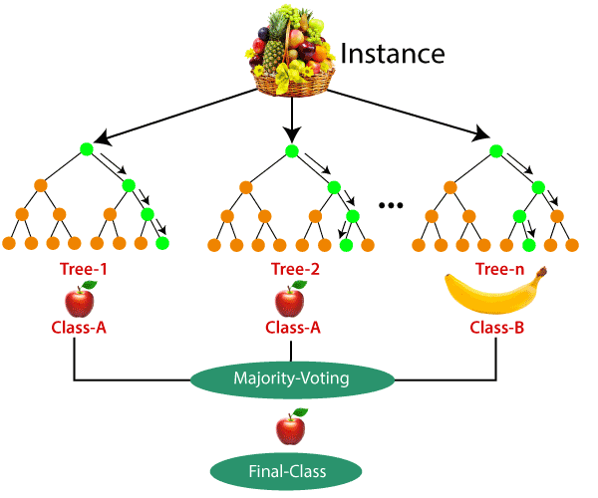
Advantages of Random Forest
High Accuracy
Robustness to Noise
Feature Importance
Generalization
In our Implementation of the model,
it achieved an accuracy of 98.53%

Slide 12
Tabular Comparison of Various Algorithms
Algorithm | Accuracy
Random Forest Classifier | 93.53%
Support Vector Machines | 80.97%
KNN | 73.17%
Gradient Boosting Classifier | 89.26%

Slide 13
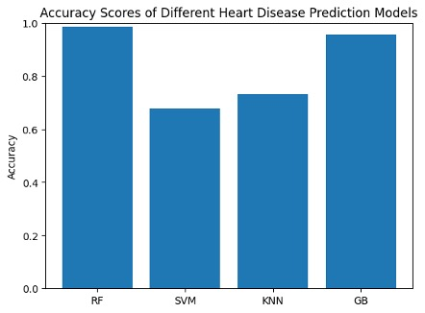

Slide 14
Conclusion
In conclusion, developing and evaluating machine learning-based heart disease prediction models have shown great potential in improving the accuracy and efficiency of cardiac risk assessment.
However, further research and validation are necessary to ensure that these models are reliable, transparent, and ethical in their implementation. With continued investment and collaboration, machine learning-based heart disease prediction models have the potential to revolutionize the field of cardiology and ultimately improve patient outcomes.

Slide 15
Future Scope
There is significant future scope for machine learning-based heart disease prediction models. Here are some potential areas of development
Personalization
Integration with electronic health records (EHRs)
Real-time monitoring

Slide 16
References
[1] Development of a machine learning-based prediction model for heart disease using cardiac biomarkers and clinical data by A. B. Zaman, T. L. Asselbergs, and R. C. Kraaijenhagen, (2020).
[2] A deep learning-based framework for predicting heart disease by M. A. Hoque and S. T. Ahmed, (2020)
[3] Heart disease prediction using machine learning: A review by A. S. Alazab, A. S. Almgren, and A. Al-Fuqaha, (2021).
[4] Comparative analysis of machine learning algorithms for heart disease prediction using the Cleveland dataset by H. M. Alhazmi and A. I. Alharbi, (2021)
[5] Machine learning-based prediction of coronary artery disease using clinical data by H. Kim, Y. K. Kim, and J. Y. Hwang, (2021)

Slide 17
[6] An ensemble of machine learning algorithms for predicting heart disease by F. Li, Y. Li, and Y. Li, (2022)
[7] Development of a machine learning-based prediction model for heart disease using laboratory and clinical data by J. L. Clevenger, M. C. Grant, and S. R. Thomas, (2020)

Slide 18

Thank you

