Slide 1
Topic Identify the best source of recruitment for a tech startup, based on previous data of candidate sources and recruitment strategies
Group Members
1.Swati Mahajan 243555
2.Sakshi Borekar 243508

Slide 2
Introduction Objective: To determine the most effective recruitment sources for a tech startup by analyzing historical data and strategies.
Why Its Matters : Efficient recruitment can save time and resources while ensuring the right talent is hired.

Slide 3
Data Overview
Dataset Description: Our dataset includes 107355 of candidates recruited
Key Metrics:
Attrition
Performance rating
Sales quota
Recruiting source.
Purpose:
To understand which sources have been most effective in past recruitment efforts.

Slide 4
HR Analytics
Role in Recruitment: HR Analytics plays a crucial role in enhancing recruitment efficiency by leveraging data to make informed decisions.
Predictive Analytics: By analyzing historical data, HR analytics can forecast which candidates are most likely to succeed and stay with the company long-term.
Optimization: Continuous analysis allows for the optimization of recruitment strategies, reducing both cost and time to hire.
Performance Metrics: HR analytics also enables the measurement of recruitment success through metrics like cost per hire, quality of hire, and retention rates.
Tools and Techniques: Common tools include Applicant Tracking Systems (ATS) and HR dashboards that visualize data and identify trends.

Slide 5

Reading your data into a Dataframe in Python
To read the data into a data frame in Python, you must execute the following steps:
Import packages - pandas, ggplot

Slide 6
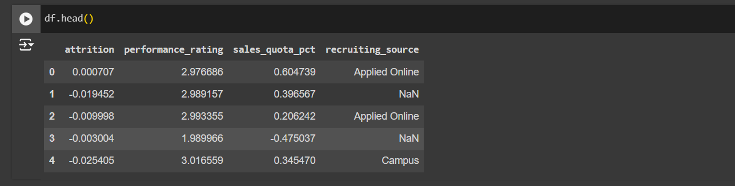
Read your data from CSV to a data frame
Take a closer look at the data using the head() function and check if the data got imported properly

Slide 7
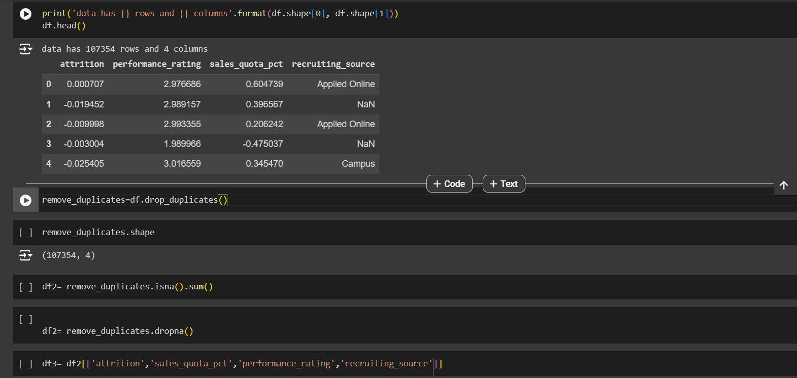
Pre-Processing:

Slide 8
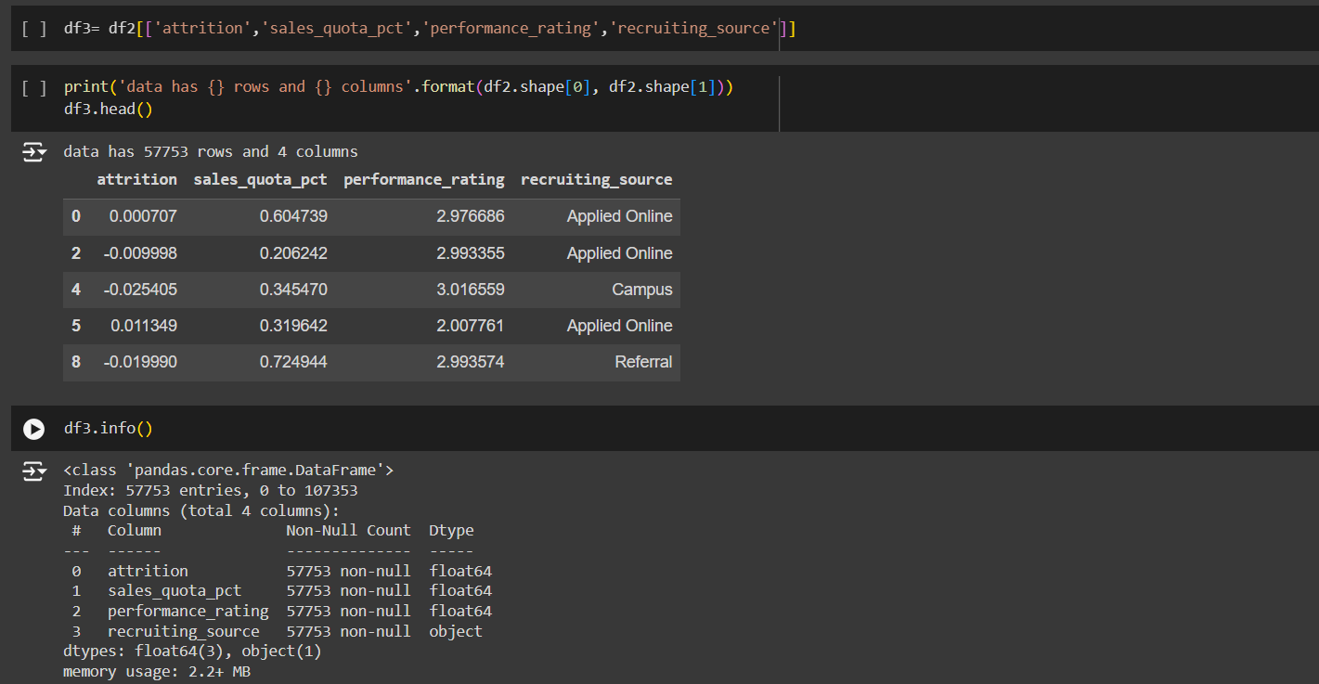

Slide 9
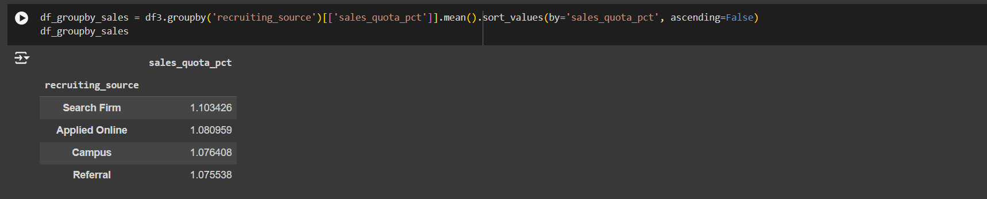
Get Average Sales Numbers and Attrition Numbers Print out the average Sales Number grouped by Recruiting Source

Slide 10
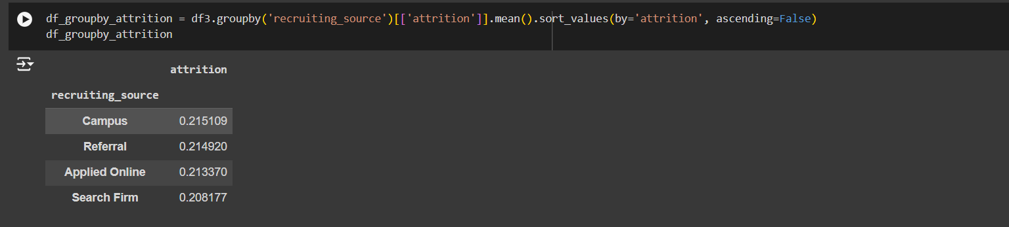
Print out the average Attrition Number grouped by Recruiting Source

Slide 11
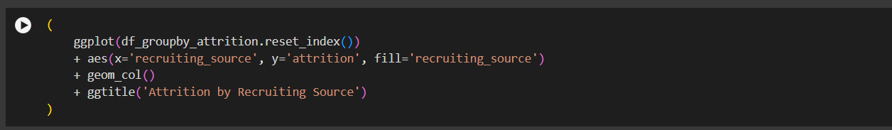
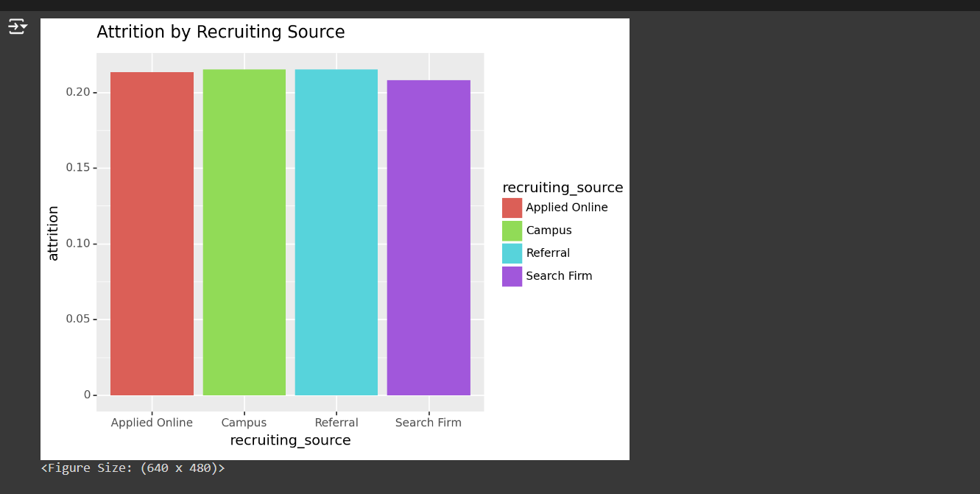
Visualize Attrition differences by Recruiting Source Plot a chart using ggplot in Python that illustrates Attrition numbers by the Recruiting Source.

Slide 12
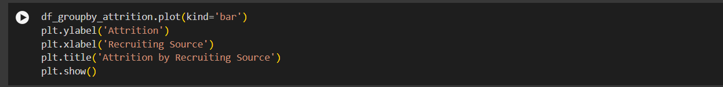
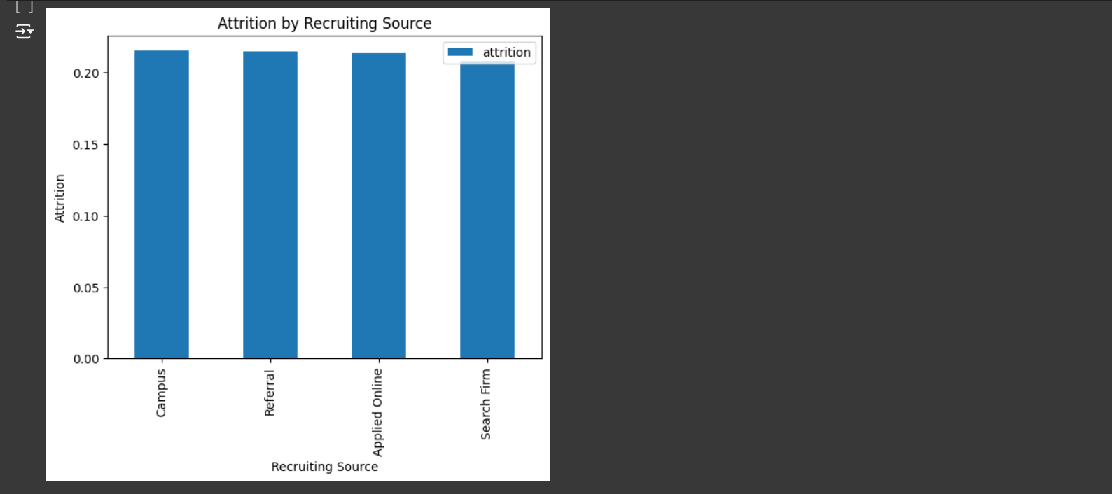
Plot a chart using matplotlib in Python that illustrates Attrition numbers by the Recruiting Source.

Slide 13
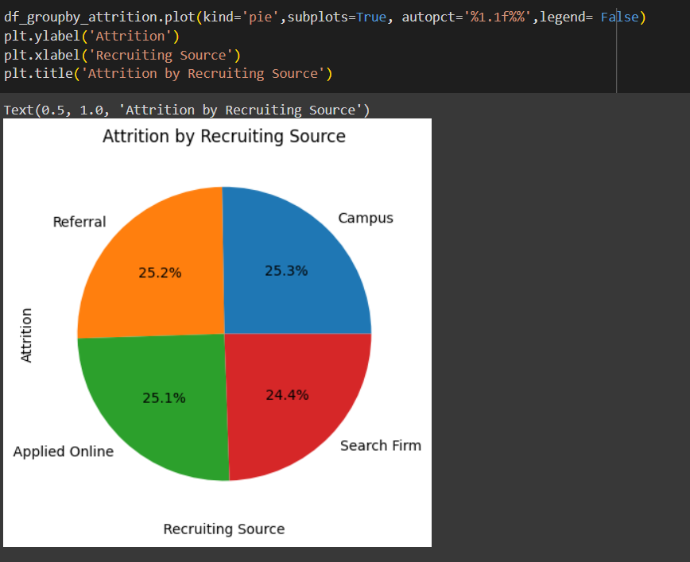
Here we can see that Search Firm has lowest Attrition.

Slide 14
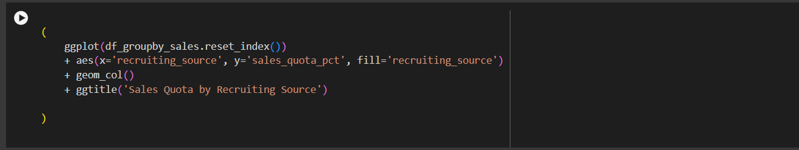
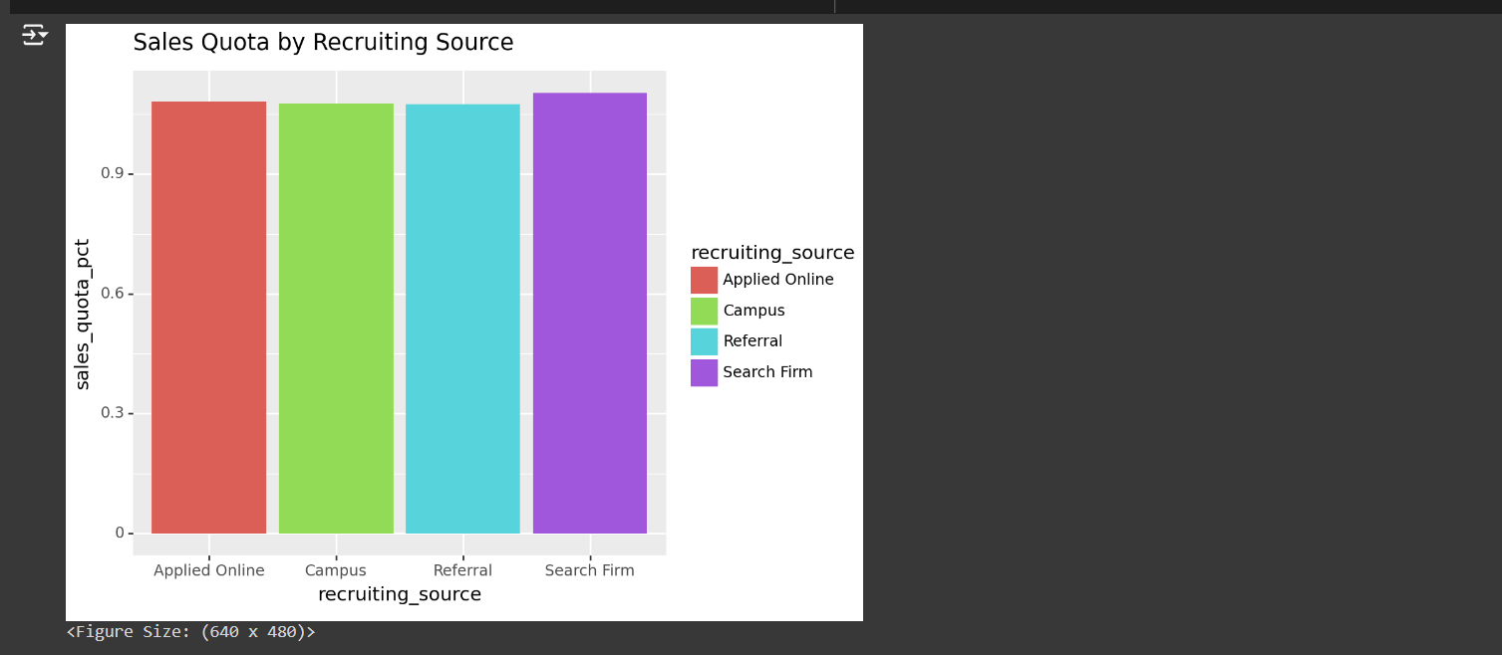
Visualize Sales differences by Recruiting Source
Plot a chart using ggplot in Python that illustrates Sales numbers by the Recruiting Source

Slide 15
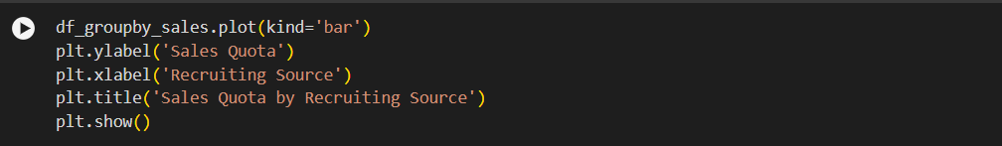
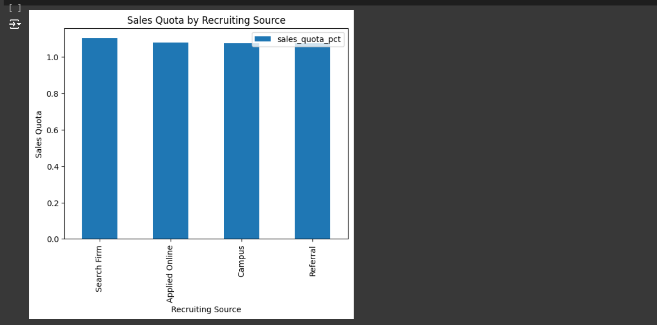
Plot a chart using matplotlib in Python that illustrates Sales numbers by the Recruiting Source

Slide 16
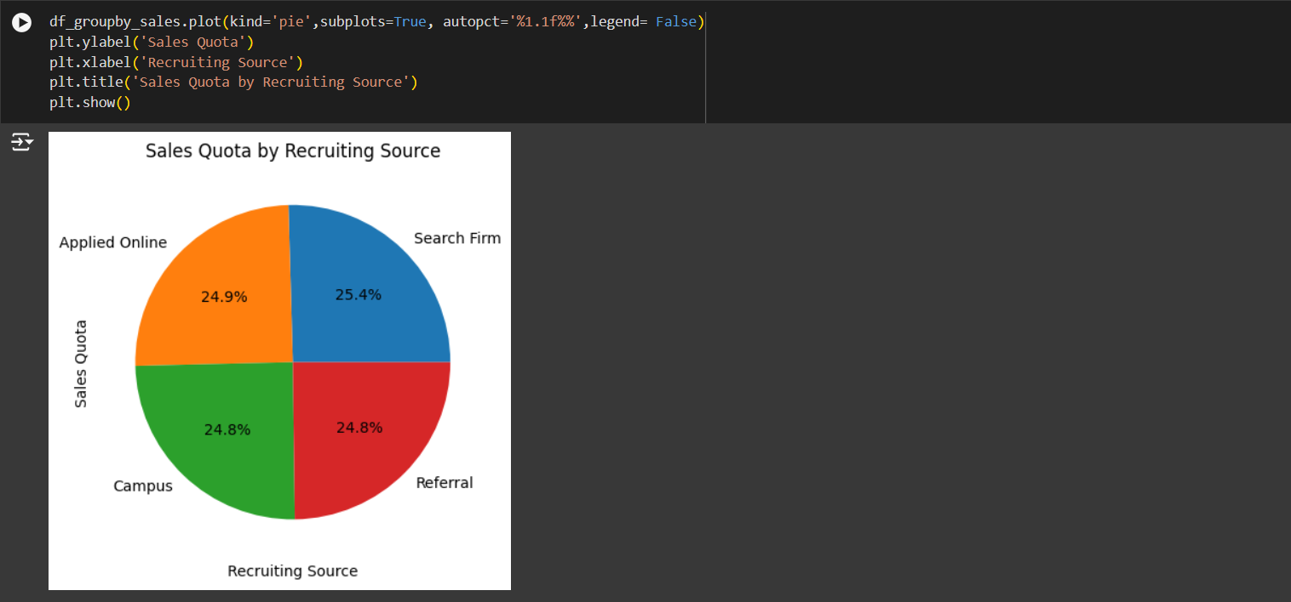
Here we can see that Search Firm has highest sales quota(sales numbers).

Slide 17
Conclusion
In this project, we are looking for sources that have high Sales numbers and low Attrition numbers and after the above visualizations we can conclude ‘Searchfirm’ is the recruiting source that have high sales numbers and low attrition.
So we can conclude that Searchfirm is best source of recruitment based of previous data of candidate.

Slide 18
Thank you

