Slide 1

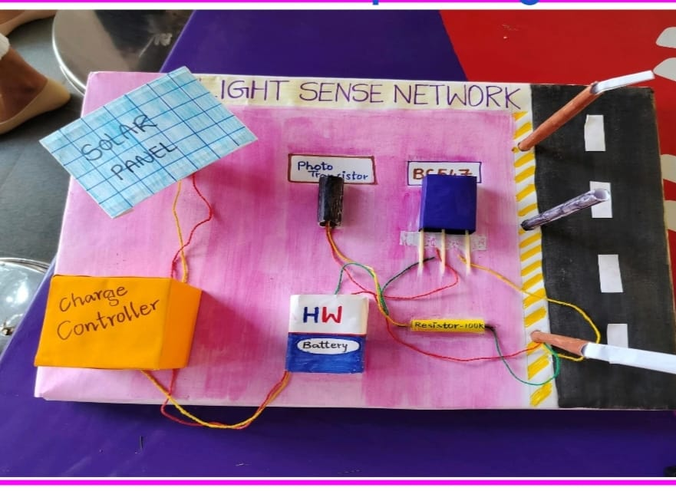

CMR College of Engineering & Technology
(UGC Autonomous)
Kandlakoya , Medchal Road, Hyderabad 501401
Centre for Engineering Education Research (CEER) INTRODUCTION TO SOCIAL INNOVATION-A.Y 2024-25
LIGHT SENSE NETWORK
Need Statement
Urban areas worldwide are plagued by inefficient street lighting systems, leading to several critical issues.
Proposed Soluation
Solution for the problem is to make automatic street light using photo transistor by replacing LDR sensor, that can done automated operation of the light.We should use solar panel to recharge battery when its energy is Completed.
Concept Design
2. Root Cause of the Problem
People tend to leave the appliances on for a very long time without switching it Off. Due to carelessness of user large amount of power is consumed and thus energy is wasted.
3. Existing Solutions
Street lights which produce light by using electricity There is already an existing solution for light sense network using LDR sensor Also using solar for automated operation
4. Gaps in the Existing Solutions
LDR’s can be sensitive to ambient light, leading to false triggers during daytime It also causes unnecessary energy consumption
7. Pictures with Stakeholders
Team Details
Kashish Singh 24H51A66E4 CSM-D
Project Coordinators
K.RAJU, Asst.Professor,(CEER/ECE) NAUSHADALAM, Asst.Professor,(CEER/CSC) G.BHANUPRPIYA, Asst.Professor,(CEER/CSE)

