Slide 1

Introduction to Artificial Intelligence
• Artificial Intelligence represents one of the most transformative technologies of the 21st century.
• AI systems can process vast amounts of data, recognize patterns, and make decisions that previously...

Slide 2

Supervised Learning Fundamentals
• It involves training algorithms on labeled datasets, where the correct answers are provided.
• The algorithm learns to map inputs to outputs through numerous examples.

Slide 3
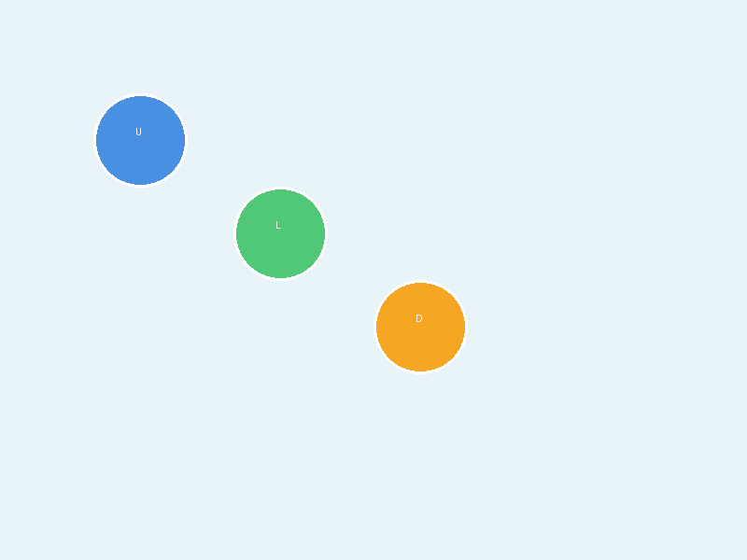
Unsupervised Learning Techniques
• Unsupervised learning works with unlabeled data, discovering hidden patterns without guidance.
• Clustering algorithms like K-means and hierarchical clustering group similar data points together.

