Slide 1

C++ OBJECT-ORIENTED MINI PROJECT
HOTEL
HAVEN
Hotel Room Reservation System
Presented by: Swayam Krupesh Nakhwa
Roll No.: BT24ECE080
Course: Introduction to Object Oriented Programming
Semester: 5th Semester
Guided by: Aparna Wamanrao Bondade Ma'am
Indian Institute of Information Technology Nagpur
Project Presentation | 2026

Slide 2
Project overview
A locally hosted hotel booking demonstration.
C++ backend with an object-oriented reservation domain.
Responsive browser UI built with HTML, CSS, and JavaScript.
Six sample rooms across Standard, Deluxe, and Suite categories.
CSV persistence keeps reservations between local runs.
CORE WORKFLOW
Browse rooms
Check availability
Reserve a room
Manage booking
HOTEL HAVEN | C++ OOP MINI PROJECT
2

Slide 3
Problem, objectives & scope
PROBLEM
OBJECTIVES & BOUNDARIES
Room booking combines dates, capacity, price, and room availability.
Invalid or overlapping stays must be rejected.
Business rules should be testable apart from the web page.
Demonstrate OOP using a complete application workflow.
Validate bookings and persist records to CSV.
Educational local app; no payments, secure accounts, or production hosting.
HOTEL HAVEN | C++ OOP MINI PROJECT
3

Slide 4
System architecture
Browser UI
HTTP Server
BookingService
Domain Model
CSV Repository
HTML / CSS / JS
Static + JSON API
Business rules
Room + Booking
Local persistence
Request flow: browser submits a request -> C++ server routes it -> service validates and coordinates domain objects -> repository loads or saves CSV data -> JSON response returns to the browser.
Presentation | transport | application | domain | persistence
HOTEL HAVEN | C++ OOP MINI PROJECT
4

Slide 5
Object-oriented design
Encapsulation
Private state in Room and Booking; intentional operations/accessors.
Abstraction
Room category contract and BookingRepository interface.
Inheritance
StandardRoom, DeluxeRoom, and SuiteRoom specialize Room.
Polymorphism
Room catalog stores base-class pointers; virtual category dispatch.
Composition
BookingService coordinates rooms, bookings, and repository.
HOTEL HAVEN | C++ OOP MINI PROJECT
5

Slide 6
Booking workflow & rules
1
Choose dates
2
Check room availability
3
Enter guest details
4
Validate request
5
Calculate total
6
Save reference
Reject invalid date ranges, malformed email, unknown rooms, over-capacity parties, and overlapping active stays.
Checkout on a date allows the next guest to check in that same date; cancelled stays release the room.
HOTEL HAVEN | C++ OOP MINI PROJECT
6

Slide 7
Persistence & verification
CSV DATA LIFECYCLE
TEST COVERAGE
Repository interface separates storage from business logic.
CSV repository loads and saves booking records.
Runtime data stays local and is excluded from Git.
Do not use real guest data in this demo.
Leap dates, invalid calendar dates, and night totals.
References, prices, email normalization, and persistence.
Date overlap and adjacent check-in/check-out.
Capacity checks, cancellation authorization, and CSV round trip.
HOTEL HAVEN | C++ OOP MINI PROJECT
7

Slide 8
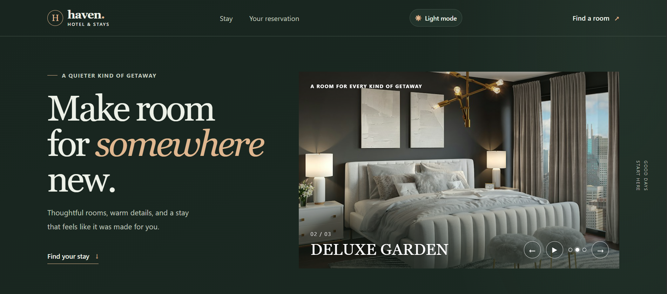
The interface: desktop
Room slideshow highlights Classic King, Deluxe Garden, and The Corner Suite.
HOTEL HAVEN | C++ OOP MINI PROJECT
8

Slide 9
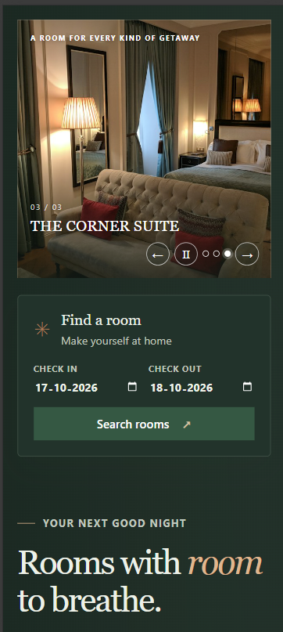
The interface: mobile
Responsive layouts
Designed for narrow screens as well as desktop.
Accessibility basics
Labels, alt text, focus visibility, skip link, and reduced-motion support.
HOTEL HAVEN | C++ OOP MINI PROJECT
9

Slide 10
Run locally
01
Install Git and MinGW g++; ensure g++ is on PATH.
02
Clone: git clone https://github.com/Swayam-nakhwa/hotel-haven-app.git
03
Run .\run.bat in PowerShell or the VS Code terminal.
04
Open http://127.0.0.1:8080; keep the terminal open.
05
Run .\test.bat to execute C++ tests.
Windows-only local demo. Press Ctrl+C in the server terminal to stop it.
HOTEL HAVEN | C++ OOP MINI PROJECT
10

Slide 11
Limitations & next steps
CURRENT LIMITS
POSSIBLE EXTENSIONS
No secure account authentication or payment processing.
Local CSV storage; not designed for concurrent production usage.
Single-threaded HTTP demo and Windows-specific server.
No public deployment or production load/security testing.
Database and safe concurrent booking transactions.
Portable build and production-grade server.
Secure identity, administration, notifications, and payments.
Deployment with appropriate privacy and security review.
HOTEL HAVEN | C++ OOP MINI PROJECT
11

Slide 12
THANK YOU
Hotel Haven brings C++ OOP concepts into a complete booking workflow.
Questions?
HOTEL HAVEN | C++ OOP MINI PROJECT
12

