Slide 1
asep: Early Warning for Sepsis When Vitals Are Missing
Predicting sepsis 6 hours before onset from bedside vital signs
Abhinay Kharb
24MID0185
Swayam Mohanty
24MID0088
Omi Menass
24MID0236
Course: Data Science Programming — Course Project, Final Review
Faculty / Guide:
Notes:
Introduce the team. The project builds an end-to-end sepsis early-warning system around a pre-trained machine-learning model, designed for clinics that cannot measure every vital sign.

Slide 2
Problem Statement
Intended users
Sepsis needs to be caught early, but small clinics cannot measure everything
1
Nurses and health workers
Triage the patient queue
Sepsis is the body's extreme response to infection; it can progress to organ failure and shock within hours.
Early-warning tools usually assume a full ICU monitor. Primary-care clinics (e.g. Indonesian puskesmas) may have only a BP cuff and a thermometer.
Bedside scores such as qSOFA and SIRS use fixed thresholds and simply ignore what was not measured.
An ML model can combine whatever vitals are available into one calibrated risk estimate.
2
Primary-care clinics
Limited equipment, no ICU
3
Referring doctors
Decide when to escalate
Notes:
Why ML: the risk depends on combinations of vitals and must still work when some are missing. Fixed-threshold rules cannot weigh partial information. The users are frontline health workers in low-resource settings; the system is decision support, not a diagnosis.

Slide 3
Objectives
Predict
Estimate the risk of sepsis within the next 6 hours from 7 bedside vitals plus age and length of stay.
1
Handle missing data
Score correctly when any vital is unavailable, sending it as unknown (NaN) and never as 0.
2
Evaluate
Measure AUROC, AUPRC, confusion matrices and risk-tier calibration, and compare against qSOFA, SIRS and NEWS2.
3
Deploy
Serve predictions through a REST API and an interactive triage dashboard with clear Low / Medium / High tiers.
4
Verify
Test edge cases: missing vitals, invalid input, and that worsening vitals never lower the risk.
5
Notes:
Five measurable objectives, each tied to the problem: predict, cope with missing equipment, evaluate against the bedside rules clinicians already use, deploy as a usable tool, and verify its behaviour.

Slide 4
Proposed Solution
Input
Processing
Model
Output
9 values: age, hours since admission, HR, Temp, Resp, SBP, DBP, SpO₂, EtCO₂
Validate ranges, blank → NaN, derive MAP = DBP + (SBP − DBP)/3
LightGBM in ONNX format, run with onnxruntime on CPU
riskScore 0–1, risk tier, next steps, abnormal vitals
System components
generate_test_data.py
Synthetic patient-hour data
evaluate_model.py
Metrics and baseline comparison
app.py (Flask)
/api/predict, /api/metrics, …
Web dashboard
Triage · Validation · Data tabs
Expected outcome: a health worker enters whatever vitals they have and gets a calibrated risk tier in under a second.
Notes:
Walk the pipeline left to right. Key design point: missing values flow through as NaN and the model handles them natively, so there is no imputation step. MAP is derived from SBP and DBP inside the model graph, and also shown in the UI with the same formula.

Slide 5
Dataset & Data Preparation
400
11,917
Preprocessing
Missing values
Kept as NaN (never 0). Last observation carried forward within each patient.
patients
patient-hours
Outliers
Readings outside plausibility bounds discarded before forward fill (e.g. SBP 40–260).
29
9 + 1
septic patients (7.3%)
features + target
Equipment profiles
Full, medium, minimal, pulse-ox only: unavailable sensors are always NaN.
Source: synthetic data we generated, modelled on PhysioNet/CinC 2019 ICU distributions. Real patient records need credentialed access, so the generator creates realistic hourly trajectories.
Target: SepsisLabel = 1 from 6 h before onset (PhysioNet convention).
Dropout
12% of hourly readings removed at random to mimic disconnections.
Feature engineering
MAP derived from SBP and DBP. No scaling or encoding needed for tree models.
Notes:
Be clear that the evaluation data is synthetic and explain why: PhysioNet credentials. Septic patients' vitals drift towards SIRS / Sepsis-3 physiology before onset; 15% of non-septic patients have a mimic episode (e.g. isolated fever). Missingness after preprocessing: EtCO2 71%, SpO2 19%, BP and Resp 12%.

Slide 6
Methodology
Evaluation process
Prediction model
Gradient-boosted decision trees (LightGBM), exported to ONNX.
Pre-trained by team MyLove (Datathon 2026) on PhysioNet/CinC 2019; we integrate, evaluate and deploy it.
Why trees: they handle NaN natively, capture non-linear thresholds (e.g. fever, low BP) and need no scaling.
Why ONNX: 385 KB, CPU only, no GPU or internet, predictable output.
1
Generate
400 synthetic patients, fixed seed
2
Score
every patient-hour with the model
3
Compare
against qSOFA, SIRS, NEWS2 on the same columns
4
Measure
AUROC, AUPRC (class imbalance), confusion matrix, tier calibration, alarm lead time
Notes:
No training happens in our pipeline, so there is no train/test split on our side. The model card reports a by-patient split on PhysioNet. AUPRC is the primary metric because only about 3% of patient-hours are positive, and AUROC alone looks optimistic under heavy imbalance.

Slide 7
Model Implementation
Model | LightGBM, 352 trees, ONNX opset 15 (ai.onnx.ml 1)
Input | input: float32 [N, 9], NaN = not measured
Output | riskScore: float32 [N], calibrated 0–1
Thresholds | Low < 0.3 ≤ Medium < 0.6 ≤ High
Horizon | Sepsis onset within 6 hours
Core inference (app.py)
session = ort.InferenceSession(
"sepsis-model.onnx")
# blank or missing field -> NaN
row = [nan if v is None else float(v)
for v in payload_values]
risk = session.run(["riskScore"],
{"input": np.array([row],
dtype=np.float32)})[0][0]
tier = ("High" if risk >= 0.6 else
"Medium" if risk >= 0.3 else "Low")
Tools and libraries
Python 3.12
onnxruntime
NumPy
pandas
scikit-learn
Flask
Tailwind CSS
Chart.js
Notes:
The model is loaded once at server start. Input validation rejects non-numbers and physiologically impossible values (for example SBP 0 from a broken cuff) and requires at least two vitals. The real code in app.py also checks plausibility ranges; the snippet is simplified.

Slide 8
Results & Evaluation: Model Comparison
0.874
AUROC
0.278
AUPRC (9.2× base rate)
53%
sensitivity at ≥ 0.6
94%
Best on this data: partial NEWS2. We keep the ONNX model in the app because it works with any subset of vitals and gives a calibrated, tiered score. The rules score well here because our generator shifts vitals across exactly their thresholds (see Challenges).
specificity at ≥ 0.6
Notes:
All numbers are our own, from evaluate_model.py on the synthetic data. Be upfront that NEWS2 wins here. Model selection justification: on real ICU data the rules are much weaker (they use fixed thresholds), while the model degrades gracefully when vitals are missing. Validating on real PhysioNet data is our main future step.

Slide 9
Results & Evaluation: Risk Tiers & Errors
Confusion matrix at the High cutoff (0.6)
 | Predicted + | Predicted −
Actual + | TP 191 | FN 168
Actual − | FP 700 | TN 10,858
21%
98.5%
0.31
PPV
NPV
F1
17 of 29 septic patients reached High before onset; median lead time 7 h.
103 of 371 non-septic patients reached High at least once, so alerts need clinician review.
High tier is 22× riskier than Low; the tiers rank patients correctly.
Notes:
The tiers are well ordered: 0.95% observed sepsis in Low, 5.6% in Medium, 21.4% in High. At the High cutoff, specificity is 94% and NPV 98.5%, so a Low result is reassuring, while PPV of 21% means High is a prompt to review, not a diagnosis.

Slide 10
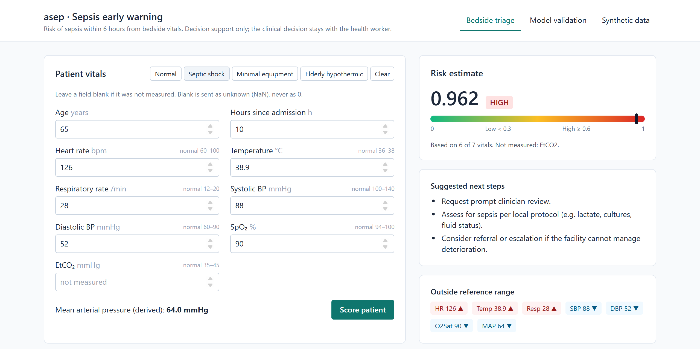
Application / Output
Example inputs → outputs
Healthy adult
HR 78, Temp 36.8, RR 15, BP 122/78
0.181
Low
Septic shock
HR 126, Temp 38.9, RR 28, BP 88/52
0.962
High
BP cuff + thermometer
HR 108, Temp 38.6, RR 24, BP 104/66
0.961
High
Bedside triage tab: septic-shock example scored 0.962 (High), with EtCO₂ not measured.
Elderly, hypothermic
HR 112, Temp 35.4, RR 26, BP 92/54
0.747
Other tabs: ROC / PR curves and a data explorer that loads any row into the form.
Use: a health worker enters available vitals; the tier sets how often to re-check and when to escalate.
High
Notes:
Live demo here if possible: run python app.py and open localhost:5000. Show a preset, then clear a field to show missing values are handled. Example 3 shows the minimal-equipment case: no SpO2 or EtCO2, still scored High.

Slide 11
Challenges & Solutions
Challenge
How we addressed it
No access to real patient records
Built a physiologically grounded synthetic generator with sepsis trajectories, mimics and equipment profiles.
Missing sensors at small clinics
Pass unknowns as NaN, never 0; the tree model routes missing values down learned branches.
Faulty readings (e.g. cuff reads 0 mmHg)
Plausibility bounds reject impossible values before forward fill and in the API.
Severe class imbalance (3% positive)
Report AUPRC and lift over base rate, not accuracy; check tier calibration.
Synthetic data favours threshold rules
Reported honestly; flagged in the dashboard; real-data validation planned.
Notes:
The last challenge is the important one to explain well: because the generator moves septic vitals across the very thresholds SIRS and NEWS2 use, those rules get an unrealistic advantage on synthetic data. We did not tune the generator to make our model win.

Slide 12
Conclusion & Future Scope
Objectives achieved
Future scope
✓
Working end-to-end system: data → model → API → dashboard
Validate on real PhysioNet 2019 records to replace synthetic results.
Train and compare our own models (logistic regression, random forest, LightGBM).
Use trends over several hours, not just the latest reading.
Explain each prediction (SHAP) on the dashboard.
Offline mobile app for clinics with poor connectivity.
✓
Scores with any subset of vitals; missing values handled correctly
✓
Clear tier separation: 0.95% → 5.6% → 21.4% observed sepsis
✓
Verified: published example reproduced (0.9618); worse vitals raise risk (0.02 → 0.98)
✓
Fast: about 97,000 patient-hours scored per second on a laptop CPU
Notes:
Key finding: the system works end to end and its risk tiers are well ordered, but the synthetic comparison shows simple rules can match it when vitals are clean, so real-data validation is the priority.

Slide 13
References
1
Dataset
Reyna MA, Josef CS, Jeter R, et al. Early Prediction of Sepsis From Clinical Data: The PhysioNet/Computing in Cardiology Challenge 2019. Critical Care Medicine 2020;48(2):210–217. physionet.org/content/challenge-2019/1.0.0
2
Model
asep-sepsis-onnx, team MyLove, Datathon 2026: pre-trained LightGBM model and model card (README).
3
Clinical scores
Singer M, et al. The Third International Consensus Definitions for Sepsis and Septic Shock (Sepsis-3). JAMA 2016;315(8):801–810. Royal College of Physicians. National Early Warning Score (NEWS) 2, 2017.
4
Libraries
ONNX Runtime (onnxruntime.ai) · LightGBM · scikit-learn · pandas · NumPy · Flask · Chart.js · Tailwind CSS documentation.
Notes:
Credit the model clearly: the ONNX model was trained by team MyLove; our work is the data generation, evaluation, API, dashboard and testing.

