Slide 1
Strategic Blueprint for Margin Recovery
Margin erosion of 12% in the core tier due to aggressive competitor pricing and customer churn.

Slide 2
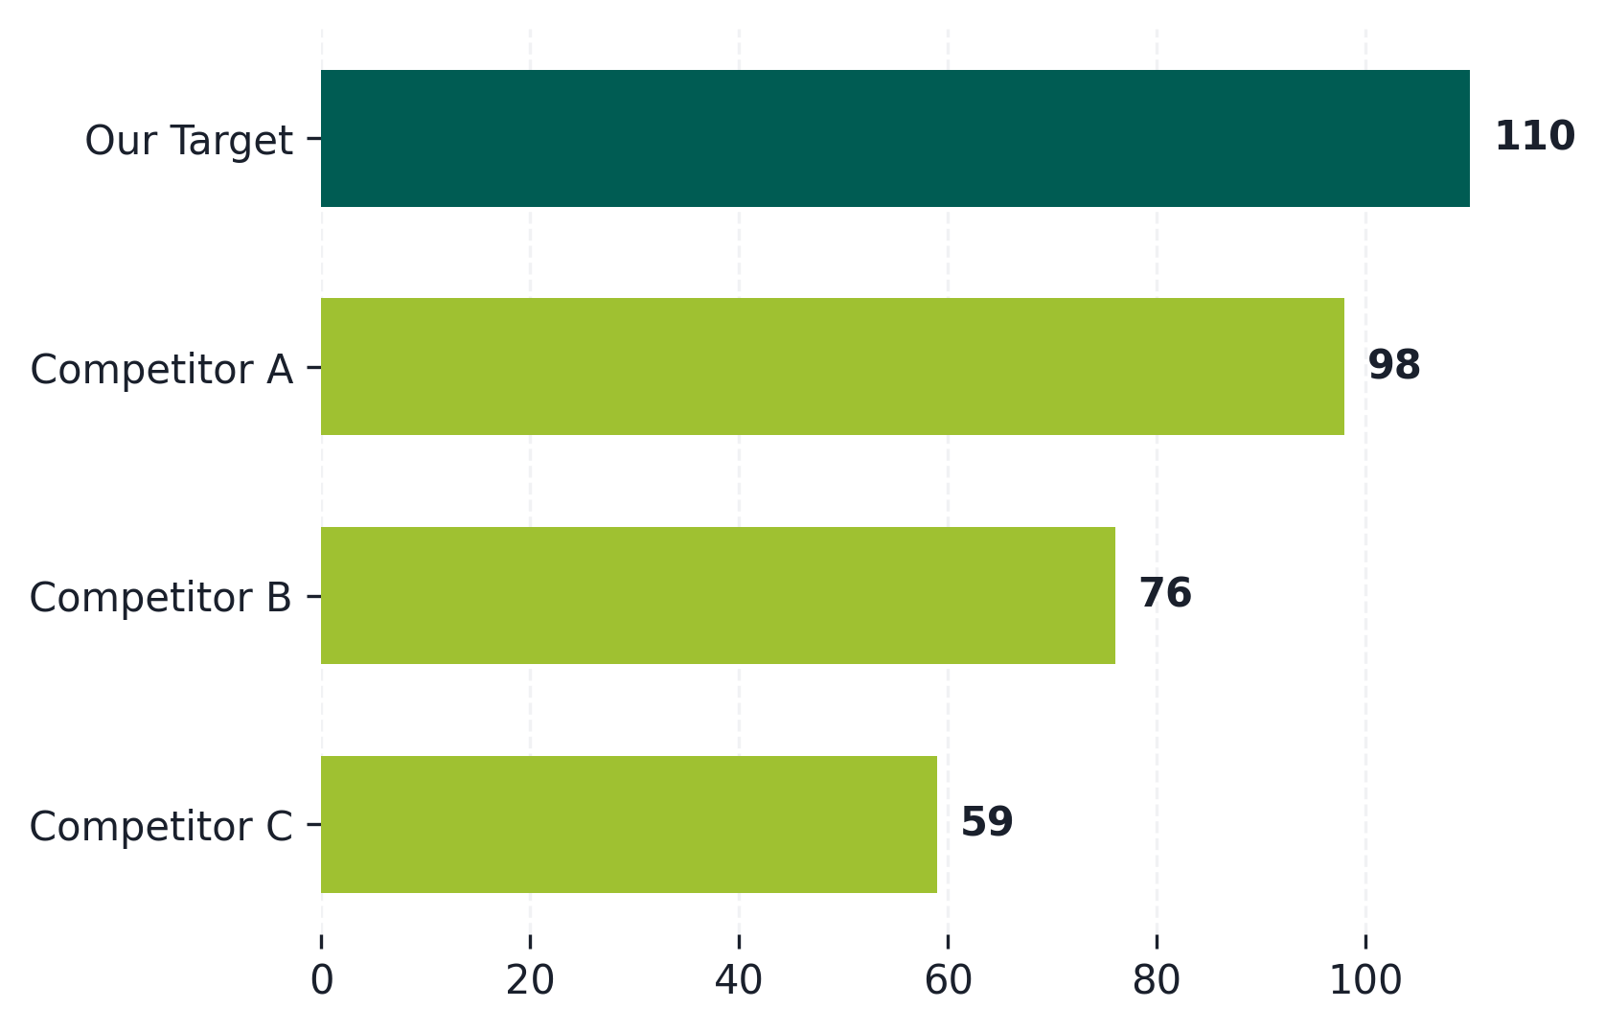
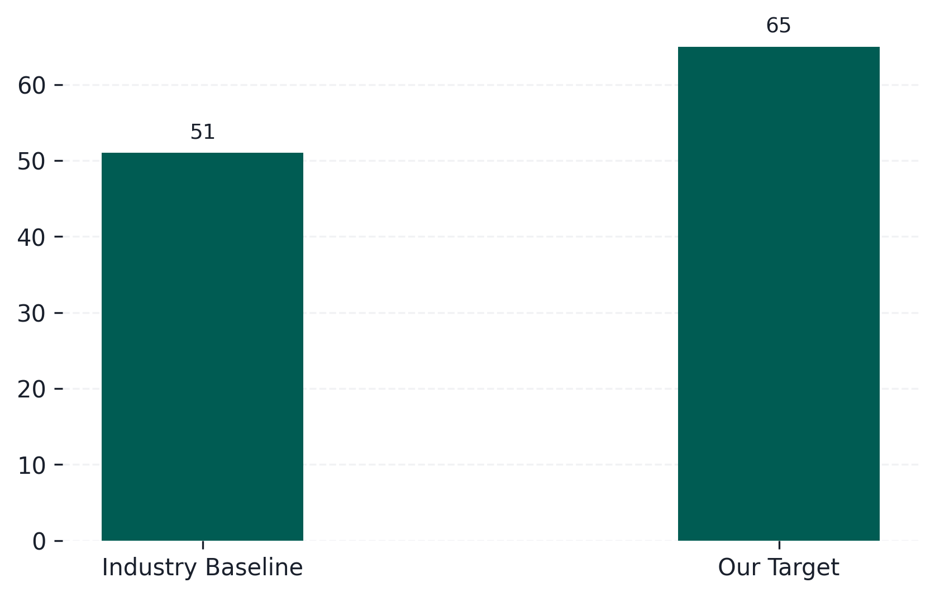
Strategic Blueprint for Margin Recovery
Growth Trend Analysis (chart1)
Growth Trend Analysis (chart2)
Target Scenario projects a steady recovery over baseline.
Target Scenario projects a steady recovery over baseline.

Slide 3
Strategic Blueprint for Margin Recovery
Strategic Initiative for Left Title
Strategic Initiative for Right Title
01 Key Milestone Playbook step1
Detailing action plan milestones and critical project execution steps.
01 Key Milestone Playbook step5
Detailing action plan milestones and critical project execution steps.
01 Key Milestone Playbook step2
Detailing action plan milestones and critical project execution steps.
01 Key Milestone Playbook step6
Detailing action plan milestones and critical project execution steps.
01 Key Milestone Playbook step3
Detailing action plan milestones and critical project execution steps.
01 Key Milestone Playbook step7
Detailing action plan milestones and critical project execution steps.
01 Key Milestone Playbook step4
Detailing action plan milestones and critical project execution steps.
01 Key Milestone Playbook step8
Detailing action plan milestones and critical project execution steps.
↑ 49% — Conversion rate indicator
↑ 46% — Conversion rate indicator

Slide 4
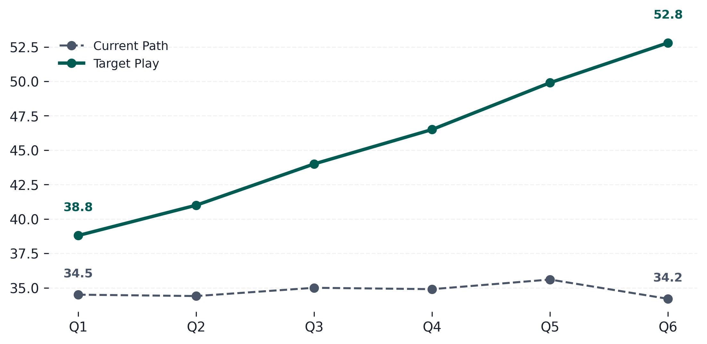
Strategic Blueprint for Margin Recovery
Growth Trend Analysis (chart_panel)
Focusing on customer churn reduction.
Optimizing pricing tier models.
Upgrading partner sales networks.
Automating client onboarding workflows.
Target Scenario projects a steady recovery over baseline.

Slide 5
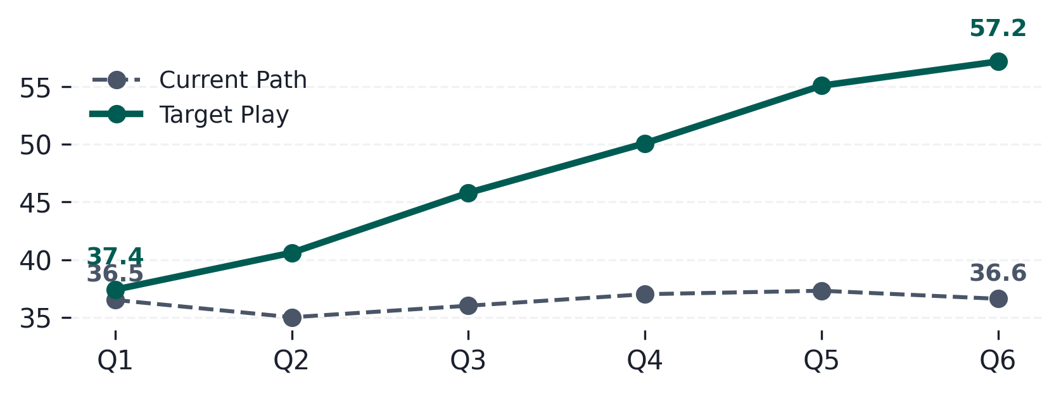
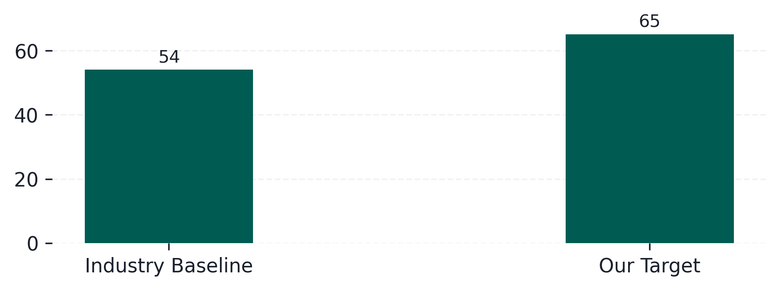
Strategic Blueprint for Margin Recovery
↑ 20%
Growth in premium segments
↑ 13%
Growth in premium segments
↑ 10%
Growth in premium segments
↑ 26%
Growth in premium segments
Growth Trend Analysis (chart_panel1)
Growth Trend Analysis (chart_panel2)
Target Scenario projects a steady recovery over baseline.
Target Scenario projects a steady recovery over baseline.

Slide 6
Strategic Blueprint for Margin Recovery
Strategic Resource Allocations
01 Key Milestone Playbook card1
Detailing action plan milestones and critical project execution steps.
Key Workstream | Budget Allocation | Target Outcome
Customer Retention Engine | $150K | +15% margin
Premium Tier Feature Expansion | $200K | +10% volume
Channel Partner Referral Program | $350K | +25% conversion
Sales Team Direct Enablement | $100K | +5% scale
01 Key Milestone Playbook card2
Detailing action plan milestones and critical project execution steps.
01 Key Milestone Playbook card3
Detailing action plan milestones and critical project execution steps.
01 Key Milestone Playbook card4
Detailing action plan milestones and critical project execution steps.
Marketing and retention account for 68% of initial resource allocation.

