Slide 1
Reversing Margin Erosion: A Strategic Blueprint for Sustainable Profitability
Current margin performance is under pressure due to a combination of rising input costs, competitive pricing pressures, and inefficiencies in the value chain. We must implement structural changes across
product mix, operational efficiency, and market positioning to restore healthy margins.

Slide 2
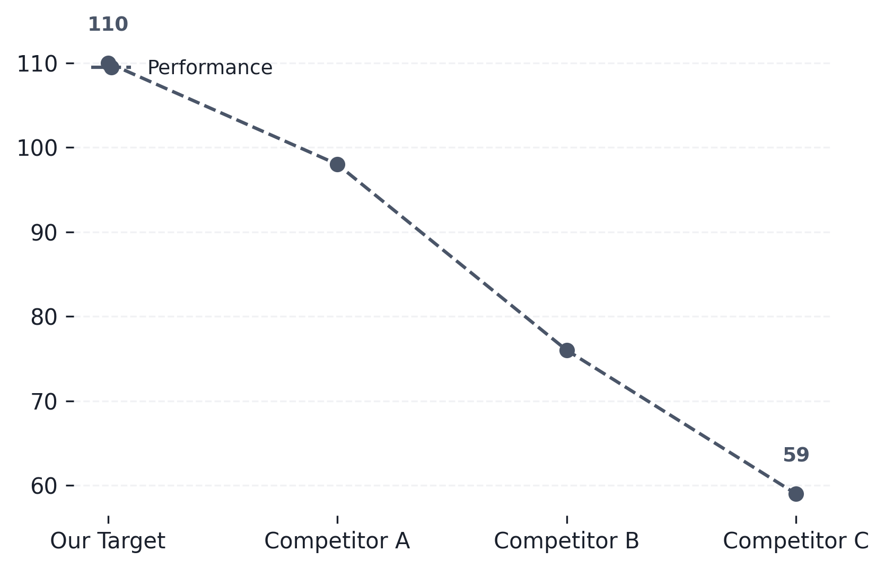
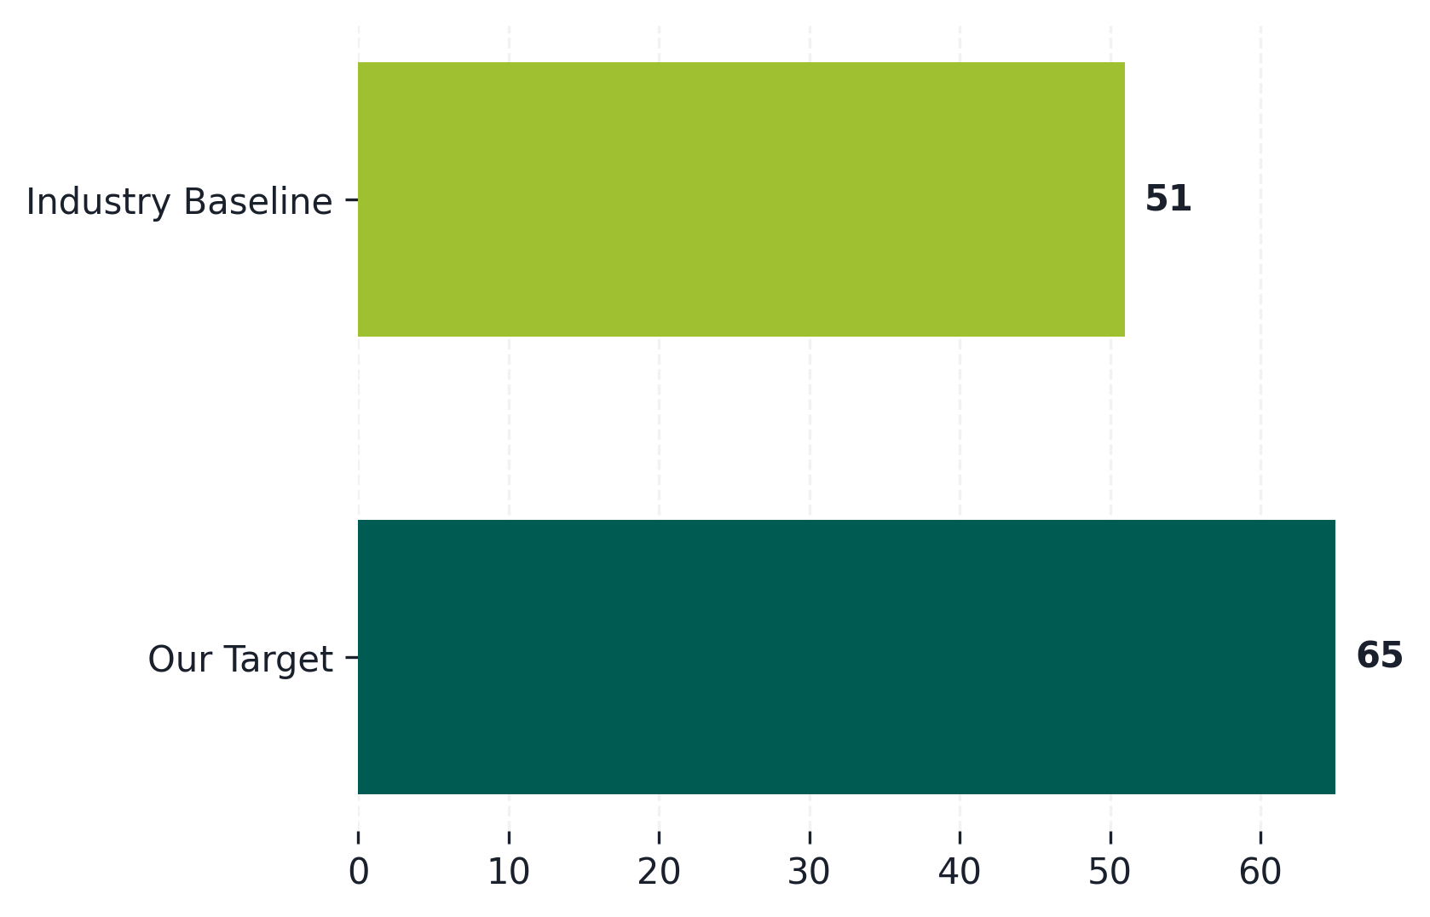
Premium Volume Growth: Benchmarking Against Key Competitors
Our Premium Volume Trend (Last 3 Years)
Competitive Volume Comparison (Market Share %)
Show consistent year-over-year growth in premium segment volume compared to industry average.
Identify market share gaps and opportunities where premium volume growth can accelerate.

Slide 3
Strategic Initiatives: Scaling Premium Operations through Expansion and Loyalty
Expansion Playbooks (Growth Focus)
Customer Loyalty Workstreams (Retention Focus)
Develop new market entry playbooks
Identify high-potential adjacent markets for premium service rollout.
Enhance personalized CX journey
Implement tailored engagement strategies based on customer lifecycle stage.
Optimize distribution channels
Streamline partnerships and physical touchpoints to enhance availability.
Launch tiered loyalty programs
Incentivize repeat purchases and increase lifetime value (LTV).
Product line diversification
Introduce premium tiers or complementary products to increase basket size.
Build community advocacy
Create exclusive member experiences to foster brand attachment.
Build scalable infrastructure
Invest in technology and operational capacity for rapid scaling.
Proactive service recovery
Establish dedicated support channels for high-value customers.
↑ 44% — New Market Penetration
↑ 46% — Customer Retention Rate

Slide 4
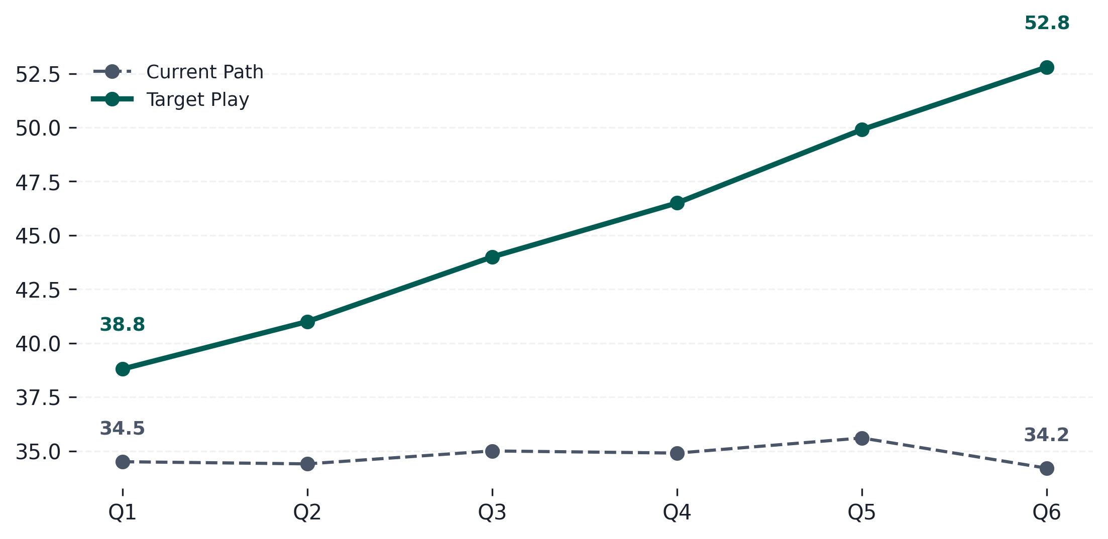
Projected Market Share Recovery Trajectory (Next 6 Quarters)
Market Share Growth Projection
• Focus on high-growth segments identified in the Q3 analysis.
• Accelerate product adoption through targeted digital campaigns.
• Optimize distribution channels to capture underserved regional
markets.
• Strengthen key partnerships for increased market penetration.
Consistent execution of strategic initiatives is expected to drive market share recovery and...

Slide 5
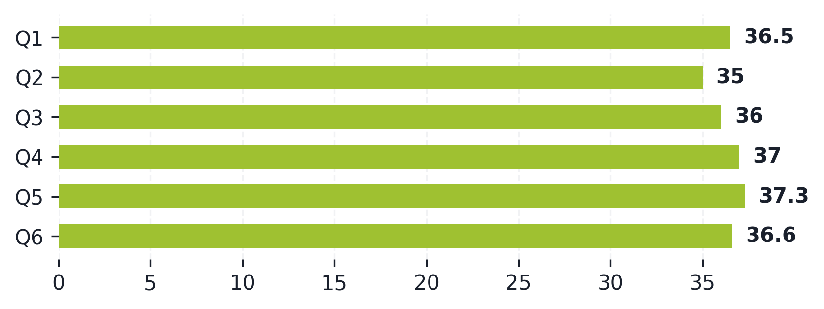
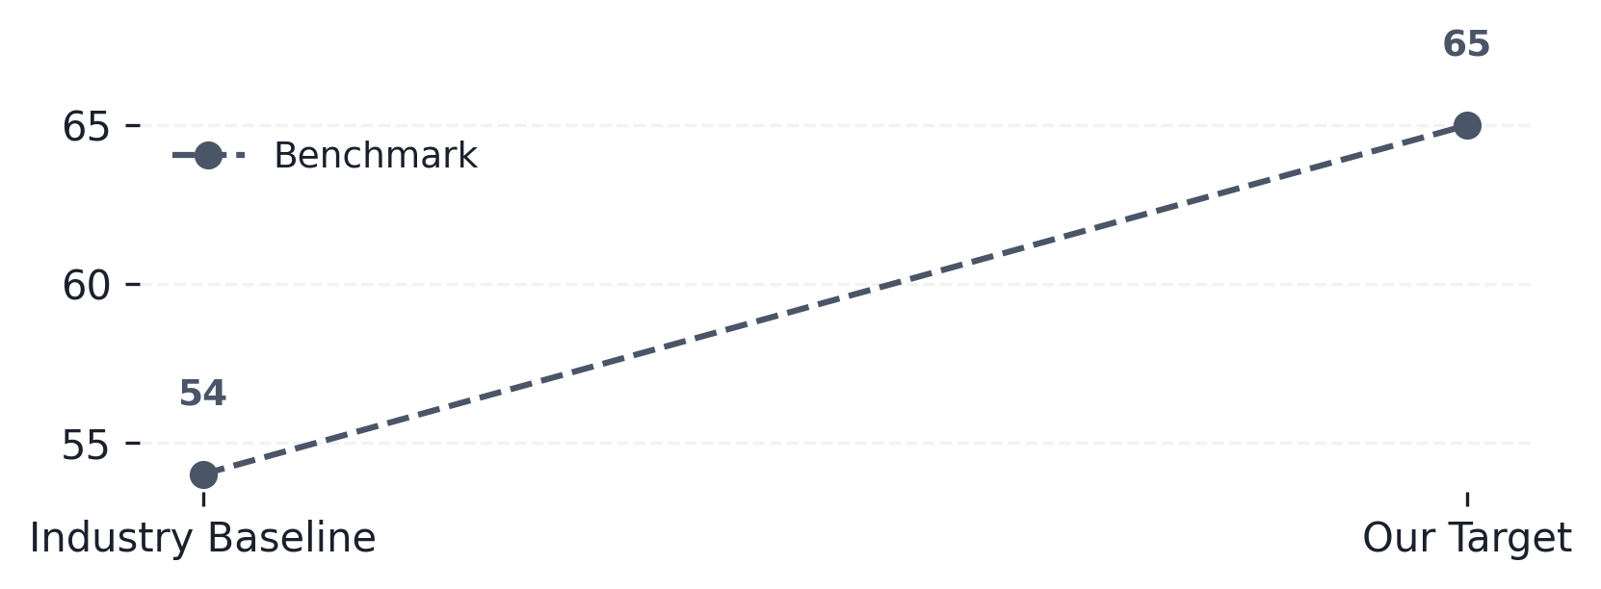
Projected Financial Gains & Key Performance Indicators
↑ 20%
↑ 13%
↑ 10%
↑ 26%
Revenue Uplift Projection by Quarter
Conversion Rate Improvement vs. Benchmark
Anticipate significant revenue acceleration driven by market share recovery and optimized sales...
Achieving targeted conversion uplifts will maximize ROI and validate the proposed operational...

Slide 6
Resource Allocation & Next Steps: Phased Implementation Plan
Key Action Areas and Required Resources
Immediate Priority: Tech Stack Audit
Conduct a comprehensive audit of current systems to identify integration gaps and necessary upgrades for scalability.
Key Workstream | Budget Allocation | Target Outcome
Phase 1: Foundation Build-out (Q3) | $150K | +15% margin
Phase 2: Optimization & Scale (Q4) | $200K | +10% volume
Phase 3: Full Rollout & Governance (H1 Next Year) | $350K | +25% conversion
Resource Allocation Focus: Talent Gap
Prioritize hiring or upskilling specialized roles (e.g., Data Scientists, Process Engineers) needed for execution.
Risk Mitigation: Stakeholder Buy-in
Establish a cross-functional steering committee to ensure alignment and secure buy-in from all impacted departments.
Next Milestone: Pilot Go/No-Go Decision
Set a firm date for the Q3 pilot review, defining clear success metrics and decision criteria.

