Slide 1
Strategic Blueprint for Margin Recovery
Sustained margin erosion due to rising input costs, increased competitive pricing pressure, and suboptimal product mix requires immediate strategic intervention. We must stabilize profitability while
positioning for sustainable growth.

Slide 2
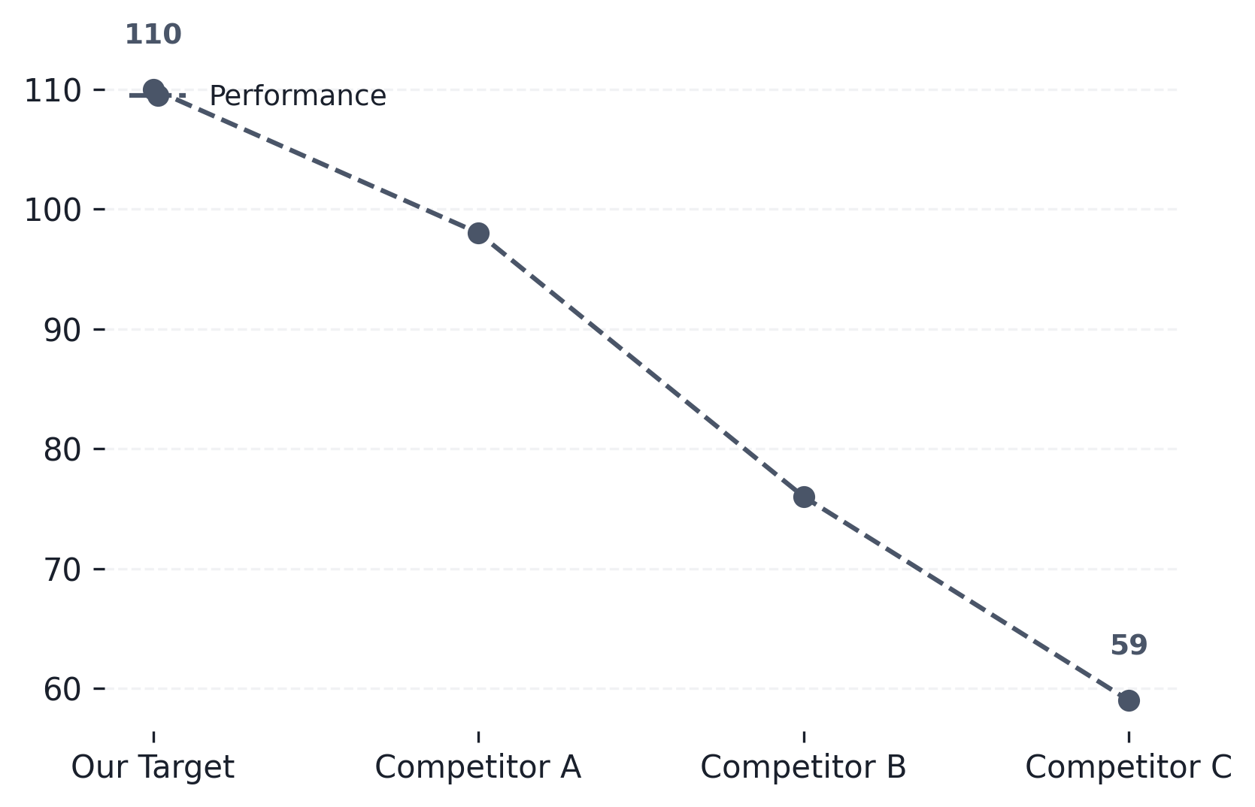
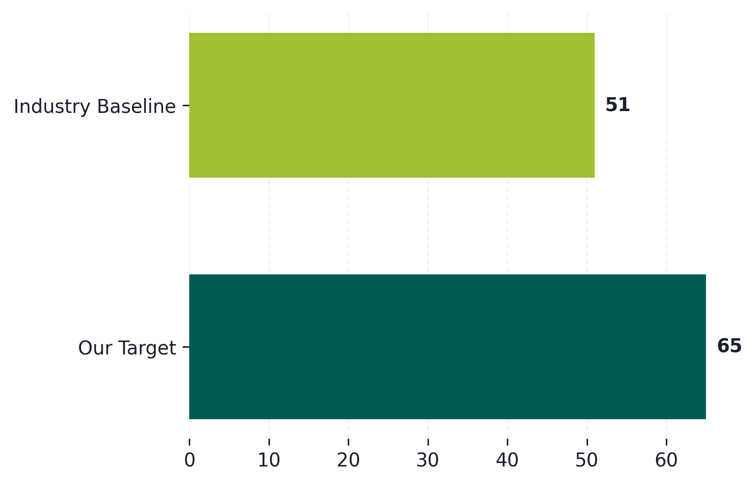
Premium Volume Growth: Benchmarking Against Key Competitors
Historical Premium Volume Trend (Our Company vs. Competitors)
Market Share Contribution by Premium Segment (YoY)
Our premium volume growth has shown steady acceleration, outpacing the average trend of key...
Competitor C shows strong penetration in the high-end segment, indicating a potential area for...

Slide 3
Strategic Initiatives for Scaling Premium Operations and Loyalty Growth
Expansion Playbooks: Market Reach
Customer Loyalty: Retention & Value
Develop tiered market entry playbooks
Tailor expansion strategies for diverse geographic and segment needs.
Implement advanced loyalty tiers
Reward high-value customers with exclusive benefits and early access.
Optimize distribution channels
Integrate new retail partners and digital sales touchpoints.
Personalize customer journey mapping
Use data analytics to predict needs and preemptively engage users.
Localize product offerings
Adapt core products to meet regional tastes and cultural nuances.
Build community advocacy programs
Incentivize referrals and create brand evangelists through engagement.
Establish strategic partnerships
Leverage third-party networks for accelerated market penetration.
Enhance post-purchase support
Provide premium, proactive service to maximize lifetime value (LTV).
↑ 44% — New Market Coverage
↑ 46% — Customer Retention Rate

Slide 4
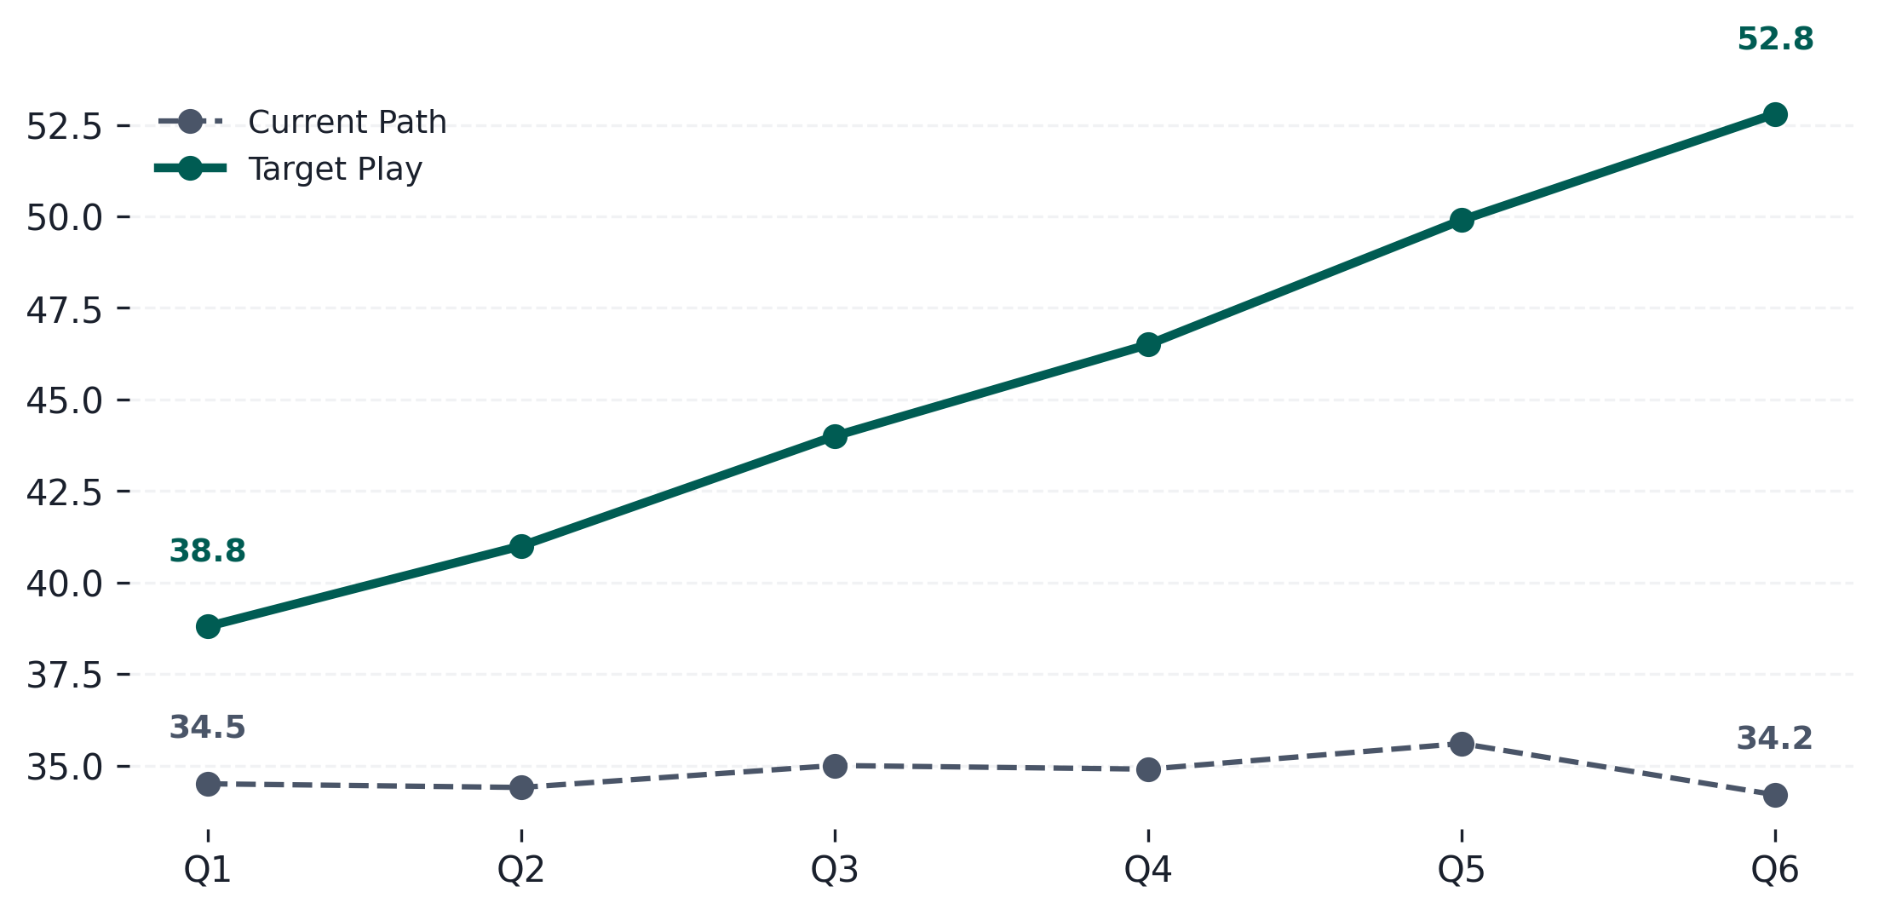
Projecting Market Share Recovery Over the Next Six Quarters
Market Share Trajectory (Q1 2024 - Q6 2025)
• Focus on high-margin premium product lines to accelerate
revenue capture.
• Expand distribution channels into underserved regional markets.
• Enhance digital presence through targeted marketing campaigns
to boost brand visibility.
• Optimize operational efficiency to maintain competitive pricing
while improving margins.
Consistent execution of strategic initiatives is projected to drive market share recovery and...

Slide 5
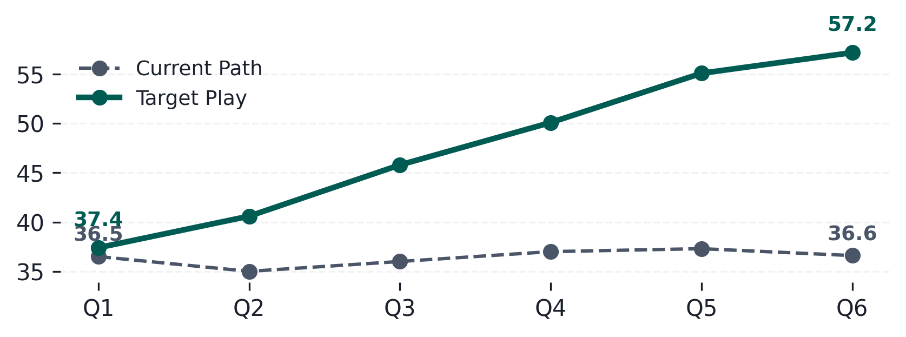
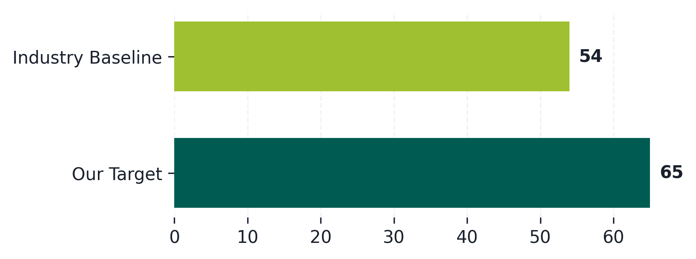
Projected Financial Gains & Key Performance Indicators
↑ 20%
↑ 13%
↑ 10%
↑ 26%
Revenue Uplift Projection by Quarter
Conversion Rate Improvement vs. Baseline
Demonstrates accelerated revenue growth driven by market share recovery and optimized sales...
Achieving a 15% lift in conversion rate is critical to meeting projected revenue targets.

Slide 6
Resource Allocation & Next Steps: Prioritizing Implementation Tracks
Phased Resource Commitment
High Priority Immediate Action: Finalize Budget Approval
Secure sign-off on the proposed $XM budget allocation to initiate hiring and vendor contracts immediately.
Key Workstream | Budget Allocation | Target Outcome
Phase 1: Foundation Buildout (Q3) | $150K | +15% margin
Phase 2: Pilot Launch & Iteration (Q4) | $200K | +10% volume
Phase 3: Scale & Optimization (H1 Next Year) | $350K | +25% conversion
Critical Path Resource Mobilization: Staffing Plan
Recruit key roles (Product Manager, Data Scientist) within the next 30 days to support Phase 1 development.
Must-Do Risk Mitigation: Legal & Compliance
Engage external counsel early to ensure full compliance across all target markets before launch.
Target Date Next Milestone: Pilot Program Kickoff
Establish clear success metrics and operational readiness for the Q4 pilot program launch.
A staggered approach minimizes initial risk while ensuring continuous learning and resource...

