Slide 1


| Tech Management, SRI-B
CLAWS
CLASH OF THE
<RV College Of Engineering>_<DeepThinkers>
<From passive transcripts to proactive intelligence.>
Swayam Goyal
Priyanshi Gupta
Yash Purwar
Yash Bhalotia

Slide 2
Idea
Problem Statement
Who Faces It: Cross-Functional Teams
Product Managers who have to chase down updates, and Engineers who lose valuable deep- work time to administrative tasks.
Why It's Critical: Velocity
Undocumented action items directly delay shipping. If it’s not tracked, it doesn't get done.
Theme: Productivity Platform Moving from "talking about work" to "actually executing work.“
The Problem: The Meeting "Black Hole“
Hours of unstructured conversation result in lost decisions, forgotten deadlines, and zero analytics on team alignment.

Slide 3
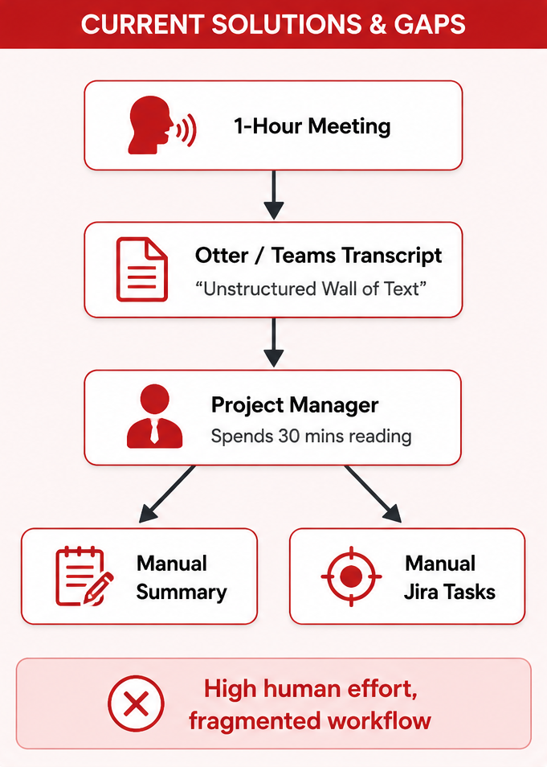
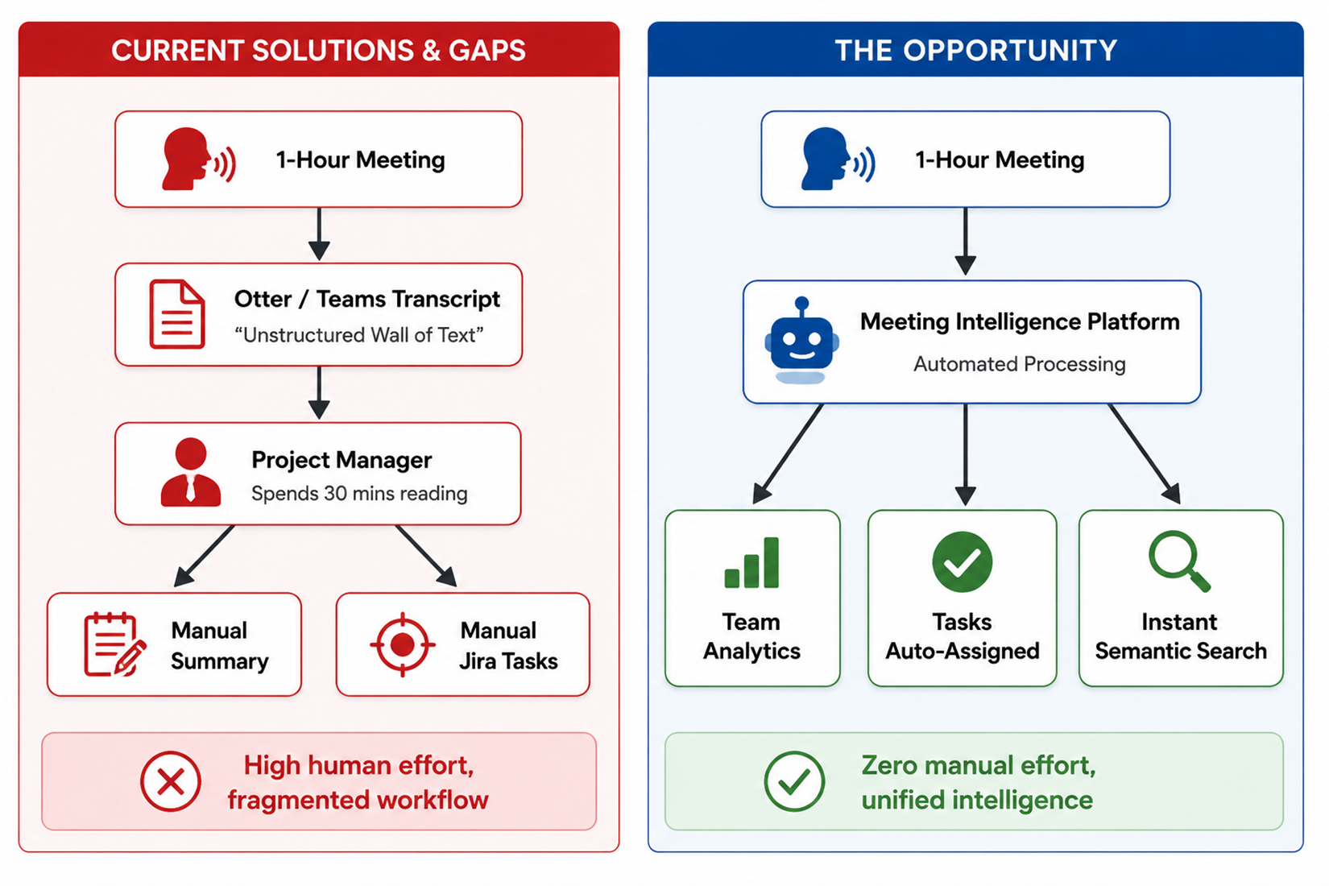
Current Solution & Gaps
Existing Solutions: Built-in Teams/Zoom transcripts and standard note-taking apps.
What’s Missing: They provide Data, not Intelligence.
You get a raw log of what was said, but zero context on what needs to be done, who is accountable, or how productive the team actually is over time.
No centralized way to search past decisions.
The Opportunity: From Passive Recording to Active Analytics.
Building a semantic layer over team conversations to provide instant AI-driven search, automated deadlines, and high-level team productivity metrics.

Slide 4
Our Solution: Meeting Intelligence Platform
What We Built
An end-to-end, AI-powered platform that converts raw meeting conversations into structured, actionable, and searchable data.
The Core Idea (How it works)
Ingest & Understand: We process unstructured meeting transcripts.
Extract & Structure: The AI isolates key decisions, extracts action items, and detects deadlines automatically.
Visualize & Act: This structured data is piped directly into a centralized dashboard for team-wide analytics and task tracking.
Key Features
Automated Summaries & Smart Tasks: Instant extraction of "Who does what, and by when" without manual note-taking.
Productivity Analytics: Interactive dashboards (via Recharts) tracking meeting frequency and team ROI over time.
AI Insights Feed: Smart alerts highlighting project bottlenecks, deadlines, and behavioural trends.
Centralized Semantic Search: Instantly query past meetings to find specific decisions or context.

Slide 5
Idea
Demo/Product Walkthrough
3. Macro-Level Visibility (Analytics Screen)
How User Interacts: A manager navigates to the Analytics tab to review the week's performance.
The Key Moment: Interactive charts visualize the team's true meeting ROI—comparing time spent in meetings vs. actual actionable tasks generated.
1. The Ingestion Flow (Dashboard Screen)
How User Interacts: User uploads meeting audio or drops a transcript link into the dashboard.
The Key Moment: The GenAI instantly processes the unstructured audio in the background, eliminating all manual data entry.
2. The "Aha!" Moment (Meeting Detail Screen)
How User Interacts: The user clicks to open the newly processed meeting.
The Key Moment: Instead of reading a 20-page transcript, the AI presents a 3-bullet summary and automatically generates a list of action items with detected deadlines.
4. Proactive Intelligence (AI Insights Feed)
How User Interacts: The user checks the AI side-panel alerts.
The Key Moment: The system shifts from passive to active, automatically warning the user about at-risk deadlines based on previous meeting commitments.

Slide 6
Idea
Tech & Architecture
Frontend & UI Tech Stack
Framework: Next.js for high-performance server-side rendering.
Styling & UI: Tailwind CSS with a premium dark-mode aesthetic.
Data Visualization: Recharts for interactive productivity analytics.
Micro-interactions: Framer Motion & Lucide React.
AI Usage & Intelligence Layer
Transcription: OpenAI Whisper API (or AssemblyAI) for high-accuracy speech-to-text.
Core LLM: Gemini 1.5 Pro / GPT-4o for semantic understanding, summarization, and task extraction.
AI Framework: LangChain for orchestrating prompts and structuring the output JSON data.
Simple System Flow
Ingestion: Raw meeting audio/video is uploaded to the system.
Transcription: Speech-to-Text API converts audio into a raw transcript.
AI Processing: The LLM processes the transcript to generate summaries, isolate decisions, and extract deadlines.
Delivery: Structured JSON data is sent to the Next.js frontend to populate the analytics dashboard and tasks feed.

Slide 7
Impact & Use cases
Real-Life Use Cases (Who uses this today?)
Software Engineering (Agile Teams):
Scenario: Daily stand-ups and sprint planning.
Impact: Automatically captures technical blockers and extracts verbal commitments into trackable developer tasks.
Product Management:
Scenario: Cross-functional stakeholder syncs.
Impact: Instantly documents feature requests and automatically assigns research or design tasks to the right team members.
Sales & Client Success:
Scenario: Customer discovery calls.
Impact: Extracts client commitments (e.g., "Send pricing by Friday") and prevents critical follow-ups from slipping through the cracks.
Scale Potential (The Future)
From Tool to Infrastructure: Moving beyond a standalone dashboard to become the "Operating System" for enterprise communication.
Ecosystem Integration: Seamlessly piping structured data directly into tools companies already use (Slack, Jira, Salesforce).
Company Memory: Building an AI-driven, centralized corporate brain where years of project decisions can be queried instantly via natural language.

Slide 8
Differentiation & Our MOAT
Our Strong Moats (Sustainable Advantage)
Moat 1: "The Corporate Brain" (Data Gravity)
The Concept: The longer a company uses our platform, the smarter our semantic search becomes regarding their internal jargon, past decisions, and project history.
The Advantage: After 6 months of use, a company has built a massive "Corporate Memory Bank." The switching cost to a competitor is incredibly high because they would lose this instantly searchable history.
Moat 2: Deep Workflow Entanglement
The Concept: We aren’t just another dashboard you have to check. The end-goal is to pipe these AI-extracted tasks directly into the tools teams already use (Jira, Slack, Linear).
The Advantage: Once we are embedded directly into a developer’s task pipeline, ripping out our software breaks their operational flow. We become infrastructure, not just an accessory.
Why We Stand Out (The Paradigm Shift)
From Passive to Active: Competitors (like built-in Teams transcripts) just dump passive "walls of text" onto the screen. We actively extract, structure, and assign tasks.
Micro vs. Macro: Other tools look at one meeting in isolation. We provide macro-level analytics on team-wide productivity, calculating the true ROI of time spent in meetings across weeks and months.

Slide 9
Demo Link
GitHub Repo: https://github.com/SwayamGoyal11/Samsung_Prism Demo Link: https://drive.google.com/file/d/1Ci0ppXRqfLMNus-Y1DCgF6Tqs6IW7lsn/view?usp=sharing

