Slide 1
QualityGuard AI
Deep learning-based industrial product defect detection and quality inspection
School of Computer Engineering, KIIT · Academic Year 2026–2027
Priyanshu Aryan Panda · Swayamjit Sahoo · Sakshi Sahoo · Biswajeet Behera · Lohitakhya Sahu · Srutiman Mohapatra
Notes:
Introduce the team and the project: an AI-assisted visual inspection system for industrial products.

Slide 2
Manual inspection does not scale
1
Slow
2
Inconsistent
Inspection becomes a bottleneck at high production volume
Results vary between inspectors and over a long shift
3
Misses small defects
4
Poor records
Fine cracks and inclusions are hard to see consistently
Paper records make trends and root causes hard to trace
Notes:
These are the four limitations of manual inspection listed in the proposal's problem statement.

Slide 3
What QualityGuard AI delivers
1
Classify
2
Localise
3
Explain
Transfer-learning CNNs name the defect type
Anomaly detection marks where the defect is
Grad-CAM and heat-maps show the evidence
4
Decide
5
Report
6
Operate
Profile rules give PASS, FAIL or REVIEW
One-click PDF inspection report
Web app: review, alerts, analytics

Slide 4
End-to-end inspection workflow
Image input
Validation and preprocessing
CNN classifier and anomaly models
Severity and decision rules
Grad-CAM and localisation
Report and review
Two complementary engines
Human in the loop
Supervised classifier: which known defect is present
Unsupervised anomaly detection: any deviation from good parts, located down to the pixel
Unfamiliar, uncertain or contradictory cases are routed to an inspector
Inspector feedback is exported as a retraining dataset

Slide 5
Three public industrial datasets
1800
292
335
NEU-CLS steel surfaces
MVTec AD bottle
MVTec AD metal nut
6 defect classes × 300, grayscale; classification
good parts plus 3 defect types, pixel masks; anomaly
good parts plus 4 defect types, pixel masks; anomaly
Preparation
Checks for corrupt files, exact duplicates (SHA-256), near duplicates (perceptual hash) and image quality
Stratified 70 / 15 / 15 split; duplicates kept in one split so test images never leak into training
Every split is versioned and each model records the dataset version it was trained on

Slide 6
Transfer learning plus anomaly detection
Classifiers (NEU-CLS)
Anomaly detection (MVTec)
Baseline: custom CNN trained from scratch
Transfer learning: 7 pre-trained models (MobileNet, EfficientNet, ResNet, DenseNet, ConvNeXt, ViT)
Train the head on a frozen backbone, then fine-tune all layers; AdamW, cosine LR, early stopping
Augmentation: flips, rotations, zoom, brightness and contrast, noise
Temperature calibration and an out-of-distribution check
Trained only on defect-free images, so it can flag defect types it has never seen
PatchCore: memory bank of ResNet-18 patch features
PaDiM: Gaussian model of features at each image position
Thresholds tuned on validation data; anomaly map → defect mask → area and regions
Engine disagreement → REVIEW REQUIRED

Slide 7
Results
Every model evaluated once on its held-out test split

Slide 8
Pre-trained models: top scores, faster
Model | Acc. | ms/img | MB
mobilenet_v2 | 100.0% | 31 | 8.9
efficientnet_b0 | 100.0% | 41 | 16.1
convnext_tiny | 100.0% | 65 | 111.3
resnet50 | 100.0% | 95 | 94.1
mobilenet_v3_small | 99.6% | 16 | 6.1
vit_tiny | 99.6% | 37 | 22.1
densenet121 | 99.6% | 116 | 27.8
custom_cnn | 99.6% | 13 | 4.9
4 of 7 pre-trained models classify all 270 test images correctly; the others reach 99.6% (one image), each within 8 epochs. The from-scratch CNN reaches 99.6% but needs 25 epochs. NEU-CLS is an easy benchmark: validate on real line images before deployment.

Slide 9
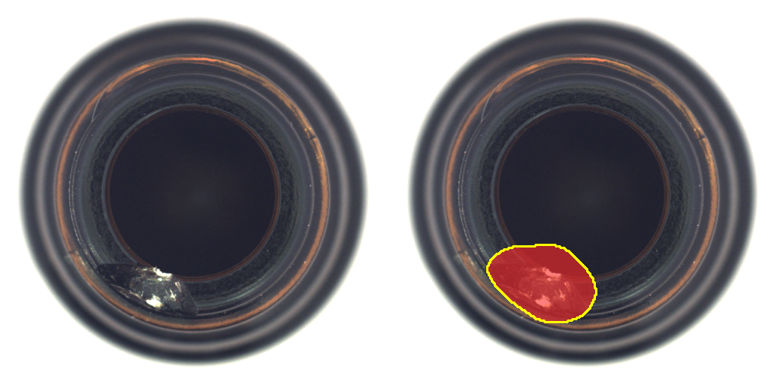
Anomaly detection finds and outlines defects
1.000
0.982
image AUROC
pixel AUROC · bottle
1.000
0.983
image AUROC
pixel AUROC · metal_nut
Left: input with a small break. Right: estimated defect region from the PatchCore anomaly map.
With the review-margin rule: bottle 100.0% of auto-decided items correct, 7.1% sent to review; metal_nut 100.0% of auto-decided items correct, 20.3% sent to review.

Slide 10
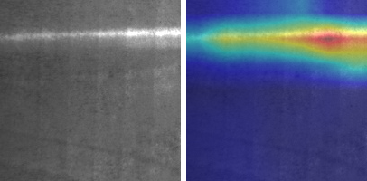
Grad-CAM shows where the model looked
Explanations on every result
Grad-CAM, Grad-CAM++ and Score-CAM for classifiers
Anomaly heat-maps, a segmentation mask and region boxes
A Grad-CAM map is an explanation, not a defect boundary; the UI labels it that way
An image of the wrong product is flagged as unfamiliar instead of being forced into a class
NEU steel, class scratches: the heat-map sits on the scratch line.

Slide 11
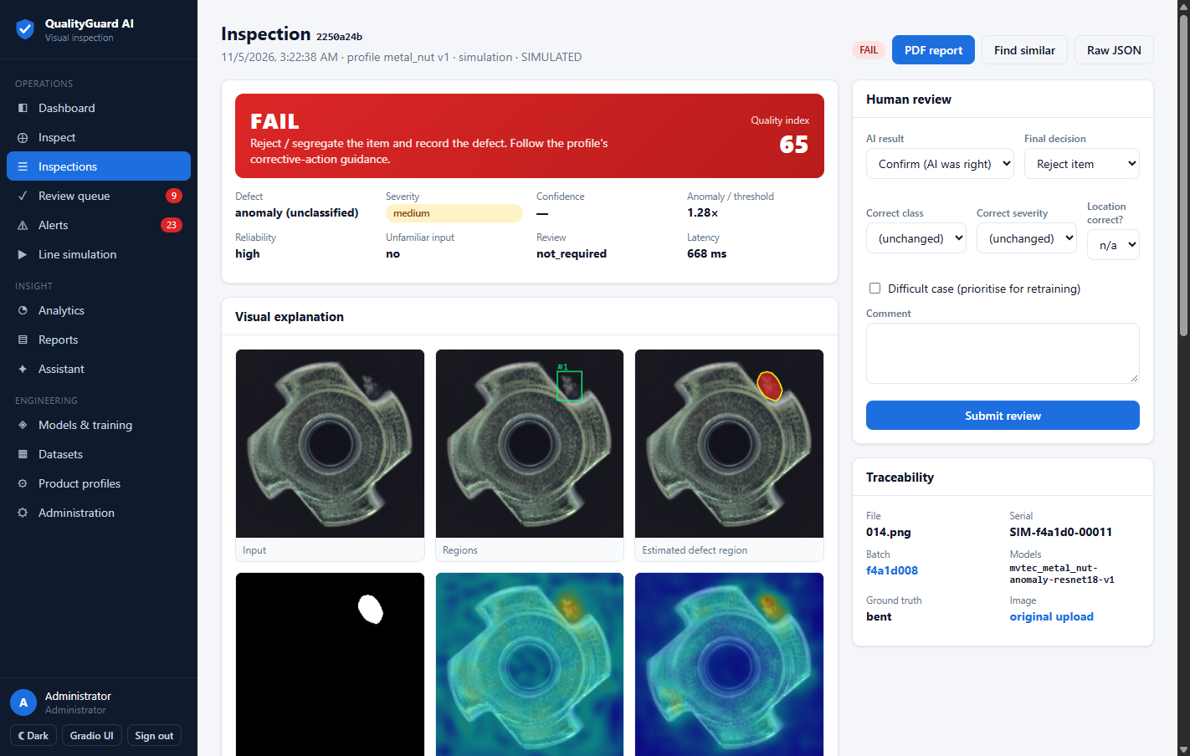
The QualityGuard web application
Inspect a single image, camera feed, batch, folder or video
Review queue, alerts and live dashboard
Analytics, drift checks and PDF reports
Model registry with approval-gated deployment
Gradio UI at /gradio, as in the proposal
FastAPI · React · SQLite/PostgreSQL · PyTorch · REST API with JWT and API keys

Slide 12
Rules turn model outputs into decisions
INCONCLUSIVE
Image fails validation or looks unfamiliar
Severity
Area bands: defect area ratio sets the level
Escalated by region count and anomaly intensity
Per-class minimum levels
Quality index = 100 − deduction
REVIEW
Engines disagree, low confidence, or a score near its threshold
FAIL
Severity at or above the profile's reject level
PASS
No defect, or a defect below the reject level
Checked in order; the first match decides.

Slide 13
Tested end to end
64
16
15
0
automated tests
app pages
permissions
missed defects
unit, API, workflow and browser
rendered in a real browser (Playwright) with no JS errors
across 5 user roles
on auto-decided anomaly test items
The tests run real inspections through the trained models: single, batch, video and camera capture, through to the PDF report, review feedback and the XAI lab.

Slide 14
Limitations and next steps
Limitations
Future scope
Benchmark images are clean; re-validate on real line images
NEU-CLS has no defect-free class
Severity rules are examples, not standards
CPU only: about 0.25 s per image for anomaly models
MVTec AD is licensed for non-commercial use only
Validate MQTT line signals against a real PLC / reject gate
Supervised segmentation trained on inspector masks
Deploy the INT8 MobileNetV2 (ONNX) on an edge device
Run the active-learning retraining loop on real line data
Object detection for multiple defects per image

Slide 15
Thank you
An explainable, human-in-the-loop inspection system, built and tested end to end
Demo: run uvicorn, then open http://127.0.0.1:8000 (dashboard) and /gradio · Questions?

