Slide 1
Phishing
Narwhal Sentinels

Slide 2

Basic Understanding
Phishing is the fraudulent attempt to obtain sensitive information such as usernames, passwords, and credit card details, often for malicious reason.
It is typically carried out by email spoofing and it often directs users to enter personal information at a fake website, the looks of which are identical to the legitimate site, only differs in the URL.

Slide 3
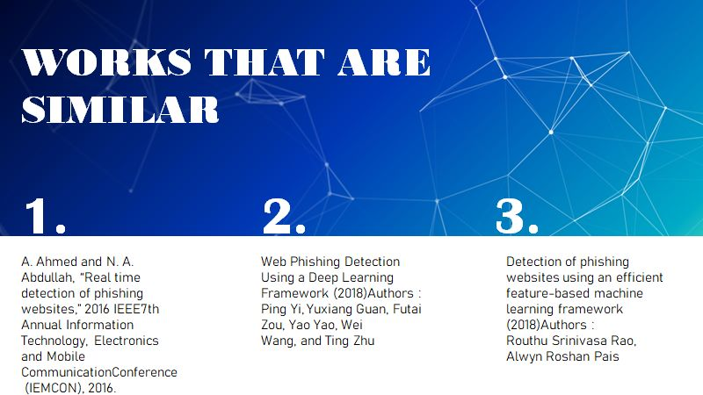

Slide 4
Phishing Detection
Implementation
Server
Side
Client
Side
Directory Based
Rule Based
ML Approach
Rule Based
ML Approach

Slide 5
Proposed System
A Browser plugin that aims to detect phishing websites and warn the user.
ML BASED APPROACH
Real time detection of phishing websites discusses an approach based on features from only the URL of the website.
They were able to come up with a detection mechanism that is capable of detecting various types of phishing attacks maintaining a low rate of false alarms.
DRAWBACKS
The main disadvantage is that rule based methods are usually not the best performers in terms of prediction quality. Other methods (Forests, SVM, deep-nets) tends to be better.

Slide 6
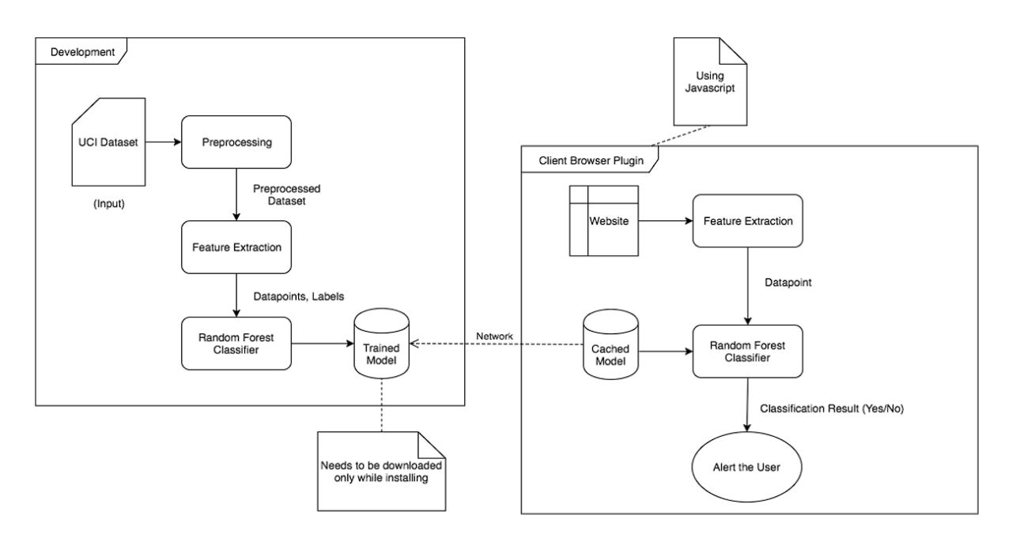
System Architecture

Slide 7
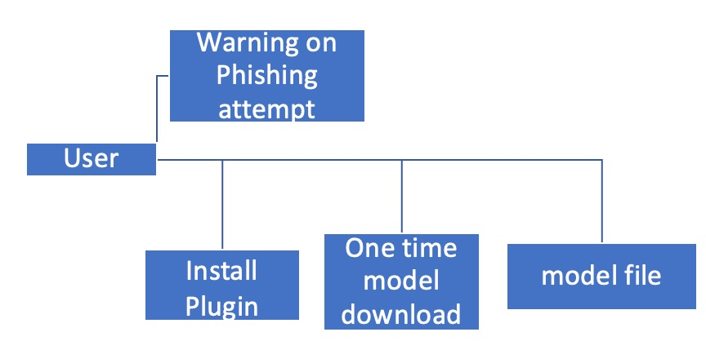
USE CASE DIAGRAM
Pre condition -
The user visits a website and have plugin installed.
Post condition -
The user is warned in-case it is a phishing website.

Slide 8
USE CASE DIAGRAM
The overall use case diagram of the entire system is shown in the figure.
The user can install the plugin and then can continue his normal browsing behaviour.

Slide 9
USE CASE DIAGRAM
He only needs to download the model once.
This plugin will automatically check the browsing pages for phishing and warns the user for the same.

Slide 10
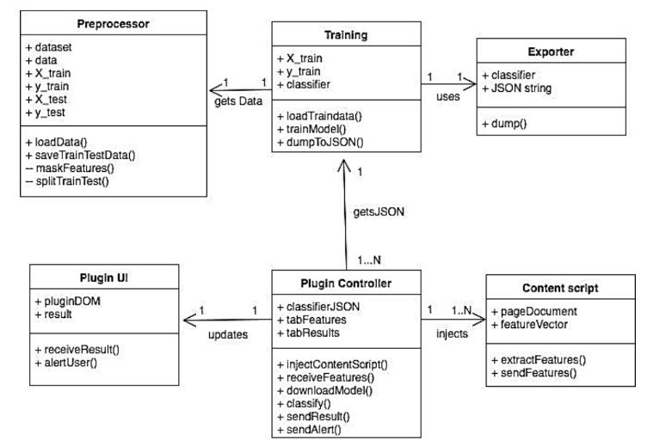
Class Diagram
This diagram depicts the functions of various modules in the system clearly.

Slide 11
TRAINING
INPUT : Training and testing data npy format.
OUTPUT: Trained random forest classifier model.

Slide 12
TRAINING
Pseudocode:
Start
Load training set from file calculate cross validation score.
Train random forest classifier load testing set from file
Calculate F1 score on testing set.
End

Slide 13

PLUGIN
INPUT : Website viewed by the user.
OUTPUT: Alert/Popup to the user.

Slide 14
Examples

Slide 15
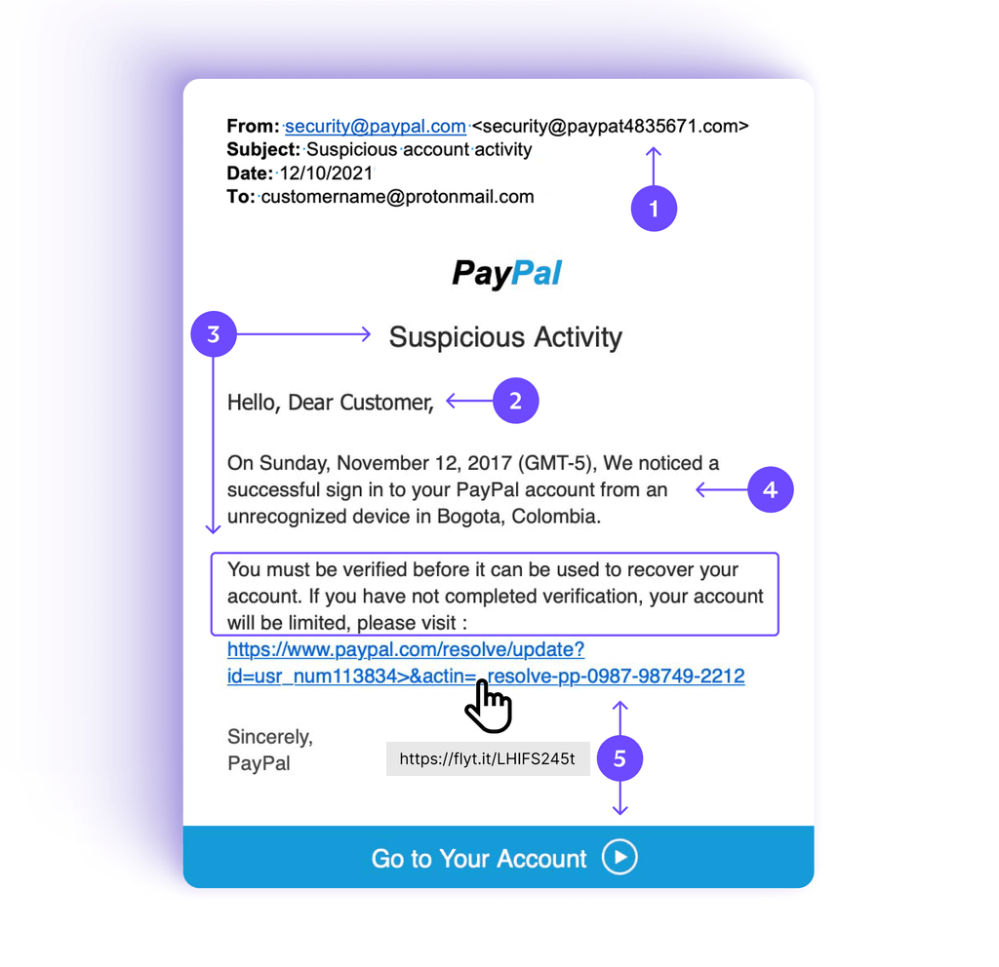
Victim was attempted to get phished by faking the paypal order.

Slide 16
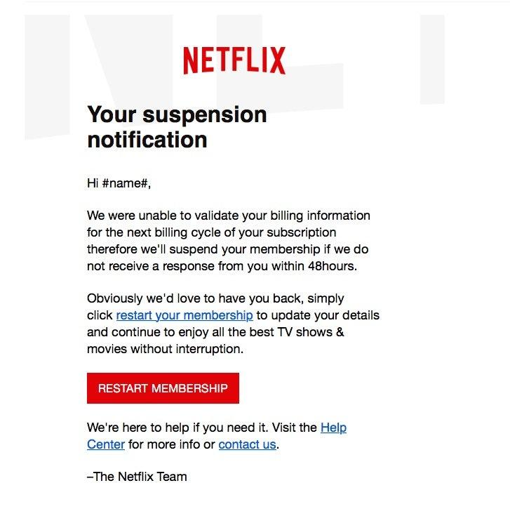
Victim was attempted to get phished by faking the netflix order.
The hacker used urgency inorder to easily phish the victim.

Slide 17
