Slide 1
DBMS PROJECT PRESENTATION
FASHION SHOW
MANAGEMENT SYSTEM
Swayamshree Saswatee Sahu
Reg. No.: 25BAI0210
BACSE202 | Database Systems
A practical database implementation using SQL and PL/SQL

Slide 2
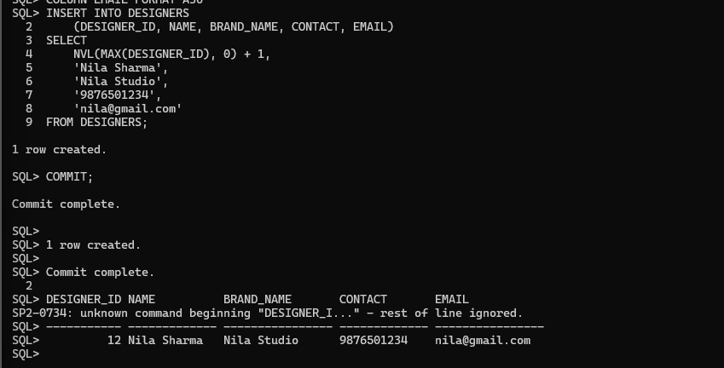
CRUD TECHNIQUES / 01
CREATE Operation – INSERT
WHAT THIS SHOWS
Inserts a new designer record into DESIGNERS.
Uses NVL(MAX(DESIGNER_ID), 0) + 1 to generate the next ID.
The output confirms one row created and the transaction committed.
The final displayed record is Nila Sharma.
FASHION SHOW MANAGEMENT SYSTEM • BACSE202 DATABASE SYSTEMS
2

Slide 3
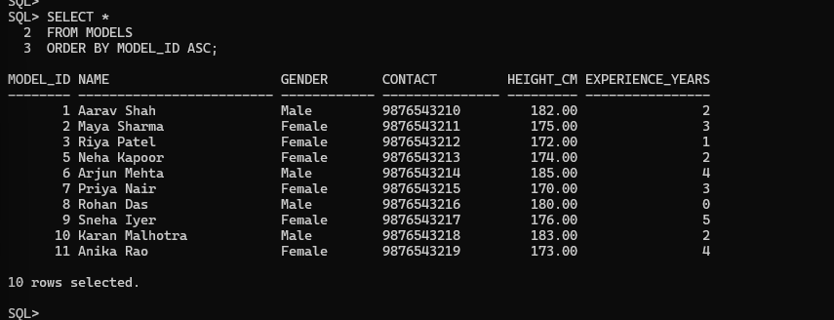
CRUD TECHNIQUES / 02
READ Operation – SELECT
WHAT THIS SHOWS
Retrieves all rows from the MODELS table.
ORDER BY MODEL_ID ASC sorts the records by model ID.
The result displays model details including gender, contact, height and experience.
The query returns 10 rows.
FASHION SHOW MANAGEMENT SYSTEM • BACSE202 DATABASE SYSTEMS
3

Slide 4
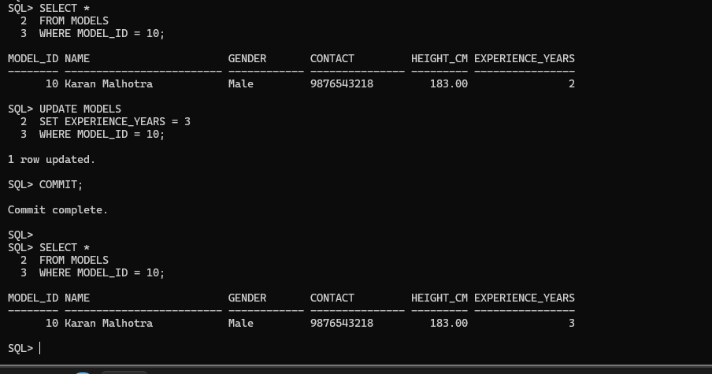
CRUD TECHNIQUES / 03
UPDATE Operation
WHAT THIS SHOWS
Selects model ID 10 before making the change.
Updates EXPERIENCE_YEARS from 2 to 3.
COMMIT saves the change.
The final SELECT verifies the updated value.
FASHION SHOW MANAGEMENT SYSTEM • BACSE202 DATABASE SYSTEMS
4

Slide 5
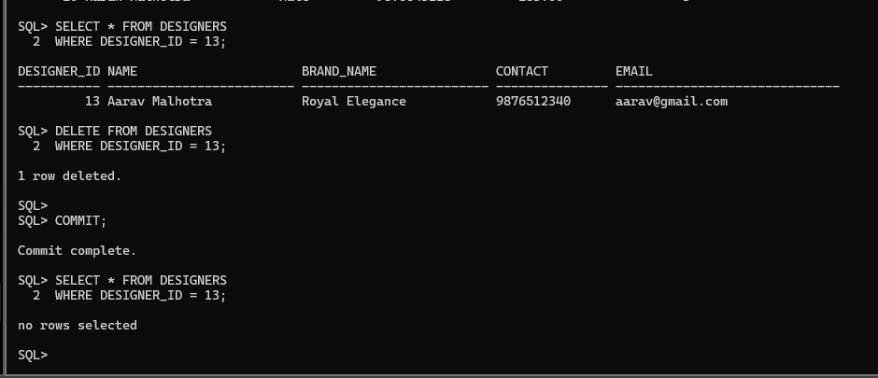
CRUD TECHNIQUES / 04
DELETE Operation
WHAT THIS SHOWS
Selects designer ID 13 before deletion.
DELETE removes the matching row from DESIGNERS.
COMMIT saves the deletion.
The final query returns no rows, confirming removal.
FASHION SHOW MANAGEMENT SYSTEM • BACSE202 DATABASE SYSTEMS
5

Slide 6
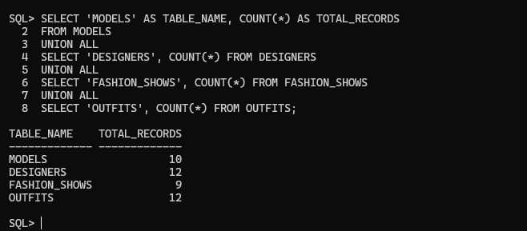
CRUD TECHNIQUES / 05
CRUD Summary – Record Counts
WHAT THIS SHOWS
UNION ALL combines the counts from four tables.
MODELS: 10 records; DESIGNERS: 12 records.
FASHION_SHOWS: 9 records; OUTFITS: 12 records.
The summary reports 43 records in total.
FASHION SHOW MANAGEMENT SYSTEM • BACSE202 DATABASE SYSTEMS
6

Slide 7
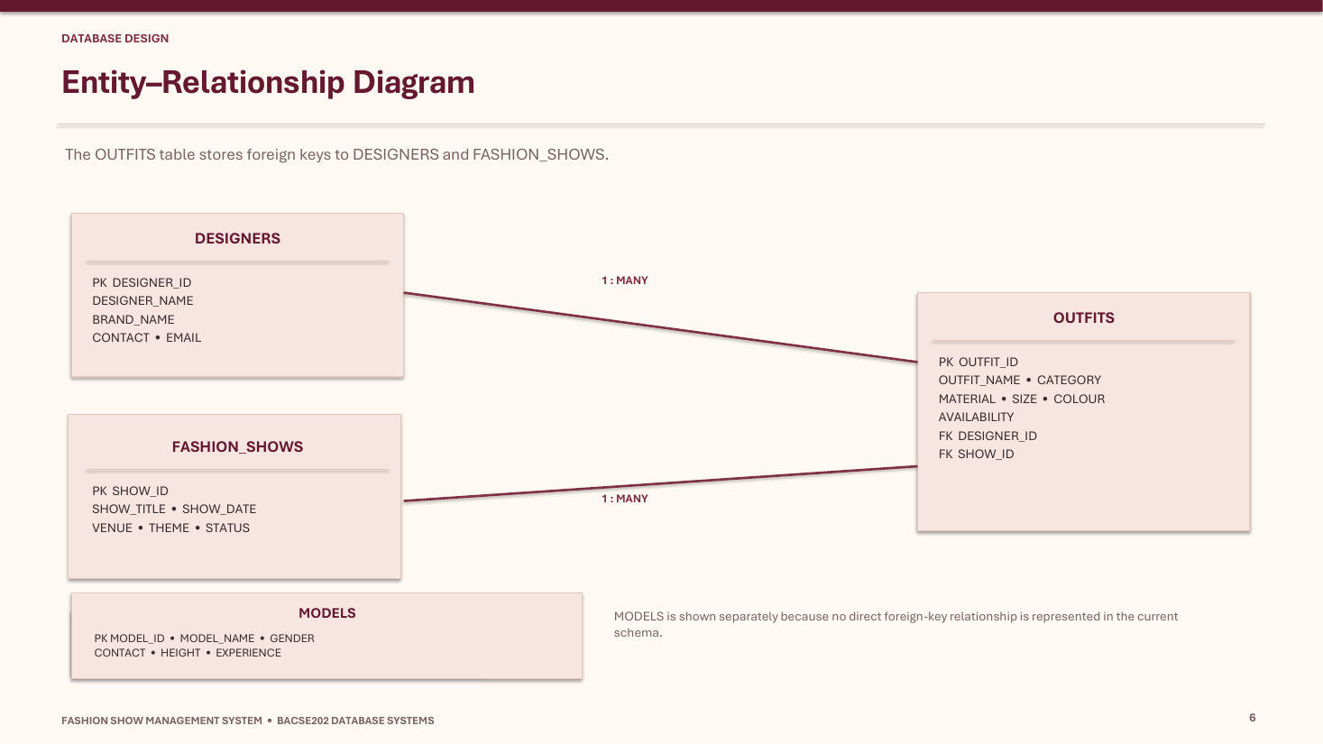
DATABASE DESIGN
Entity–Relationship Diagram
KEY POINTS
DESIGNERS → OUTFITS: One designer can be associated with many outfits.
FASHION_SHOWS → OUTFITS: One fashion show can contain many outfits.
MODELS: The MODELS table stores model details as its own entity.
Relationships: DESIGNERS (1) → (Many) OUTFITS; FASHION_SHOWS (1) → (Many) OUTFITS.
FASHION SHOW MANAGEMENT SYSTEM • BACSE202 DATABASE SYSTEMS
7

Slide 8
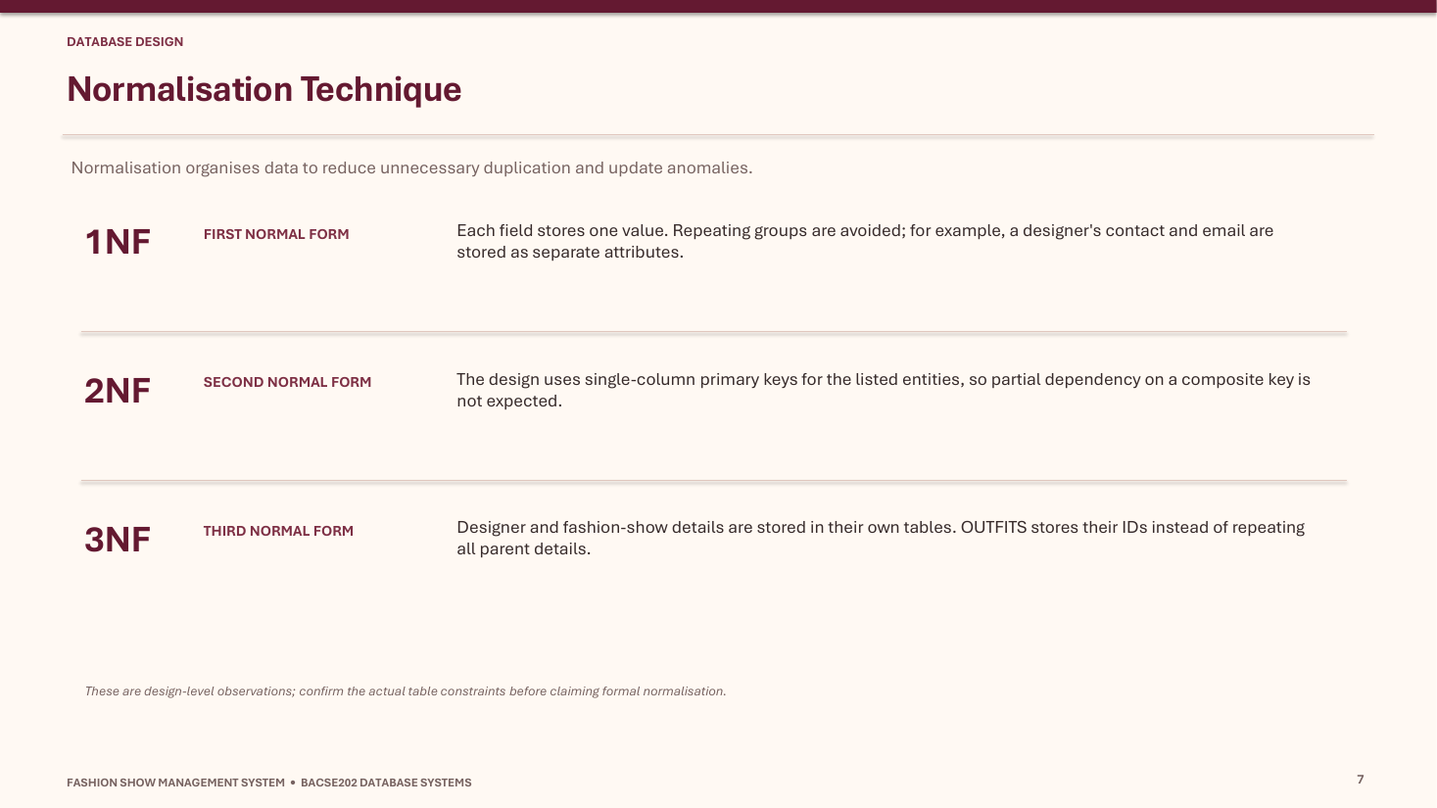
DATABASE DESIGN
Normalisation Technique
KEY POINTS
1NF: Each field stores a single, atomic value; repeating groups are avoided.
2NF: Every non-key attribute depends on the whole primary key.
3NF: Designer and fashion-show details are kept in their own tables; OUTFITS stores their IDs.
Purpose: Reduce redundancy and help prevent update, insertion and deletion anomalies.
FASHION SHOW MANAGEMENT SYSTEM • BACSE202 DATABASE SYSTEMS
8

Slide 9
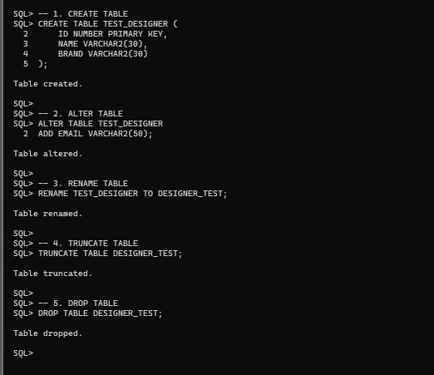
SQL LANGUAGE / DDL
DDL – Data Definition Language
WHAT THIS SHOWS
CREATE TABLE creates TEST_DESIGNER.
ALTER TABLE adds the EMAIL column.
RENAME changes the table name.
TRUNCATE removes its rows; DROP removes the table.
FASHION SHOW MANAGEMENT SYSTEM • BACSE202 DATABASE SYSTEMS
9

Slide 10
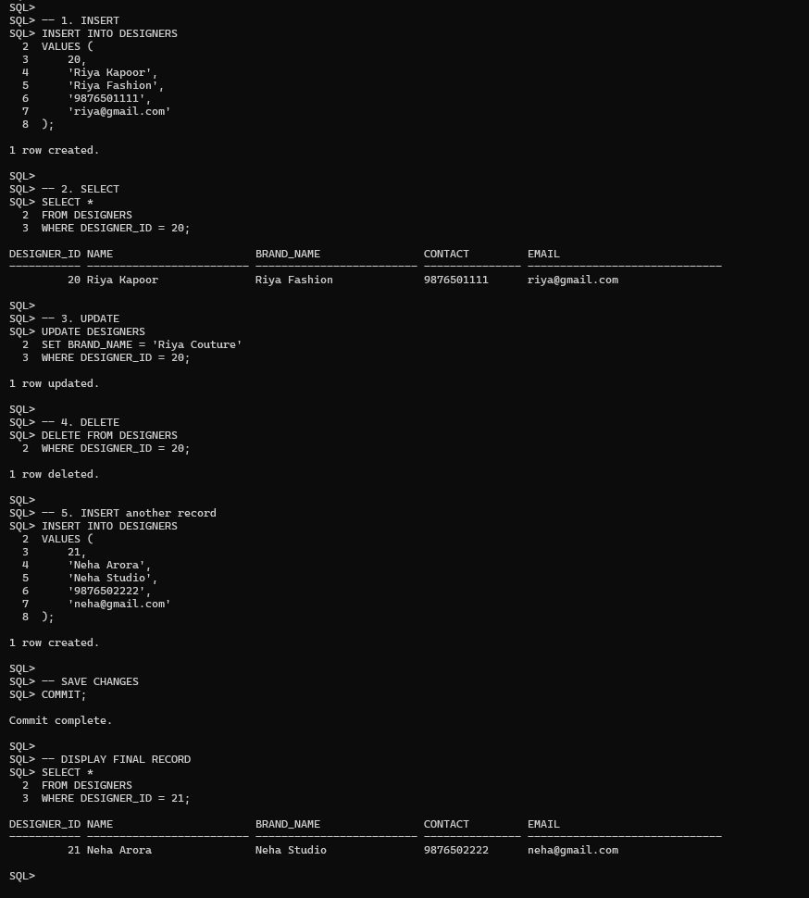
SQL LANGUAGE / DML
DML – Data Manipulation Language
WHAT THIS SHOWS
INSERT adds designer records.
SELECT retrieves the inserted record.
UPDATE changes the brand name.
DELETE removes the selected record; a later INSERT adds Neha Arora.
COMMIT saves the transaction.
FASHION SHOW MANAGEMENT SYSTEM • BACSE202 DATABASE SYSTEMS
10

Slide 11
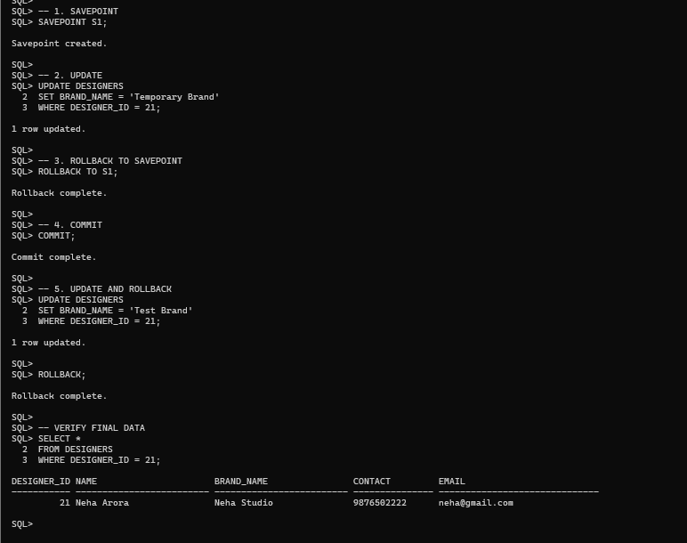
SQL LANGUAGE / TCL
TCL – Transaction Control Language
WHAT THIS SHOWS
SAVEPOINT S1 marks a point in the transaction.
ROLLBACK TO S1 reverses changes after the savepoint.
COMMIT saves the current transaction.
ROLLBACK reverses an uncommitted update.
The final SELECT verifies Neha Studio remains unchanged.
FASHION SHOW MANAGEMENT SYSTEM • BACSE202 DATABASE SYSTEMS
11

Slide 12
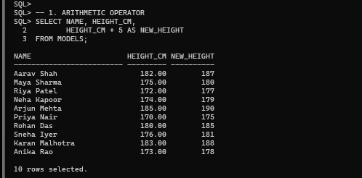
OPERATORS / ARITHMETIC
Arithmetic Operator
WHAT THIS SHOWS
Adds 5 to each model's HEIGHT_CM.
Uses HEIGHT_CM + 5 and labels the calculated value NEW_HEIGHT.
Displays the original and calculated heights for 10 models.
FASHION SHOW MANAGEMENT SYSTEM • BACSE202 DATABASE SYSTEMS
12

Slide 13
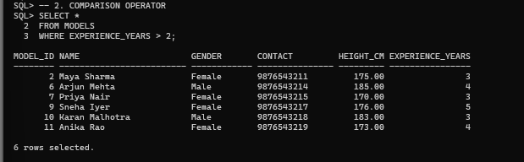
OPERATORS / COMPARISON
Comparison Operator
WHAT THIS SHOWS
Uses EXPERIENCE_YEARS > 2.
Returns models with more than two years of experience.
The displayed result contains 6 rows.
FASHION SHOW MANAGEMENT SYSTEM • BACSE202 DATABASE SYSTEMS
13

Slide 14
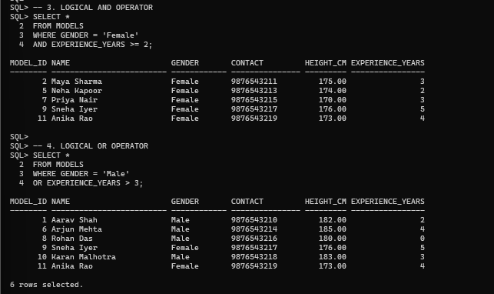
OPERATORS / LOGICAL
Logical AND and OR Operators
WHAT THIS SHOWS
AND: Gender is Female and experience is at least 2 years.
OR: Gender is Male or experience is greater than 3 years.
The screenshot shows both queries and their outputs.
FASHION SHOW MANAGEMENT SYSTEM • BACSE202 DATABASE SYSTEMS
14

Slide 15
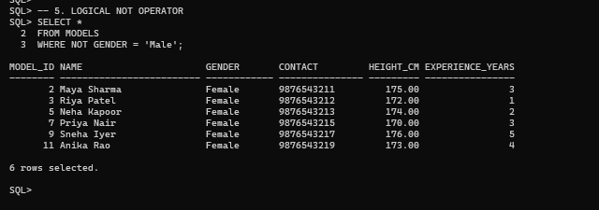
OPERATORS / LOGICAL
Logical NOT Operator
WHAT THIS SHOWS
Uses NOT GENDER = 'Male'.
Returns records that do not meet the Male condition.
The output contains 6 female model records.
FASHION SHOW MANAGEMENT SYSTEM • BACSE202 DATABASE SYSTEMS
15

Slide 16
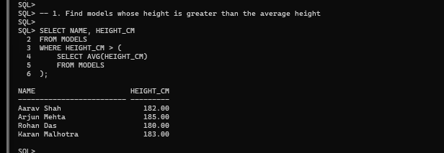
SUBQUERIES / 01
Subquery 1 – Models Above Average Height
WHAT THIS SHOWS
Finds models whose height is greater than the average height.
The inner query calculates AVG(HEIGHT_CM).
The outer query returns the matching names and heights.
Four models appear in the output.
FASHION SHOW MANAGEMENT SYSTEM • BACSE202 DATABASE SYSTEMS
16

Slide 17
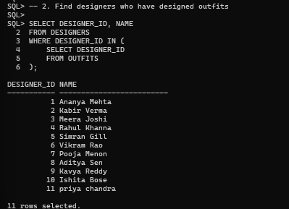
SUBQUERIES / 02
Subquery 2 – Designers with Outfits
WHAT THIS SHOWS
Finds designers whose IDs occur in OUTFITS.
Uses IN with a nested SELECT.
The output lists 11 designers.
FASHION SHOW MANAGEMENT SYSTEM • BACSE202 DATABASE SYSTEMS
17

Slide 18
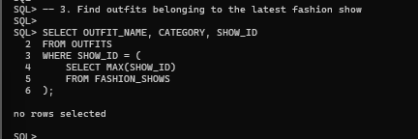
SUBQUERIES / 03
Subquery 3 – Outfits in Latest Fashion Show
WHAT THIS SHOWS
Finds outfits associated with the maximum SHOW_ID.
The inner query calculates MAX(SHOW_ID).
The actual output is 'no rows selected'; it is retained as shown.
FASHION SHOW MANAGEMENT SYSTEM • BACSE202 DATABASE SYSTEMS
18

Slide 19
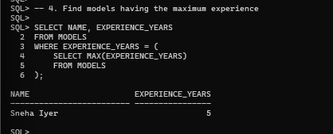
SUBQUERIES / 04
Subquery 4 – Model with Maximum Experience
WHAT THIS SHOWS
Finds the maximum EXPERIENCE_YEARS value.
The outer query returns the model matching that value.
Sneha Iyer is shown with 5 years of experience.
FASHION SHOW MANAGEMENT SYSTEM • BACSE202 DATABASE SYSTEMS
19

Slide 20
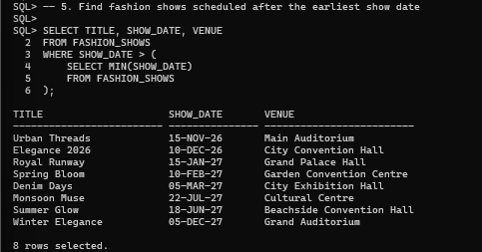
SUBQUERIES / 05
Subquery 5 – Shows After Earliest Show Date
WHAT THIS SHOWS
Finds the earliest date using MIN(SHOW_DATE).
Returns shows scheduled after that date.
The output displays 8 fashion shows.
FASHION SHOW MANAGEMENT SYSTEM • BACSE202 DATABASE SYSTEMS
20

Slide 21
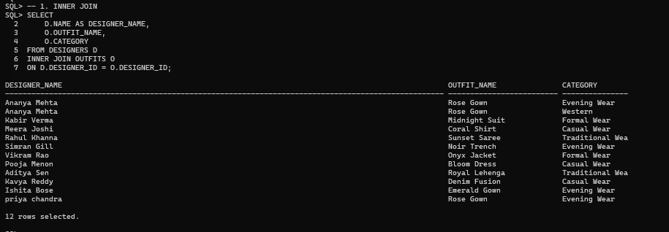
JOINS / 01
INNER JOIN
WHAT THIS SHOWS
Returns rows where DESIGNER_ID matches in both tables.
Shows designer names alongside outfit names and categories.
The query returns 12 rows.
FASHION SHOW MANAGEMENT SYSTEM • BACSE202 DATABASE SYSTEMS
21

Slide 22
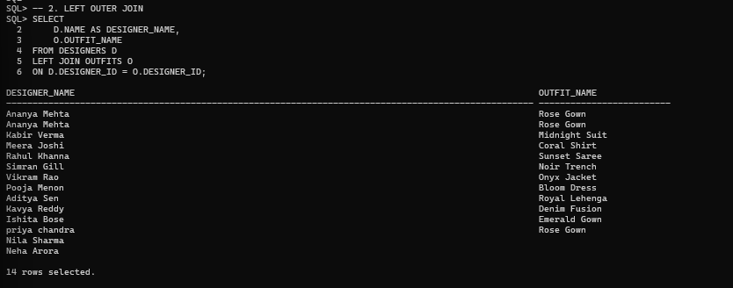
JOINS / 02
LEFT OUTER JOIN
WHAT THIS SHOWS
Returns every designer from the left table.
Matching outfit details are displayed where available.
Designers without outfits remain in the result with a blank outfit value.
The query returns 14 rows.
FASHION SHOW MANAGEMENT SYSTEM • BACSE202 DATABASE SYSTEMS
22

Slide 23
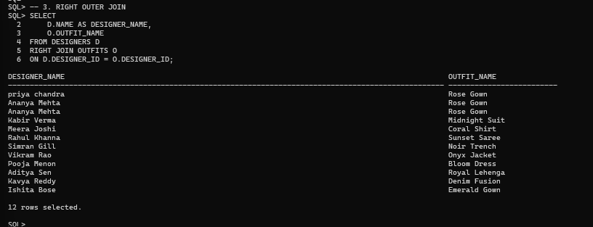
JOINS / 03
RIGHT OUTER JOIN
WHAT THIS SHOWS
Returns all rows from OUTFITS, the right table.
Matching designer details are displayed where available.
The query returns 12 rows.
FASHION SHOW MANAGEMENT SYSTEM • BACSE202 DATABASE SYSTEMS
23

Slide 24
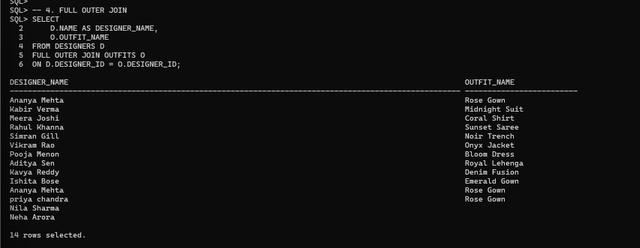
JOINS / 04
FULL OUTER JOIN
WHAT THIS SHOWS
Returns matching rows and unmatched rows from both tables.
Keeps designers without outfits and outfits without a matching designer.
The query returns 14 rows.
FASHION SHOW MANAGEMENT SYSTEM • BACSE202 DATABASE SYSTEMS
24

Slide 25
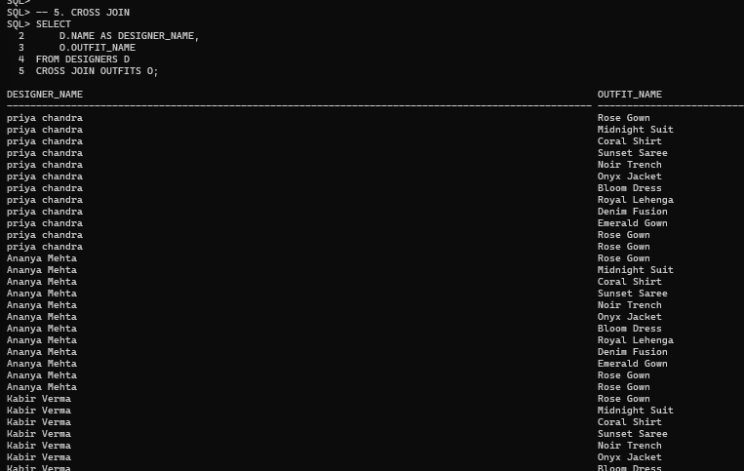
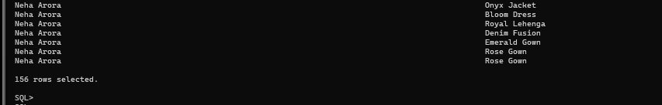
JOINS / 05
CROSS JOIN
WHAT THIS SHOWS
Combines every designer with every outfit.
Produces a Cartesian product of the two tables.
The full output reports 156 rows.
The two screenshots are consecutive parts of the same output.
FASHION SHOW MANAGEMENT SYSTEM • BACSE202 DATABASE SYSTEMS
25

Slide 26
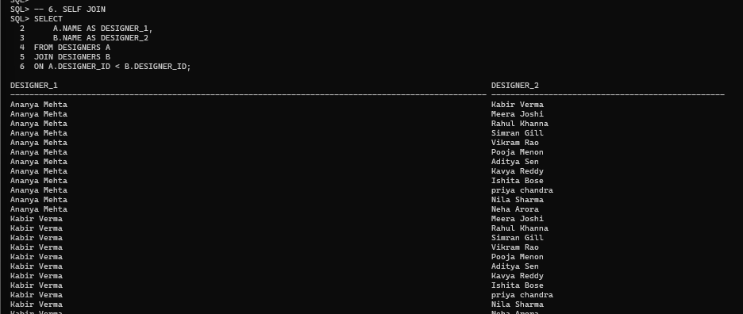
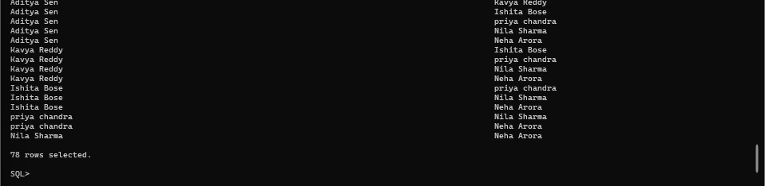
JOINS / 06
SELF JOIN
WHAT THIS SHOWS
Joins DESIGNERS with itself using aliases A and B.
A.DESIGNER_ID < B.DESIGNER_ID avoids pairing a designer with themself or repeating reversed pairs.
The full output reports 78 rows.
The two screenshots are consecutive parts of the same output.
FASHION SHOW MANAGEMENT SYSTEM • BACSE202 DATABASE SYSTEMS
26

Slide 27
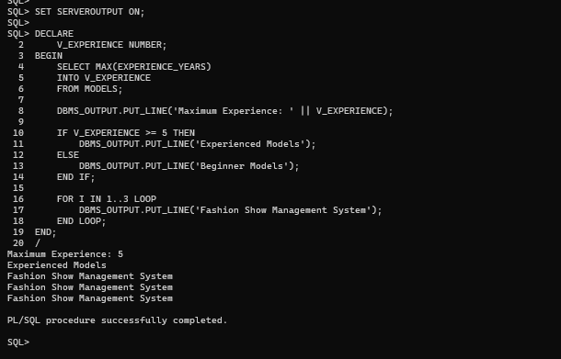
PL/SQL / CONTROL STRUCTURES
PL/SQL Control Structures
WHAT THIS SHOWS
SELECT INTO retrieves the maximum model experience.
IF–ELSE checks whether experience is at least 5 years.
A FOR loop prints the project name three times.
The block completes successfully.
FASHION SHOW MANAGEMENT SYSTEM • BACSE202 DATABASE SYSTEMS
27

Slide 28
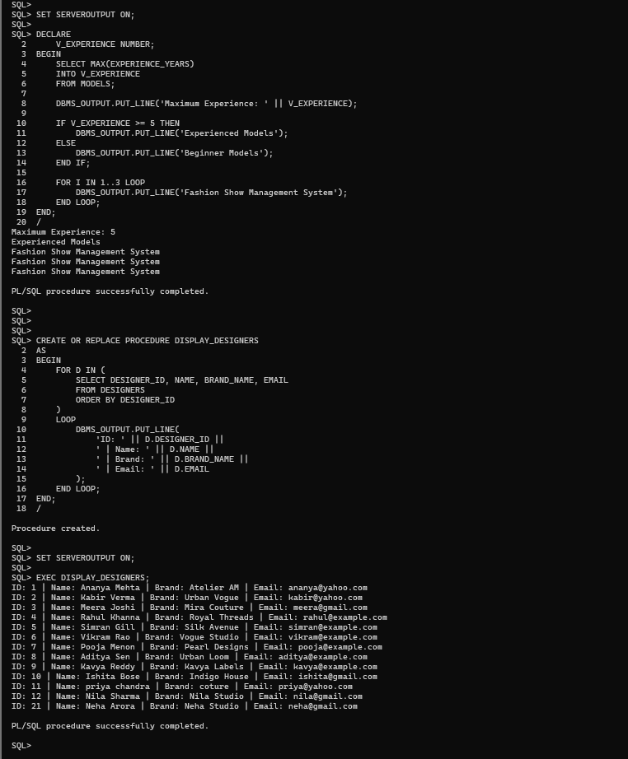
PL/SQL / STORED PROCEDURES
Stored Procedure – DISPLAY_DESIGNERS
WHAT THIS SHOWS
CREATE OR REPLACE PROCEDURE defines DISPLAY_DESIGNERS.
A cursor FOR loop retrieves designers ordered by ID.
DBMS_OUTPUT prints ID, name, brand and email.
The procedure is created and executed successfully.
FASHION SHOW MANAGEMENT SYSTEM • BACSE202 DATABASE SYSTEMS
28

Slide 29
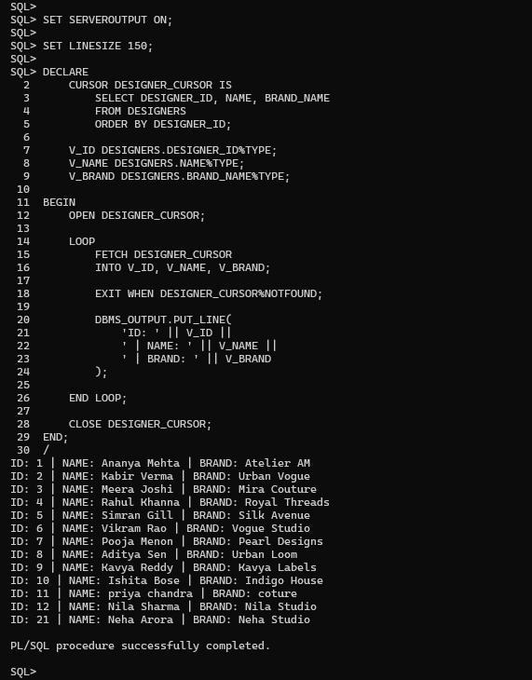
PL/SQL / CURSORS
Cursors – Explicit Cursor
WHAT THIS SHOWS
Declares DESIGNER_CURSOR to retrieve designer ID, name and brand.
OPEN starts the cursor; FETCH retrieves each row.
%NOTFOUND ends the loop when no more rows remain.
CLOSE releases the cursor; the block completes successfully.
FASHION SHOW MANAGEMENT SYSTEM • BACSE202 DATABASE SYSTEMS
29

Slide 30
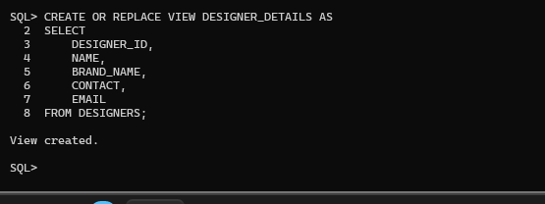
DATABASE OBJECTS / VIEWS
Views – Creating DESIGNER_DETAILS
WHAT THIS SHOWS
CREATE OR REPLACE VIEW defines DESIGNER_DETAILS.
The view selects designer ID, name, brand, contact and email.
Oracle confirms: View created.
FASHION SHOW MANAGEMENT SYSTEM • BACSE202 DATABASE SYSTEMS
30

Slide 31
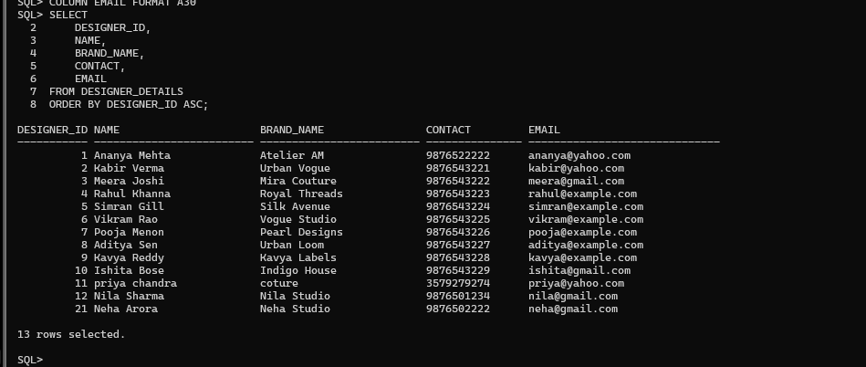
DATABASE OBJECTS / VIEWS
Views – Retrieving View Data
WHAT THIS SHOWS
SELECT retrieves data from DESIGNER_DETAILS.
ORDER BY DESIGNER_ID ASC sorts the output.
The screenshot displays 13 designer records.
FASHION SHOW MANAGEMENT SYSTEM • BACSE202 DATABASE SYSTEMS
31

Slide 32
Thank You
Fashion Show Management System
Swayamshree Saswatee Sahu • 25BAI0210
BACSE202 | Database Systems
Questions & Discussion

