Slide 1
APIs
13 April

Slide 2

What is Interface

Slide 3
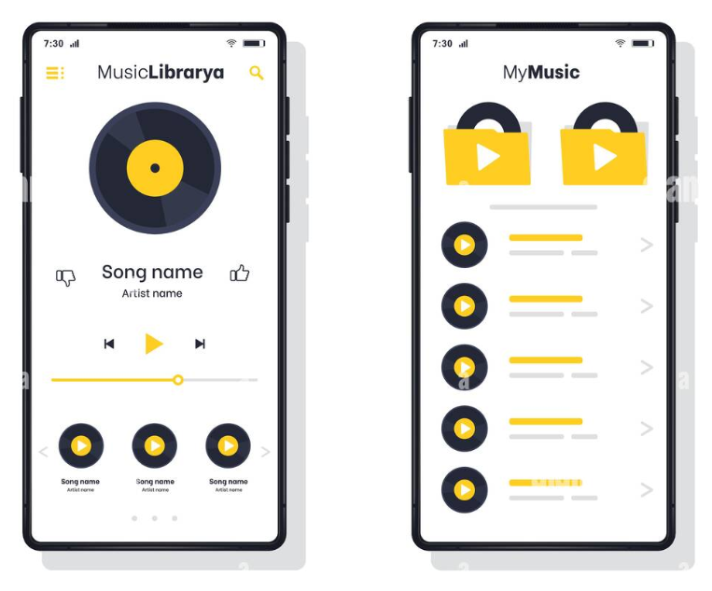
GUI

Slide 4
Python libaries
Requests: A simple, elegant HTTP library for Python, enabling you to send HTTP/1.1 requests.
Flask: A micro web framework for building APIs in Python. It's lightweight and easy to use.
Django Rest Framework (DRF): A powerful and flexible toolkit for building Web APIs in Django.
FastAPI: A modern, fast (high-performance) web framework for building APIs with Python 3.7+.
Tornado: A Python web framework and asynchronous networking library, suitable for long-lived connections and high-performance requirements.
Falcon: A minimalist WSGI library for building speedy web APIs and app backends.
Pyramid: A web framework aimed at taking small web apps into big web apps.
AIOHTTP: A Python asyncio-based HTTP client/server framework.
Bottle: A fast, simple and lightweight WSGI micro web-framework for Python.
Sanic: A web server and web framework that's written to be fast.

Slide 5

Remote APIs
Twitter API: Access Twitter's data and functionality, like tweets, posting, searching, and user info.
Google Maps API: Embed maps, get directions, search places, and perform geocoding.
GitHub API: Interact with repositories, issues, pull requests, users, and more.
Stripe API: Integrate with Stripe's payment processing for transactions and subscriptions.
YouTube API: Manage videos, metadata, search, and user accounts.
OpenWeatherMap API: Retrieve weather forecast and current weather data globally.
Twilio API: Integrate messaging, voice, and video communication features into applications.

Slide 6
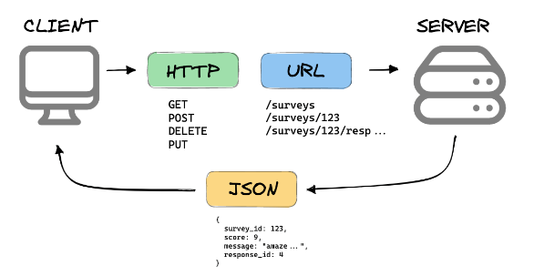
How web works?

Slide 7
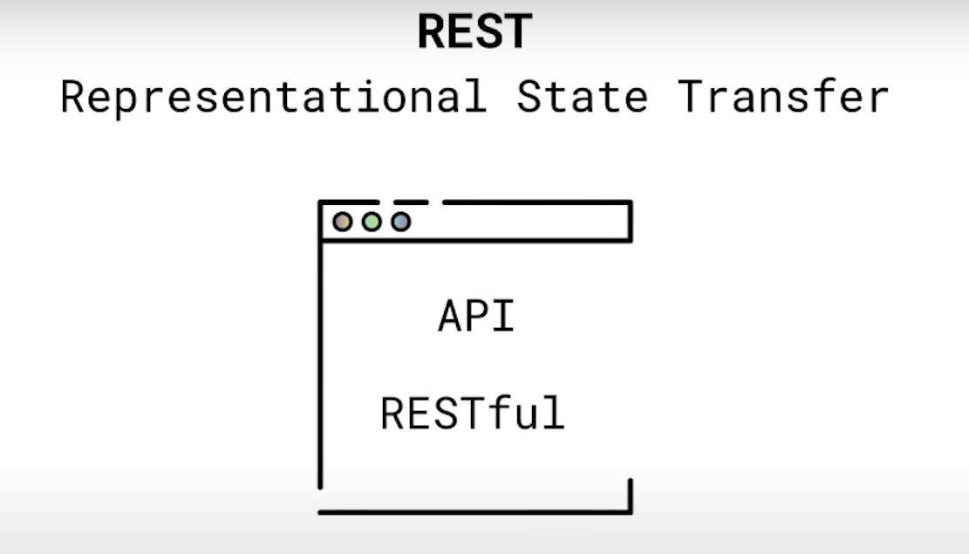

Slide 8
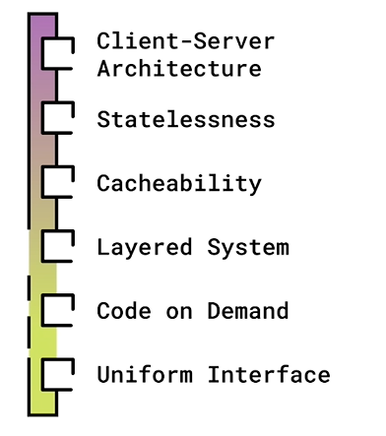
REST API is an API that follows the principles of REST

Slide 9
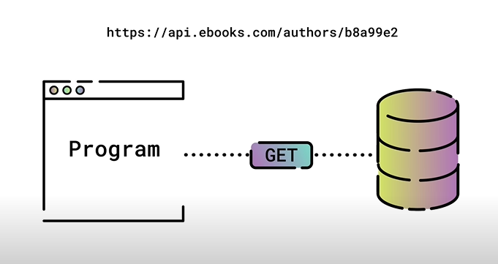
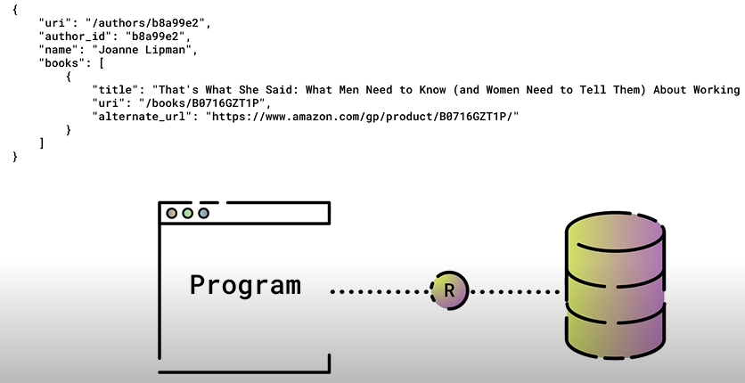

Slide 10
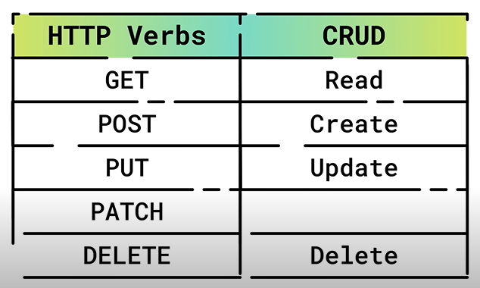
https://apilist.fun/

