Slide 1
Week-1
30th,31st March

Slide 2
What is web scraping, and why is it used?
Web scraping is the technique of automatically extracting data from websites.
Saving time and effort on manual data collection

Slide 3

Real-world examples of web scraping.
1. Price Monitoring
Web Scraping can be used by companies to scrap the product data for their products and competing products as well to see how it impacts their pricing strategies. Companies can use this data to fix the optimal pricing for their products so that they can obtain maximum revenue.
2. Market Research
Web scraping can be used for market research by companies. High-quality web scraped data obtained in large volumes can be very helpful for companies in analyzing consumer trends and understanding which direction the company should move in the future.
3. News Monitoring
Web scraping news sites can provide detailed reports on the current news to a company. This is even more essential for companies that are frequently in the news or that depend on daily news for their day-to-day functioning. After all, news reports can make or break a company in a single day!
4. Sentiment Analysis
If companies want to understand the general sentiment for their products among their consumers, then Sentiment Analysis is a must. Companies can use web scraping to collect data from social media websites such as Facebook and Twitter as to what the general sentiment about their products is. This will help them in creating products that people desire and moving ahead of their competition.
5. Email Marketing
Companies can also use Web scraping for email marketing. They can collect Email ID’s from various sites using web scraping and then send bulk promotional and marketing Emails to all the people owning these Email ID’s.

Slide 4
Legal and ethical considerations.
Don't break the web: Denial of Service attacks
View robots.txt file. Robots.txt is a file used by websites to let 'bots' know if or how the site should be crawled and indexed.
https://www.facebook.com/robots.txt
https://www.monash.edu/robots.txt
https://www.linkedin.com/robots.txt

Slide 5
Overview of the tools and libraries we’ll be using.
Beautiful Soup
pip install beautifulsoup4
Selenium
pip install selenium

Slide 6
Tasks: Pick a case study of web scraping. Highlight the importance of respecting robots.txt and terms of service of websites.

Slide 7

Introduction to HTML structure: tags, attributes, and elements.
Static page
https://realpython.github.io/fake-jobs/
import requests
URL = "https://realpython.github.io/fake-jobs/"
page = requests.get(URL)
print(page.text)
Hidden Websites
https://docs.python-requests.org/en/latest/user/authentication/
https://httpbin.org/basic-auth/user/pass

Slide 8
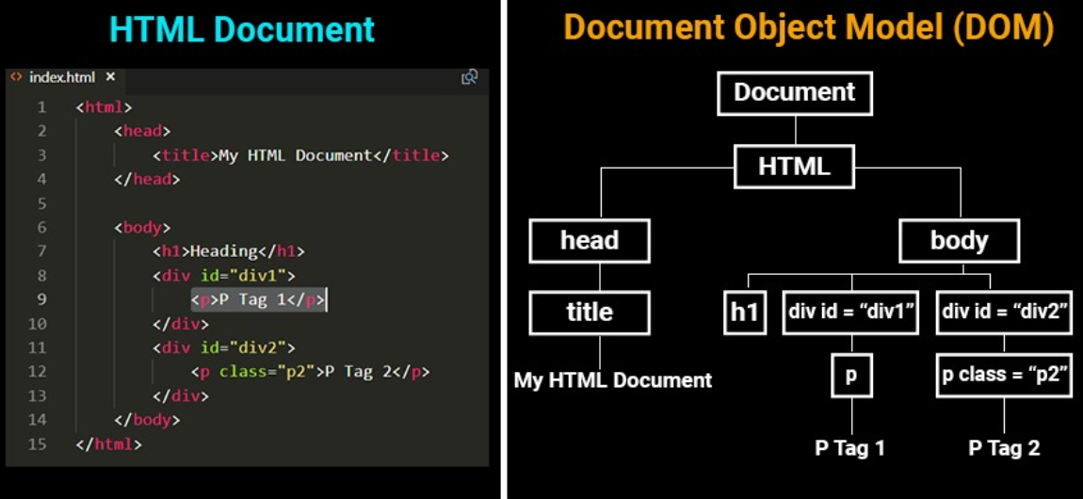
Understanding the Document Object Model (DOM).

Slide 9
Task: Inspect element exercise: Participants use browser tools to examine the structure of a web page. Identify common HTML tags and their attributes.

Slide 10
What is the HTTP protocol?
HTTP is used to make requests to web servers to retrieve web pages, which can then be processed and the data extracted.

Slide 11

Send an HTTP GET request: The scraper sends a GET request to the URL of the target page.
Receive the HTTP response: The server responds with the HTML content of the page.
Parse the response: The scraper parses the HTML to extract data.
Data extraction: Using various parsing techniques, the scraper extracts the required information from the page.
Follow links: If the scraper needs to navigate through web pages, it will send additional GET requests to follow hyperlinks.

Slide 12
Exploring HTTP verbs: GET, POST, PUT, DELETE. Status codes and their meanings.
HTTP Verb | CRUD | Entire Collection (e.g. /customers) | Specific Item (e.g. /customers/{id})
POST | Create | 201 (Created), 'Location' header with link to /customers/{id} containing new ID. | 404 (Not Found), 409 (Conflict) if resource already exists..
GET | Read | 200 (OK), list of customers. Use pagination, sorting and filtering to navigate big lists. | 200 (OK), single customer. 404 (Not Found), if ID not found or invalid.
PUT | Update/Replace | 405 (Method Not Allowed), unless you want to update/replace every resource in the entire collection. | 200 (OK) or 204 (No Content). 404 (Not Found), if ID not found or invalid.
PATCH | Update/Modify | 405 (Method Not Allowed), unless you want to modify the collection itself. | 200 (OK) or 204 (No Content). 404 (Not Found), if ID not found or invalid.
DELETE | Delete | 405 (Method Not Allowed), unless you want to delete the whole collection—not often desirable. | 200 (OK). 404 (Not Found), if ID not found or invalid.

Slide 13
Task: Use a REST client to make simple GET and POST requests. Examine the structure of HTTP requests and responses.

Slide 14
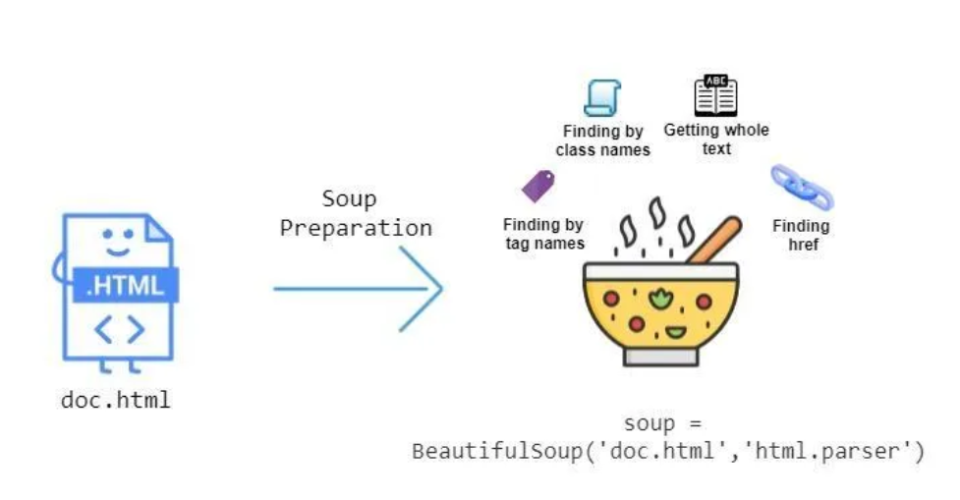
Introduction to the BeautifulSoup library.

Slide 15
Fetching web pages using requests.

Slide 16
Introduction to BeautifulSoup for parsing HTML.

Slide 17
Navigating the DOM with BeautifulSoup.

Slide 18
Task: Write a Python script to fetch a web page’s content and parse the title.

Slide 19
Introduction to lxml and its advantages.
lxml can be more lenient than BeautifulSoup in parsing HTML documents that have errors.
It can parse pages that are not well-formed or have broken HTML, similar to how browsers do.
Standards Compliance: lxml aims to be fully compliant with XML and HTML standards

Slide 20
Quick overview of Scrapy framework for large scale scraping.
Scrapy is an open-source web crawling framework for Python, designed for scraping and extracting data from websites.
It is used for large-scale web scraping tasks that require a powerful and versatile solution to handle complex data extraction.
Scrapy provides built-in support for data extraction, handling requests, and processing, ideal for building scalable web spiders.
It has a steeper learning curve and can be too complex for simple scraping tasks, with overkill features for small projects.

Slide 21
Task: Write a Python script to fetch and parse an HTML table using lxml. Discuss scenarios where Scrapy might be a more suitable tool.

Slide 22
Assignment: Create a Python script that scrapes job listings from a website and summarizes the information into a CSV file.

