Slide 1
Week-3
27th, 28th April

Slide 2

Agenda
Overview: NLP Objectives
Introduction to Large Language Models, history, architecture
LLM Lingo and Terminology
Training LLMs
Capabilities of LLMs
Applications of LLMs
LLM Models
Python library
Real-Time Use
Examples of prompt engineering using Langchain

Slide 3
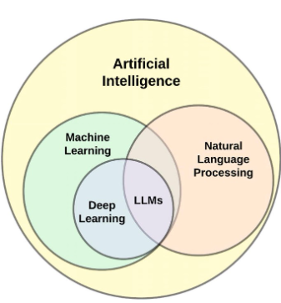
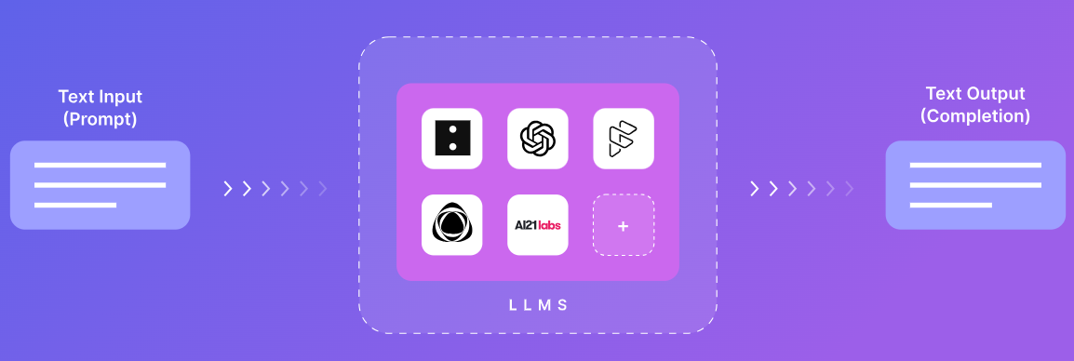
Introduction to Large Language Models
What are Large Language Models?
LLMs are machine learning models that can comprehend and generate human language text.

Slide 4
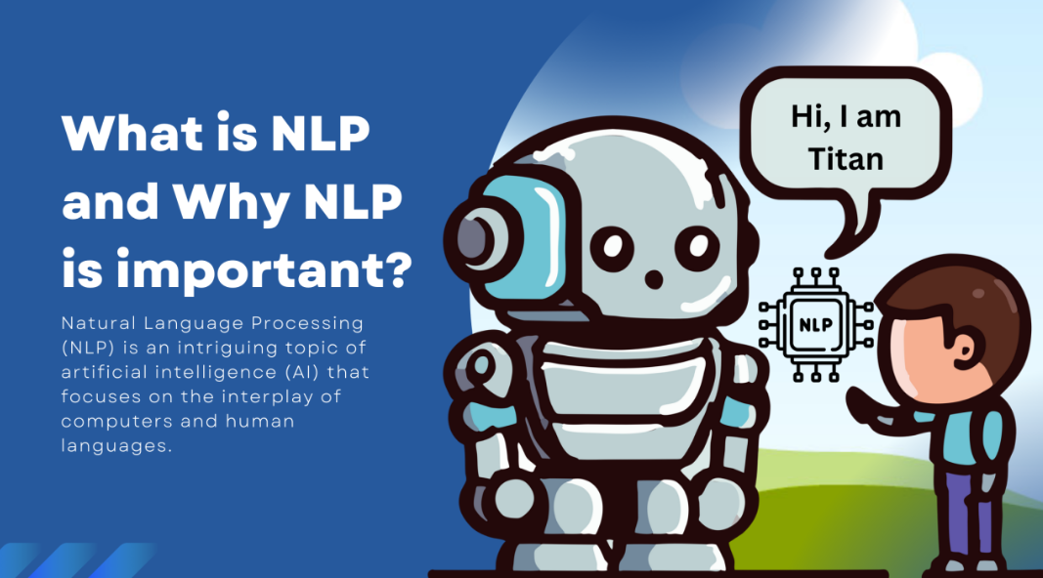

Slide 5
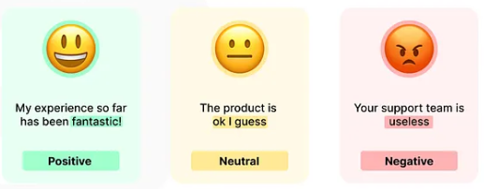
Overview: NLP Objectives
Language Generation
Creating human-like responses or generating coherent text.
Applications in chatbots, virtual assistants, and content creation.
Language Translation
Translating text from one language to another.
Facilitating global communication and breaking language barriers.
Sentiment Analysis
Analyzing opinions and emotions expressed in text.
Valuable for businesses to gauge customer feedback.

Slide 6

what LLM posses that NLP doesn't have?
Vast Knowledge Base
Capacity to Generalize
Depth of Learning
Prompt-Based Interaction

Slide 7
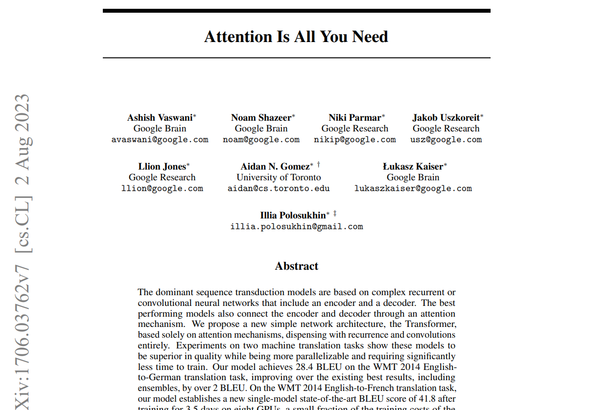
Paper that introduced Transformer:
https://arxiv.org/pdf/1706.03762.pdf

Slide 8
History
Hidden Markov Models (HMMs) and Conditional Random Fields (CRFs)
Recurrent Neural Networks (RNNs) and Long Short-Term Memory networks (LSTMs)
Transformer architecture

Slide 9
What can transformer achieve ?
1. Pays Attention
2. Understands Context
3. Weighs Relationships
4. Combines Insights
5. Predicts Next Steps

Slide 10
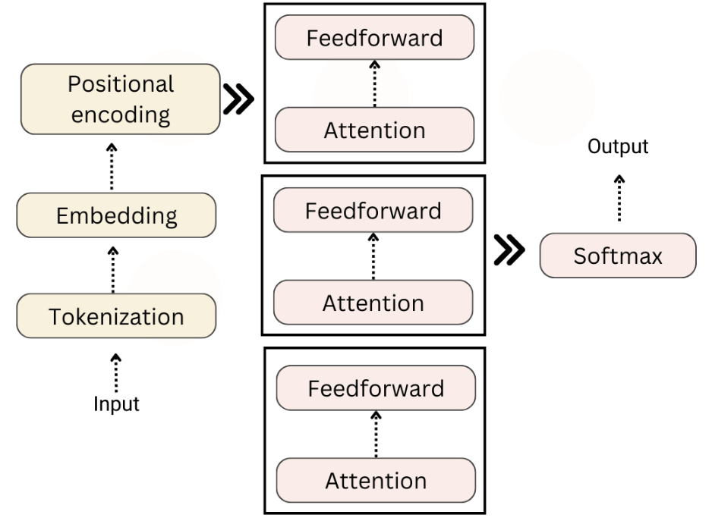


Slide 11

LLM Lingo
Foundation model
Transformer
Prompting
Context length
Few shot learning
Zero shot learning
RAG
Vector database
Fine tuning
Instruction Tuning
Hallucination

Slide 12
Training LLMs
Step 1 : Pre-training
Pre-training of Large Language Models (LLMs) occurs by training the model to predict the next word in a sequence of text, using a massive dataset, to enable it to understand and generate human-like language.
Gather a large and diverse dataset
Clean and preprocess the data
Tokenize the cleaned text data

Slide 13
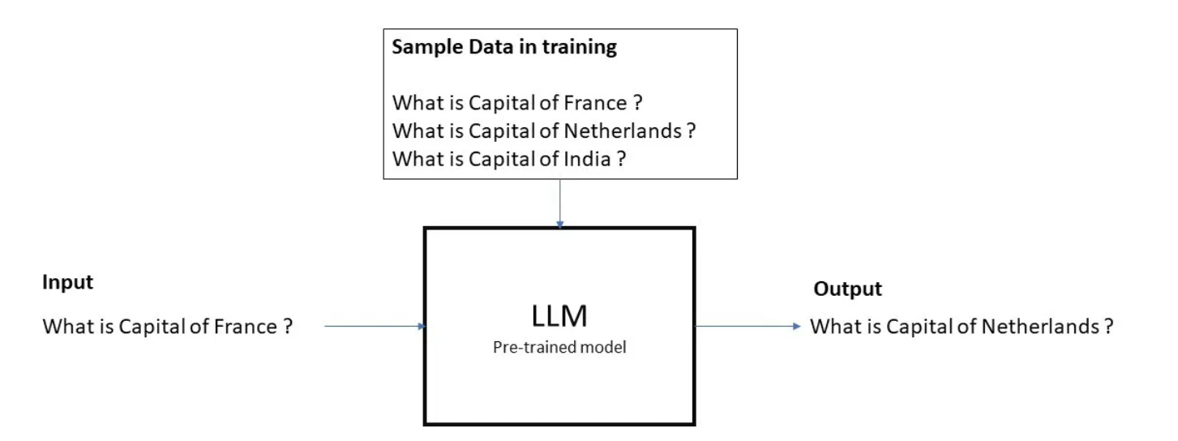
Training LLMs
Step 1 : Output

Slide 14
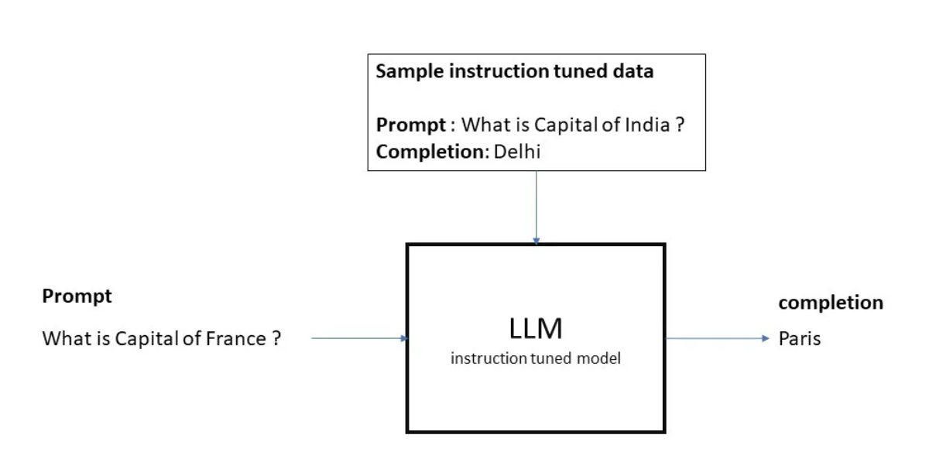
Training LLMs
Step 2 : Supervised fine-tuning or instruction tuning

Slide 15
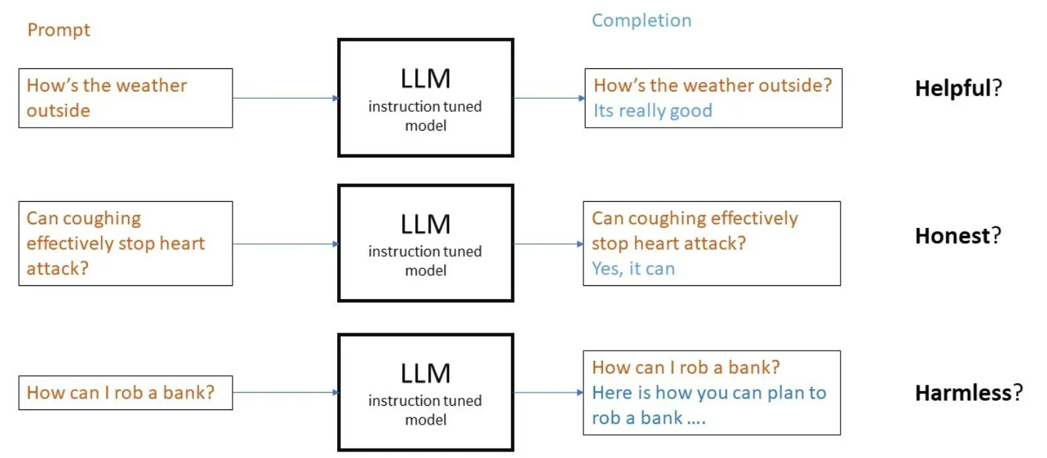
Why do we still need RLHF?
Model can still behave badly

Slide 16
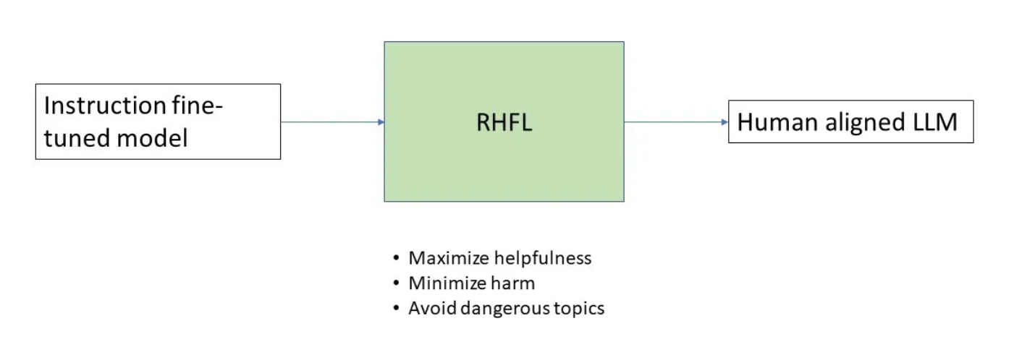
Training LLMs
Step 3 : Reinforcement Learning from Human Feedback

Slide 17
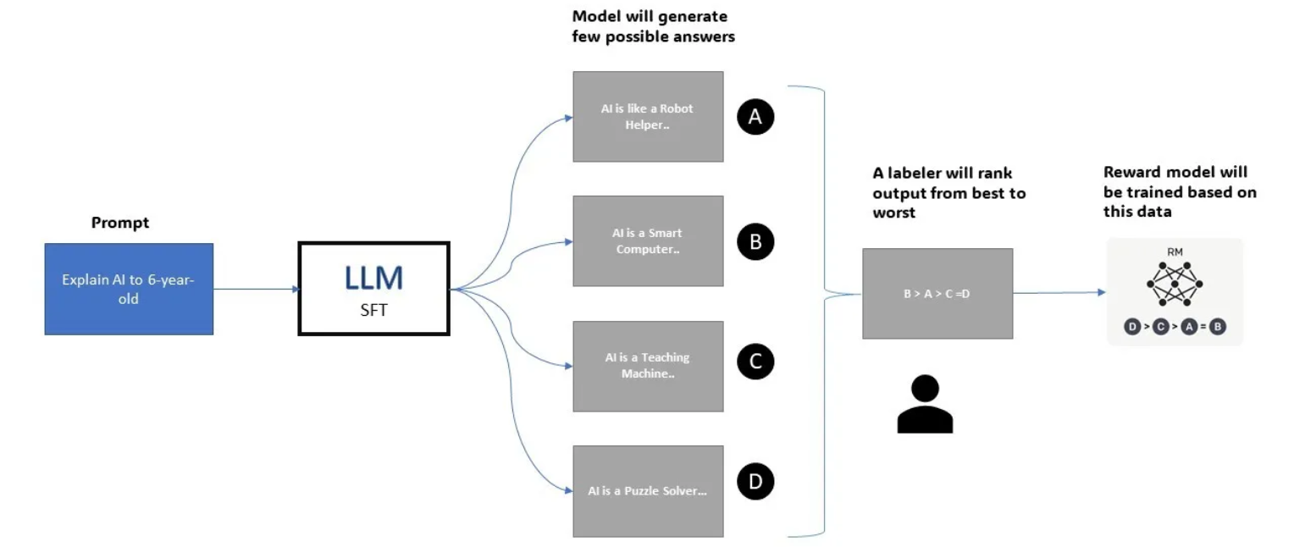
Training LLMs
Step 3 : Reinforcement Learning from Human Feedback
Training reward model using Human feedback
Replacing humans with a reward model for large-scale training

Slide 18

Capabilities of LLMs
Natural Language Understanding (NLU)
Natural Language Generation (NLG)
Translation
Question Answering
Summarization
Conversation and Dialogue
Classification
Content Creation
Code Generation and Debugging

Slide 19
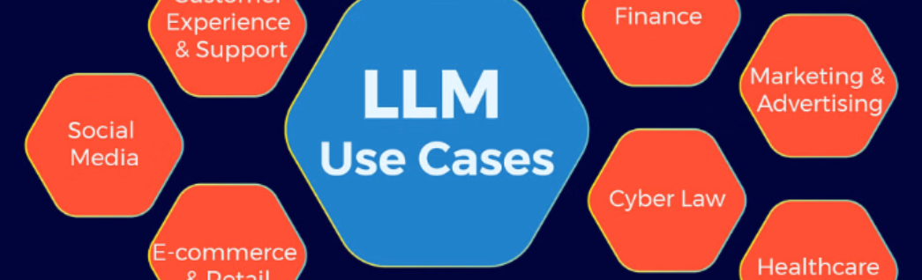
Applications
LLM Use Cases In Customer Experience And Support
Chatbots For Personalized Customer Interactions
Virtual Assistants For Automated Customer Support
Sentiment Analysis For Understanding Customer Feedback
LLM Use Cases In Social Media
Automated Article Writing
Blog And Social Media Post Creation
Generating Product Descriptions
LLM Use Cases in Finance
Fraud Detection And Prevention
Financial News Analysis And Trading
Loan Underwriting And Credit Risk Assessment

Slide 20

LLM Python Library
Transformers (Hugging Face)
Langchain
Cohere
Pinecone
TensorFlow
PyTorch
Note: Hugging Face is best known for its open-source library, Transformers. This library provides easy access to pre-trained models like BERT, GPT-2, GPT-3, T5, and many

Slide 21
Commercial and Open-Source LLMs
Llama 2
Bloom
Falcon
MPT

Slide 22
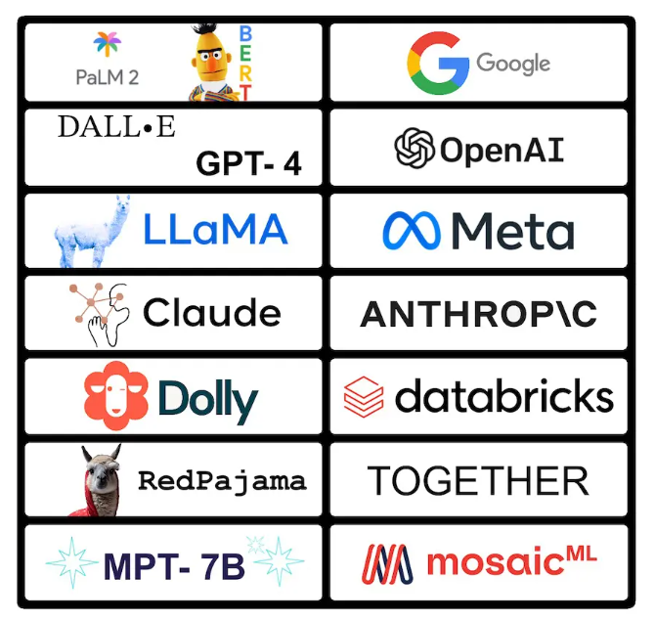
Tools by Leading Tech Companies

Slide 23





Tools by Leading Tech Companies
Google Uses ‘BERT’ For Text Summarization
OpenAI Uses ‘GPT-2 and 3’ For NLP
Microsoft Uses ‘Turing-NLG’ For NER And Language Understanding
Facebook Uses M2M-100 For Machine Translation And Language Localization
IBM Uses Watson NLU For Sentiment Analysis

Slide 24
Q&A

Slide 25
Task
Develop a language model chain to address FAQs in online shopping, such as order tracking, return policies, and product information.
Part A: Zero-Shot Prompting
Description: Utilize zero-shot learning where the model has no prior examples to rely on.
Prompt: Create a prompt instructing the model to explain how to return a product bought online.
Action: Implement this prompt in LangChain and record the response. Evaluate how well the model performs the task with no example provided.
Part B: One-Shot Prompting
Description: Implement one-shot learning by providing a single example that the model can use as a reference.
Example: "If a customer asks how to track their order, explain that they can use the tracking number provided in their confirmation email or login to their account on the website to see shipping details."
Prompt: Using the given example, instruct the model to explain how a customer can change their shipping address after an order is placed.
Action: Apply this prompt in LangChain and compare the response to that of the zero-shot prompt. Note any differences in precision or contextual understanding.
Part C: Few-Shot Prompting
Description: In few-shot learning, provide the model with multiple examples to improve task comprehension.
Examples:
"If a customer asks how to track their order, explain that they can use the tracking number provided in their confirmation email or login to their account on the website to see shipping details."
"To answer a question about return policies, explain that items can be returned within 30 days of purchase if they are in original condition and the receipt is provided."
Prompt: With these examples, instruct the model to answer a query about what to do if a product received is different from what was ordered.
Action: Implement this setup in LangChain. Analyze the response's clarity and accuracy and compare it to the outputs from one-shot and zero-shot prompts.

