Slide 1

Name : Sweekar K T Employee Id : EI13047
Database Practice
Technology training
Campus batch – 2022 Aug - Oct 2022

Slide 2
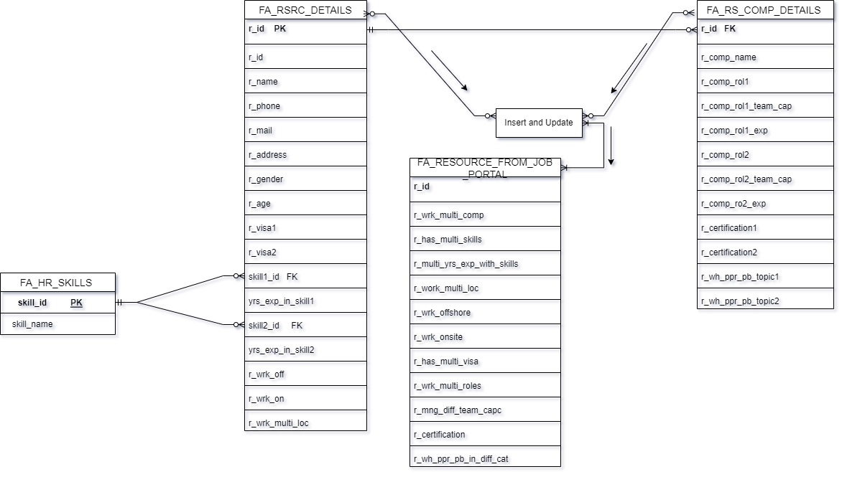
Database Concepts - SQL Server
1. Operations performed :
DDL(CREATE, DROP, ALTER)
DML,(INSERT,UPDATE,DELETE)
DQL(SELECT(JOINS, AGGREGATE
2. Normalization – 1NF, 2NF, 3NF
3. Joined the tables
4.Created views for different scenarios. The code and the snapshots are uploaded
in GitHub.
Fig. Entity Relation Diagram

Slide 3
Integration Services using SSIS
Tasks performed:
Data source creation : Cinema Ticket and Car sales
1. Business scenario : Cinema Ticket
Flat file Datasource
SQl Server DB
2. Connection – Connected to the flat file source
3. Extracted the data from the source
4. Transformation - Data Conversion, Conditional split to create separate tables for each film type.
5. Load - new DWH
a) New Target - FA_M2_SCD1_CAR_SALES for SCD1
a) New Target - FA_M2_SCD2_CAR_SALES for SCD2
DB Name : Sweekar
6). Used Aggregate package to aggregate the table based on a column. Data source: Car sales excel file, Target : sweekar Database
Git hub link:
Code and the Snapshots are uploaded in GitHub

Slide 4
Reporting Services using SSRS
Created a report to help car companies or anyone who are looking to start a new car dealership, Inserted map in the report to show the sales of cars in the geographical area, Inserted a column chart to show the time of the year when the car sales are the highest.
Created a report showing a car company’s specific details for the company to review.
Used the following elements,
MAP
Column Chart, Stacked column chart
PARAMETERS to individually view separate groups(ex:Carmaker, sales in a state etc.)

Slide 5
Integration services using IICS
Made connection to the database.
Performed Extract Transform(sort) and Load from DB to DB
Performed SCD1 and SCD2 in a mapping task.
Performed Aggregate task on Carmaker column of car sales table.
Performed a replication task on a table considering an auditing scenario from one DB to another.
Performed a replication task on entire DB

Slide 6
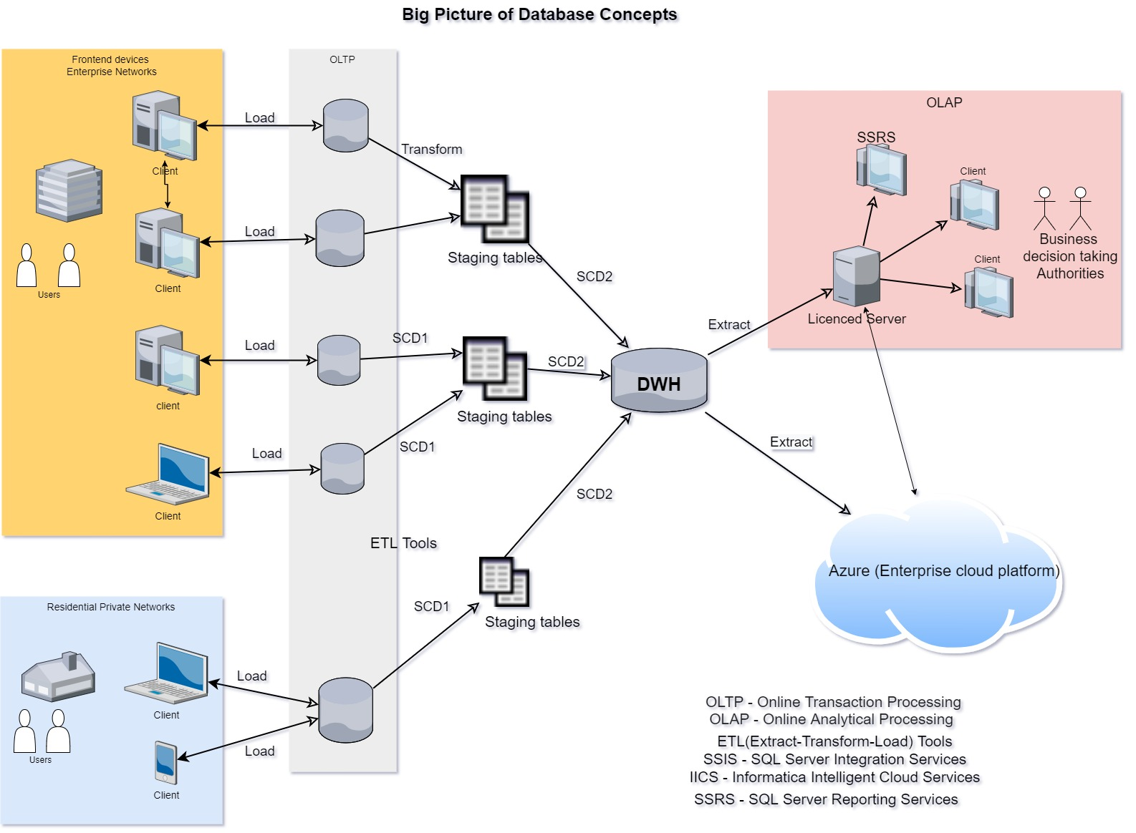
Big Picture

Slide 7
Links
GitHub
Blog
Presentation

