Slide 1
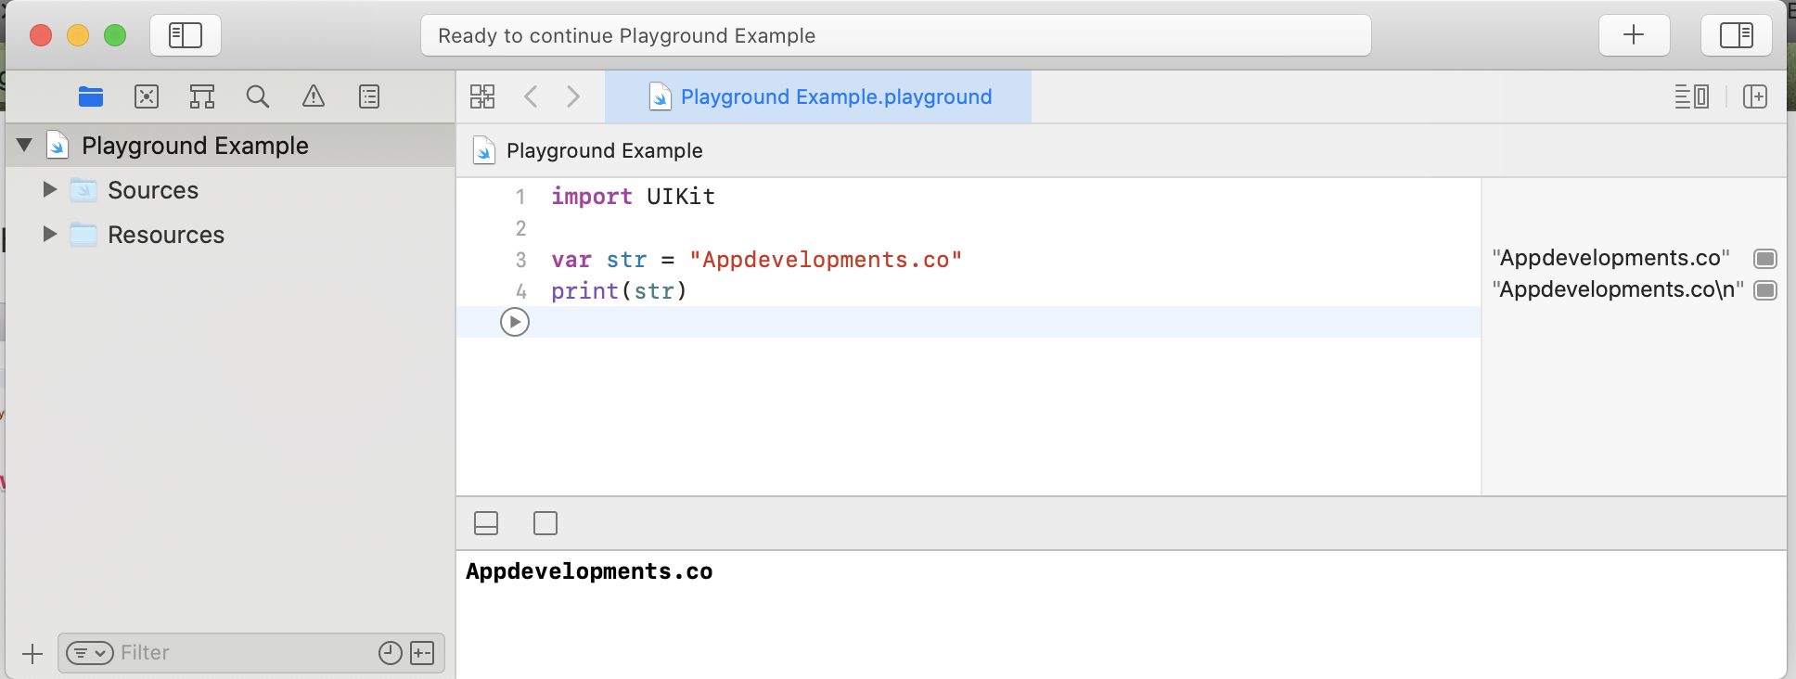
Show Navigator
Activity View
Show Inspectors
Pause/Play Button
Results Area
Navigator Area
Debug Area

