Slide 1
SEASONAL LIVING GUIDE / TEAM 05 / REVIEW DRAFT
Seasonal Living Guide
Regional temperature comparison and seasonal reference information
Team 05 · Weather Data Analysis
Evidence-based draft · November 11, 2026
One sequential Codex implementation; human contribution review pending
Historical grid data · LST dates · Results and limits in docs/test-results.md
1
Notes:
English rehearsal draft. Follow docs/demo-script.md. No personal speaking role is assigned. Verify the source package commit before final demonstration.

Slide 2
SEASONAL LIVING GUIDE / TEAM 05 / REVIEW DRAFT
A historical question, made explicit
Which requested location most often met both of my limits?
Same dates. Known valid-day denominator. Separate analysis menus.
Five locations: Seoul, Busan, Daegu, Gwangju and Jeju.
Historical gridded reanalysis; LST dates; preferences rather than safety scores.
Historical grid data · LST dates · Results and limits in docs/test-results.md
2
Notes:
English rehearsal draft. Follow docs/demo-script.md. No personal speaking role is assigned. Verify the source package commit before final demonstration.

Slide 3
SEASONAL LIVING GUIDE / TEAM 05 / REVIEW DRAFT
Data you can reproduce
5,480 NASA daily records · 2023–2025 · 1,096 dates per point
Five raw hashes match the supplied source version. Zero missing/duplicate dates.
72 KASI calendar-reference dates; 12 RDA monthly editorial items.
Reference snapshots adopted from supplied appendices; final almanac cross-check not performed.
Historical grid data · LST dates · Results and limits in docs/test-results.md
3
Notes:
English rehearsal draft. Follow docs/demo-script.md. No personal speaking role is assigned. Verify the source package commit before final demonstration.

Slide 4
SEASONAL LIVING GUIDE / TEAM 05 / REVIEW DRAFT
Six tables, deliberate relationships
Composite weather key: location_id + weather_date
Plans and selected locations are a normalized parent/association pair.
InnoDB FKs and pairwise CHECKs protect valid records.
Calendar and food guides are separate lookups, without artificial weather FKs.
Historical grid data · LST dates · Results and limits in docs/test-results.md
4
Notes:
English rehearsal draft. Follow docs/demo-script.md. No personal speaking role is assigned. Verify the source package commit before final demonstration.

Slide 5
SEASONAL LIVING GUIDE / TEAM 05 / REVIEW DRAFT
Complex grouping
Group by location × year × month, or location × year.
Valid-day means, ranges, extremes, matching and exceedance counts.
Thresholds classify days; they never remove the denominator.
Jan–Feb 2024: 60 valid days per point; raw-day weighted means.
Historical grid data · LST dates · Results and limits in docs/test-results.md
5
Notes:
English rehearsal draft. Follow docs/demo-script.md. No personal speaking role is assigned. Verify the source package commit before final demonstration.

Slide 6
SEASONAL LIVING GUIDE / TEAM 05 / REVIEW DRAFT
OLAP: details and the bigger picture
Year → month → day → month → year uses real SQL changes.
Drill dates intersect the common comparison period.
WITH ROLLUP creates annual, location and grand totals.
Five points × 60 days = 300 location-days, not 300 distinct dates.
Historical grid data · LST dates · Results and limits in docs/test-results.md
6
Notes:
English rehearsal draft. Follow docs/demo-script.md. No personal speaking role is assigned. Verify the source package commit before final demonstration.

Slide 7
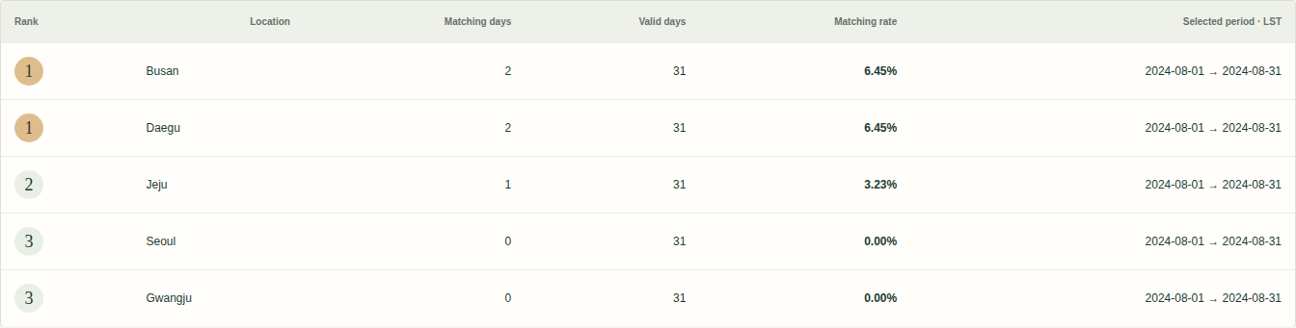
SEASONAL LIVING GUIDE / TEAM 05 / REVIEW DRAFT
Dense ranks preserve ties
August 2024 · maximum ≤28°C · daily range ≤10°C
Busan and Daegu: 2/31 = 6.45%, shared rank 1.
Top 1 returns both tied first-place regions. Unrounded DECIMAL rates determine ranks; display values round afterward.
Historical grid data · LST dates · Results and limits in docs/test-results.md
7
Notes:
English rehearsal draft. Follow docs/demo-script.md. No personal speaking role is assigned. Verify the source package commit before final demonstration.

Slide 8
SEASONAL LIVING GUIDE / TEAM 05 / REVIEW DRAFT
Windows preserve continuous history
Seoul · January 1, 2024 · daily mean metric
7-day mean 1.14°C · 30-day mean 0.30°C
Scan 29 days before display start, partition only by location. Incomplete/invalid/discontinuous frames stay NULL.
Historical grid data · LST dates · Results and limits in docs/test-results.md
8
Notes:
English rehearsal draft. Follow docs/demo-script.md. No personal speaking role is assigned. Verify the source package commit before final demonstration.

Slide 9
SEASONAL LIVING GUIDE / TEAM 05 / REVIEW DRAFT
Plans, Session and complete writes
Real web create, list/detail, edit, apply and delete.
Parent and all selected links commit together.
Saved common conditions are validated before applying to Session.
Shared demonstration records; no private per-user ownership claim.
Historical grid data · LST dates · Results and limits in docs/test-results.md
9
Notes:
English rehearsal draft. Follow docs/demo-script.md. No personal speaking role is assigned. Verify the source package commit before final demonstration.

Slide 10
SEASONAL LIVING GUIDE / TEAM 05 / REVIEW DRAFT
Show actual failure evidence
Create: parent INSERT succeeds, later child FK fails, no residues remain.
Update: body and old links change, later child fails, original snapshot restored.
CLI-only failure boundary; no web failure switch.
Native binding, escaped script, CSRF, strict dates/IDs and Unicode limits tested.
Historical grid data · LST dates · Results and limits in docs/test-results.md
10
Notes:
English rehearsal draft. Follow docs/demo-script.md. No personal speaking role is assigned. Verify the source package commit before final demonstration.

Slide 11
SEASONAL LIVING GUIDE / TEAM 05 / REVIEW DRAFT
Install from delivered SQL + PHP
Actual official XAMPP: PHP 8.2.12 / Apache 2.4.58 / MariaDB 10.4.32
htdocs/team05 · unchanged team05 defaults · network mode none
Create/insert, reset, all nine screens, CRUD and rollback suites passed.
Actual dump restored by bundled mysql client; data and keys match.
Historical grid data · LST dates · Results and limits in docs/test-results.md
11
Notes:
English rehearsal draft. Follow docs/demo-script.md. No personal speaking role is assigned. Verify the source package commit before final demonstration.

Slide 12
SEASONAL LIVING GUIDE / TEAM 05 / REVIEW DRAFT
Demonstrate the same version
Review package records COMMIT_SHA and verifies every archive member.
Report/paper PDFs and result captures reflect executed tests.
No performance benchmark or user study was performed.
Human contribution confirmation, English rehearsal and course upload remain pending.
Historical grid data · LST dates · Results and limits in docs/test-results.md
12
Notes:
English rehearsal draft. Follow docs/demo-script.md. No personal speaking role is assigned. Verify the source package commit before final demonstration.

