Slide 1

Project Review
Done by Quincy

Slide 2

TCGA Open Data Set Analysis Project
Simple Project Review

Slide 3
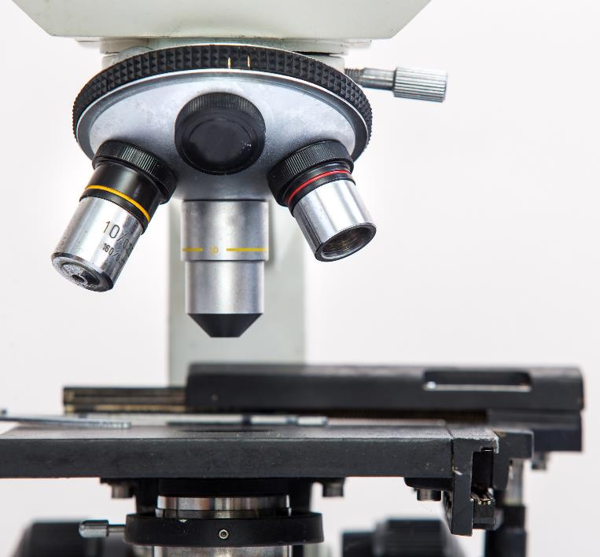
Gathering Clinical Data from TCGA
Generate CSV File with the data as needed
Pick up one gene which is TP53 as the test gene to generate a new csv file contains all the clinical data for 460 patients as needed
The file contains the clinical data which are the patient id, days to follow up, days to death, days to new tumor event after initial treatment, days to last known alive
Alson contains the maximum days of death, maximum days of follow up, minimal days of new tumor event after initial treatment, overall survival days, disease free survival days
In addition to these, the vital status, last vital status, valid variant classification, censored group, tp54 gene mutation and expression

Slide 4
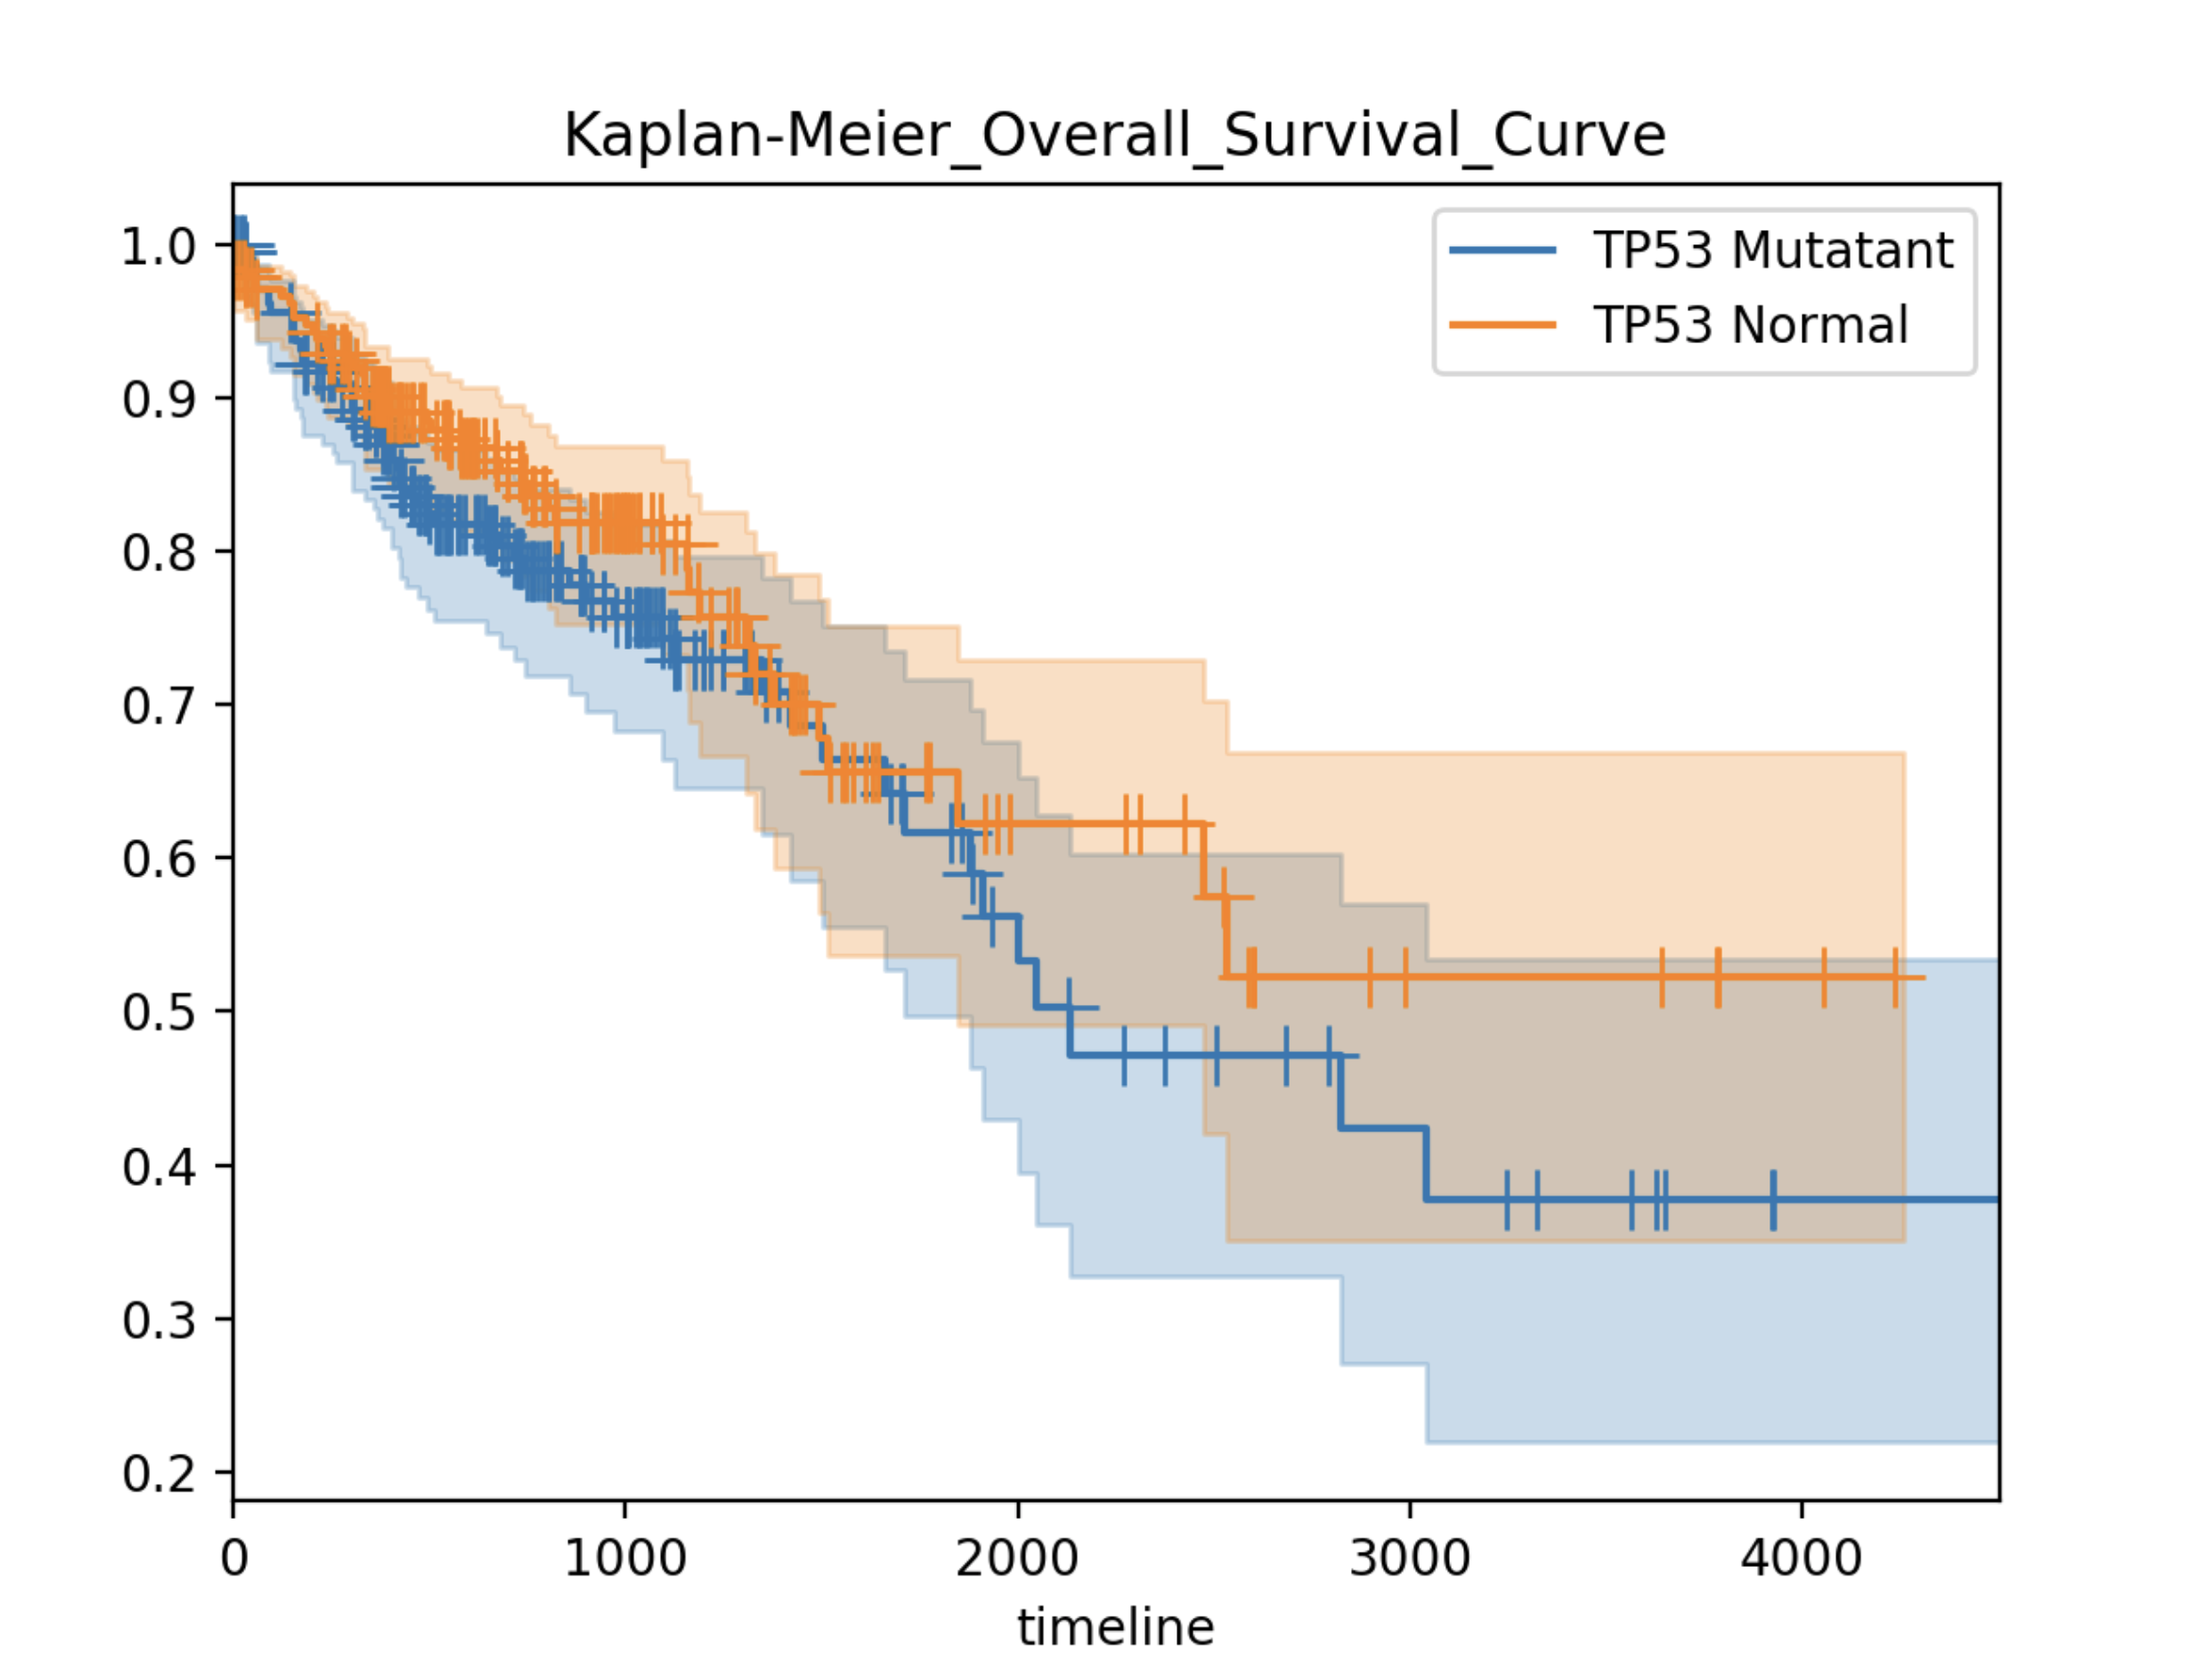
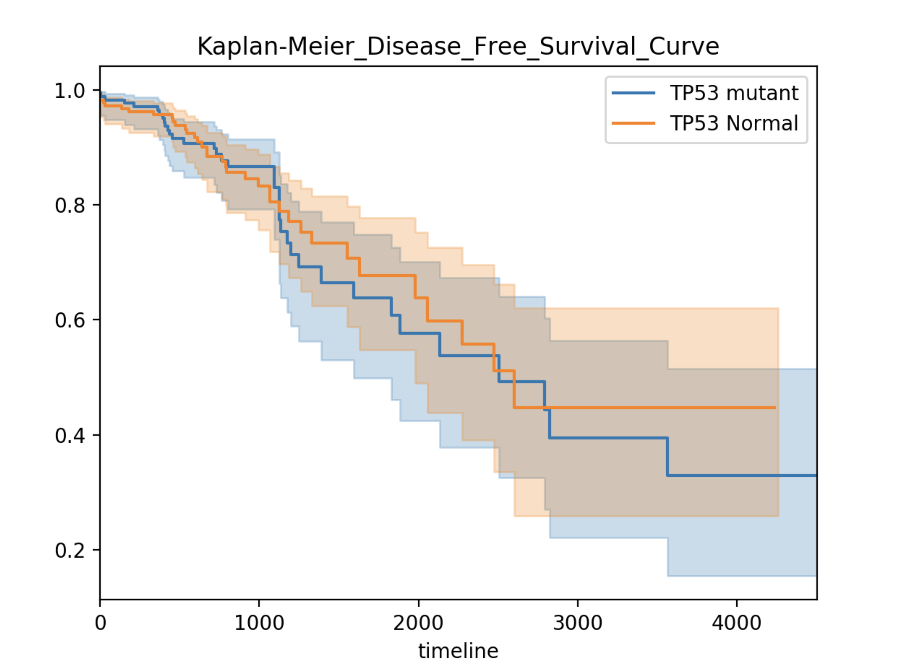
Survival Curve
Based on the csv file
Generate Kaplan-Meier Survival Curve based on the csv file and output the overall survival and disease free survival curves
The overall survival curve is the upper left one
The disease free survival curve is the lower left one

Slide 5
RNA & Protein Expression Analysis
RNA Expression Analysis
Protein Expression Analysis
Based on the L3 csv file download from TCPA dataset by UT-Southwestern Medical Center, the generated new csv file and the metadata json file to analyse the RNA Exp.
Use the median value as the separated line to divide the RNAseq Exp data into high (upper half) and low (lower half) two groups, calculate these P-Values, and generate the overall and disease free survival curves
Separate the RNAseq Exp data into high (upper quartile) and low (lower quartile) two groups, calculate these P-Values, and generate the overall and disease free survival curves
Based on the L3 csv file download from TCPA dataset by UT-Southwestern Medical Center and the generated new csv file to analyse the Protein Exp.
Use the median value as the separated line to divide the Protein Exp data into high (upper half) and low (lower half) two groups, calculate these P-Values, and generate the overall and disease free survival curves
Separate the Protein Exp data into high (upper quartile) and low (lower quartile) two groups, calculate these P-Values, and generate the overall and disease free survival curves

Slide 6
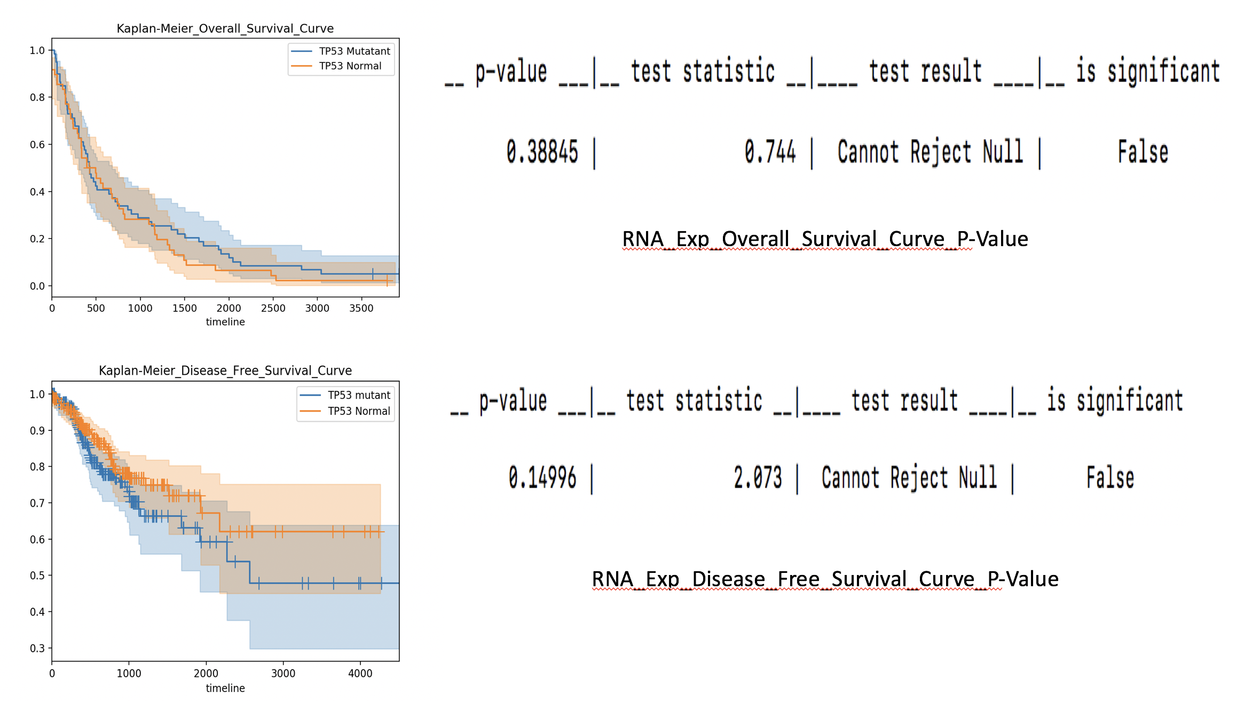
RNA Expression Survival Curve
Growth
Shows
Sales

Slide 7
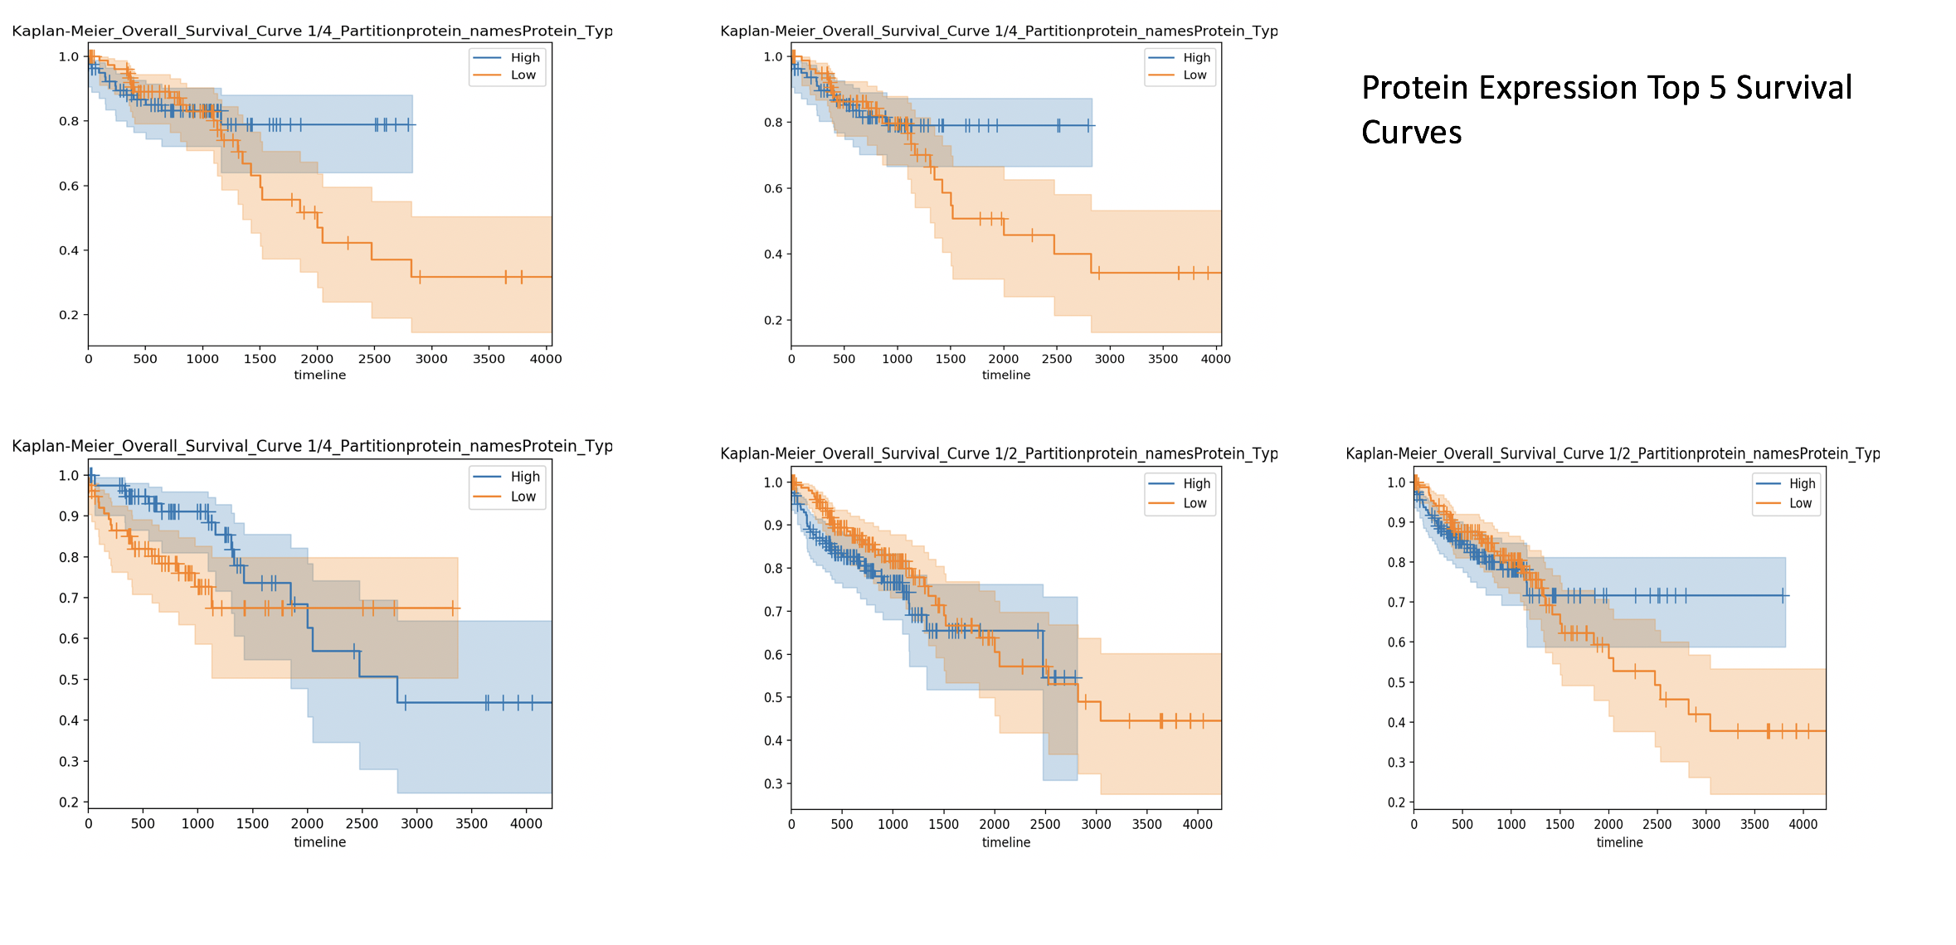
Protein Expression Survival Curve
Growth
Shows
Sales

Slide 8
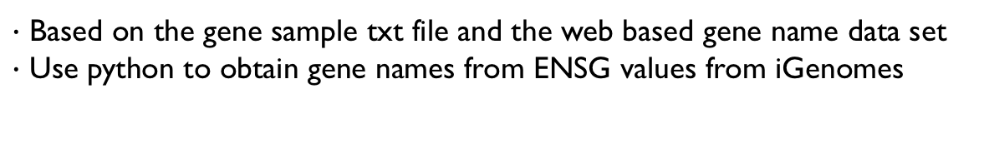
Gene Table Generation
$∙$ Based on the gene sample txt file and the web based gene name data set
$∙$ Use python to obtain gene names from ENSG values from iGenomes
Growth
Shows
Sales

