Slide 1
V2.3.0
New Features and Process

Slide 2
Search Invoices By SKU
This feature can be found in the sales page.
Using the same textbox for invoice searching, you can now enter a SKU and the invoices that have that item will be returned for the location you have selected.

Slide 3
Changing Customer Mid Sale
If you want to change or add a customer mid sale, the functionality of doing so has now been added.
Notice at the top of the sale there is a textbox showing the current customer’s name and a button that reads Select Different Customer.
To change the customer, type the first and/or last name, or phone number of the customer you are looking for and press the button.

Slide 4
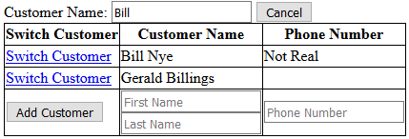
Changing Customer Mid Sale cont.
If the customer is found, it will return
them in a list.
To switch the customer, click the blue text.
When you switch a customer mid sale, all inventory already in the cart will remain in the cart.
Adding a customer is as easy as entering a first and last name in the boxes at the bottom of the list. The phone number is optional.
This will show up at the bottom of every search.
If you want to add a customer, an easy way to do that is leave the customer name box empty and pressing the button next to it for a blank sale.
The newly added customer will become the customer of the current sale.

Slide 5

Searching For Customers and Items
When you make a search for either customers or items, the list will be broken up into 25 rows per page.
This was added to allow easier navigation when searching for an item in a big list.
To change between pages, press the numbered buttons at the bottom of the list.

Slide 6
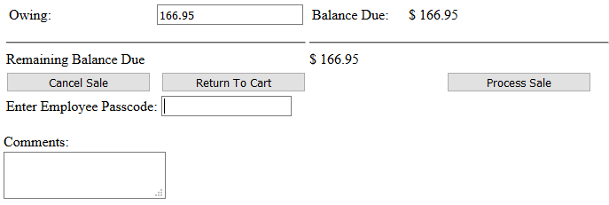
Changes in Processing Sales
Before a sale can be processed, the user must now enter their employee passcode in the checkout screen.
The textbox for doing that is located near the bottom of the page.

Slide 7
Adding Customers to Email List
If you want to add a customer to the email list, create the customer or go to their profile page and press Edit Customer.
Next the email textbox is a checkbox for adding the customer to the email list.

Slide 8
Export – Email List
To go along with the ability of adding customers to an email list, a new export has been created.
You will find this under the Settings header in the Export Items To Excel section.
The information exported is the first, and last name, and the customer’s email address.

Slide 9
Viewing Invoices On Customer Profiles
When you view a customer’s profile, you now see all invoices that are associated with them.

Slide 12
Minor Updates/Changes
Returns now show up on the homepage.
Invoices now have a timestamp.
Pressing enter on the sales page searches for invoices.

