Slide 1
Introduction to Data Structures
HW 1 (Total 20 points)
Jong Hwan Ko
jhko@skku.edu

Slide 2
1. Dynamic Array (6 points)
1. Implement a dynamic array as in the code fragments 5.3 in the textbook
2. Doubling vs. incremental replacement
The original code implements the ‘doubling’ replacement strategy in the append() method
Add append_incremental() method with an input parameter c to implement the incremental replacement strategy with a constant c
Experimentally compare the runtime of append() and append_incremental() over a sequence of n calls, as in the code fragment 5.4 and Table 5.2

Slide 3
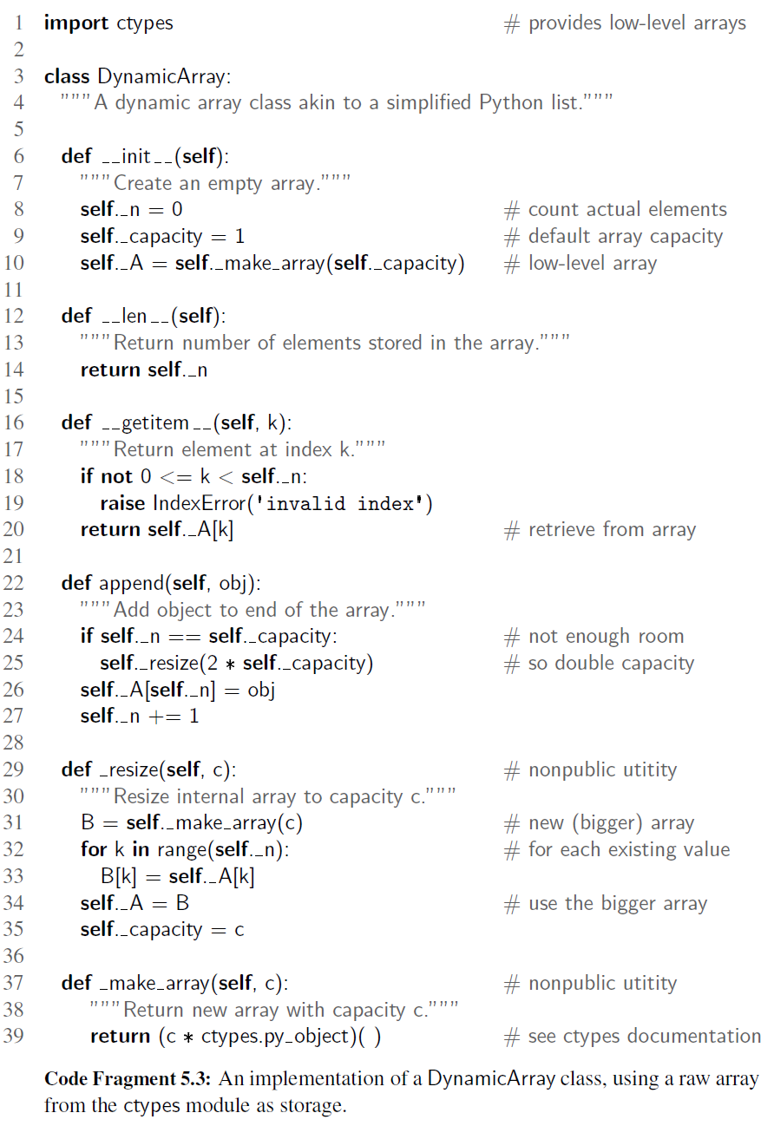
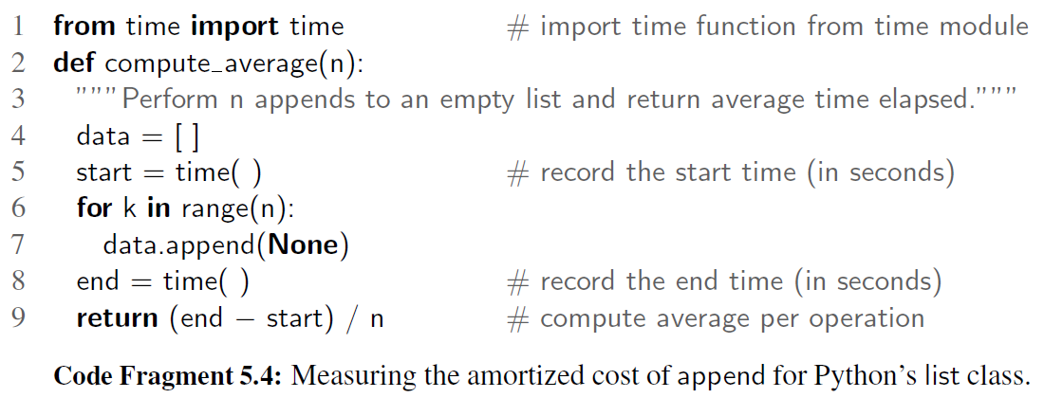
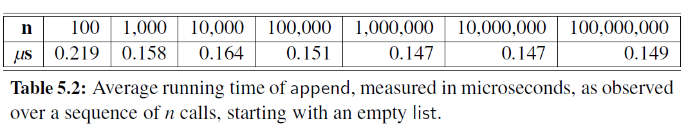
1. Dynamic Array

Slide 4
2. Stack (6 points)
1. Implement an array-based stack as in the code fragments 6.1 and 6.2 in the textbook
2. Using this stack data structure, implement a program that determines whether the user’s string input is palindrome or not

Slide 5
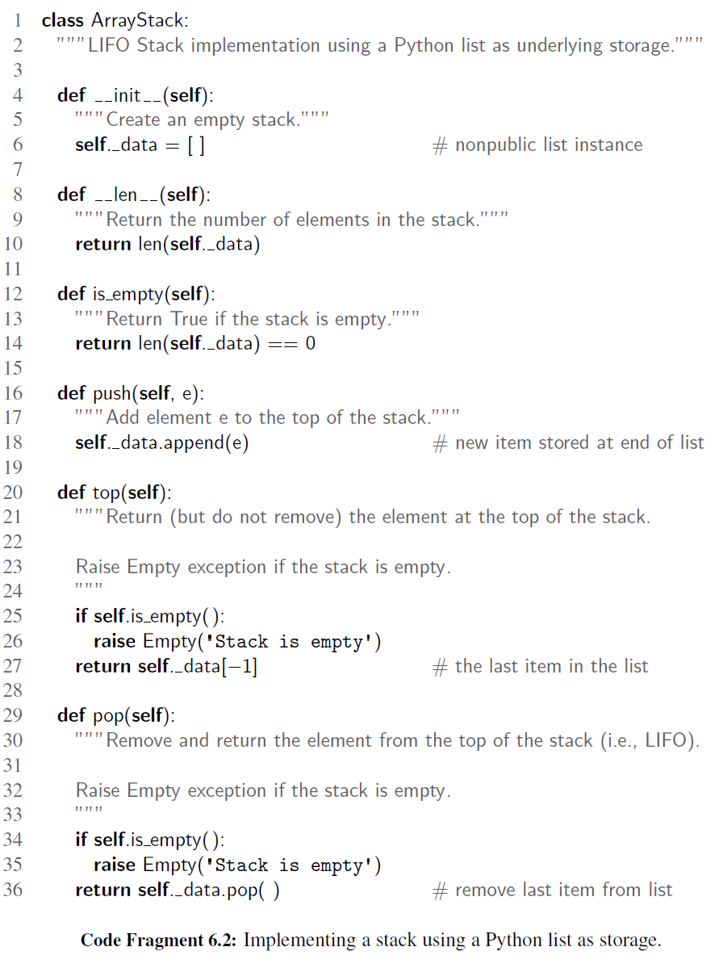
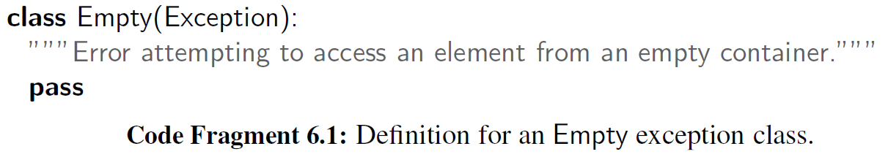
2. Stack

Slide 6
3. Queue (8 points)
1. Implement an array-based double-ended queue with the abstract data type in chap. 6.3.1, based on the code fragments 6.6 and 6.7.
2. Implement the palindrome checker using this Deque data structure
3. Compare the asymptotic running time of the stack-based and Deque-based palindrome checker algorithms. Also perform some experiments to compare the actual running time of the two implementations for the various number of string size ‘n’

Slide 7
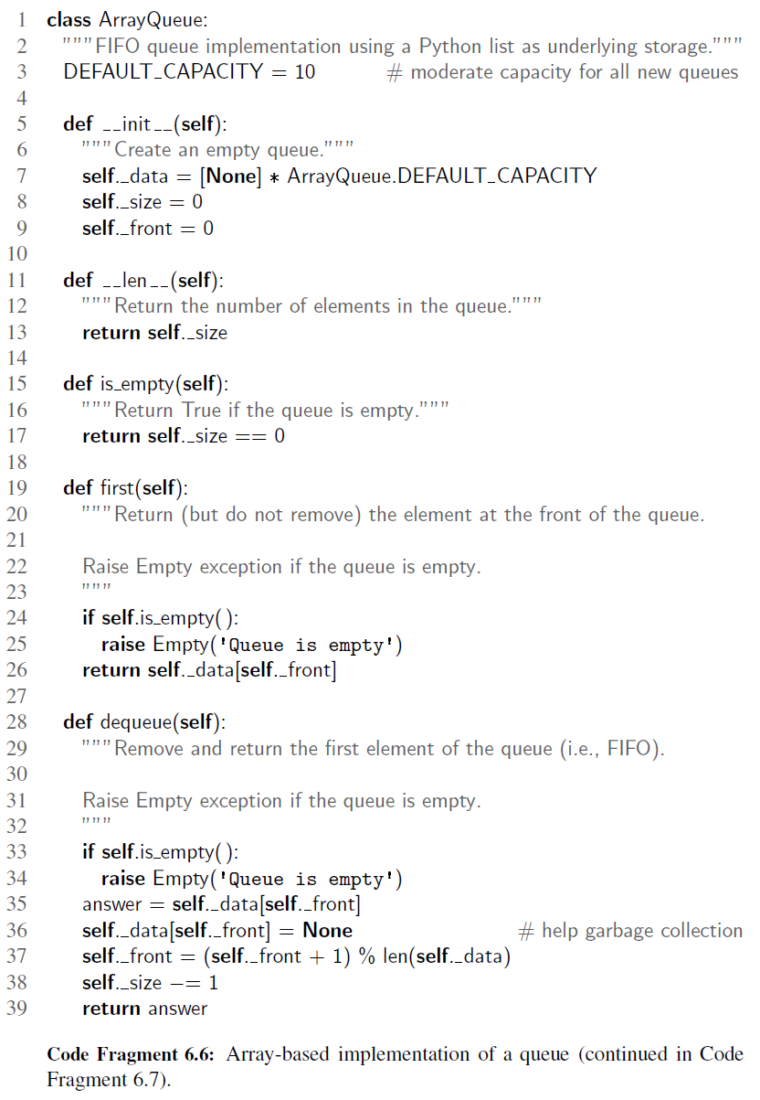
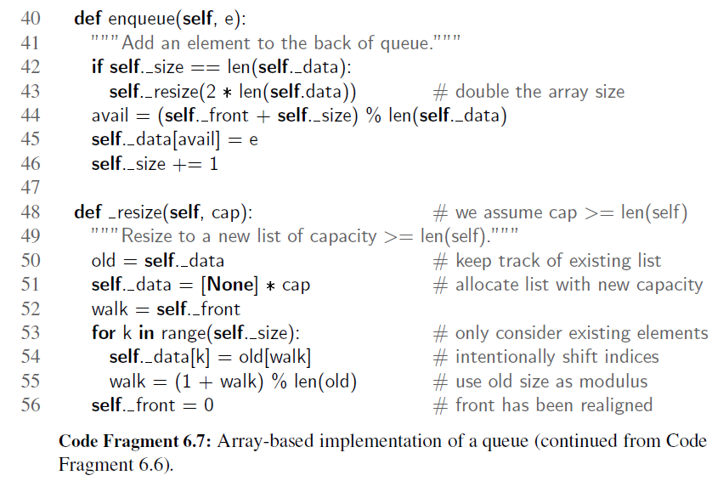
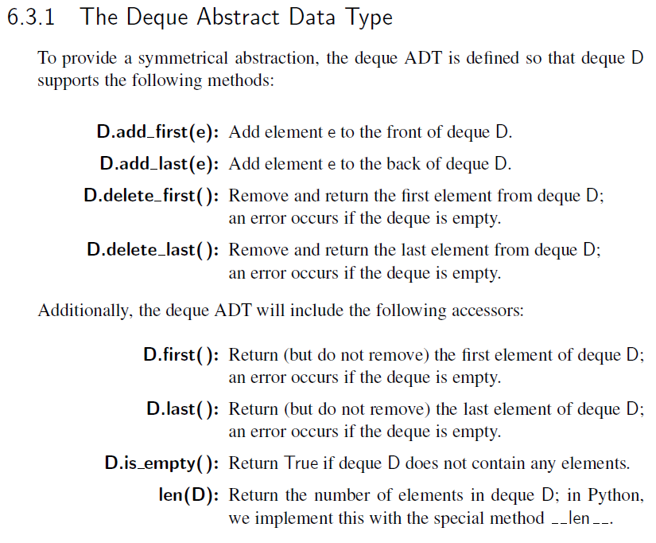
3. Queue

