Slide 1
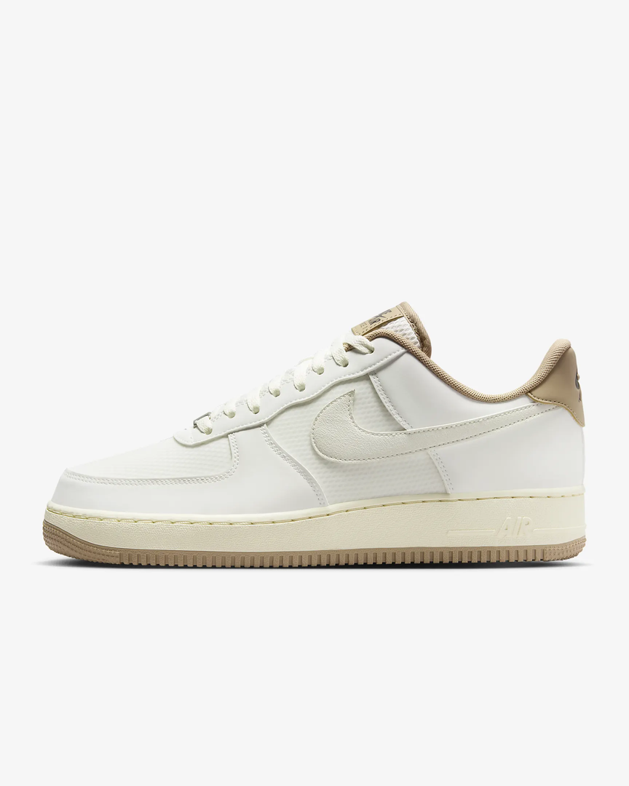
MINI GAME

Slide 2
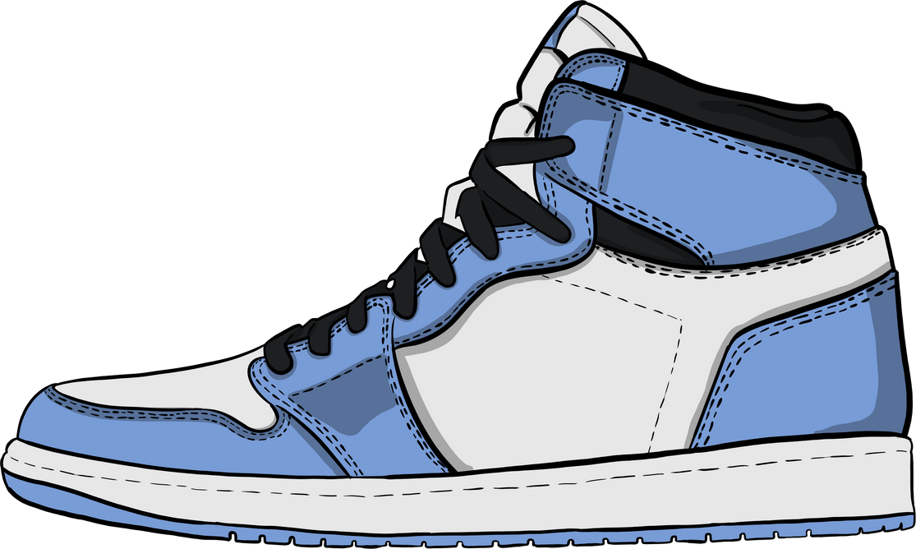











QUESTION:
When were the legendary AF1 sneakers first launched?
1980
1981
1982
1983

Slide 3

Who is this?

Slide 4
QUESTION:
When were the legendary AF1 sneakers first launched?
1980
1981
1982
1983

