Slide 1

Jay Humphreys | Greg Hansell | Alex Elias | Chris Sweet

Slide 2


The HiveMap Vision
“???”

Slide 3
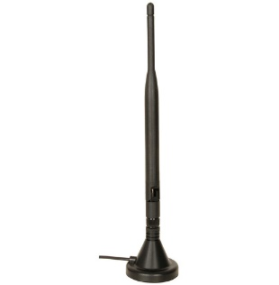

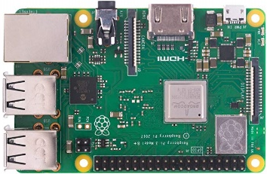
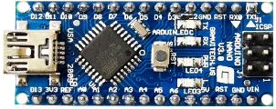





Network Topology
nRF24
nRF24
nRF24
http
http
nRF24
http
A Layer:
Arduinos and Sensors
π Layer:
Raspberry Pis

Slide 4
Next Steps

Slide 5
Next Steps

