Slide 1
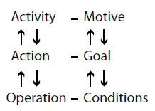
Activity Theory
requires considerable learning and experience
helps to identify tensions and contradictions

Slide 2
Grounded Theory
Collect data
Analyse data
Develop theory
depends on the skills of the analyst
very time-consuming
generates new theory

Slide 3
Hybrid Theories
CSCW
CMC
DAI
Hybrid Theory
difficult for other researchers to use in practice
synthesizes new concepts

