Slide 1
OmniCare CX Agent
AI-Powered SMS Auto-Responder using Vonage APIs
DevNetwork Hackathon 2025 – Vonage Challenge #2
Sweety Seelam

Slide 2

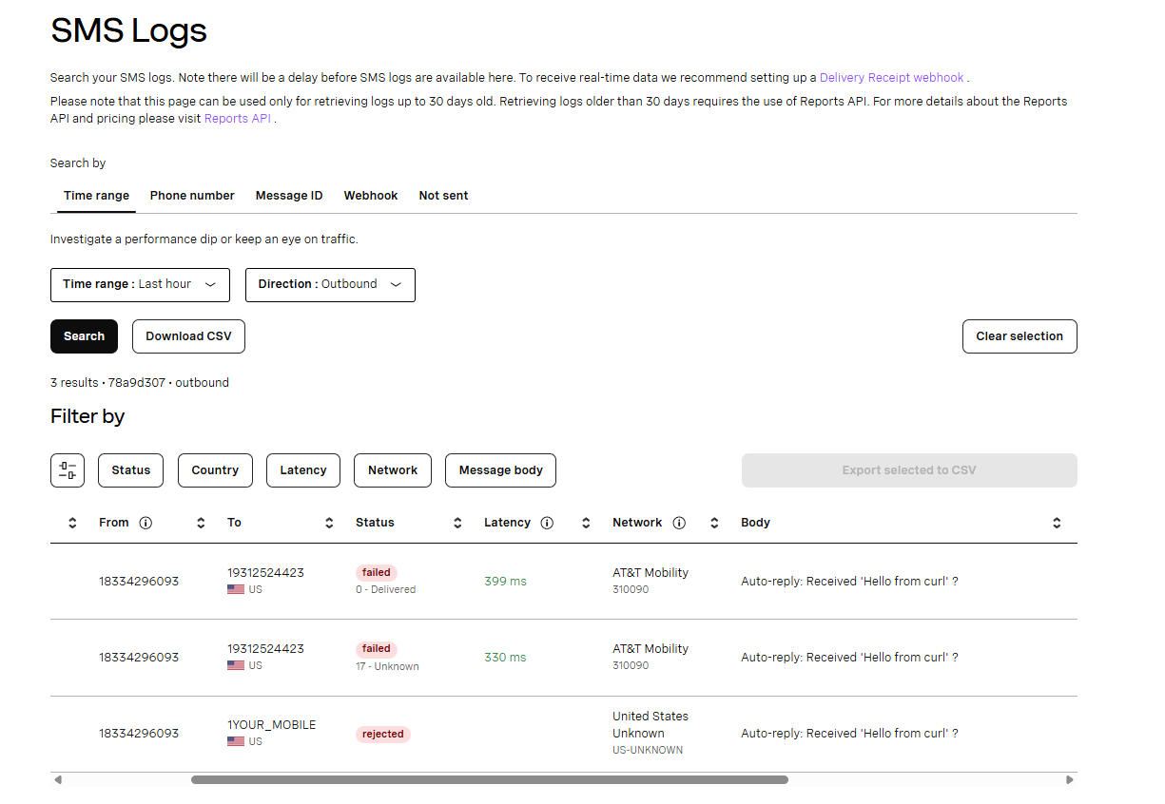
Problem
Customers often send inquiries via SMS but receive delayed responses.
This hurts customer experience & retention.

Slide 3
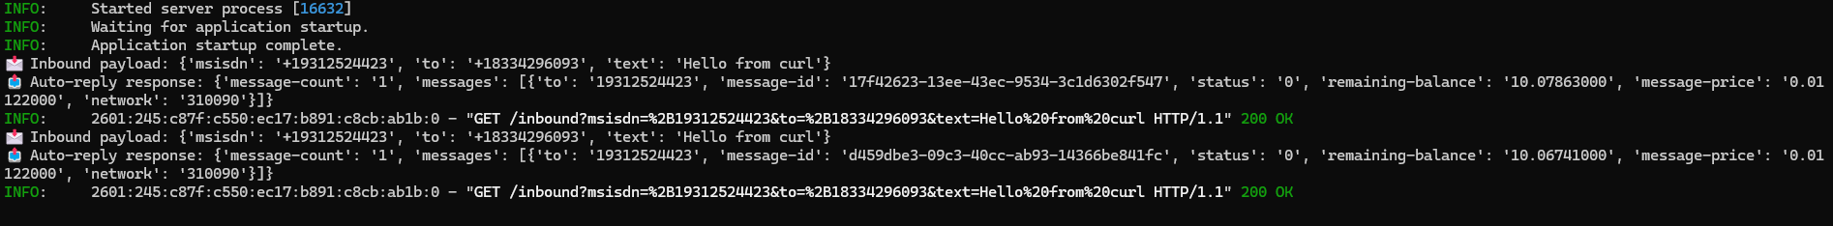
Solution
OmniCare CX Agent: Automated SMS responder.
Instant acknowledgment of inbound SMS using Vonage APIs.
Extensible to WhatsApp, Messenger, and Viber.

Slide 4
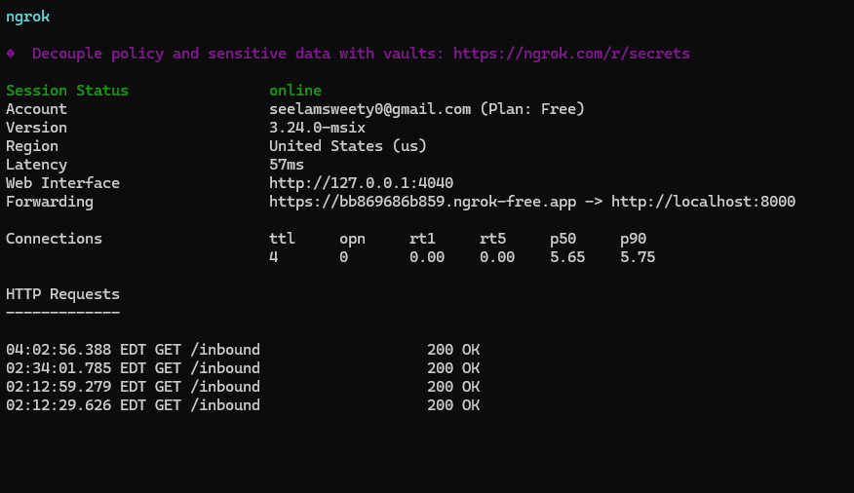
Tech Stack
Python + FastAPI
Vonage SMS API
ngrok (webhook tunnel)
dotenv for secrets

Slide 5
What’s Next
AI/NLP for smart contextual replies
Multi-channel expansion
CRM integration (Salesforce, HubSpot)
Cloud deployment (AWS/GCP/Azure)

Slide 6
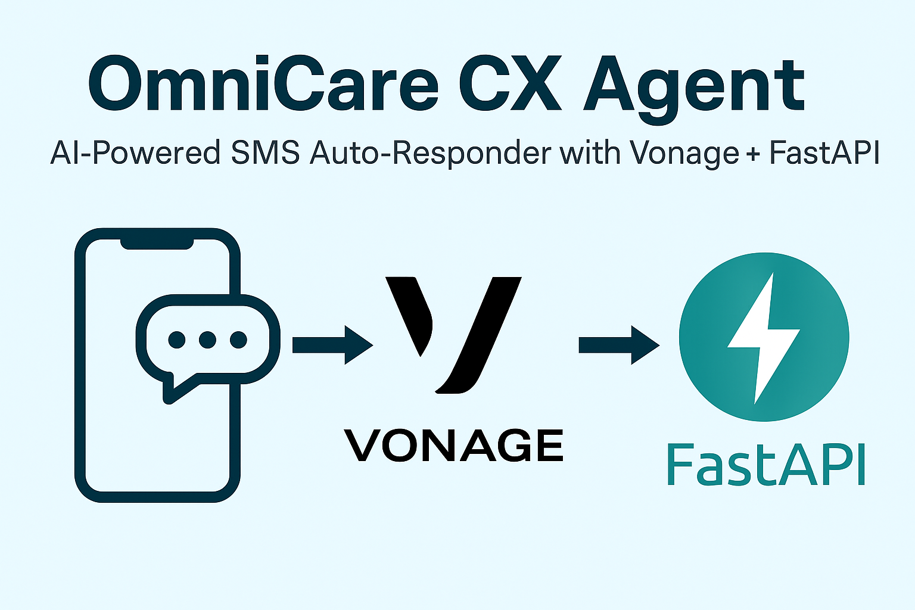
Thank You
Thank you for watching.
GitHub Repo: https://github.com/SweetySeelam2/DevNetwork-Devpost-Hackathon
Built by Sweety Seelam

