Slide 1
Submarine propellers
Modern submarines use highly skewed propellers with an odd number of blades.
The governing factors in submarine propeller design are cavitation and vibration often at the expense of propeller efficiency
Odd number of blades is chosen to minimize vibration
An odd number of blades is used because there are an even number of appendages at the stern
a rudder at the top and bottom
stern planes both port and starboard
An odd number of blades guarantees that no two blades will be entering the disturbed flow behind the appendages at the same time.

Slide 2
Submarine propellers
The forces causing vibration will not reinforce each other

Slide 3
Submarine propellers
Skewed propeller advantages.
• Reduced Vibration. The entire blade does not enter disturbed flow at the same time. In fact, the blade tip may be leaving as another part of the same blade is entering. The amount of the propeller subjected to a disturbance at any one time is reduced and therefore vibration is reduced.
• Reduced Cavitation. The shape is thought to produce a radial flow near the blade tips which sweeps cavitation sheets into the tip flow (vortices - or rotating flow). Here the cavitation bubbles collapse gradually reducing the noise level.

Slide 4
Submarine propellers
Skewed propeller disadvantages.
• Very inefficient for backing.
• Very difficult and expensive to manufacture.
• The unusual shape reduces the strength of the blades.
For the special considerations of submarine operation and the absolute need for stealth, the advantages of the highly skewed propeller outweigh the disadvantages.

Slide 5
Submarine propellers configurations
Single axial propeller
Ship-like twin screw propulsion

Slide 6
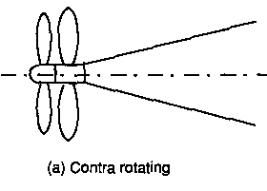
Submarine propellers variations

Slide 7
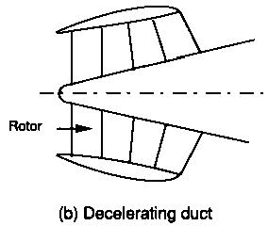
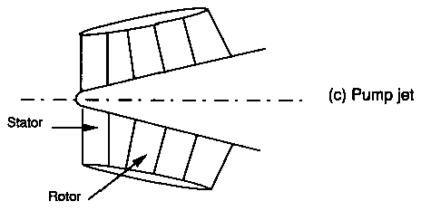
Submarine propellers duct variations

Slide 8
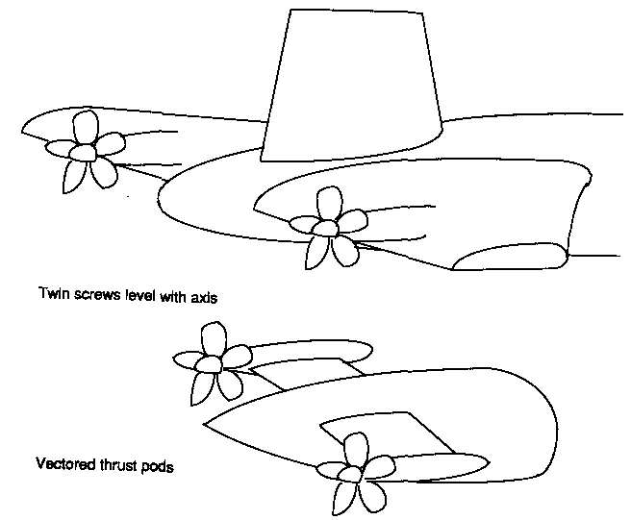
Submarine propellers twin screw variations

