Slide 1

Stanford CS224W: Reasoning over Knowledge Graphs
Note to other teachers and users of these slides: We would be delighted if you found our material useful for giving your own lectures. Feel free to use these slides verbatim, or to modify them to fit your own needs. If you make use of a significant portion of these slides in your own lecture, please include this message, or a link to our web site: http://cs224w.Stanford.edu
CS224W: Machine Learning with Graphs
Jure Leskovec, Stanford University
http://cs224w.stanford.edu

Slide 2
Announcements
10/31: Homework 3 released
11/4 (Mon): Homework 2 due
Gradescope submissions close at midnight
HW 2 was updated last Wednesday (check Ed)!
Recitation recording is on Edstem
11/5 (Tues): No class – election day
Attend Stanford Graph Learning Workshop: https://snap.stanford.edu/graphlearning-workshop-2024/
11/7 (Thurs): Colab 3 due
11/7 (Tues): Project Milestone due

Slide 3
Response to high-frequency feedbacks
Ed post
We will enforce 24 hours response time.
Assignment description
We will make sure to expand the homework description to make them clear

Slide 4
Recap: KG Completion Task
Given an enormous KG, can we complete the KG?
For a given (head, relation), we predict missing tails.
(Note this is slightly different from link prediction task)
missing relation: genre
J.R.R Tolkien
Science Fiction
Example task: Predict the tail “Science Fiction” for (“J.K. Rowling”, “genre”)
genre
genre
Influence
genre
Fantasy
Stephen King
genre
Influence
J.K. Rowling
Influence
Influence
C.S. Lewis
genre
Influence
Alan Poe
Tragicomedy
Lloyd Alexander

Slide 5
Today: Reasoning over KGs
Goal:
How to perform multi-hop reasoning over KGs?
Reasoning over Knowledge Graphs
Answering multi-hop queries
Path Queries
Conjunctive Queries
Query2Box

Slide 6
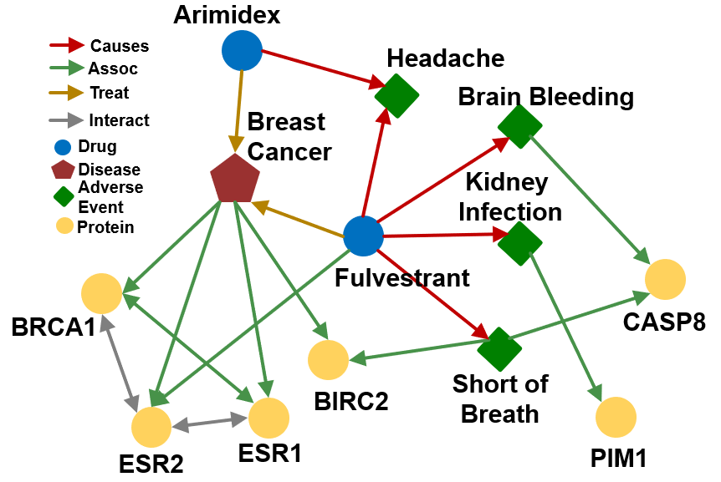
Example KG: Biomedicine

Slide 7
Predictive Queries on KG
Can we do multi-hop reasoning, i.e., answer complex queries on an incomplete, massive KG?
Query Types | Examples: Natural Language Question, Query
One-hop Queries | What adverse event is caused by Fulvestrant? (e:Fulvestrant, (r:Causes))
Path Queries | What protein is associated with the adverse event caused by Fulvestrant? (e:Fulvestrant, (r:Causes, r:Assoc))
Conjunctive Queries | What is the drug that treats breast cancer and caused headache? ((e:BreastCancer, (r:TreatedBy)), (e:Migraine, (r:CausedBy))
In this lecture, we only focus on answering queries on a KG! The notation will be detailed next.
One-hop Queries
Path Queries
Conjunctive Queries

Slide 8
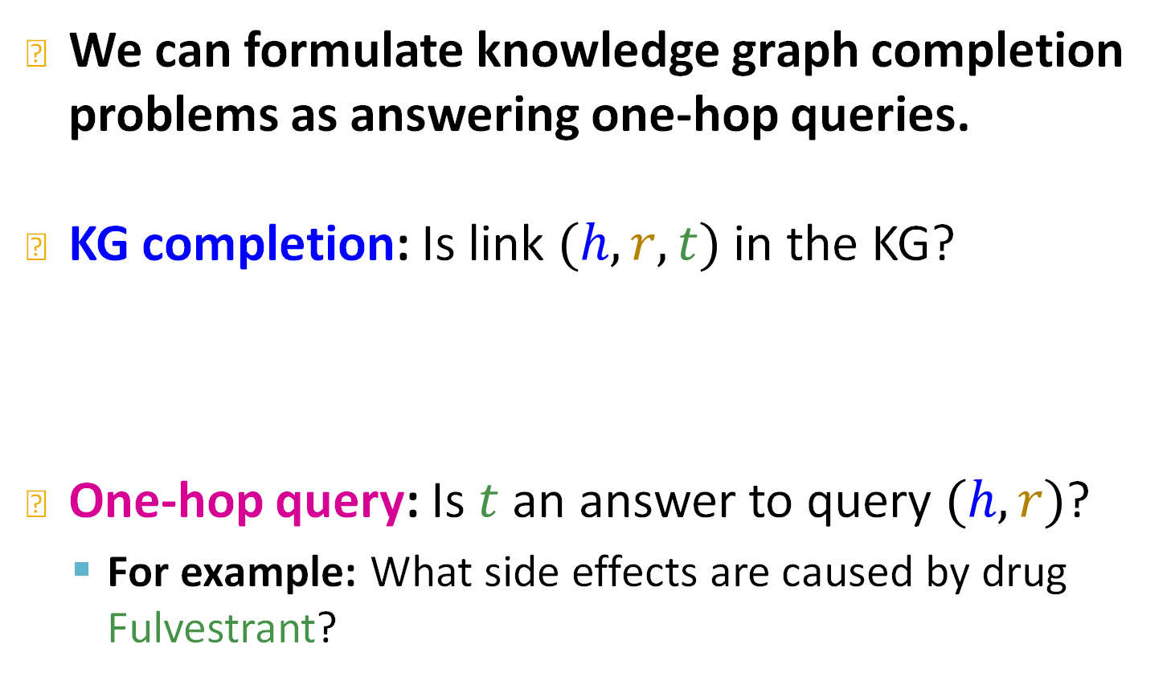
Predictive One-hop Queries
We can formulate knowledge graph completion problems as answering one-hop queries.
KG completion: Is link $(h,r,t)$ in the KG?
One-hop query: Is $t$ an answer to query $(h,r)$?
For example: What side effects are caused by drug Fulvestrant?

Slide 9


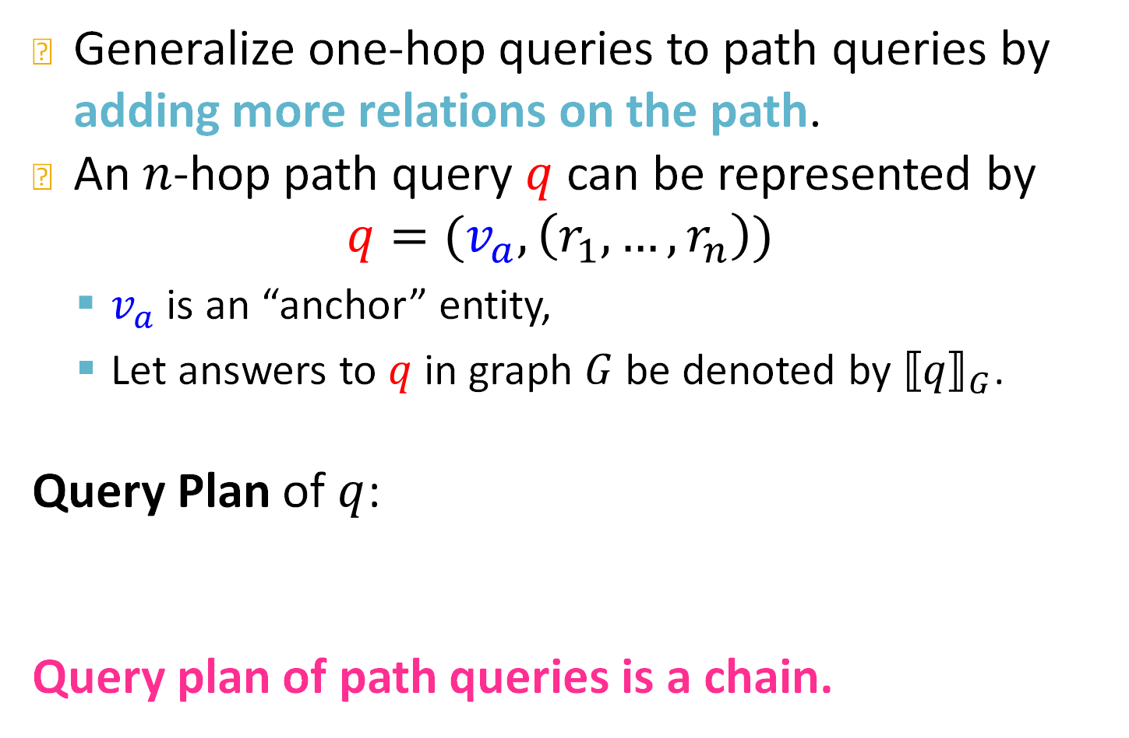



Path Queries
Generalize one-hop queries to path queries by adding more relations on the path.
An $n$-hop path query $q$ can be represented by
$$q=(v_{a},\left(r_{1},…,r_{n}\right))$$
$v_{a}$ is an “anchor” entity,
Let answers to $q$in graph $G$ be denoted by ${⟦q⟧}_{G}$.
Query Plan of $q$:
Query plan of path queries is a chain.
$$r_{1}$$
$$r_{2}$$
…
$$r_{n}$$
$$v_{a}$$
$$V_{?}$$

Slide 10


Path Queries
Question: “What proteins are associated with adverse events caused by Fulvestrant?”
$v_{a}$ is e:Fulvestrant
$\left(r_{1},r_{2}\right)$ is (r:Causes, r:Assoc)
Query: (e:Fulvestrant, (r:Causes, r:Assoc))
Causes
Assoc
$$V$$
$$V_{?}$$
Fulvestrant

Slide 11
Path Queries
Question: “What proteins are associated with adverse events caused by Fulvestrant?”
Query: (e:Fulvestrant, (r:Causes, r:Assoc))
Given a KG, how to answer a path query?

Slide 12
Traversing Knowledge Graphs
We answer path queries by traversing the KG: “What proteins are associated with adverse events caused by Fulvestrant?”
Query: (e:Fulvestrant, (r:Causes, r:Assoc))
Fulvestrant
Start from the anchor node (Fulvestrant).

Slide 13
Traversing Knowledge Graphs
We answer path queries by traversing the KG: “What proteins are associated with adverse events caused by Fulvestrant?”
Query: (e:Fulvestrant, (r:Causes, r:Assoc))
Headache
Brain Bleeding
Causes
Fulvestrant
Short of
Breath
Start from the anchor node “Fulvestrant” and traverse the KG by the relation “Causes”, we reach entities {“Brain Bleeding”, “Short of Breath”, “Kidney Infection”, “Headache”}.
Kidney
Infection

Slide 14
Traversing Knowledge Graphs
We answer path queries by traversing the KG: “What proteins are associated with adverse events caused by Fulvestrant?”
Query: (e:Fulvestrant, (r:Causes, r:Assoc))
Headache
Brain Bleeding
CASP8
Causes
BIRC2
Fulvestrant
Short of
Breath
Assoc
Start from the nodes {“Brain Bleeding”, “Short of Breath”, “Kidney Infection”, “Headache”} and traverse the KG by the relation “Assoc”, we reach entities {“CASP8”, “BIRC2”, “PIM1”}. These are the answers.
Kidney
Infection
PIM1
Answers!

Slide 15
However, KGs are incomplete
Answering queries seems easy: Just traverse the graph.
But KGs are incomplete and unknown:
Many relations between entities are missing or are incomplete
For example, we lack all the biomedical knowledge
Enumerating all the facts takes non-trivial time and cost, we cannot hope that KGs will ever be fully complete
Due to KG incompleteness, one is not able to identify all the answer entities

Slide 16
Example: Incomplete KG
We answer path queries by traversing the KG: “What proteins are associated with adverse events caused by Fulvestrant?”
Query: (e:Fulvestrant, (r:Causes, r:Assoc))
Headache
Brain Bleeding
CASP8
Causes
BIRC2
Fulvestrant
Missing Answer!
Short of
Breath
Assoc
Kidney
Infection
PIM1
Answers!

Slide 17



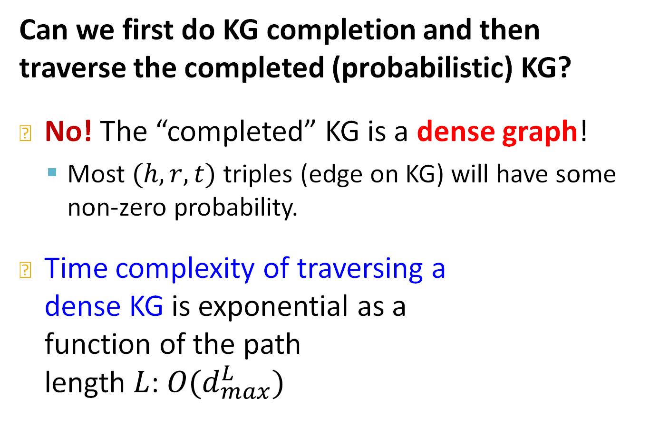





Can KG Completion Help?
Can we first do KG completion and then traverse the completed (probabilistic) KG?
No! The “completed” KG is a dense graph!
Most $(h,r,t)$ triples (edge on KG) will have some non-zero probability.
Time complexity of traversing a dense KG is exponential as a function of the path length $L$: $O(d_{max}^{L})$
$$v_{1}$$
$$r_{2}$$
$$v_{1}$$
$$r_{1}$$
$$v_{2}$$
…
…
$$v_{2}$$
…
$$v_{d_{max}}$$
$$v_{a}$$
…
$$v_{d_{max}}$$

Slide 18


Task: Predictive Queries
We need a way to answer path-based queries over an incomplete knowledge graph.
We want our approach to implicitly impute and account for the incomplete KG.
Task: Predictive queries
Want to be able to answer arbitrary queries while implicitly imputing for the missing information
Generalization of the link prediction task
Causes
Assoc
$$V$$
$$V_{?}$$
Fulvestrant

Slide 19
Outline of the Lecture
1) Given entity embeddings, how do we answer an arbitrary query?
Path queries: Using a generalization of TransE
Conjunctive queries: Using Query2Box
And-Or Queries: Using Query2Box and query rewriting
(We will assume entity embeddings and relation embeddings are given)
2) How do we train the embeddings?
The process of determining entity and relation embeddings which allow us to embed a query.

Slide 20
Stanford CS224W: Answering Predictive Queries on Knowledge Graphs
CS224W: Machine Learning with Graphs
Jure Leskovec, Stanford University
http://cs224w.stanford.edu

Slide 21
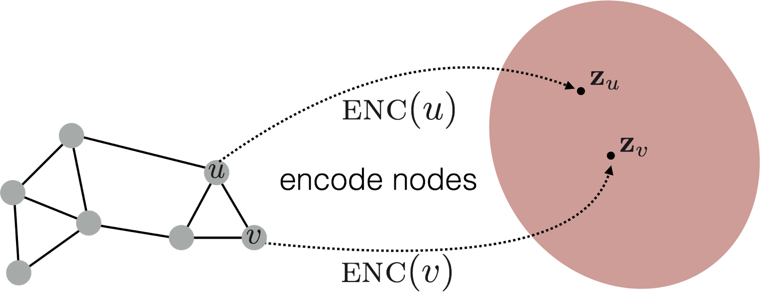
General Idea
Predictive
query
Reason in the embedding space
Knowledge graph
Embedding space
Map queries into embedding space. Learn to reason in that space
Embed query into a single point in the Euclidean space: answer nodes are close to the query.
Query2Box: Embed query into a hyper-rectangle (box) in the Euclidean space: answer nodes are enclosed in the box.
[Embedding Logical Queries on Knowledge Graphs. Hamilton, et al., NeurIPS 2018]
[Query2box: Reasoning over Knowledge Graphs in Vector Space Using Box Embeddings. Ren, et al., ICLR 2020]

Slide 22


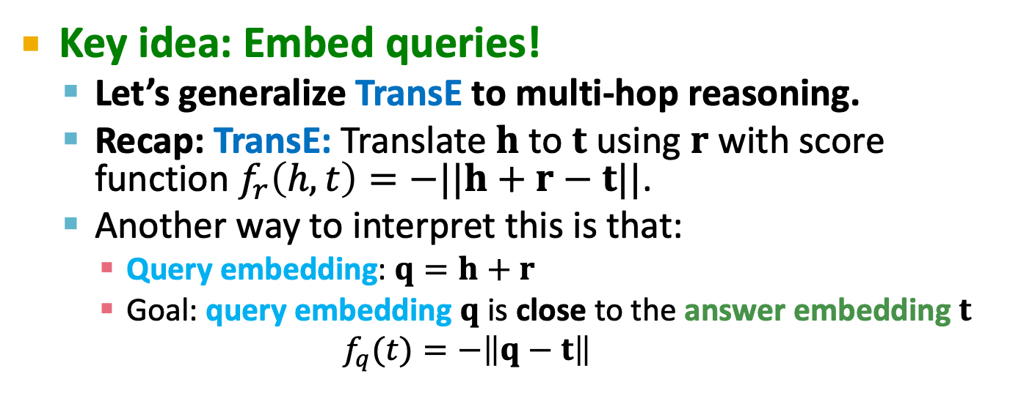




Idea: Traversing KG in Vector Space
Guu, et al., Traversing knowledge graphs in vector space, EMNLP 2015.
Key idea: Embed queries!
Let’s generalize TransE to multi-hop reasoning.
Recap: TransE: Translate $h$ to $t$ using $r$ with score function $f_{r}\left(h,t\right)=−||h+r−t||$.
Another way to interpret this is that:
Query embedding: $q=h+r$
Goal: query embedding $q$ is close to the answer embedding $t$
$$f_{q}(t)=−\left\|q−t\right\|$$
New York
$$r$$
$$q$$
Nationality
$$q$$
$$h$$
$$t$$
Obama
American
Distance $(q,t)$ is small

Slide 23



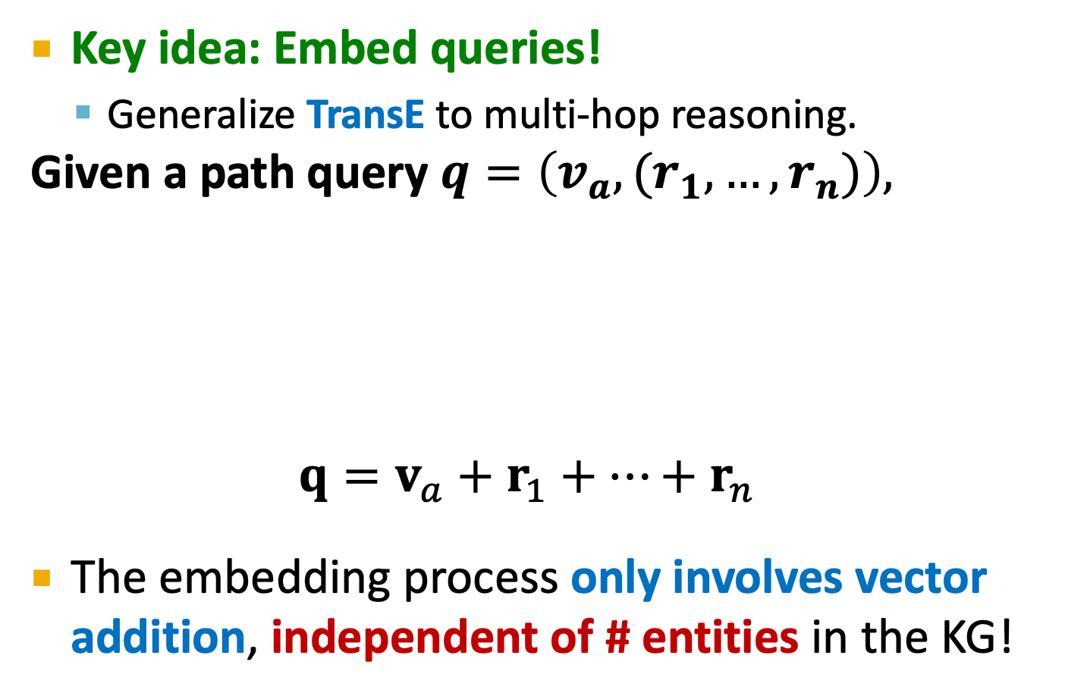



Traversing KG in Vector Space
Key idea: Embed queries!
Generalize TransE to multi-hop reasoning.
Given a path query $q=\left(v_{a},(r_{1},…,r_{n})\right),$
$$q=v_{a}+r_{1}+…+r_{n}$$
The embedding process only involves vector addition, independent of # entities in the KG!
$$r_{1}$$
$$r_{2}$$
$$v_{a}$$
$$r_{n}$$
$$…$$
$$q$$

Slide 24
Traversing KG in Vector Space (1)
Embed path queries in vector space.
Question: “What proteins are associated with adverse events caused by Fulvestrant?”
Query: (e:Fulvestrant, (r:Causes , r:Assoc))
Follow the query plan:
Query Plan
Embedding Process
Fulvestrant
Fulvestrant

Slide 25
Traversing KG in Vector Space (2)
Embed path queries in vector space.
Question: “What proteins are associated with adverse events caused by Fulvestrant?”
Query: (e:Fulvestrant, (r:Causes , r:Assoc))
Follow the query plan:
Query Plan
Embedding Process
Fulvestrant
Brain Bleeding
Causes
Fulvestrant
Causes
Headache
Short of
Breath
Kidney
Infection

Slide 26

Traversing KG in Vector Space (3)
Embed path queries in vector space.
Question: “What proteins are associated with adverse events caused by Fulvestrant?”
Query: (e:Fulvestrant, (r:Causes , r:Assoc))
Follow the query plan:
Query Plan
Embedding Process
Fulvestrant
CASP8
$$q$$
Brain Bleeding
BIRC2
PIM1
Causes
Assoc
Fulvestrant
Answers!
Causes
Assoc
Headache
Short of
Breath
Kidney
Infection

Slide 27
Traversing KG in Vector Space (4)
Insights:
We can train TransE to optimize knowledge graph completion objective
Since TransE can naturally handle compositional relations, it can handle path queries by translating in the latent space for multiple hops using addition of relation embeddings.
DistMult / ComplEx, since they cannot handle compositional relations, cannot be easily extended to handle path queries.

Slide 28
Conjunctive Queries
Can we answer more complex queries with logic conjunction operation?
Conjunctive Queries: “What are drugs that cause Short of Breath and treat diseases associated with protein ESR2?”
((e:ESR2, (r:Assoc, r:TreatedBy)), (e:Short of Breath, (r:CausedBy))
Query plan:
ESR2
Intersection
Assoc
TreatedBy
Short of
Breath
CausedBy
Intersection

Slide 29
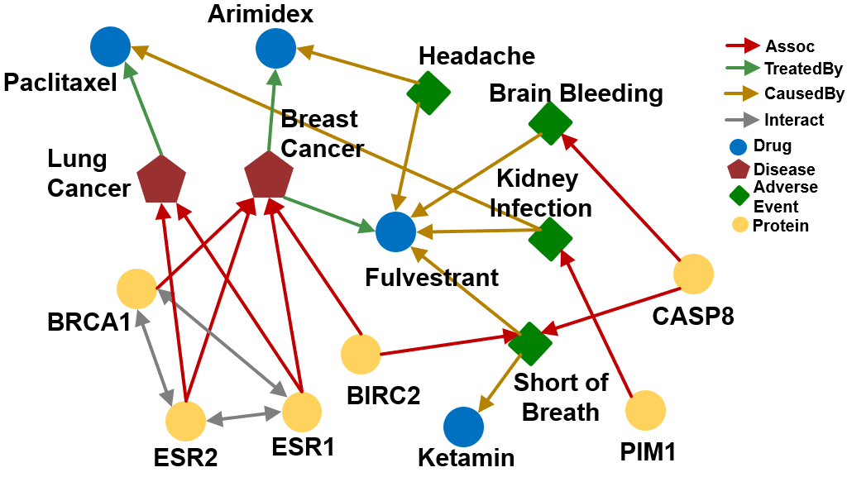
Conjunctive Queries
“What are drugs that cause Short of Breath and treat diseases associated with protein ESR2?”
((e:ESR2, (r:Assoc, r:TreatedBy)), (e:Short of Breath, (r:CausedBy))
How do we answer the question by KG traversal?

Slide 30
Traversing KG for Conjunctive Queries
“What are drugs that cause Short of Breath and treat diseases associated with protein ESR2?”
((e:ESR2, (r:Assoc, r:TreatedBy)), (e:Short of Breath, (r:CausedBy))
Traverse KG from anchor nodes: ESR2 and Short of Breath:
Lung
Cancer
Traverse from the first anchor “ESR2” by relation “Assoc”, we reach a set of entities {“Lung Cancer”, “Breast Cancer”}
Assoc
Breast
Cancer
ESR2

Slide 31
Traversing KG for Conjunctive Queries
“What are drugs that cause Short of Breath and treat diseases associated with protein ESR2?”
((e:ESR2, (r:Assoc, r:TreatedBy)), (e:Short of Breath, (r:CausedBy))
Traverse KG from anchor nodes: ESR2 and Short of Breath:
Lung
Cancer
Paclitaxel
Traverse from the set of entities {“Lung Cancer”, “Breast Cancer”} by relation TreatedBy, we reach a set of entities {“Paclitaxel”, “Arimidex”, “Fulvestrant”}
Assoc
Breast
Cancer
Arimidex
ESR2
Fulvestrant
TreatedBy

Slide 32
Traversing KG for Conjunctive Queries
“What are drugs that cause Short of Breath and treat diseases associated with protein ESR2?”
((e:ESR2, (r:Assoc, r:TreatedBy)), (e:Short of Breath, (r:CausedBy))
Traverse KG from anchor nodes: ESR2 and Short of Breath:
Paclitaxel
Traverse from the second anchor “Short of Breath” by relation “CausedBy”, we reach a set of entities {“Fulvestrant”, “Ketamin”, “Paclitaxel”}
Fulvestrant
Short of
Breath
Ketamin
CausedBy

Slide 33
Traversing KG for Conjunctive Queries
“What are drugs that cause Short of Breath and treat diseases associated with protein ESR2?”
((e:ESR2, (r:Assoc, r:TreatedBy)), (e:Short of Breath, (r:CausedBy))
Traverse KG from anchor nodes: ESR2 and Short of Breath:
Lung
Cancer
Paclitaxel
We take intersection between the two sets and get the answers {“Fulvestrant”, “Paclitaxel”}
Assoc
Breast
Cancer
Arimidex
ESR2
Fulvestrant
TreatedBy
Short of
Breath
Ketamin
CausedBy

Slide 34
Traversing KG for Conjunctive Queries
“What are drugs that cause Short of Breath and treat diseases associated with protein ESR2?”
((e:ESR2, (r:Assoc, r:TreatedBy)), (e:Short of Breath, (r:CausedBy))
Traverse KG from anchor nodes: ESR2 and Short of Breath:
Lung
Cancer
Paclitaxel
Assoc
Breast
Cancer
Arimidex
ESR2
ESR2
Fulvestrant
TreatedBy
If this link is missing, then we cannot find Fulvestrant to be an
answer
Short of
Breath
Ketamin
CausedBy

Slide 35
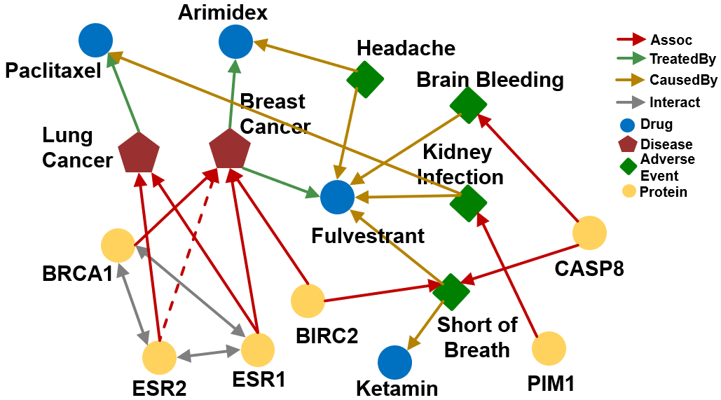
Traversing KG for Conjunctive Queries
How can we use embeddings to implicitly impute the missing (ESR2, Assoc, Breast Cancer)?
Intuition: ESR2 interacts with both BRCA1 and ESR1. Both proteins are associated with breast cancer.

Slide 36
Traversing KG in Vector Space
“What are drugs that cause Short of Breath and treat diseases associated with protein ESR2?”
((e:ESR2, (r:Assoc, r:TreatedBy)), (e:Short of Breath, (r:CausedBy))
Query plan:
ESR2
Intersection
Assoc
TreatedBy
Short of
Breath
CausedBy
Intersection
Each intermediate node represents a set of entities, how do we represent it? How do we define the intersection operation in the latent space?

Slide 37
Stanford CS224W: Query2Box: Reasoning over KGs Using Box Embeddings
CS224W: Machine Learning with Graphs
Jure Leskovec, Stanford University
http://cs224w.stanford.edu

Slide 38
Conjunctive Queries
How can we answer more complex queries with logical conjunction operation?
Query plan:
ESR2
Intersection
Assoc
TreatedBy
Short of
Breath
CausedBy
Intersection
(1) Each intermediate node represents a set of entities; how do we represent it?
(2) How do we define the intersection operation in the latent space?

Slide 39


Box Embeddings
Ren et al., Query2box: Reasoning over Knowledge Graphs in Vector Space Using Box Embeddings, ICLR 2020.
Embed queries with hyper-rectangles (boxes)
$$q=(Center\left(q\right), Offset(q))$$
For example, we can embed the adverse events of Fulvestrant with a box that enclose all the answer entities.
Short of Breath
$$q$$
Kidney
Infection
Headache
Embedding Space

Slide 40
Key Insight: Intersection
Intersection of boxes is well-defined!
When we traverse the KG to find the answers, each step produces a set of reachable entities.
How can we better model these sets?
Boxes are a powerful abstraction, as we can project the center and control the offset to model the set of entities enclosed in the box
Short of Breath
Kidney
Infection
Headache

Slide 41
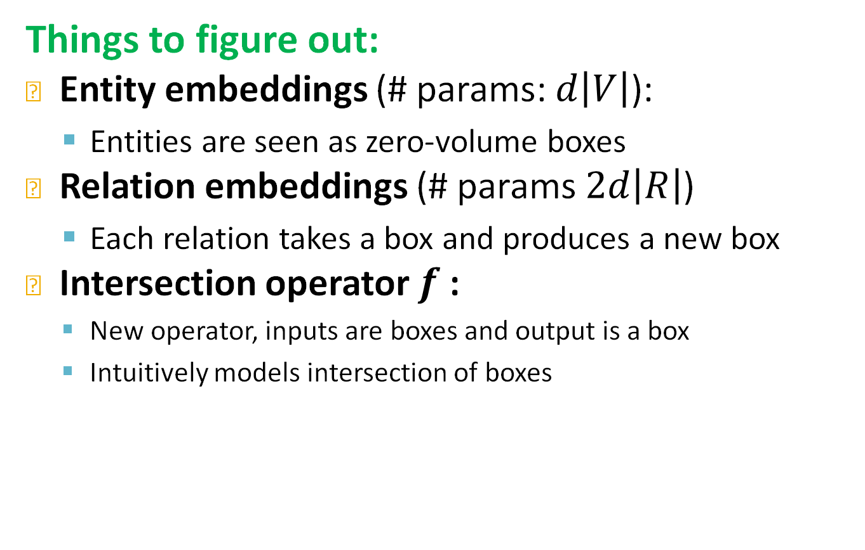
Embed with Box Embedding
Things to figure out:
Entity embeddings (# params: $d\left|V\right|$):
Entities are seen as zero-volume boxes
Relation embeddings (# params $2d\left|R\right|$)
Each relation takes a box and produces a new box
Intersection operator $f$:
New operator, inputs are boxes and output is a box
Intuitively models intersection of boxes
Notation
d: out degree
|V|: # entities
|R|: # relations

Slide 42
Embed with Box Embedding
Embed queries in vector space: “What are drugs that cause Short of Breath and treat diseases associated with protein ESR2?”
((e:ESR2, (r:Assoc, r:TreatedBy)), (e:Short of Breath, (r:CausedBy))
Traverse KG from anchor nodes: ESR2 and Short of Breath:
Query plan
Embedding Space
ESR2
Assoc
?
ESR2

Slide 43

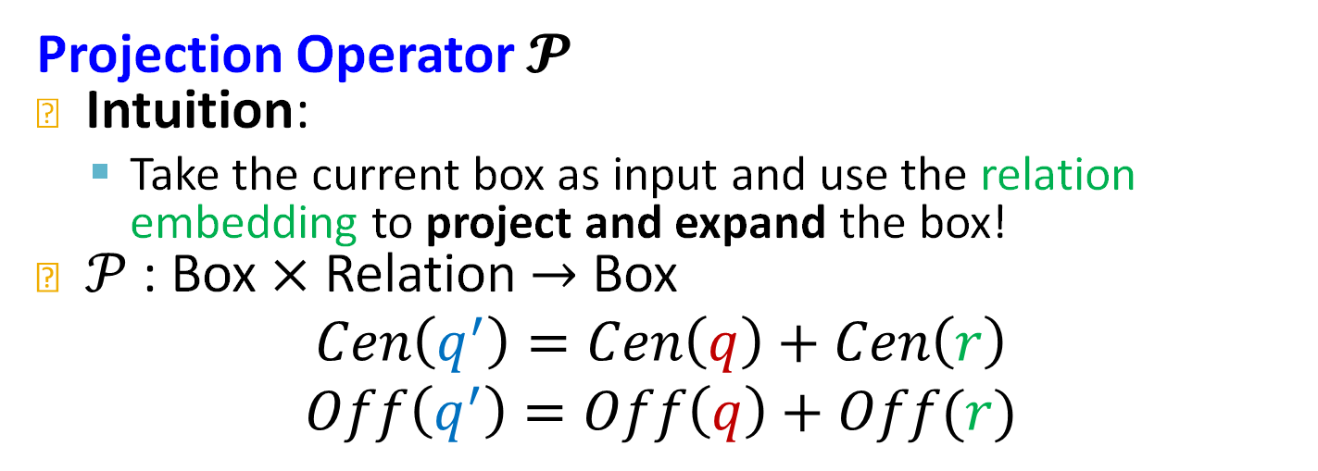


Projection Operator
Projection Operator $𝓟$
Intuition:
Take the current box as input and use the relation embedding to project and expand the box!
$𝒫$: Box $×$ Relation $→$ Box
$$Cen\left(q^{′}\right)=Cen\left(q\right)+Cen\left(r\right)$$
$$Off\left(q^{′}\right)=Off\left(q\right)+Off(r)$$
"×" (cross) means the projection operator is a relation from any box and relation to a new box
$$q′$$
$$r$$
$$q$$

Slide 44
Embed with Box Embedding
Embed queries in vector space: “What are drugs that cause Short of Breath and treat diseases associated with protein ESR2?”
Traverse KG from anchor nodes: ESR2 and Short of Breath:
Use projection operator again following the query plan.
Query Plan
Embedding Space
Breast
Cancer
ESR2
Lung
Cancer
Assoc
Assoc
ESR2

Slide 45
Embed with Box Embedding
“What is the drug that causes Short of Breath and treats disease associated with protein ESR2?”
((e:ESR2, (r:Assoc, r:TreatedBy)), (e:Short of Breath, (r:CausedBy))
Use projection operator again following the query plan.
Query Plan
Embedding Space
Breast
Cancer
TreatedBy
ESR2
Lung
Cancer
Assoc
TreatedBy
Assoc
Arimidex
Paclitaxel
Fulvestrant
ESR2

Slide 46
Embed with Box Embedding
“What is the drug that causes Short of Breath and treats disease associated with protein ESR2?”
((e:ESR2, (r:Assoc, r:TreatedBy)), (e:Short of Breath, (r:CausedBy))
Use projection operator again following the query plan.
Query Plan
Embedding Space
Breast
Cancer
TreatedBy
ESR2
Lung
Cancer
Assoc
TreatedBy
Assoc
Arimidex
Paclitaxel
CausedBy
Fulvestrant
Short of
Breath
ESR2
Short of
Breath
Ketamin
CausedBy

Slide 47
Embed with Box Embedding
“What is the drug that causes Short of Breath and treats disease associated with protein ESR2?”
((e:ESR2, (r:Assoc, r:TreatedBy)), (e:Short of Breath, (r:CausedBy))
How do we take intersection of boxes?
Query Plan
Embedding Space
Breast
Cancer
TreatedBy
ESR2
Lung
Cancer
Assoc
TreatedBy
Intersection
Assoc
Arimidex
?
Paclitaxel
CausedBy
Fulvestrant
Short of
Breath
Intersection
ESR2
Short of
Breath
Ketamin
CausedBy

Slide 48
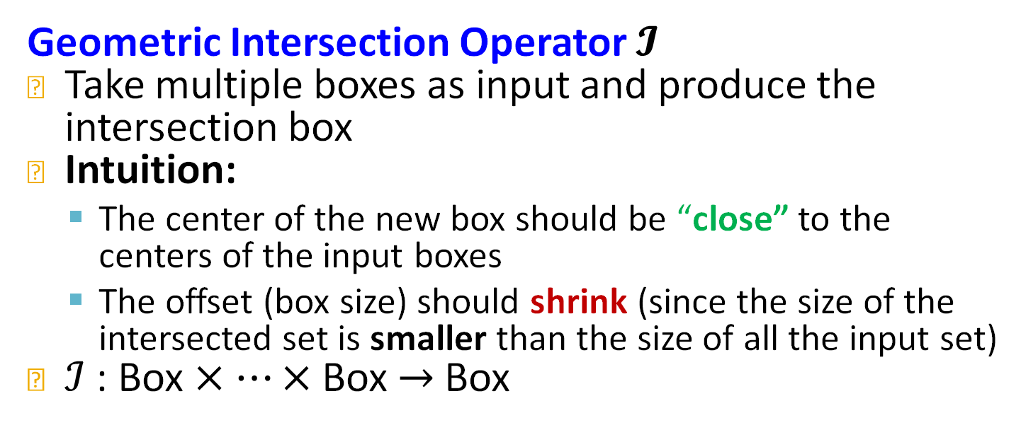
Intersection Operator
Geometric Intersection Operator $𝓘$
Take multiple boxes as input and produce the intersection box
Intuition:
The center of the new box should be “close” to the centers of the input boxes
The offset (box size) should shrink (since the size of the intersected set is smaller than the size of all the input set)
$ℐ$ : Box $×⋯×$ Box $→$ Box

Slide 49


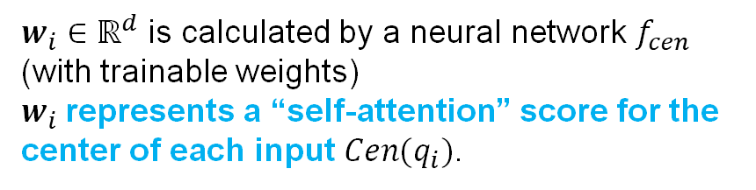
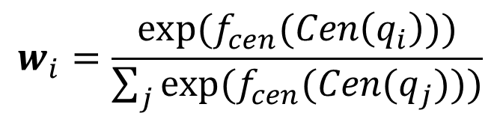
Intersection Operator
Geometric Intersection Operator $𝓘$
$ℐ$ : Box $×⋯×$ Box $→$ Box
$$Cen\left(q_{inter}\right)=\sum_{i}{w_{i}}⊙Cen\left(q_{i}\right)$$
Hadamard product (element-wise product)
$$w_{i}=\frac{exp⁡(f_{cen}(Cen\left(q_{i}\right)))}{\sum_{j}{\exp{(f_{cen}(Cen(q_{j})))}}}$$
$$Cen\left(q_{i}\right)∈ℝ^{d}$$
$$w_{i}∈ℝ^{d}$$
Intuition: The center should be in the red region!
Implementation: The center is a weighted sum of the input box centers
$w_{i}∈ℝ^{d}$ is calculated by a neural network $f_{cen}$ (with trainable weights)
$w_{i}$represents a “self-attention” score for the center of each input $Cen(q_{i})$.

Slide 50
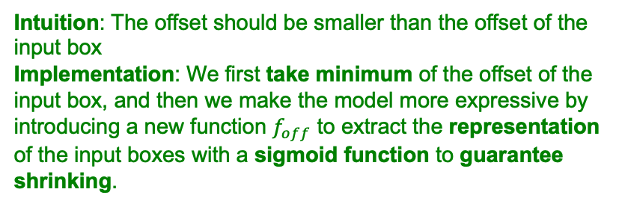
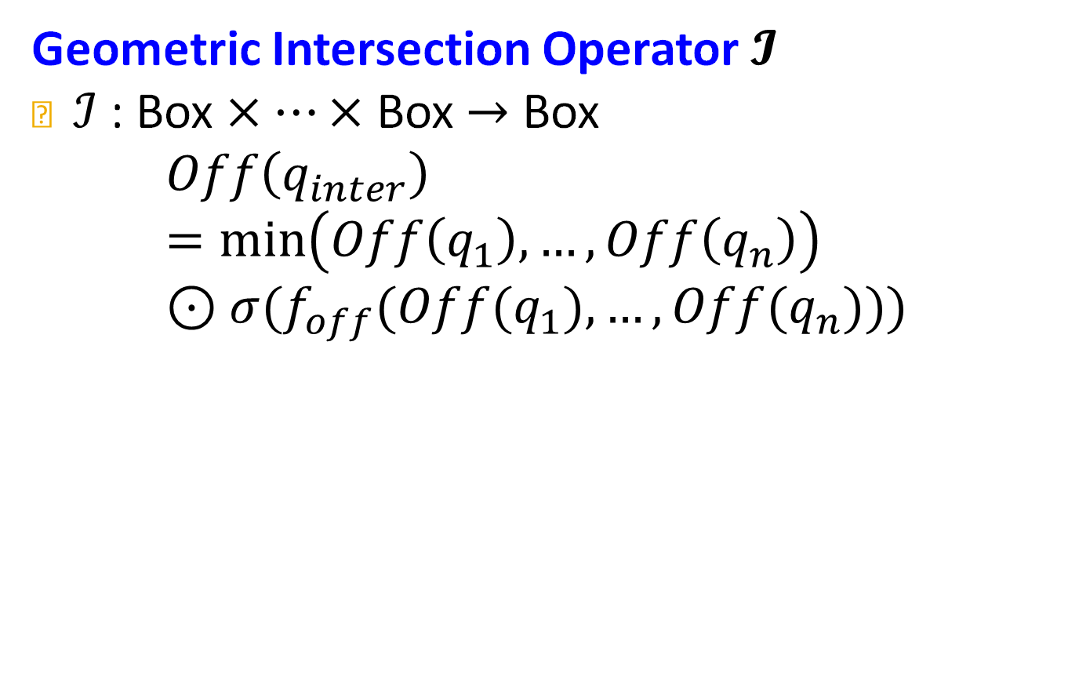
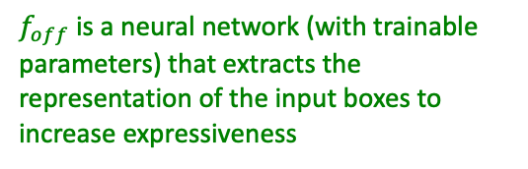
Intersection Operator
Geometric Intersection Operator $𝓘$
$ℐ$ : Box $×⋯×$ Box $→$ Box
$$Off\left(q_{inter}\right)=min\left(Off\left(q_{1}\right),…,Off\left(q_{n}\right)\right)⊙σ(f_{off}(Off(q_{1}),…,Off(q_{n})))$$
guarantees shrinking
Sigmoid function:
squashes output in (0,1)
$f_{off}$ is a neural network (with trainable parameters) that extracts the representation of the input boxes to increase expressiveness
Intuition: The offset should be smaller than the offset of the input box
Implementation: We first take minimum of the offset of the input box, and then we make the model more expressive by introducing a new function $f_{off}$ to extract the representation of the input boxes with a sigmoid function to guarantee shrinking.

Slide 51
Embed with Box Embedding
“What is the drug that causes Short of Breath and treats disease associated with protein ESR2?”
((e:ESR2, (r:Assoc, r:TreatedBy)), (e:Short of Breath, (r:CausedBy))
Use box intersection operator
Query Plan
Embedding Space
Breast
Cancer
TreatedBy
ESR2
Lung
Cancer
Assoc
TreatedBy
Intersection
Assoc
Arimidex
Paclitaxel
CausedBy
Fulvestrant
Short of
Breath
Intersection
ESR2
Short of
Breath
The shadow box represents the final box embedding of the query
Ketamin
CausedBy

Slide 52

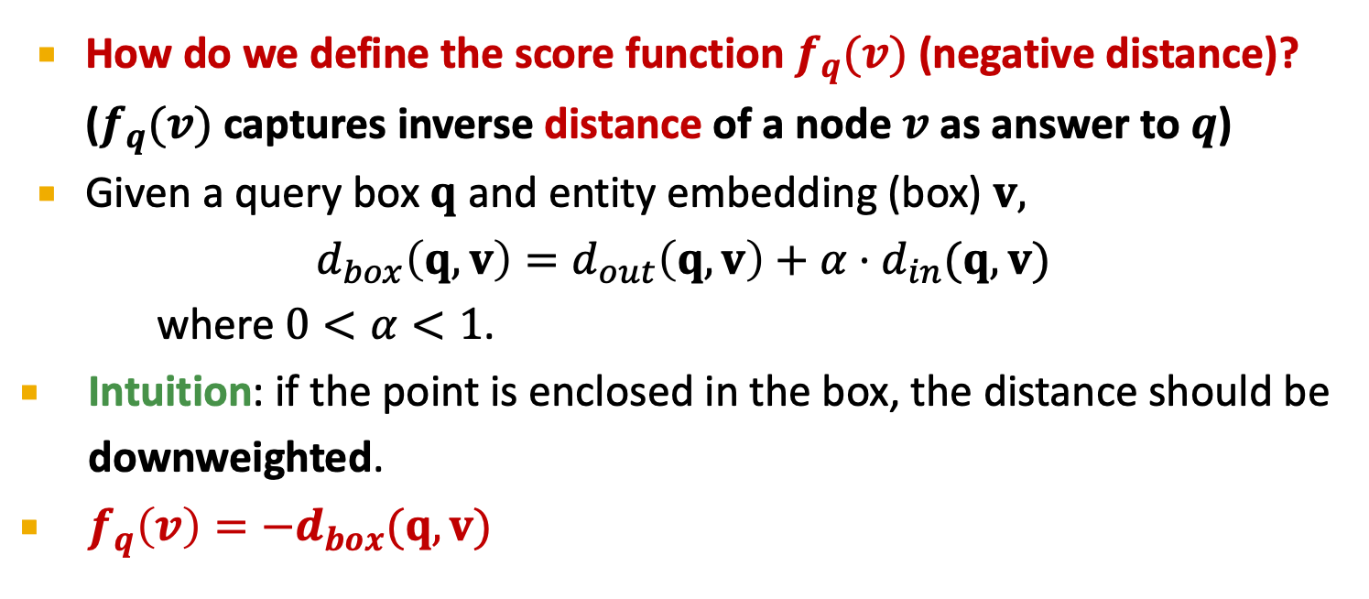



Entity-to-Box Distance
How do we define the score function $f_{q}(v)$ (negative distance)? ($f_{q}(v)$ captures inverse distance of a node $v$ as answer to $q$)
Given a query box $q$ and entity embedding (box) $v,$
$$d_{box}\left(q,v\right)=d_{out}\left(q,v\right)+α⋅d_{in}(q,v)$$
where $0<α<1$.
Intuition: if the point is enclosed in the box, the distance should be downweighted.
$f_{q}\left(v\right)=−d_{box}(q,v)$
$$v$$
$$d_{out}(q,v)$$
$$d_{in}(q,v)$$
$$Cen(q)$$

Slide 53
Extending to Union Operation
Can we embed complex queries with union? E.g.: “What drug can treat breast cancer or lung cancer?”
Conjunctive queries + disjunction is called Existential Positive First-order (EPFO) queries. We’ll refer to them as AND-OR queries.
Can we also design a disjunction operator and embed AND-OR queries in low-dimensional vector space?

Slide 54
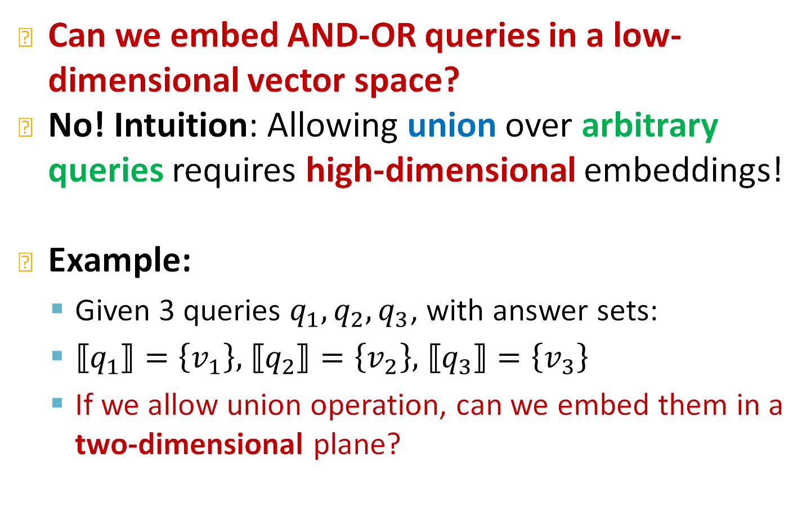
Embedding AND-OR Queries
Can we embed AND-OR queries in a low-dimensional vector space?
No! Intuition: Allowing union over arbitrary queries requires high-dimensional embeddings!
Example:
Given 3 queries $q_{1},q_{2},q_{3}$, with answer sets:
$⟦q_{1}⟧=\left\{v_{1}\right\},$ $⟦q_{2}⟧=\left\{v_{2}\right\},$ $⟦q_{3}⟧=\left\{v_{3}\right\}$
If we allow union operation, can we embed them in a two-dimensional plane?

Slide 55





Embedding AND-OR Queries
Example:
Given 3 queries $q_{1},q_{2},q_{3}$, with answer sets:
$⟦q_{1}⟧=\left\{v_{1}\right\},$ $⟦q_{2}⟧=\left\{v_{2}\right\},$ $⟦q_{3}⟧=\left\{v_{3}\right\}$
If we allow union operation, can we embed them in two-dimensional plane?
$$v_{2}$$
We want red dots (answers) to be in the box while the blue dots (negative answers) to be outside the box
$$v_{1}$$
$$v_{3}$$
$$q_{1}$$

Slide 56

Embedding AND-OR Queries
Example:
Given 3 queries $q_{1},q_{2},q_{3}$, with answer sets:
$⟦q_{1}⟧=\left\{v_{1}\right\},$ $⟦q_{2}⟧=\left\{v_{2}\right\},$ $⟦q_{3}⟧=\left\{v_{3}\right\}$
If we allow union operation, can we embed them in two-dimensional plane?
$$v_{2}$$
We want red dots (answers) to be in the box while the blue dots (negative answers) to be outside the box
$$q_{2}$$
$$v_{1}$$
$$v_{3}$$

Slide 57

Embedding AND-OR Queries
Example:
Given 3 queries $q_{1},q_{2},q_{3}$, with answer sets:
$⟦q_{1}⟧=\left\{v_{1}\right\},$ $⟦q_{2}⟧=\left\{v_{2}\right\},$ $⟦q_{3}⟧=\left\{v_{3}\right\}$
If we allow union operation, can we embed them in two-dimensional plane?
$$v_{2}$$
We want red dots (answers) to be in the box while the blue dots (negative answers) to be outside the box
$$v_{1}$$
$$v_{3}$$
$$q_{3}$$

Slide 58


Embedding AND-OR Queries
Example:
Given 3 queries $q_{1},q_{2},q_{3}$, with answer sets:
$⟦q_{1}⟧=\left\{v_{1}\right\},$ $⟦q_{2}⟧=\left\{v_{2}\right\},$ $⟦q_{3}⟧=\left\{v_{3}\right\}$
If we allow union operation, can we embed them in two-dimensional plane?
$$q_{1}∨q_{2}$$
$$v_{2}$$
We want red dots (answers) to be in the box while the blue dots (negative answers) to be outside the box
$$v_{1}$$
$$v_{3}$$

Slide 59

Embedding AND-OR Queries
Example:
Given 3 queries $q_{1},q_{2},q_{3}$, with answer sets:
$⟦q_{1}⟧=\left\{v_{1}\right\},$ $⟦q_{2}⟧=\left\{v_{2}\right\},$ $⟦q_{3}⟧=\left\{v_{3}\right\}$
If we allow union operation, can we embed them in two-dimensional plane?
$$v_{2}$$
We want red dots (answers) to be in the box while the blue dots (negative answers) to be outside the box
$$v_{1}$$
$$v_{3}$$
$$q_{2}∨q_{3}$$

Slide 60

Embedding AND-OR Queries
Example:
Given 3 queries $q_{1},q_{2},q_{3}$, with answer sets:
$⟦q_{1}⟧=\left\{v_{1}\right\},$ $⟦q_{2}⟧=\left\{v_{2}\right\},$ $⟦q_{3}⟧=\left\{v_{3}\right\}$
If we allow union operation, can we embed them in two-dimensional plane?
$$v_{2}$$
We want red dots (answers) to be in the box while the blue dots (negative answers) to be outside the box
$$v_{1}$$
$$v_{3}$$
$$q_{1}∨q_{3}$$

Slide 61
Embedding AND-OR Queries
Example:
Given 3 queries $q_{1},q_{2},q_{3}$, with answer sets:
$⟦q_{1}⟧=\left\{v_{1}\right\},$ $⟦q_{2}⟧=\left\{v_{2}\right\},$ $⟦q_{3}⟧=\left\{v_{3}\right\}$
If we allow union operation, can we embed them in two-dimensional plane?
For 3 points, 2-dimension is okay!
How about 4 points?
$$v_{2}$$
$$v_{1}$$
$$v_{3}$$

Slide 62


Embedding AND-OR Queries (2)
Example 2:
Given 4 queries $q_{1},q_{2},q_{3},q_{4}$ with answers:
$⟦q_{1}⟧=\left\{v_{1}\right\},$ $⟦q_{2}⟧=\left\{v_{2}\right\},⟦q_{3}⟧=\left\{v_{3}\right\},$ $⟦q_{4}⟧=\left\{v_{4}\right\},$
If we allow union operation, can we embed them in two-dimensional plane?
$$v_{2}$$
$$v_{1}$$
$$v_{3}$$
$$v_{4}$$

Slide 63
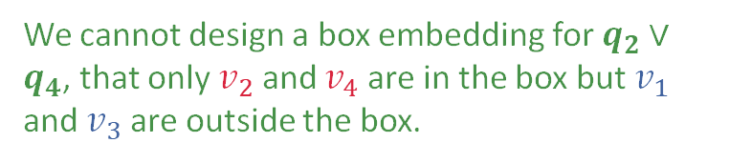
Embedding AND-OR Queries (2)
Example 2:
Given 4 queries $q_{1},q_{2},q_{3},q_{4}$ with answers:
$⟦q_{1}⟧=\left\{v_{1}\right\},$ $⟦q_{2}⟧=\left\{v_{2}\right\},⟦q_{3}⟧=\left\{v_{3}\right\},$ $⟦q_{4}⟧=\left\{v_{4}\right\},$
If we allow union operation, can we embed them in two-dimensional plane?
We cannot design a box embedding for $q_{2}∨q_{4}$, that only $v_{2}$ and $v_{4}$ are in the box but $v_{1}$ and $v_{3}$ are outside the box.
$$v_{2}$$
$$v_{1}$$
$$v_{3}$$
$$v_{4}$$

Slide 64
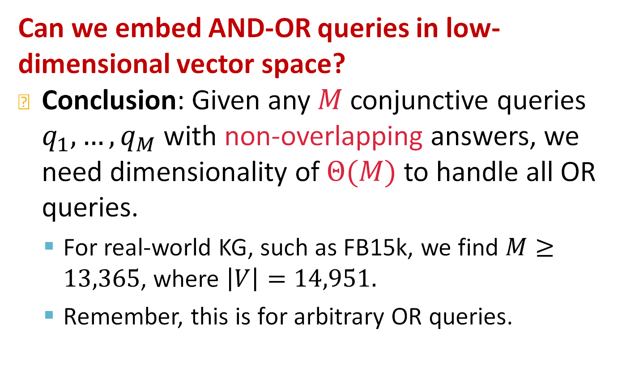
Embedding AND-OR Queries (2)
Can we embed AND-OR queries in low-dimensional vector space?
Conclusion: Given any $M$ conjunctive queries $q_{1},…{,q}_{M}$ with non-overlapping answers, we need dimensionality of $Θ(M)$ to handle all OR queries.
For real-world KG, such as FB15k, we find $M≥13,365$, where $\left|V\right|=14,951.$
Remember, this is for arbitrary OR queries.

Slide 65






Embedding AND-OR Queries (3)
Since we cannot embed AND-OR queries in low-dimensional space, can we still handle them?
Key idea: take all unions out and only do union at the last step!
Original Query Plan
Converted Query Plan
$$v_{1}$$
Push the union to the last step
Projection
Projection
Intersection
$$v_{1}$$
Projection
Union
Union
$$v_{3}$$
Projection
Intersection
Projection
Intersection
DNF
Projection
$$v_{2}$$
Intersection
$$v_{2}$$
Union
Projection
Projection
Union
Projection
Intersection
$$v_{3}$$
Projection
$$v_{3}$$
Intersection

Slide 66
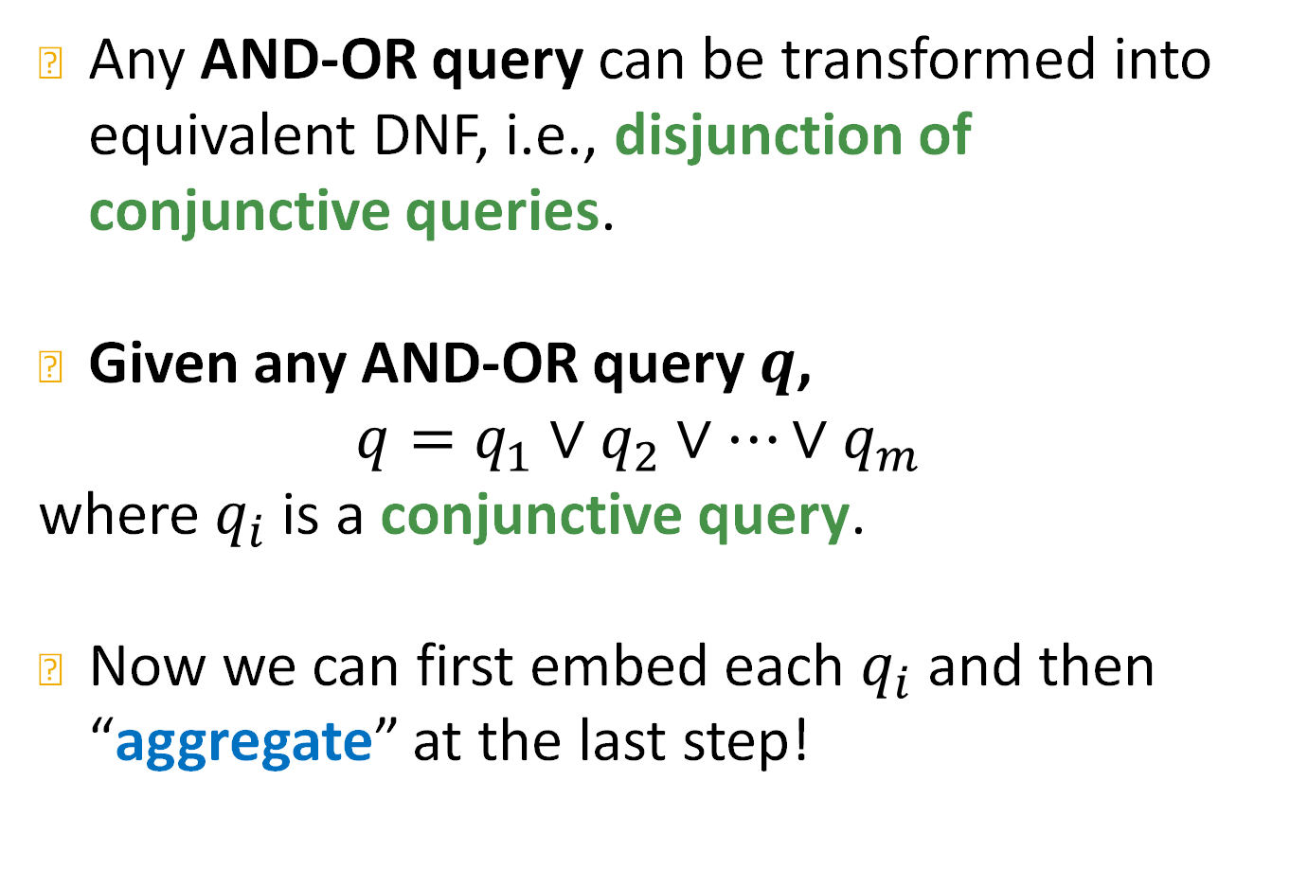
Disjunctive Normal Form
Any AND-OR query can be transformed into equivalent DNF, i.e., disjunction of conjunctive queries.
Given any AND-OR query $q$,
$$q=q_{1}∨q_{2}∨…∨q_{m}$$
where $q_{i}$ is a conjunctive query.
Now we can first embed each $q_{i}$ and then “aggregate” at the last step!

Slide 67
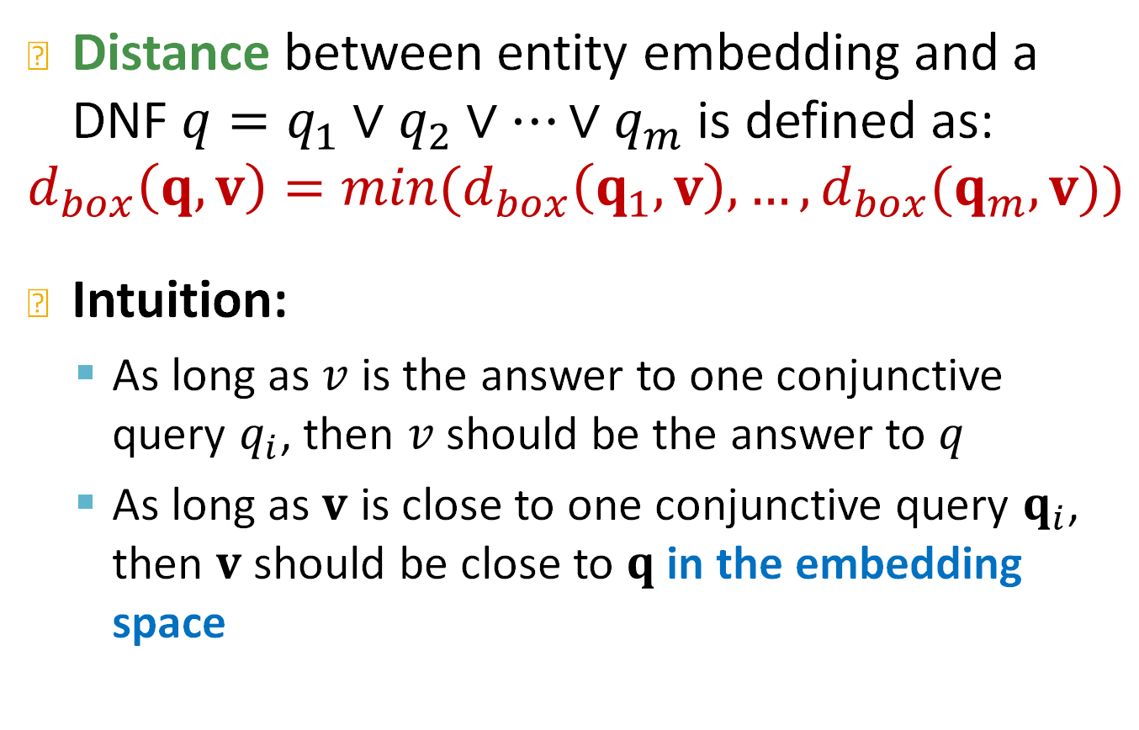
Distance Between q and an Entity
Distance between entity embedding and a DNF $q=q_{1}∨q_{2}∨…∨q_{m}$ is defined as:
$$d_{box}\left(q,v\right)=\min{(d_{box}\left(q_{1},v\right),…,d_{box}(q_{m},v))}$$
Intuition:
As long as $v$ is the answer to one conjunctive query $q_{i}$, then $v$ should be the answer to $q$
As long as $v$ is close to one conjunctive query $q_{i}$, then $v$ should be close to $q$ in the embedding space

Slide 68
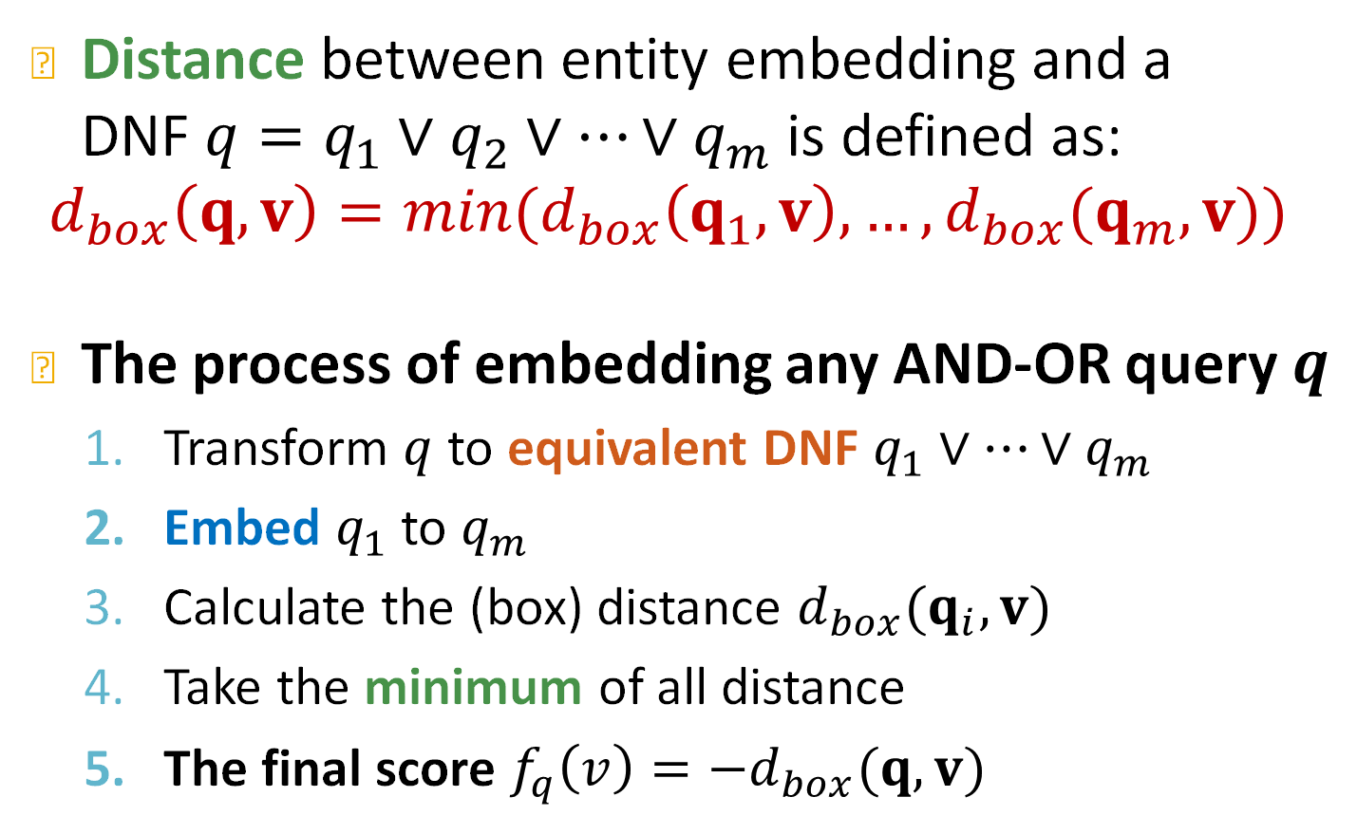
Distance Between q and an Entity
Distance between entity embedding and a DNF $q=q_{1}∨q_{2}∨…∨q_{m}$ is defined as:
$$d_{box}\left(q,v\right)=\min{(d_{box}\left(q_{1},v\right),…,d_{box}(q_{m},v))}$$
The process of embedding any AND-OR query $q$
Transform $q$ to equivalent DNF $q_{1}∨…∨q_{m}$
Embed $q_{1}$ to $q_{m}$
Calculate the (box) distance $d_{box}(q_{i},v)$
Take the minimum of all distance
The final score $f_{q}\left(v\right)=−d_{box}(q,v)$

Slide 69
Stanford CS224W: How to Train Query2box
CS224W: Machine Learning with Graphs
Jure Leskovec, Stanford University
http://cs224w.stanford.edu

Slide 70
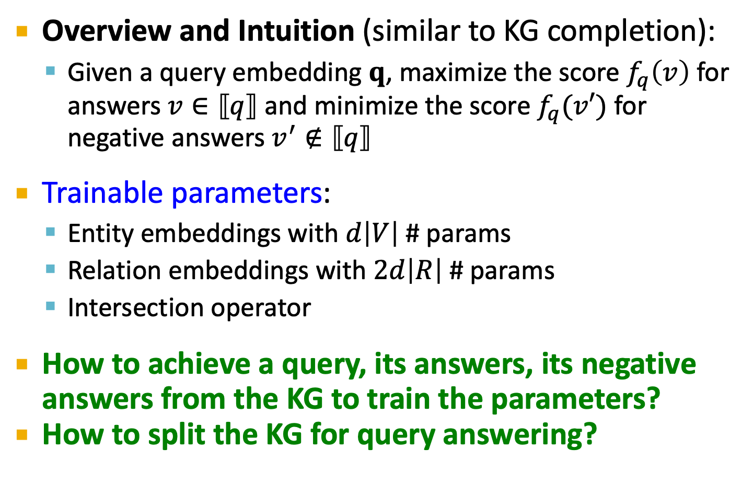
Training Overview
Overview and Intuition (similar to KG completion):
Given a query embedding $q$, maximize the score $f_{q}\left(v\right)$ for answers $v∈⟦q⟧$ and minimize the score $f_{q}(v′)$ for negative answers $v^{′}∉⟦q⟧$
Trainable parameters:
Entity embeddings with $d\left|V\right|$ # params
Relation embeddings with $2d\left|R\right|$ # params
Intersection operator
How to achieve a query, its answers, its negative answers from the KG to train the parameters?
How to split the KG for query answering?

Slide 71
Training Overview
(user specified)
Predictive
query
Reason in the embedding space
Knowledge graph
Embedding space
Each training query provides a “constrain” on the embeddings of entities.
Training loop:
Get query (q, v, v’)
Using current operators, embed q.
Compute the loss to update entity embs. and operators
Generate a set of training queries (q, v, v’).
Train entity embeddings and operators to minimize the loss (i.e., to answer the training queries correctly).

Slide 72
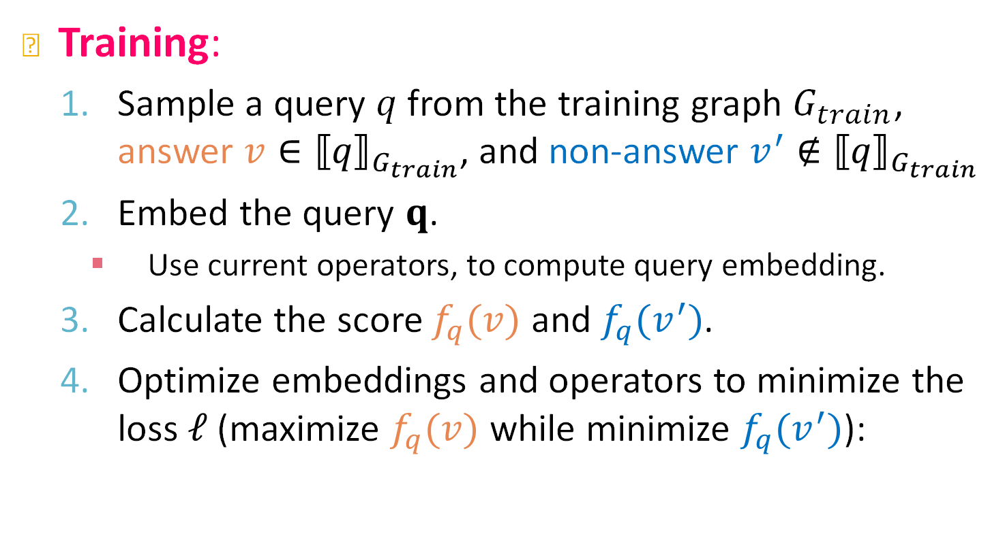
Training: Details
Training:
Sample a query $q$ from the training graph $G_{train}$, answer $v∈{⟦q⟧}_{G_{train}}$, and non-answer $v^{′}∉{⟦q⟧}_{G_{train}}$
Embed the query $q$.
Use current operators, to compute query embedding.
Calculate the score $f_{q}(v)$ and $f_{q}(v^{′})$.
Optimize embeddings and operators to minimize the loss $ℓ$ (maximize $f_{q}(v)$ while minimize $f_{q}(v^{′})$):
$$ℓ=−\log{σ\left(f_{q}\left(v\right)\right)}−\log{(1−σ\left(f_{q}(v^{′})\right)})$$

Slide 73
Query Generation from Templates
Generate queries from multiple query templates:

Slide 74
Query Generation from Templates
How can we generate a complex query?
We start with a query template
Query template is an abstraction of the query
We generate a query by instantiating every variable with a concrete entity and relation from the KG
E.g., instantiate Anchor1 with ESR2 (a node on KG)
E.g., instantiate Rel1 with Assoc (an edge on KG)
How to instantiate query template given a KG?
Query
((e:ESR2, (r:Assoc, r:TreatedBy)), (e:Short of Breath, (r:CausedBy))
Query Template
((Anchor1, (Rel1, Rel2)), (Anchor2, (Rel3))
ESR2
Assoc
TreatedBy
Intersection
Projection
Projection
Intersection
Short of
Breath
CausedBy
Intersection
Projection
Intersection

Slide 75
Query Generation from Templates
How to instantiate a query template given a KG?
Query Template
((Anchor1, (Rel1, Rel2)), (Anchor2, (Rel3))
Knowledge Graph
Lung
Cancer
Paclitaxel
Projection
Projection
Intersection
Assoc
Breast
Cancer
Arimidex
Projection
Intersection
ESR2
Fulvestrant
TreatedBy
Overview:
Start from instantiating the answer node of the query template and then iteratively instantiate the other edges and nodes until we ground all the anchor nodes
Short of
Breath
Ketamin
CausedBy

Slide 76
Query Generation from Templates
How to instantiate a query template given a KG?
Query Template
((Anchor1, (Rel1, Rel2)), (Anchor2, (Rel3))
Knowledge Graph
Lung
Cancer
Paclitaxel
Projection
Projection
Intersection
Assoc
Breast
Cancer
Arimidex
Projection
Intersection
ESR2
Fulvestrant
TreatedBy
Fulvestrant
Short of
Breath
Ketamin
Start from instantiating the root node of the query template.
Randomly pick one entity from KG as the root node, e.g., we pick Fulvestrant.
CausedBy

Slide 77
Query Generation from Templates
How to instantiate a query template given a KG?
Query Template
((Anchor1, (Rel1, Rel2)), (Anchor2, (Rel3))
Knowledge Graph
Lung
Cancer
Fulvestrant
Paclitaxel
Projection
Projection
Intersection
Assoc
Fulvestrant
Breast
Cancer
Arimidex
Projection
Intersection
ESR2
Fulvestrant
Fulvestrant
TreatedBy
Short of
Breath
Ketamin
CausedBy
Now we look at intersection. What we have is that the intersection of the sets of entities is Fulvestrant, then naturally the two sets should also contain Fulvestrant.

Slide 78
Query Generation from Templates
How to instantiate a query template given a KG?
Query Template
((Anchor1, (Rel1, Rel2)), (Anchor2, (Rel3))
Knowledge Graph
Lung
Cancer
Fulvestrant
Paclitaxel
Projection
Projection
Intersection
Assoc
Fulvestrant
Breast
Cancer
Arimidex
Projection
Intersection
ESR2
Fulvestrant
Fulvestrant
TreatedBy
TreatedBy
Short of
Breath
Ketamin
We instantiate the Projection edge in the template by randomly sample one relation associated with the current entity Fulvestrant. For example, we may select relation TreatedBy, and check what entities are connected to Fulvestrant with TreatedBy: {Breast Cancer}.
CausedBy

Slide 79
Query Generation from Templates
How to instantiate a query template given a KG?
Query Template
((Anchor1, (Rel1, Rel2)), (Anchor2, (Rel3))
Knowledge Graph
Breast Cancer
Lung
Cancer
Fulvestrant
Paclitaxel
Projection
TreatedBy
Intersection
Assoc
Fulvestrant
Breast
Cancer
Arimidex
Projection
Intersection
ESR2
Fulvestrant
Fulvestrant
TreatedBy
Assoc
Short of
Breath
Ketamin
We first look at one branch and ground the Projection edge with the relation associated with Breast Cancer, e.g., Assoc. Then we check what entities are connected to Breast Cancer with Assoc: {ESR2}.
CausedBy

Slide 80
Query Generation from Templates
How to instantiate a query template given a KG?
Query Template
((Anchor1, (Rel1, Rel2)), (Anchor2, (Rel3))
Knowledge Graph
ESR2
Breast Cancer
Lung
Cancer
Fulvestrant
Paclitaxel
Assoc
TreatedBy
Intersection
Assoc
Fulvestrant
Breast
Cancer
Arimidex
Projection
Intersection
ESR2
Fulvestrant
Fulvestrant
TreatedBy
CausedBy
Short of
Breath
Ketamin
Then we look at the second branch and ground the Projection edge with the relation associated with Fulvestrant, e.g., CausedBy. Then we check what entities are connected to Fulvestrant with CausedBy: {Short of Breath}.
CausedBy

Slide 81
Query Generation from Templates
How to instantiate a query template given a KG?
Query Template
((Anchor1, (Rel1, Rel2)), (Anchor2, (Rel3))
Knowledge Graph
ESR2
Breast Cancer
Lung
Cancer
Fulvestrant
Paclitaxel
Assoc
TreatedBy
Intersection
Assoc
Fulvestrant
Breast
Cancer
Arimidex
Short of
Breath
CausedBy
Intersection
ESR2
Fulvestrant
Fulvestrant
TreatedBy
Short of
Breath
Ketamin
We select entity from {Short of Breath}, set it as the anchor node.
CausedBy

Slide 82
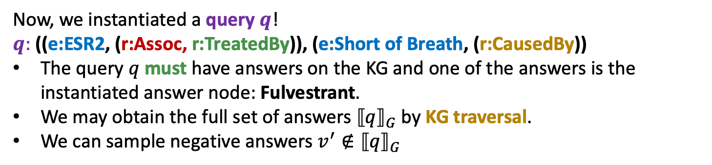
Query Generation from Templates
How to instantiate a query template given a KG?
Query Template
((Anchor1, (Rel1, Rel2)), (Anchor2, (Rel3))
ESR2
Breast Cancer
Fulvestrant
Assoc
TreatedBy
Intersection
Fulvestrant
Short of
Breath
CausedBy
Intersection
Fulvestrant
Now, we instantiated a query $q$!
$q:$ ((e:ESR2, (r:Assoc, r:TreatedBy)), (e:Short of Breath, (r:CausedBy))
The query $q$ must have answers on the KG and one of the answers is the instantiated answer node: Fulvestrant.
We may obtain the full set of answers ${⟦q⟧}_{G}$ by KG traversal.
We can sample negative answers $v^{′}∉{⟦q⟧}_{G}$

Slide 83
Stanford CS224W: Example of Query2box
CS224W: Machine Learning with Graphs
Jure Leskovec, Stanford University
http://cs224w.stanford.edu

Slide 84
Visualization
What do box embeddings actually learn?
Example: “List male instrumentalists who play string instruments”
We use t-SNE to reduce the embedding space to a 2-dimensional space, in order to visualize the query results

Slide 85
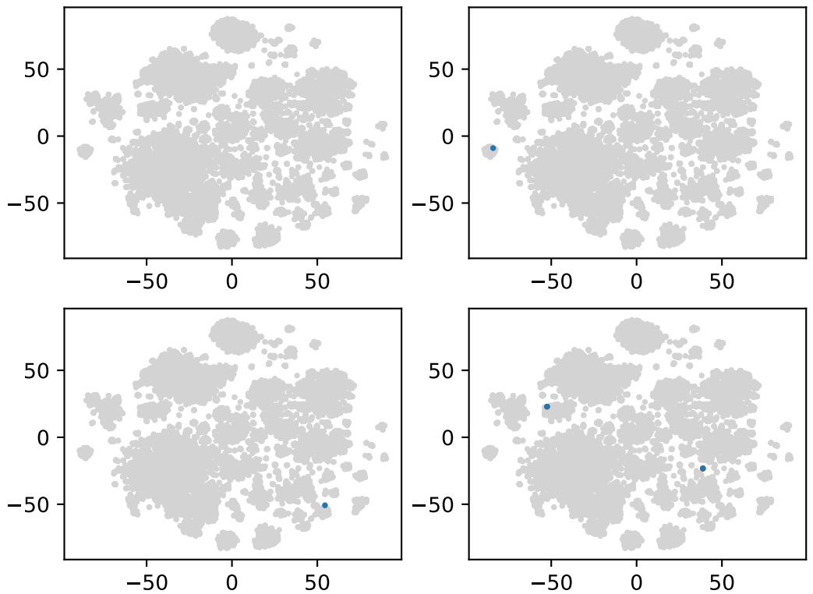
Embedding Space
Embedding of 14951 entities
“List male instrumentalists who play string instruments”
String
Instrument
Projection
Projection
Intersection
Projection
Intersection
Male

Slide 86
Embedding Space
Anchor
“List male instrumentalists who play string instruments”
String
Instrument

Slide 87
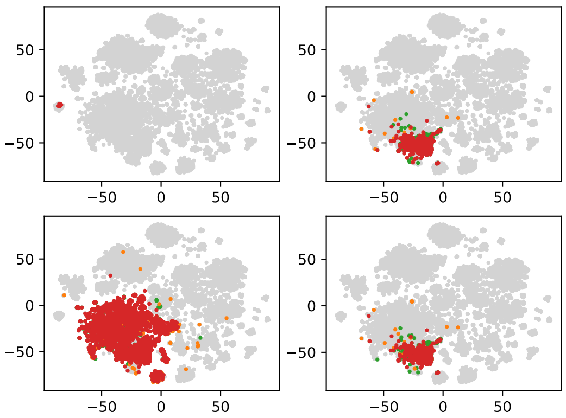
Embedding Space
# of string instruments: 10
TP
FN
FP
TN
TPR: 100%
FPR: 0%
“List male instrumentalists who play string instruments”
String
Instrument
Projection

Slide 88
Embedding Space
# of instrumentalists: 472
TP
FN
FP
TN
TPR: 98.4%
FPR: 0.01%
“List male instrumentalists who play string instruments”
String
Instrument
Projection
Projection

Slide 89
Embedding Space
Anchor
“List male instrumentalists who play string instruments”
Male

Slide 90
Embedding Space
# of men: 3555
TP
FN
FP
TN
TPR: 97.9%
FPR: 0.01%
“List male instrumentalists who play string instruments”
Projection
Male

Slide 91
Embedding Space
# of answers: 396
TP
FN
FP
TN
TPR: 99.4%
FPR: 0.01%
“List male instrumentalists who play string instruments”
String
Instrument
Projection
Projection
Intersection
Projection
Intersection
Male

Slide 92
Summary
We introduce answering predictive queries on large knowledge graphs.
The key idea is to embed queries by navigating the embedding space!
We embed the query by composing learned operators
Embedding of the query is close to its answers in the embedding space

